Slide 1
Advanced Python Course:
From “Python User” to “Python Developer”
Isabell Bludau
& Ian Dirk Fichtner

Slide 2
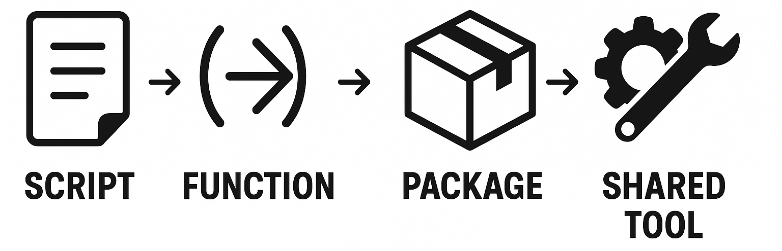
What you‘ll learn
Revisit and improve general Python programming
Write and document your own functions
Test your functions using unit tests
Set up a small Python package
Use version control and collaborative tools and share your package via GitHub

Slide 3
Course structure
Week 1: Self-organized learning using DataCamp
  Programming & developer skills
Week 2: Course project — build your own mini Python library
  Hands on in silico proteomics experiment

Slide 4

Week 1: From Python programming skills …
  String operations
  Regular expressions
  Lists and dictionaries
  List and dictionary comprehensions
  Slicing
  Loops
  If/else statements
  Using external libraries
  NumPy
  Pandas
  Simple visualizations with Matplotlib
Recommended courses:
https://app.datacamp.com/learn/courses/intro-to-python-for-data-science
https://app.datacamp.com/learn/courses/intermediate-python
This is what’s covered in the “Standard Python Course”
Who already feels comfortable with these skills – what do you need to revise?

Slide 5
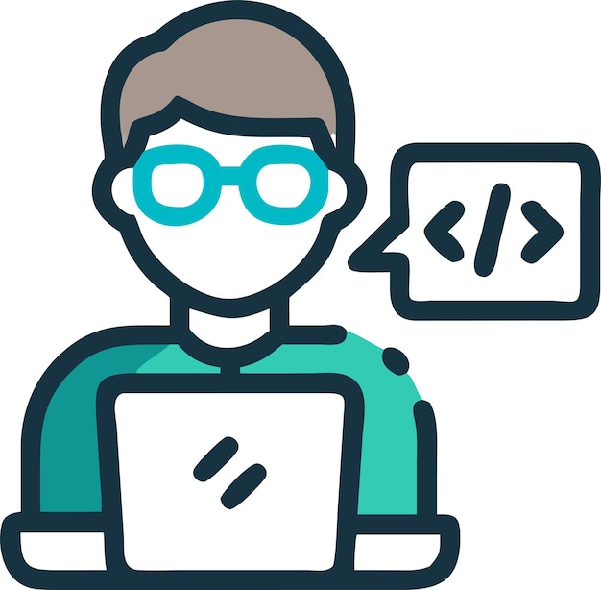
Week 1: … to Python developer skills
Writing your own functions:
https://app.datacamp.com/learn/courses/introduction-to-functions-in-python
Writing and running test functions:
https://app.datacamp.com/learn/courses/introduction-to-testing-in-python (Chapters 1-3)
Package development in Python:
https://app.datacamp.com/learn/courses/developing-python-packages
Version control and collaboration with Git and GitHub:
https://app.datacamp.com/learn/courses/introduction-to-git
https://app.datacamp.com/learn/courses/introduction-to-github-concepts
Does anyone already have experience?

Slide 6
Week 2: Course project – In-Silico Mass Spectrometry Proteomics
Goal: Perform a simulated (in silico) proteomics experiment and understand the classical MS-based workflow.
You will:
Recreate the main steps of a proteomics pipeline:
Proteins → Peptides → Spectra → Search → Score → Report
Implement each step as Python functions, then bundle them into a mini package
Apply testing, documentation, and version control practices
Produce clear plots and reports illustrating the workflow
Outcome:
A small Python library that performs a simplified proteomics search
— your first full developer-level project!

Slide 7

What you’ll need
What I expect
Python (≥ 3.10)
JupyterLab or Google Colab
pip and virtual environments
GitHub account
Active participation > there are no stupid questions!
First learn coding without AI,
then with AI assistance
Organisatorisches
Neue Prüfungsordnung – keine Klausur vorgesehen
Alte Prüfungsordnung – Klausur ist vorgesehen
Welche Prüfungsordnung habt ihr gewählt?

Slide 8

Questions

Slide 9
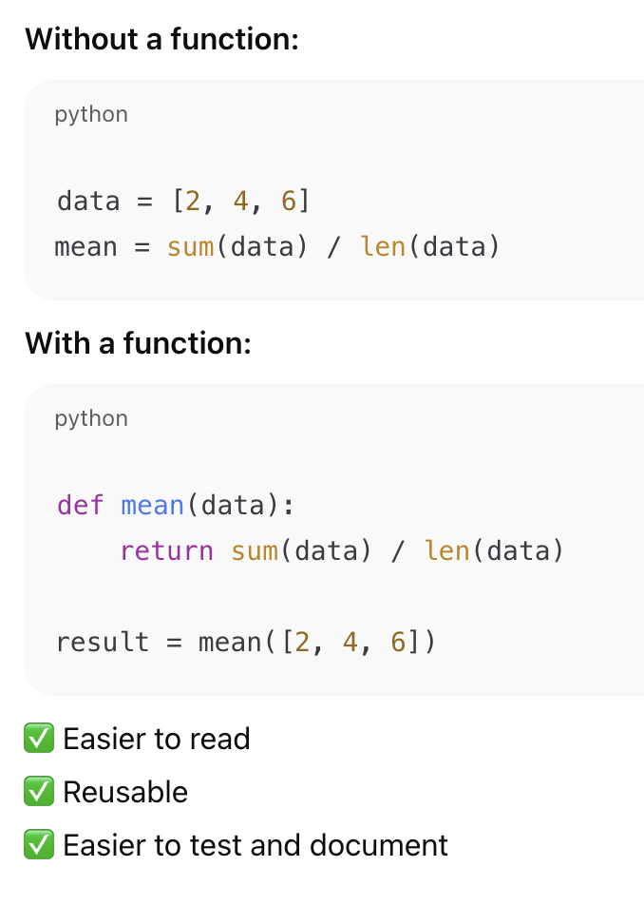
Writing your own functions
Functions turn your code into reusable, testable, and understandable building blocks.

Slide 10
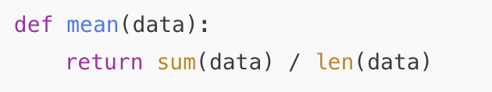
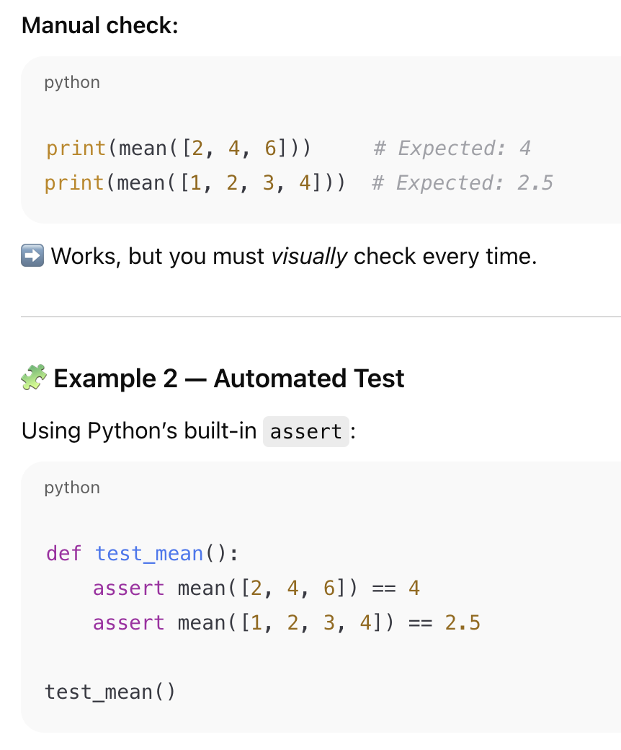
Writing test functions
Automated test:
Manual check:
Works, but you must visually check
If both assertions are true, nothing happens – your test passes
If one fails, Python stops and shows exactly wher eit failed
Testing makes your functions trustworthy, reusable, and maintainable.
Without tests, you’re guessing whether your code still works.

