Slide 1
Guidance – delete after reading
The purpose of these slides is to provide additional supportive communication material for our LPS collaborators to introduce their study participants to the concept of UK LLC opening up for research beyond COVID-19.
The slides cover: who UK LLC are, our LPS collaborators, what UK LLC does and how, what is changing (opening up for research beyond COVID-19) and how this is in the public good.
These slides are intentionally information-heavy to allow each LPS to best edit for their own purpose.
Please refer to the UK LLC Fair Processing library of materials on the Resource Hub for further information, or contact the team directly.
Don’t forget to delete this slide before saving your presentation.
This material and content has been co-produced by the UK LLC team with its partners. Copying and Licence information (CC-BY-SA). The material on this site is copyright (c) 2020-2024 of the University of Bristol. It is open and licensed under the Creative Commons Attribution ShareAlike License (CC-BY-SA) v4.0. CC BY-SA includes the following elements: BY – Credit must be given to the creator; SA – Adaptations must be shared under the same terms. The full CC-BY-SA text may be found at: https://creativecommons.org/licenses/by-sa/4.0/

Slide 2

UK LLC: Research beyond COVID-19
August 2025, v2
Notes:
This material and content has been co-produced by the UK LLC team with its partners. Copying and Licence information (CC-BY-SA). The material on this site is copyright (c) 2020-2024 of the University of Bristol. It is open and licensed under the Creative Commons Attribution ShareAlike License (CC-BY-SA) v4.0. CC BY-SA includes the following elements: BY – Credit must be given to the creator; SA – Adaptations must be shared under the same terms. The full CC-BY-SA text may be found at: https://creativecommons.org/licenses/by-sa/4.0/

Slide 3



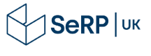






















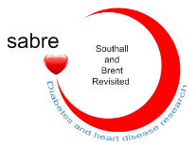





















UK Longitudinal Linkage Collaboration (UK LLC) is a partnership of universities and Longitudinal Population Studies (LPS) funded by the UK Government’s Research Councils.
Who is UK LLC?
Led by: Powered by: Funded by:
In partnership with:
Partner Longitudinal Population Studies:
Collaborators:
Notes:
This material and content has been co-produced by the UK LLC team with its partners. Copying and Licence information (CC-BY-SA). The material on this site is copyright (c) 2020-2024 of the University of Bristol. It is open and licensed under the Creative Commons Attribution ShareAlike License (CC-BY-SA) v4.0. CC BY-SA includes the following elements: BY – Credit must be given to the creator; SA – Adaptations must be shared under the same terms. The full CC-BY-SA text may be found at: https://creativecommons.org/licenses/by-sa/4.0/

Slide 4
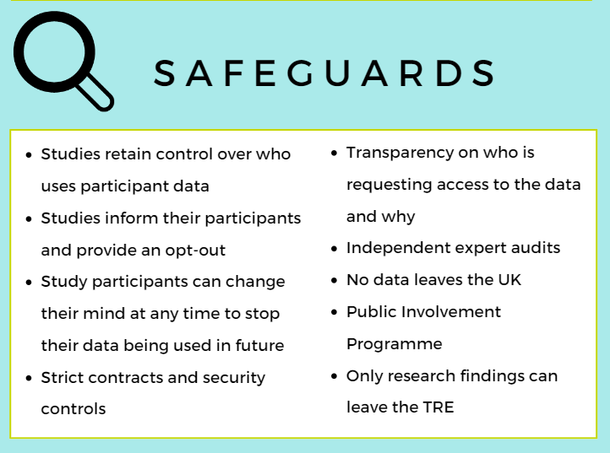
What does UK LLC do?
UK LLC is responsible for securely storing and accurately maintaining de-identified LPS datasets. Where consent has been given, these datasets are linked with de-identified, health, non-health and administrative data and made available for research in the public good.
UK LLC is the national Trusted Research Environment (TRE) for data linkage in longitudinal research. A TRE is a highly secure computer system where researchers can access and study data. Data is available in the same way as a reading library - researchers can view the information but cannot take it out.
SeRP UK at Swansea University are the trusted third party that provides the TRE for UK LLC.
Access to confidential and sensitive data is legally protected. Data can only be viewed by UK based accredited researchers from recognised institutions who have been approved to handle it. This accreditation is provided through the Office for National Statistics and is regulated by the Digital Economy Act 2017.
Notes:
This material and content has been co-produced by the UK LLC team with its partners. Copying and Licence information (CC-BY-SA). The material on this site is copyright (c) 2020-2024 of the University of Bristol. It is open and licensed under the Creative Commons Attribution ShareAlike License (CC-BY-SA) v4.0. CC BY-SA includes the following elements: BY – Credit must be given to the creator; SA – Adaptations must be shared under the same terms. The full CC-BY-SA text may be found at: https://creativecommons.org/licenses/by-sa/4.0/

Slide 5
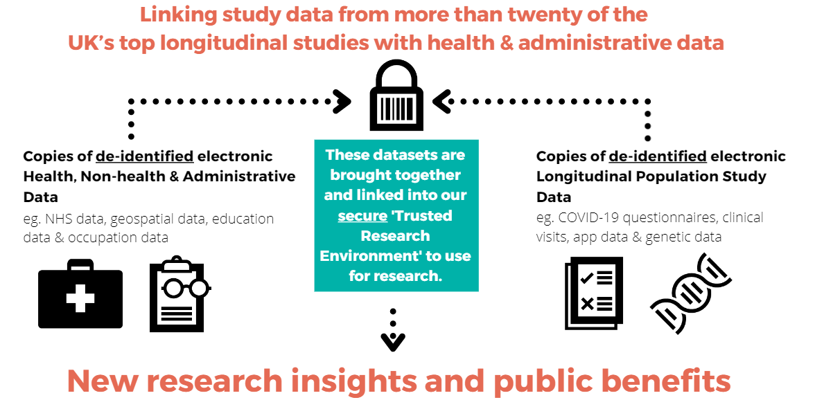
How does UK LLC work?
Through the Trusted Research Environment, UK LLC provides unique, interdisciplinary, four nations UK data linkage for longitudinal research that benefits the public.
De-identified data is data which has had personally identifiable information such as name, address and full date of birth removed or scrambled.
UK LLC is certified and audited for the most rigorous data security standards available in the UK.
This includes ISO 27001 certification, UK Statistics Authority accreditation and NHS Digital Data Security approval.
Notes:
This material and content has been co-produced by the UK LLC team with its partners. Copying and Licence information (CC-BY-SA). The material on this site is copyright (c) 2020-2024 of the University of Bristol. It is open and licensed under the Creative Commons Attribution ShareAlike License (CC-BY-SA) v4.0. CC BY-SA includes the following elements: BY – Credit must be given to the creator; SA – Adaptations must be shared under the same terms. The full CC-BY-SA text may be found at: https://creativecommons.org/licenses/by-sa/4.0/

Slide 6
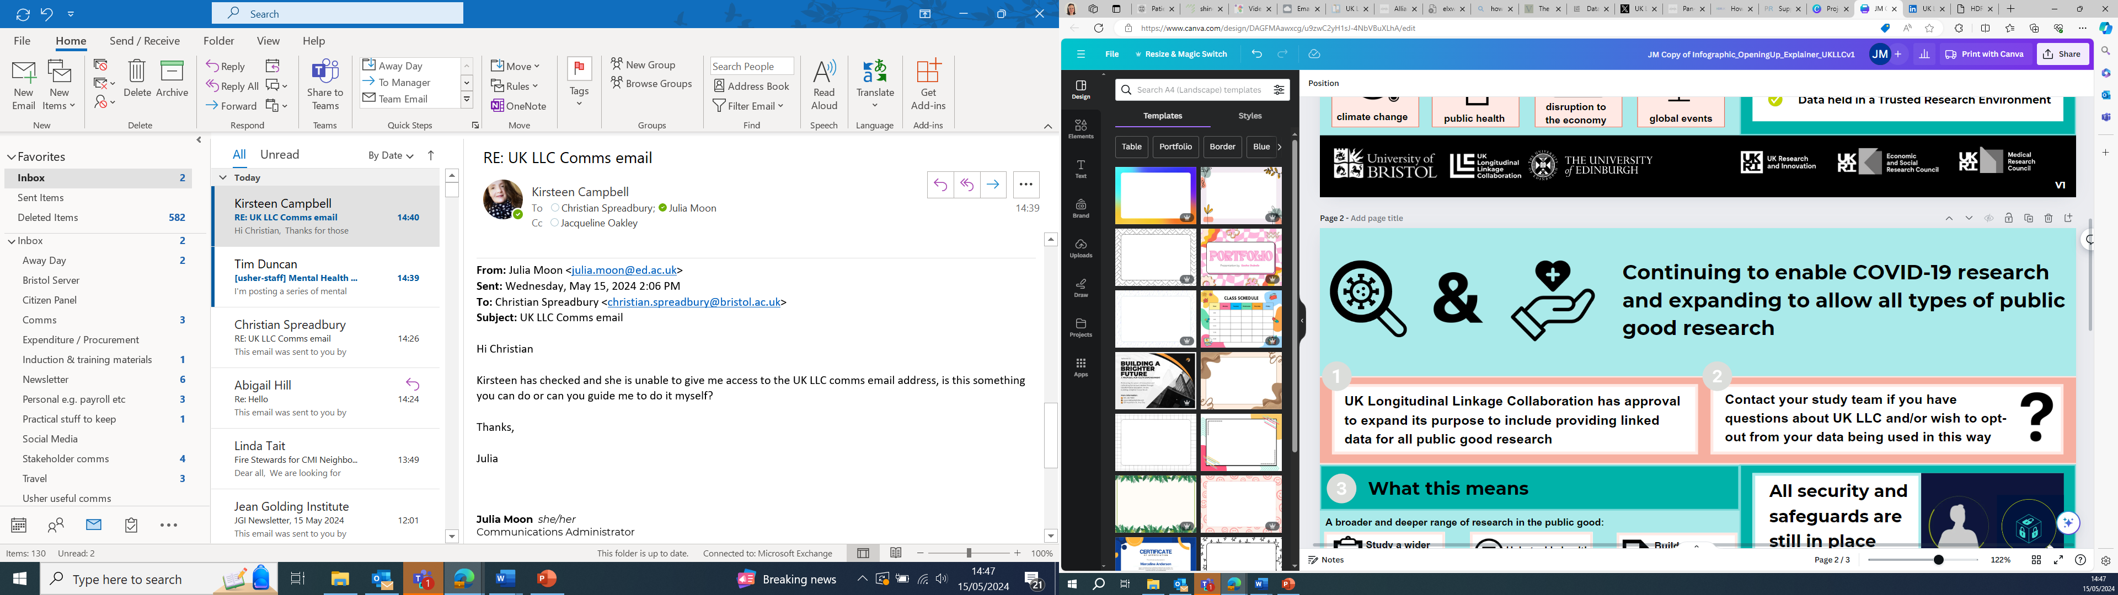
What is changing?
Research purpose
UK LLC was created as a linked data resource to enable research to understand the impacts of the COVID-19 pandemic. It has ethical approval and funding from UK Research and Innovation to continue to provide linked data for research.
Evolution
UK LLC is preparing to make data available for a wide range of public good research. Where participant agreement is in place, plans are underway to link study data with administrative data (for example, education, employment, tax & benefits records). Some partner studies have already completed the ethical and legal requirements meaning their data is available while others are still completing these steps and/or communicating to their participants.
How will researchers access the data?
The same robust application process applies. Only accredited UK based researchers can apply. The application process adheres to the highest national and international standards of information governance to ensure the safest possible use of data. UK LLC is supported at multiple levels by public contributors who inform design and decision making, including on data access.
Notes:
This material and content has been co-produced by the UK LLC team with its partners. Copying and Licence information (CC-BY-SA). The material on this site is copyright (c) 2020-2024 of the University of Bristol. It is open and licensed under the Creative Commons Attribution ShareAlike License (CC-BY-SA) v4.0. CC BY-SA includes the following elements: BY – Credit must be given to the creator; SA – Adaptations must be shared under the same terms. The full CC-BY-SA text may be found at: https://creativecommons.org/licenses/by-sa/4.0/

Slide 7
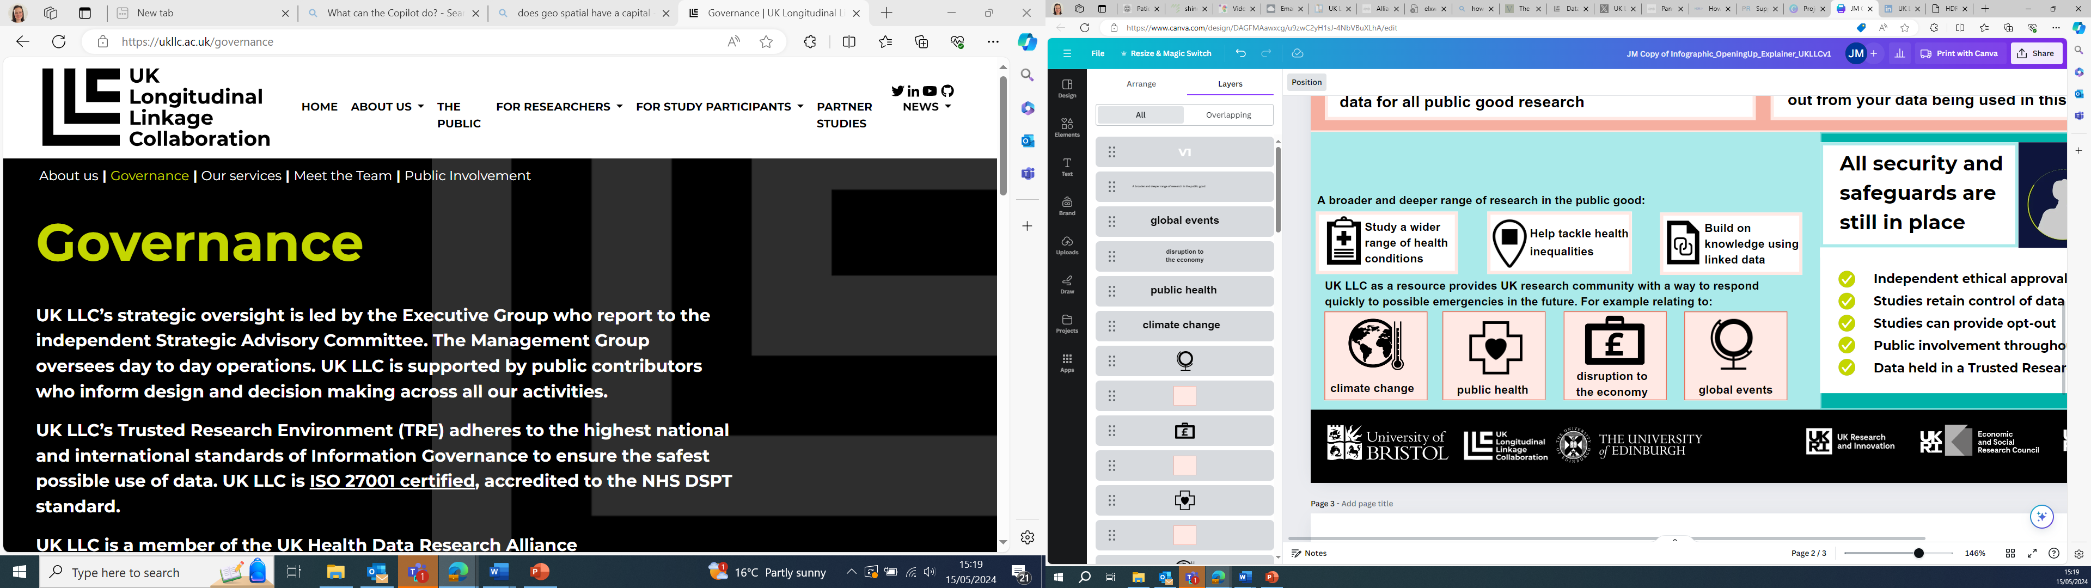
Why is UK LLC opening up?
UK LLC opening up will enhance researchers' ability to address important issues that affect people’s health and wellbeing and will help make vital improvements to our health and wellbeing more widely.
For example, researchers can examine topics such as how health and mental health conditions affect care provision among different socio-demographic groups, identify factors that can be modified to reduce risks, and understand the social impact of childhood adversity on adult health inequality.
Notes:
This material and content has been co-produced by the UK LLC team with its partners. Copying and Licence information (CC-BY-SA). The material on this site is copyright (c) 2020-2024 of the University of Bristol. It is open and licensed under the Creative Commons Attribution ShareAlike License (CC-BY-SA) v4.0. CC BY-SA includes the following elements: BY – Credit must be given to the creator; SA – Adaptations must be shared under the same terms. The full CC-BY-SA text may be found at: https://creativecommons.org/licenses/by-sa/4.0/

Slide 8
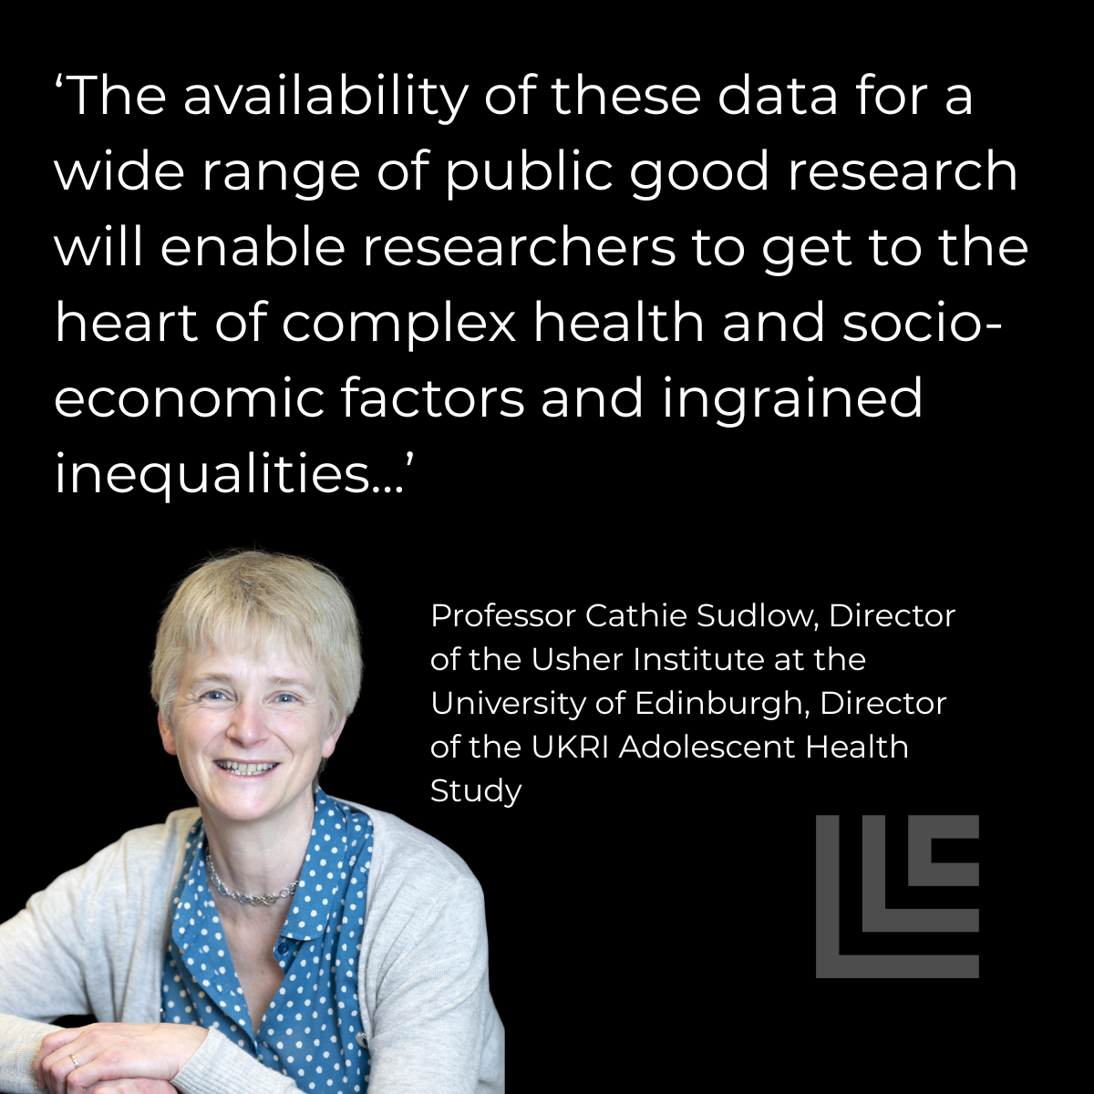
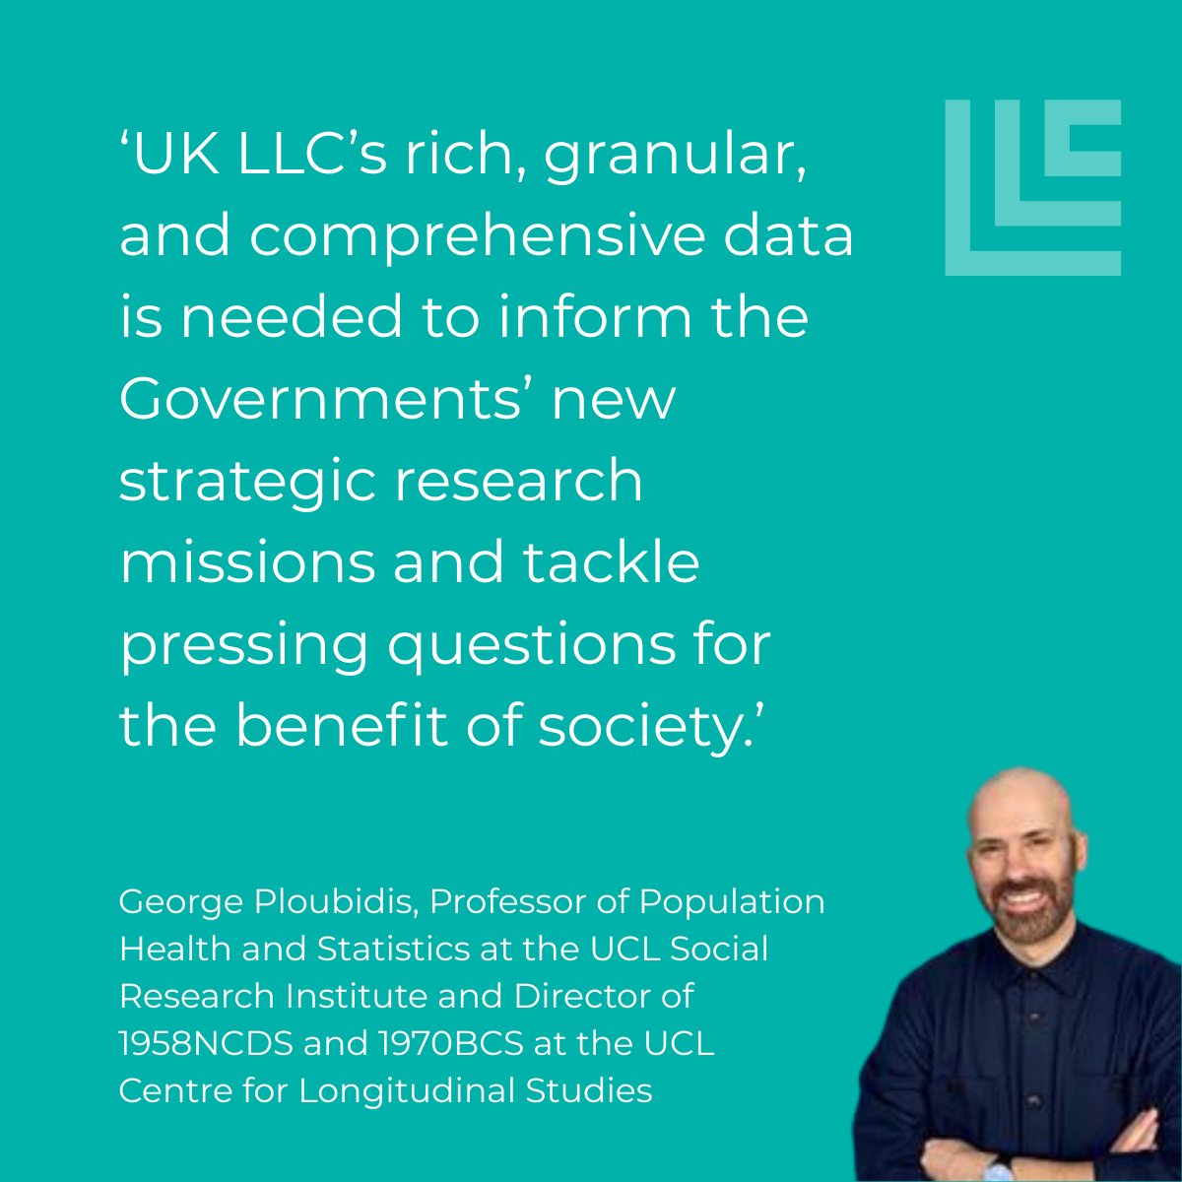
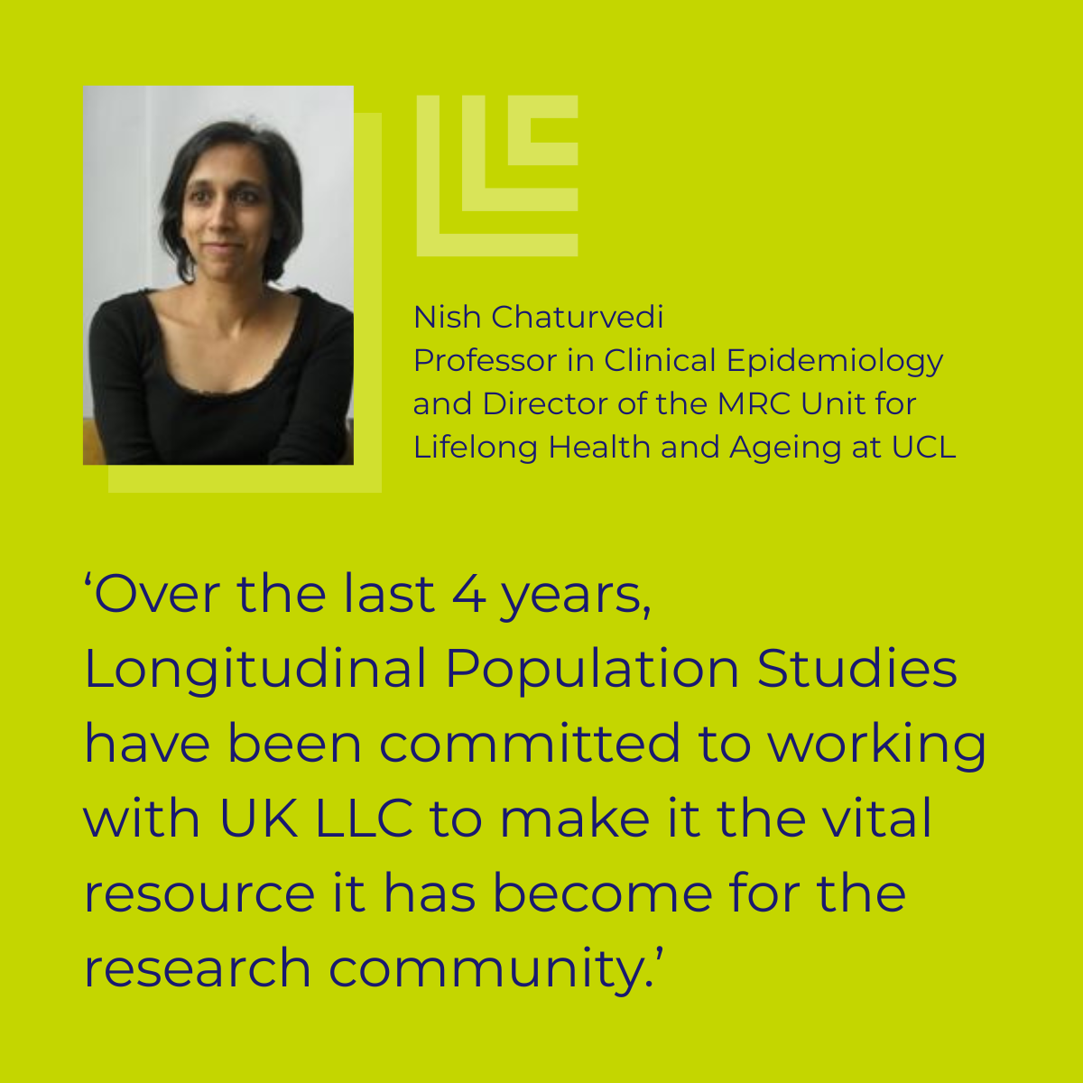
What value will this deliver?
Notes:
This material and content has been co-produced by the UK LLC team with its partners. Copying and Licence information (CC-BY-SA). The material on this site is copyright (c) 2020-2024 of the University of Bristol. It is open and licensed under the Creative Commons Attribution ShareAlike License (CC-BY-SA) v4.0. CC BY-SA includes the following elements: BY – Credit must be given to the creator; SA – Adaptations must be shared under the same terms. The full CC-BY-SA text may be found at: https://creativecommons.org/licenses/by-sa/4.0/

Slide 9
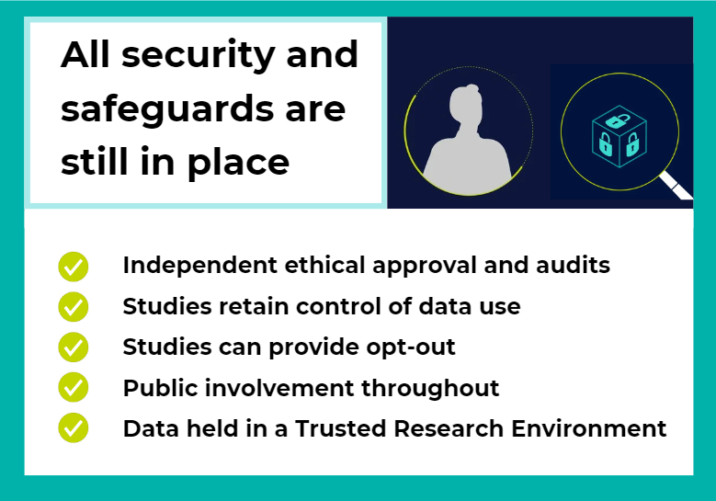
UK LLC: Always looking after your data
Questions?
Contact your study team if you have questions about UK LLC and/or wish to opt-out from your data being used in this way.
Notes:
This material and content has been co-produced by the UK LLC team with its partners. Copying and Licence information (CC-BY-SA). The material on this site is copyright (c) 2020-2024 of the University of Bristol. It is open and licensed under the Creative Commons Attribution ShareAlike License (CC-BY-SA) v4.0. CC BY-SA includes the following elements: BY – Credit must be given to the creator; SA – Adaptations must be shared under the same terms. The full CC-BY-SA text may be found at: https://creativecommons.org/licenses/by-sa/4.0/

Slide 10

Queries can be directed to info@ukllc.ac.uk
Notes:
This material and content has been co-produced by the UK LLC team with its partners. Copying and Licence information (CC-BY-SA). The material on this site is copyright (c) 2020-2024 of the University of Bristol. It is open and licensed under the Creative Commons Attribution ShareAlike License (CC-BY-SA) v4.0. CC BY-SA includes the following elements: BY – Credit must be given to the creator; SA – Adaptations must be shared under the same terms. The full CC-BY-SA text may be found at: https://creativecommons.org/licenses/by-sa/4.0/

