Slide 1
Airplane detection using multilayer feature fusion in fully convolutional neural network

Slide 2
Issues of previous works:
Low accuracy rate
High false alarm
Low detection speed
Low dimensionality in deep layers
Inadequate expression of small objects

Slide 3
Introduction
Majorly divided into two process: Locating candidate region & Classifying objects in the candidate region
For detection, a rotational invariant classifier is required
Use of RPN & adaptive pooling network as basic box work, to generate feature map
Spatial pyramid pooling is to be used to generate feature map
Fusion is used for creating detection network as deep layers have semantic information while shallow layers have location information

Slide 4
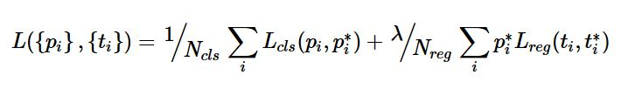
Methodology
Entire network is founded on region based CNN
Maximum pooling layer on lower layer to perform down-sampling
De-convolutional operation on higher layer to conduct up-sampling
Non-maximal inhibition method to be used to filter candidate region set
Multitask loss was used to jointly train classification and boundary box regression tasks
Detection network’s training is based on regions extracted by RPN

Slide 5
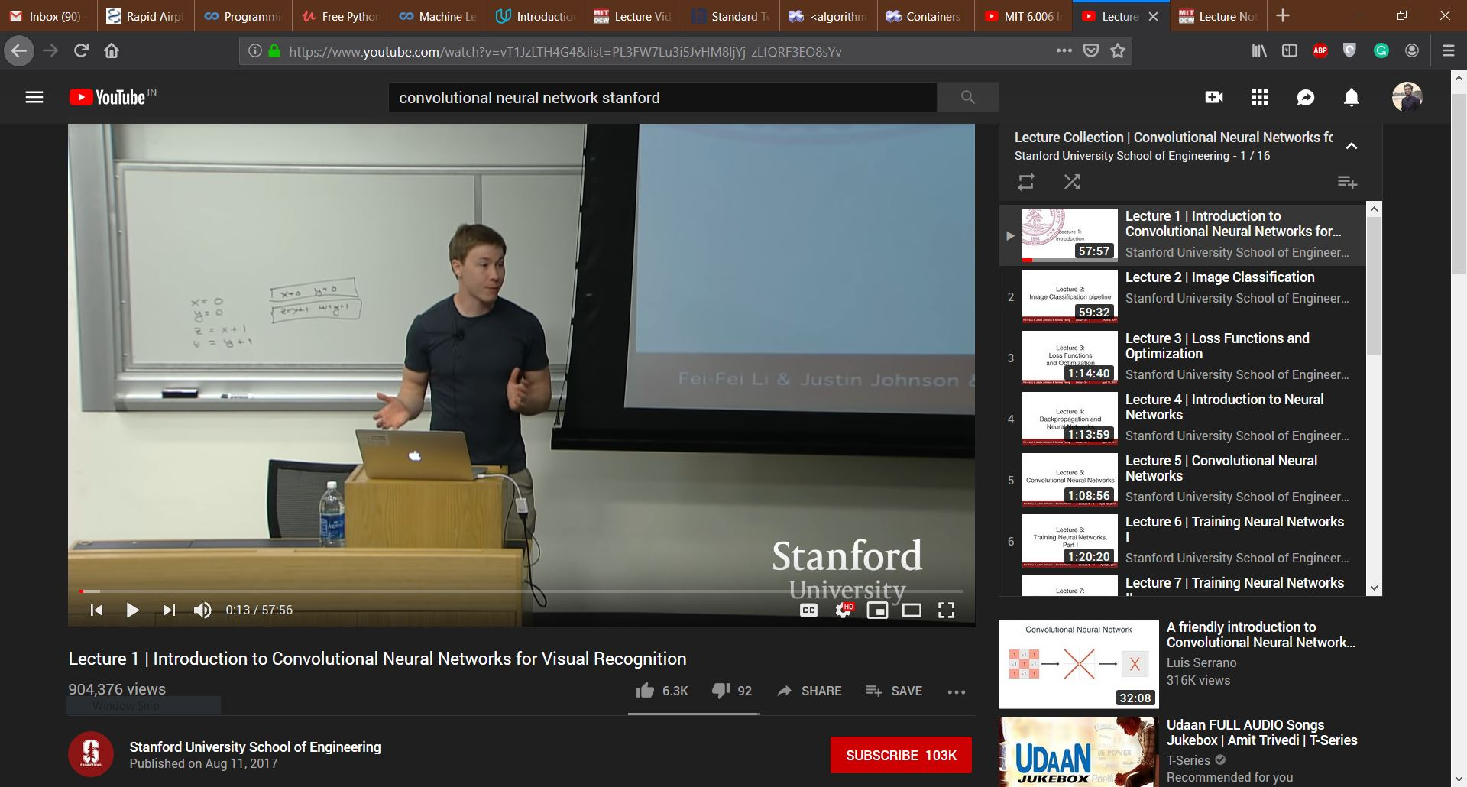
Online study content

Slide 6
Thank You!

