Slide 1
Convolutional neural network
By – Ujjwal

Slide 2
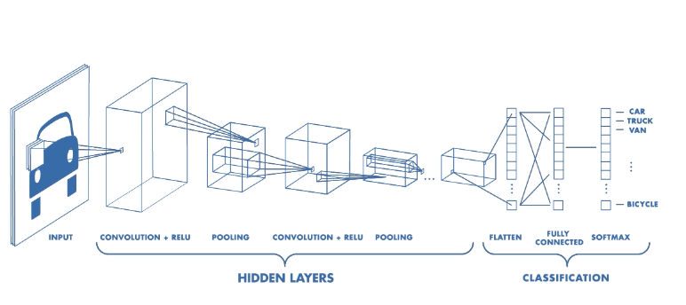
Definition of CNN
CNN networks are simply neural networks that use convolution in place of general matrix multiplication in at least one of their layers.
Convolution is a mathematical operation having linear form

Slide 3

Linear classification
Linear classification is a type of template matching architecture which learns one template per data (averages out the data)
$F (x,w)$= $wx+b$[using this form of equation to classify data into certain different classes]
x-input ; w-weights ; b-bias term
If suppose ‘x’ is $32∗32∗3$, so ‘x’ in equation will have dimension $3072∗1$
Assuming there are 10 different classes to classify then ‘w’ will be $10∗3072$ and ‘b’ will be $10∗1$
In the end we get probability of input belonging to each class and the class with maximum probability is selected as the class of input

Slide 4

Multiclass SVM model
For a given image label dataset {$x_{i},y_{i}$} for i$=1:n$ where $x_{i}$ is image, $y_{i}$ is label
Loss is defined as $L=\frac{1}{N} \sum_{1}^{n}{L_{i}(f\left(x_{i},w\right),y_{i})}$
For weight ‘w’ we start with small random weight value and then as per loss function it is being updated. To avoid overfitting of network we introduce a regularisation term and thus the new Loss function is
$L=\frac{1}{N} \sum_{1}^{n}{L_{i}(f\left(x_{i},w\right),y_{i})}$ + $λR(w)$
This handles cases where is w is 0 then 2w will also be 0 and thus there will be no updating of weight, so regularisation term handles those cases
There are 2 regularisation equation generally used $L_{1 }\& L_{2 }$
$L_{1 }$is Manhattan distance $Σ(I_{1}^{p}−I_{2}^{p})$ whereas $L_{2 }$is Euclidean distance $√Σ({I_{1}^{p}−I_{2}^{p})}^{2}$

Slide 5
Optimisation of weight parameter
Random approach of using varying weight between a know range. This works in very limited case and as a pre-requisite range of weights needs to be known beforehand.
Following slope – uses analytic gradient and accordingly updates the parameter. Issue with this is that update parameters becomes very small as it moves towards minima parameter and also using this the algorithm can get stuck forever in local minima
Advanced algorithm such as SDG+Momentum, Adagrad, Adam

Slide 6
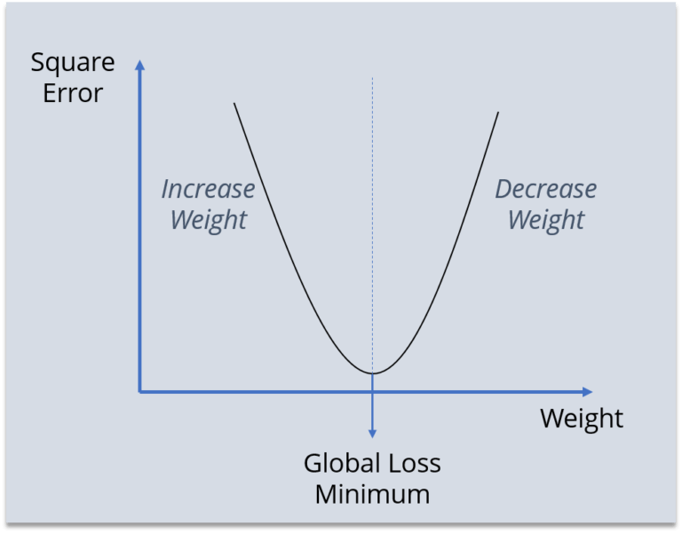
Backpropagation (A generic optimisation)
The Backpropagation algorithm looks for the minimum value of the error function in weight space using a technique called the delta rule or gradient descent. The weights that minimize the error function is then considered to be a solution to the learning problem
Using backpropagation, we wish to achieve the global
loss minima and thus this weight parameter would be
finally used for predicting the unknown dataset

Slide 7
Backpropagation (Continued)
It has majorly 3 steps: Forward network feed, Backward network feed & updating values
Pseudo code for backpropagation:
initialize network weights (with some random small values)
do
for Each training example named ex
prediction = neural network output(network, ex)
actual = known output (ex)
compute error (prediction - actual) at the output units
compute {Delta w_{h}} for all weights from hidden layer to output layer //backward pass
compute {Delta w_{i}} for all weights from input layer to hidden layer //backpass cont.
update network weights // except the input layer
until all examples classified correctly or any custom defined stopping criteria
return the network

Slide 8

Loss function
Loss function – it is a user dependent equation which varies depending upon the network structure and the data type
For univariate linear regression $h(x)=θ_{0}x+θ_{1}$, loss function
$J\left(θ_{0},θ_{1},{…θ}_{n}\right)=\frac{1}{2m}\sum_{i=1}^{m}{{({h(x)}_{i}−y_{i})}^{2}}$ where ${h(x)}_{i}$ is predicted & $y_{i}$is known value
$θ_{j}≔θ_{j}−α\frac{∂}{∂θ}(J_{θ})$ , using this $θ_{j}$is updated
Few techniques to speed up convergence:
Feature scaling: $x_{i}=\frac{x_{i}}{range of x_{i}}$
Mean normalisation: $x_{i}=\frac{x_{i}−μ}{range of x_{i}}$where $μ is mean of x_{i}$
Activation function $h(x)$ for logistic regression is sigmoid function
$h\left(x\right)=\frac{1}{1+e^{−θ^{T}x}}$
This is mainly used for classification problem i.e output is either 0 or 1
Other nonlinear activation functions are tanH, ReLU

Slide 9
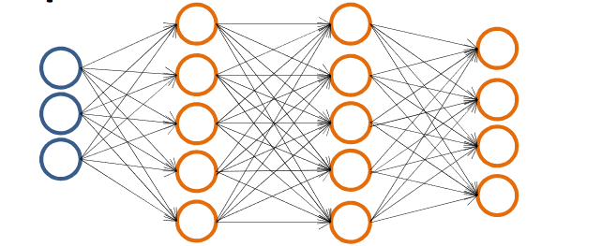

Backpropagation for CNN used
Assuming each layer is named $a^{(1)},a^{(2)},a^{(3)},a^{(4)}$ where $a^{(1)}$ is input layer $a^{(4)}$ is output layer and rest are hidden layers connected with each other; $θ^{n}$connects layer n to n+1
Forward propagation equations:
$a^{(1)}=x$ where $x$ is input layer
$z^{(2)}=θ^{(1)}∗a^{\left(1\right)} ⇒ a^{\left(2\right)}=g\left(z^{\left(2\right)}\right) \left[add a_{0}^{\left(2\right)} to a^{\left(2\right)} as bias unit\right]$ $→g\left(x\right)−sigmoid of x$
$z^{(3)}=θ^{(2)}∗a^{\left(2\right)} ⇒ a^{\left(3\right)}=g\left(z^{\left(3\right)}\right) \left[add a_{0}^{\left(3\right)} to a^{\left(3\right)} as bias unit\right]$
$z^{(4)}=θ^{(3)}∗a^{\left(3\right)}$ $⇒ a^{\left(4\right)}=g\left(z^{\left(4\right)}\right)=h_{θ}(x)$
Backpropagation equations:
$δ_{j}^{(l)}→error of node j in layer l$
$δ^{(4)}=a^{(4)}−y$
$δ^{(3)}={(θ^{(3)})}^{T}∗$ $δ^{(4)}.∗ g^{′}\left(z^{\left(3\right)}\right) .∗is element wise multiplication$
$δ^{(2)}={(θ^{(2)})}^{T}∗$ $δ^{(3)}.∗ g^{′}\left(z^{\left(2\right)}\right){ g}^{′}\left(z^{\left(n\right)}\right)=$ $a^{(n)}$.* $({1−a}^{\left(n\right)})$
No $δ^{(1)}$ term as input layer remains the same

Slide 10

Backpropagation for CNN used(2)
Updating parameter equation:
$for i=1:m ←\left(x^{i},y^{i}\right)$
$a^{(1)}=x^{i}$
$forward computation to compute a^{l} for l=2,3,4…L$
$using$ $y^{i} compute δ^{(L)}=a^{(L)}−y^{i}$
$compute δ^{(L−1)},δ^{(L−2)},…δ^{(2)}$
$∆_{ij}^{(l)}=$ $∆_{ij}^{(l)}+a_{j}^{(l)}δ_{i}^{(l+1)}$
$$end$$
$D_{ij}^{(l)}=\frac{1}{m}D_{ij}^{(l)}+\frac{λ}{m}θ_{ij}^{(l)}$ $if j≠0$
$D_{ij}^{(l)}=\frac{1}{m}D_{ij}^{(l)}$ $if j=0$
Ultimately we need to minimise $J(θ)$ either by using gradient descent or some advanced optimisation algorithm

Slide 11

Evaluating model’s fit
Bias – It means the model is underfitting. This will lead to a very high error in training data set and test or cross validation data set
Variance – It means the model is overfitting. This will lead to poor generalisation and can be identified by low error on training data set but a very high error on testing or cross validation data set
To fix the issue of overfitting, regularisation parameter is used
But if $λ$is very high, it’ll lead to high biasness (underfitting) : $J_{train}$ is high while $J_{cv}$is also very high
A lower value of $λ$ may lead to high variance (overfitting) : $J_{train}$ is very low while $J_{cv}$is very high

Slide 12
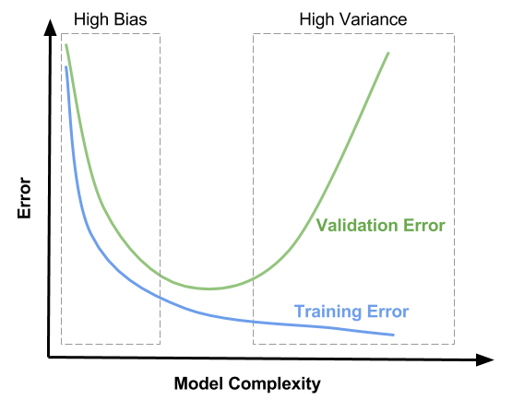
Evaluating model’s fit(2)

Slide 13
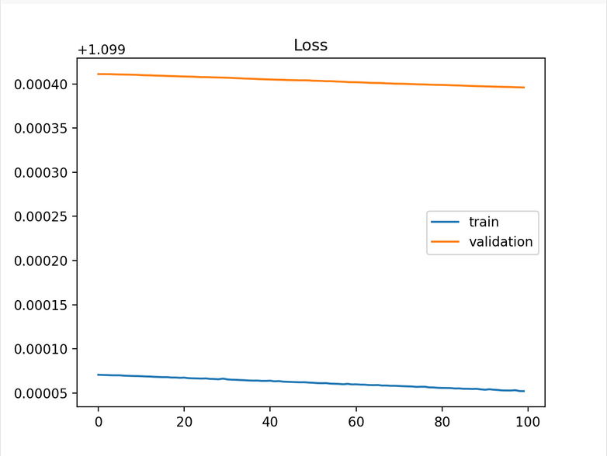
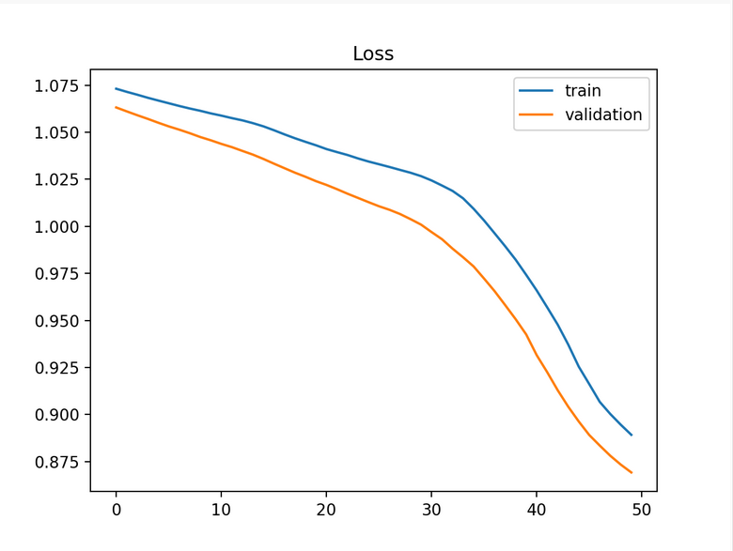
Learning Curves
A plot of model learning performance over experience or time
It has two component: training and validation curve
Underfit learning curve:

Slide 14
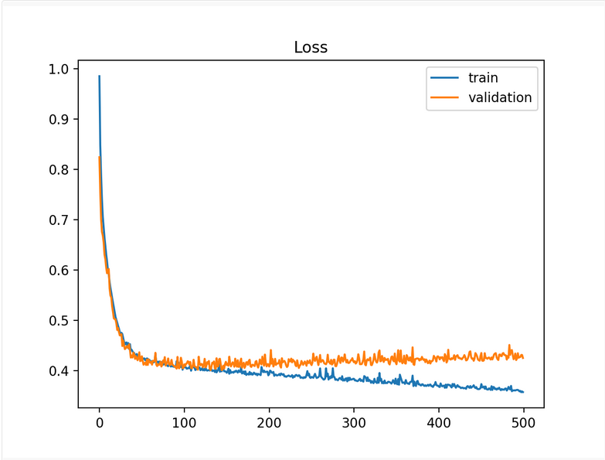
Learning Curves(2)
Overfitting learning curve:

Slide 15
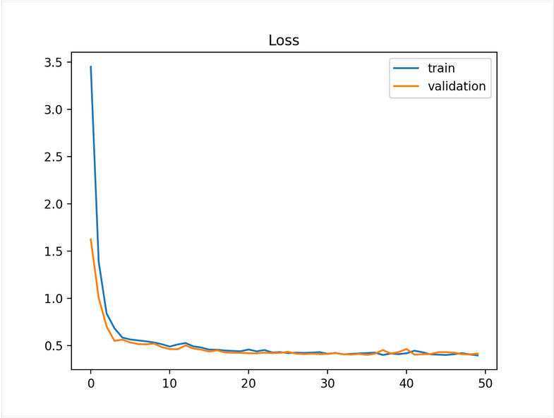
Learning Curves(3)
Good fit learning curve:

Slide 16

Learning Curves(4)
Fixes based the curve obtained:
Having more dataset fixes issue of high variance (overfitting)
Increasing degree of polynomial fixes high bias (underfitting)
Decreasing $λ$ fixes high biasness while increasing $λ$ fixes high variance
To optimise learning curve and find the appropriate hyperparameter, once a network structure is finalised then plotting the learning curve with variation of degree of polynomial and other parameter can give us the best value for a given network structure and data set
F1 score assessment
$Precision(P)=\frac{Number of true+ve }{Number of+ve predicted}=\frac{Number of true+ve}{True+ve + false+ve}$
$Recall(R)=\frac{true+ve}{Number of actual+ve}=\frac{true+ve}{true+ve + false−ve}$
$F_{1}=\frac{2PR}{P+R}$
Network with highest $F_{1}$ score is selected as the best structure

