Slide 1

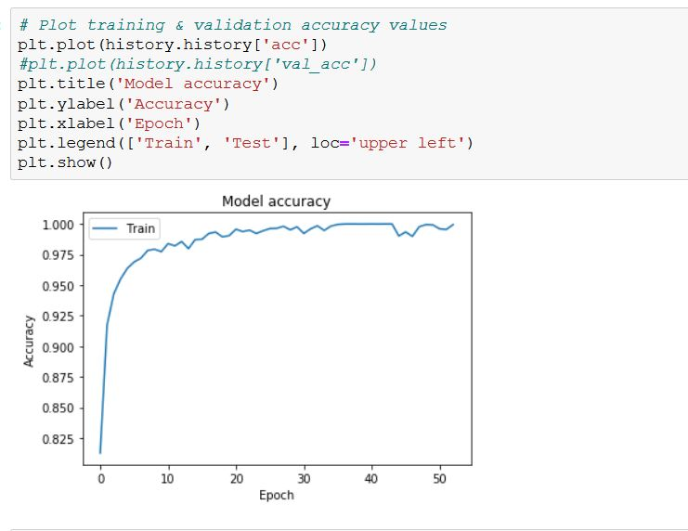
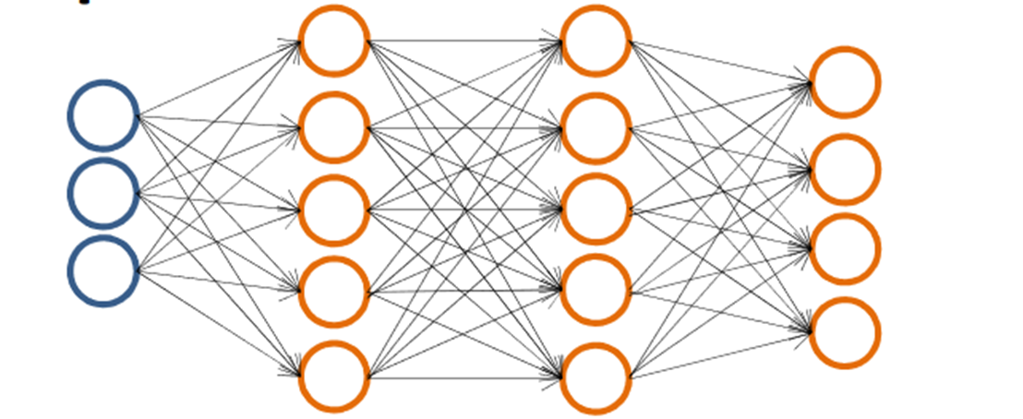
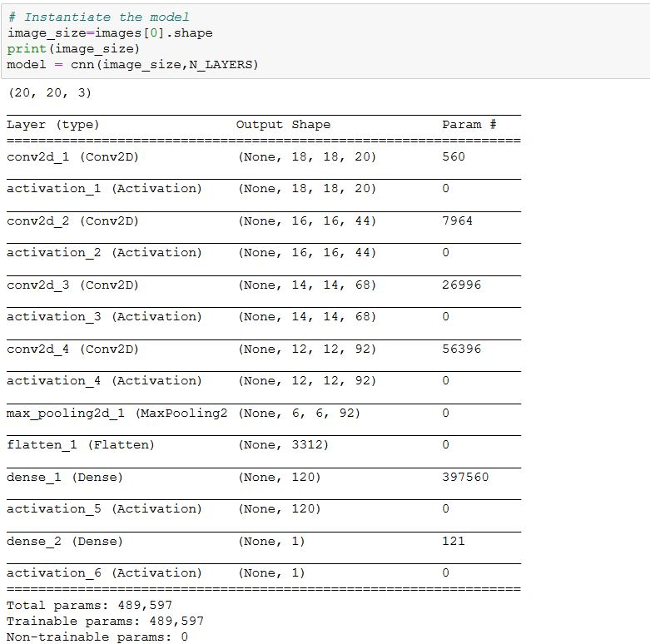
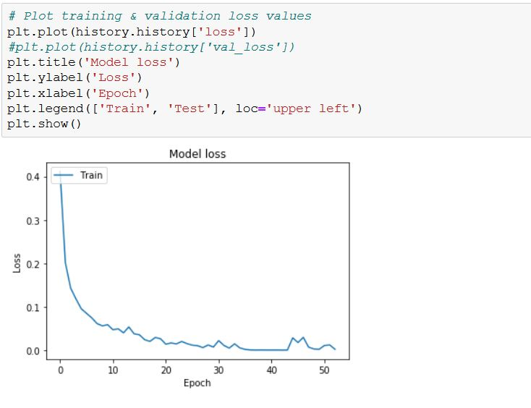
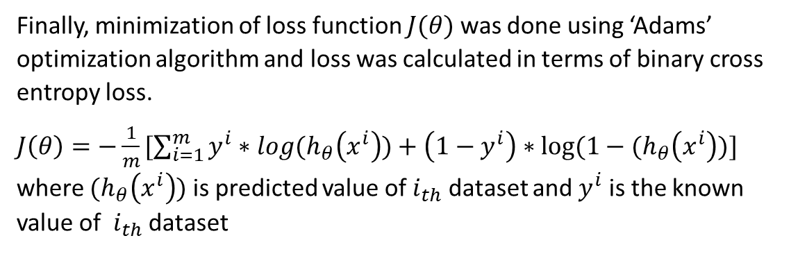
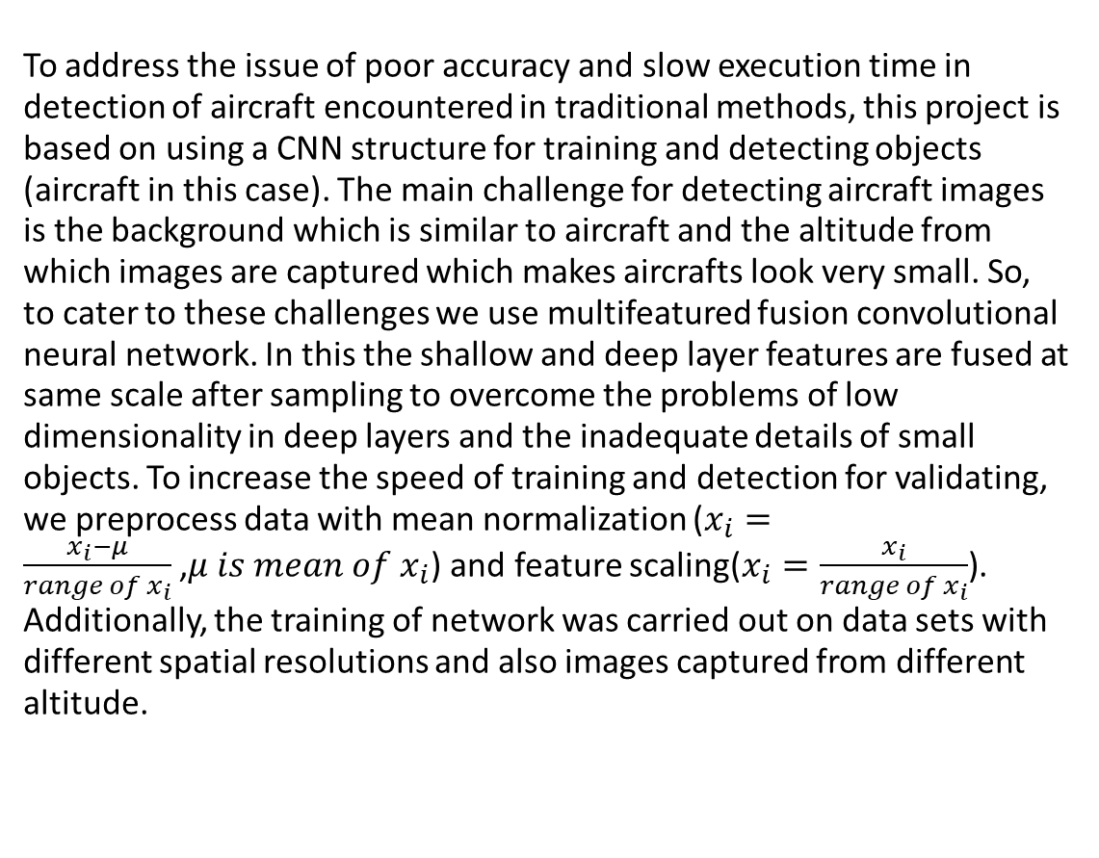
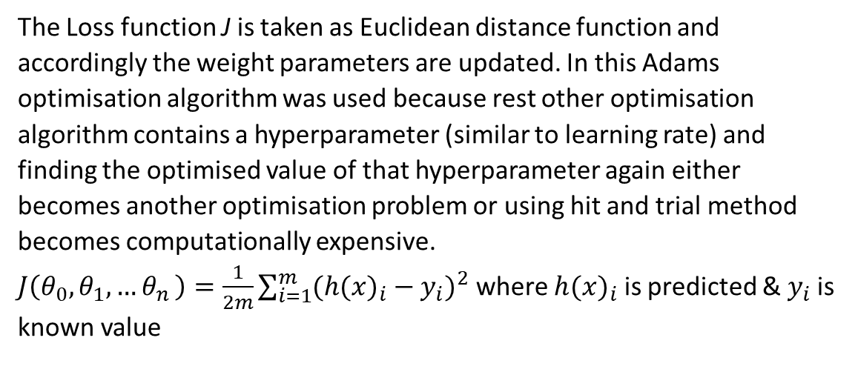
Detection of Aircraft using CNN
Ujjwal Kumar
Guide: Prof. J Indu
Department of Civil Engineering, IIT Bombay
Abstract
To address the issue of poor accuracy and slow execution time in detection of aircraft encountered in traditional methods, this project is based on using a CNN structure for training and detecting objects (aircraft in this case). The main challenge for detecting aircraft images is the background which is similar to aircraft and the altitude from which images are captured which makes aircrafts look very small. So, to cater to these challenges we use multifeatured fusion convolutional neural network. In this the shallow and deep layer features are fused at same scale after sampling to overcome the problems of low dimensionality in deep layers and the inadequate details of small objects. To increase the speed of training and detection for validating, we preprocess data with mean normalization ($x_{i}=\frac{x_{i}−μ}{range of x_{i}}$,$μ is mean of x_{i}$) and feature scaling($x_{i}=\frac{x_{i}}{range of x_{i}}$). Additionally, the training of network was carried out on data sets with different spatial resolutions and also images captured from different altitude.
The Loss function J is taken as Euclidean distance function and accordingly the weight parameters are updated. In this Adams optimisation algorithm was used because rest other optimisation algorithm contains a hyperparameter (similar to learning rate) and finding the optimised value of that hyperparameter again either becomes another optimisation problem or using hit and trial method becomes computationally expensive.
$J\left(θ_{0},θ_{1},{…θ}_{n}\right)=\frac{1}{2m}\sum_{i=1}^{m}{{({h(x)}_{i}−y_{i})}^{2}}$ where ${h(x)}_{i}$ is predicted & $y_{i}$is known value
Limitations & Future Improvements:
Major limitation is due to shallow layer which has led to overfitting of equation on dataset
Shifting architecture similar to VGG net would increase parameter from 0.5M to 146M, thus a significantly higher accuracy can be obtained
Training dataset contains a total of 32000 images with around 20% of aircraft images, thus due to low percentage model has poor generalisation
Augmentation applied on dataset might help model to generalise better
Resolution of dataset is 20*20*3, thus higher resolution data might provide spatial depth
Bounding box problem can be extended using sliding window technique applied on this model
Methodology
Input Image
Convolution 2D
ReLU Activation
(4 layers)
Max Pooling
Flatten
Dense
ReLU Activation
Fully connected layer
Sigmoid function
Finally, minimization of loss function $J(θ)$ was done using ‘Adams’ optimization algorithm and loss was calculated in terms of binary cross entropy loss.
$J\left(θ\right)=−\frac{1}{m}[\sum_{i=1}^{m}{y^{i}∗log{(h}_{θ}\left(x^{i}\right))+\left(1−y^{i}\right)∗log⁡(1−{(h}_{θ}\left(x^{i}\right))}]$
where ${(h}_{θ}\left(x^{i}\right))$ is predicted value of $i_{th}$ dataset and $y^{i}$ is the known value of $i_{th}$ dataset
Layer wise computation:
Fully connected layer
Forward Propagation
Backward Propagation
Loss function minimisation
Final Classification
Results
Conclusion
The overall accuracy on the validation data set obtained was around 98.5% while the accuracy on training data set was around 75.32%.
CNN architecture does provide a more accurate solution for identification of objects in images. Although training the model does take some time but it’s time can be decreased by using GPU based computation and. Post training, the prediction takes very little time. This method is definitely quite accurate, fast and the model once trained its weight can be saved and a predicting software GUI can be made out of it.
Bibliography
X. Li, S. Wang, B. Jiang and X. Chan, "Airplane detection using convolutional neural networks in a coarse-to-fine manner," 2017 IEEE 2nd Information Technology, Networking, Electronic and Automation Control Conference (ITNEC), Chengdu, 2017, pp. 235-239. doi:10.1109/ITNEC.2017.8284943
Xu, Yuelei et al. “Rapid Airplane Detection in Remote Sensing Images Based on Multilayer Feature Fusion in Fully Convolutional Neural Networks.” Sensors (Basel, Switzerland) vol. 18,7 2335. 18 Jul. 2018, doi:10.3390/s18072335
Chen, Xueyun, Shiming Xiang, Cheng-Lin Liu and Chunhong Pan. “Aircraft Detection by Deep Convolutional Neural Networks.” IPSJ Trans. Computer Vision and Applications 7 (2014): 10-17.
Dataset obtained from Kaggle - https://www.kaggle.com/rhammell/planesnet/data

