Slide 1
Object detection(aircraft) & bounding box problem [BTP2]
By – Ujjwal & Geordi
Supervisor – Prof. J Indu

Slide 2
Objective
Aircraft detection in the input image and creating bounding box along its location
Creating a UI platform to perform testing on any random images

Slide 3
Limitations of BTP-1

Slide 4
Methodology
CGI Dataset
Augmentation
Building Model
Training
Testing
Web based deployment

Slide 5
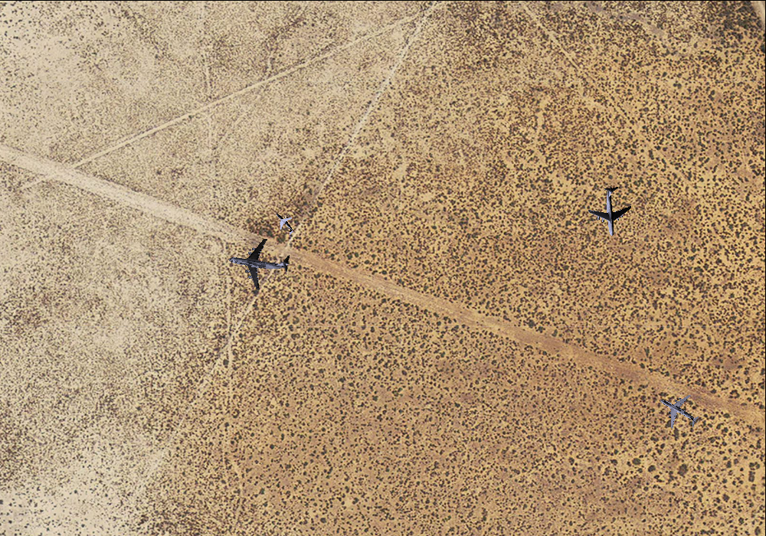
Methodology – CGI Dataset
400 computer generated image
csv file containing location of aircraft in images

