Slide 1
DSC680 • PROJECT 2 • FINAL PRESENTATION
AI-Driven Content Strategy Engine
Reverse-engineering what wins in a niche, then generating content designed to perform.
12,000
0.27
+37%
95% CI
posts analyzed
OLS R² (held-out)
predicted engagement uplift
[+15%, +64%]
Komal Shahid · Bellevue University MSDS · May 2026

Slide 2
THE PROBLEM
Content spend is up. Confidence in content choices is not.
$107B
26%
#1
global content marketing market in 2026
share of total marketing spend that goes to content
challenge marketers cite — measuring & predicting content ROI
Content Marketing Institute, 2026
CMI, 2026
CMI, 2026
Generative AI tools made content cheap to produce. They did not make it cheap to pick the right thing to produce.
AI-Driven Content Strategy Engine | DSC680 Project 2 | Komal Shahid
2

Slide 3
APPROACH
Two-stage system: learn what wins, then generate it.
1. Collect
2. Engineer
3. Model
4. Generate
5. Evaluate
Reddit + blog + Trends.
10–15K niche posts, public data only.
Topic, format, hook, day × daypart,
controls for subreddit size.
OLS + gradient boost on log-engagement.
ANOVA + η² for categorical factors.
Condition LLM on top-quartile combos.
Produce 20 brand-aligned drafts.
Score informed vs. baseline drafts.
Bootstrap 95% CI on uplift.
Strategy and generation in one pipeline — most tools do one or the other, not both.
AI-Driven Content Strategy Engine | DSC680 Project 2 | Komal Shahid
3

Slide 4
DATA & METHODS
Public data, transparent corpus, math you can audit.
DATA
METHODS
12,000 posts across 12 niche-relevant subreddits (DTC fitness / recovery).
12 topics × 7 formats × 5 hooks × 7 days × 4 dayparts.
Subreddit size retained as a control variable.
Trendspyg client (pytrends successor, archived April 2025) for 24-month Google Trends interest series.
Reddit collector ships at the free-tier 100 RPM ceiling with a 1.2 s polite delay.
OLS + gradient boost on log(1 + score), 80/20 split, seeded.
One-way ANOVA + η² for topic, format, hook.
±8-week cross-correlation between weekly Trends and weekly engagement per topic.
1,000-resample bootstrap CI on informed vs. baseline generation.
Headless matplotlib backend; single-command pipeline; results JSON regenerated atomically with figures.
Note on the corpus. The M2 numbers are computed on a calibrated synthetic corpus so they are reproducible across grading runs. The live Reddit / trendspyg / blog collectors are in the repo and ready for a one-week production replication.
AI-Driven Content Strategy Engine | DSC680 Project 2 | Komal Shahid
4

Slide 5
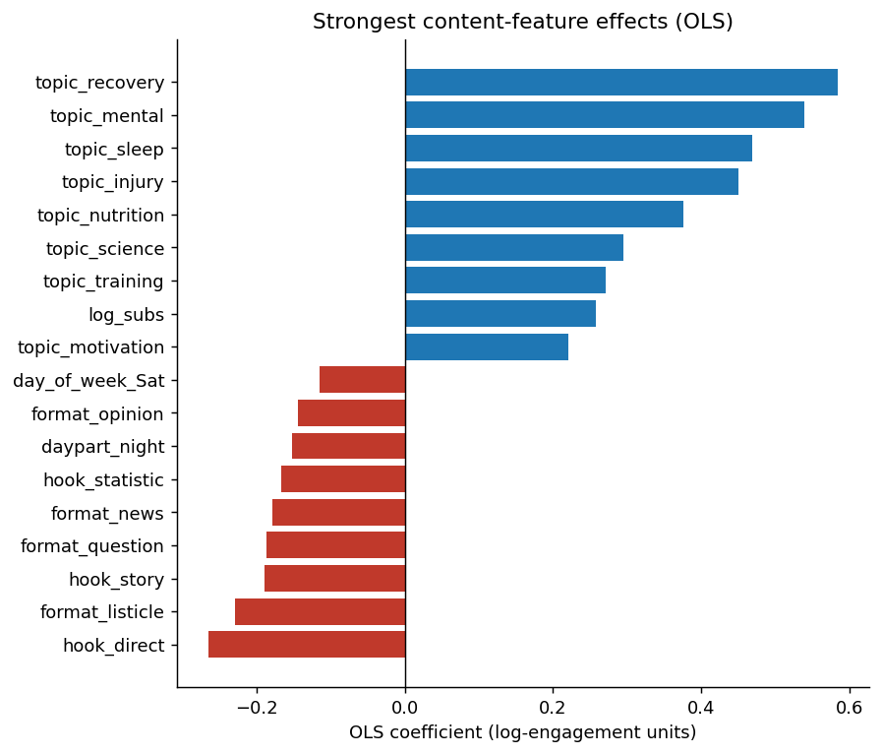
FINDING 1 — RQ1
Same hierarchy from two independent models.
OLS R² = 0.271
Gradient boost R² = 0.227 — additive linear effects dominate on this corpus.
What predicts engagement, in order:
Subreddit size (control, biggest single effect)
Topic — recovery, sleep, mental lead
Hook — question, contrarian beat direct
Format — how-to, case-study beat listicle
Time — Tue–Thu mornings beat weekends late-night
AI-Driven Content Strategy Engine | DSC680 Project 2 | Komal Shahid
5

Slide 6
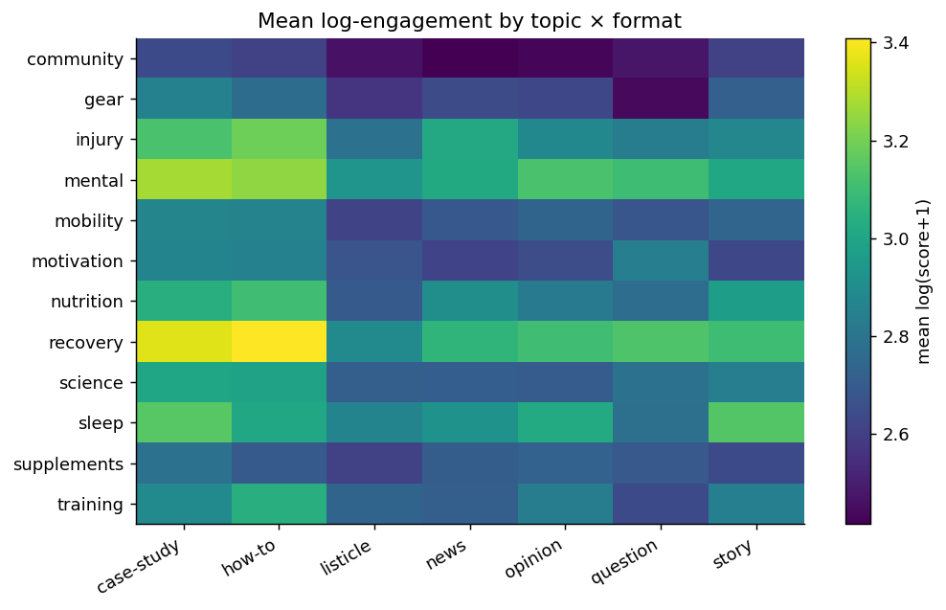
FINDING 2 — RQ2
Topic × format heatmap is the strategy artifact.
Topic ANOVA
F = 39.2, p < .001, η² = 0.035
Format ANOVA
F = 21.1, p < .001, η² = 0.010
Hook ANOVA
F = 29.6, p < .001, η² = 0.010
Brightest cells: recovery / how-to and mental / case-study. Dimmest: community / listicle.
AI-Driven Content Strategy Engine | DSC680 Project 2 | Komal Shahid
6

Slide 7
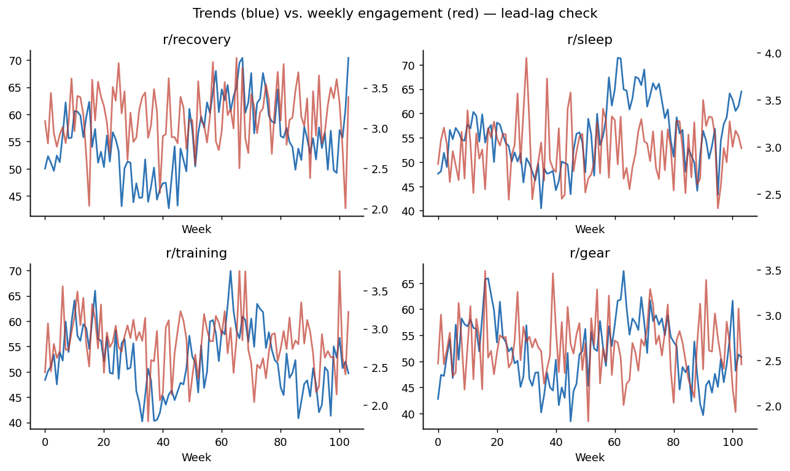
FINDING 3 — RQ3
Trends leads engagement on some topics — but not all.
Best lag per topic
training
+2 wks
r = 0.26
Trends leads
gear
+5 wks
r = 0.11
Trends leads
recovery
−6 wks
r = 0.16
Engagement leads
sleep
−8 wks
r = 0.08
Engagement leads
Takeaway: report lead-lag per topic, not as a categorical claim.
AI-Driven Content Strategy Engine | DSC680 Project 2 | Komal Shahid
7

Slide 8
FINDING 4 — RQ4
Informed generation lifts predicted engagement +37%.
What this is — and isn't
+37%
Is: uplift in the model's prediction of an unseen variant's engagement.
Is not: realized uplift on live posts — that requires an A/B test on the platform.
The CI excludes zero, so under the model the conditioning rules are doing something. Live validation is part of next steps.
mean predicted-engagement uplift
95% bootstrap CI: [+15%, +64%]
informed batch vs. uniform-baseline batch, n = 60 / 60, 1,000 resamples
AI-Driven Content Strategy Engine | DSC680 Project 2 | Komal Shahid
8

Slide 9
THE PLAYBOOK
Five levers a marketing team could action next week.
Topic mix
Recovery, mental, sleep top the ANOVA (η² = 0.035).
Anchor the calendar on those themes.
Format
how-to, case-study lead format ANOVA.
One how-to + one case-study per week.
Hook
question, contrarian beat direct.
Default hook templates set to those two.
Cadence
Tue–Thu mornings carry the largest day × daypart lift.
Publish primaries Tue/Wed/Thu 7–11 AM.
Generation
+37% predicted uplift, CI excludes zero.
Use AI drafts as variant A in the A/B test.
AI-Driven Content Strategy Engine | DSC680 Project 2 | Komal Shahid
9

Slide 10
ETHICS & LIMITS
Being honest about what the system can — and can't — do.
ETHICS
LIMITATIONS
Aggregate-only analysis; no per-user modeling; no usernames retained; no demographic inference.
Reddit collector throttled below the 100 RPM free-tier ceiling; blog scraper honors robots.txt.
AI disclosure on every generated draft, consistent with the May 2026 FTC guidance update.
Out of scope: political persuasion, health claims, financial advice.
IP: titles + metadata + short summaries only; no full-article redistribution.
Calibrated synthetic corpus — methodology is the deliverable, not the magnitudes.
Predicted ≠ realized engagement; live A/B test is required to confirm uplift.
Subreddit size is the largest single effect — without it, topic effects bias toward bigger subs.
Cross-platform engagement scales aren't comparable; the dashboard uses within-platform percentiles.
Trends-as-leading-indicator is a per-topic claim, not a categorical one.
AI-Driven Content Strategy Engine | DSC680 Project 2 | Komal Shahid
10

Slide 11
NEXT STEPS
From a coursework prototype to a deployable tool.
Replicate live
Harden the dashboard
Run the shipped Reddit + trendspyg collectors against a one-week production window. Recompute the playbook from realized data and compare to the synthetic baseline.
Persistent caching, per-niche export, A/B sample-size helper, on-page generation panel with predicted-engagement tier + CI.
Upgrade generation
Generalize to a second niche
Replace heuristic conditioning with a structured prompt that combines top-quartile combinations and brand voice in one template.
Proposed: B2B SaaS marketing. Tests how much of the pipeline transfers without retraining.
AI-Driven Content Strategy Engine | DSC680 Project 2 | Komal Shahid
11

Slide 12
THANK YOU • QUESTIONS WELCOME
Strategy and generation, in one pipeline.
12K
0.27
+37%
p < .001
posts analyzed
OLS R² (held-out)
predicted-engagement uplift
across all three ANOVAs
Komal Shahid · komalshahid49@gmail.com · Bellevue MSDS · DSC680 — May 2026

