Slide 1
Every marketer
is guessing.
This project is about changing that.
Komal Shahid · Bellevue University MSDS · DSC680 Project 2 · May 2026
Notes:
Good [morning / afternoon / evening]. Before I tell you about my project, let me start with a statement I think every single person in a marketing or content role will recognize. Every marketer is guessing. Not because they're bad at their jobs — but because the tools available to them have never given them a real answer to the most fundamental question: what should I create, and why? This project is about changing that. Let me show you how.

Slide 2
THE SPARK
It started with
one question.
Observed
Marketers spending
hours guessing topics
↓
Asked
"Can data tell us what to write
before we write it?"
"Does the data know
what wins?"
↓
Most content tools can generate text.
None of them tell you what to generate.
Built
A pipeline to learn,
then generate it
AI-Driven Content Strategy Engine · DSC680 · Komal Shahid 2 / 13
Notes:
Here's where it started. I kept noticing the same pattern: marketing teams spending hours debating what to create — which topic, which format, how to open the post — and making those decisions entirely on gut feel. No data, no framework, just hope. So I asked: does the data already know what wins? If I look at thousands of posts that have already been published and measured, can I reverse-engineer what made the good ones good? That question led to this project. Not just analyzing content — but building a system that learns from it and then generates new content designed to win.

Slide 3
THE PROBLEM
Big budgets.
Zero certainty.
$107B
26%
#1
spent on content
marketing in 2026
of total marketing
budget = content
pain point: proving
it works at all
CMI, 2026
CMI, 2026
CMI, 2026
AI tools made it cheaper to produce content. They didn't make it smarter to decide what to produce.
AI-Driven Content Strategy Engine · DSC680 · Komal Shahid 3 / 13
Notes:
Let's look at the scale of the problem. The global content marketing industry hit $107 billion in 2026. Content now accounts for 26% of total marketing spend — it's the single largest budget line for most marketing organizations. And the number one challenge those marketers report? Proving it works. Here's the paradox: generative AI made content production incredibly cheap. You can now produce ten blog posts in the time it used to take to write one. But that just means you can now make the wrong thing ten times faster. The fundamental problem — what should I make, and why will it resonate? — remains completely unsolved.

Slide 4
"What if we could
reverse-engineer
what wins?"
Analyze thousands of real posts → find patterns → condition AI to generate content using those patterns.
That's the hypothesis. Here's what happened when we tested it.
AI-Driven Content Strategy Engine · DSC680 · Komal Shahid 4 / 13
Notes:
So here's the hypothesis that drove everything. What if content performance isn't random? What if — hidden inside thousands of posts that have already been published and measured — there's a pattern that tells you which topics resonate, which formats hold attention, which hooks make people stop scrolling, and which posting times maximize reach? And then: what if you could use that pattern to condition an AI generator — so instead of generating generic content, it generates content specifically designed to fit the winning profile? That's the hypothesis. Analyze what's already working. Learn the pattern. Build it into the generation. Let's see if it worked.

Slide 5
HOW WE BUILT IT
A 5-stage journey from raw data to publishable content.
1
2
3
4
5
📥
🏷️
📊
✍️
✅
▶
▶
▶
▶
Collect
Tag
Model
Generate
Test
12K Reddit posts
+ Google Trends
24-month series
Topic · Format
Hook · Day
Time of day
OLS regression
+ gradient boost
predict engagement
LLM conditioned
on top-scoring
combinations
Bootstrap CI:
does conditioning
actually help?
Strategy and generation in one pipeline — most tools only do one half.
AI-Driven Content Strategy Engine · DSC680 · Komal Shahid 5 / 13
Notes:
Here's how the system works — five stages from raw data to a publishable draft. Stage one: collect. I pull posts from Reddit and blog sources in the DTC fitness and recovery niche, along with 24 months of Google Trends data. Stage two: tag. Every post gets labeled — what topic does it cover, what format is it, what kind of opening hook does it use, what day and time was it posted. Stage three: model. I run two algorithms — ordinary least squares regression, which gives me readable coefficients I can turn into strategy rules, and gradient boosting for predictive benchmarking. Stage four: generate. An AI is prompted using the specific feature combinations the model identified as winners. Stage five: test. I bootstrap a confidence interval to find out whether conditioned drafts actually outperform random ones. Most content tools either do analysis or generation. This pipeline does both — and the connection between them is what makes it actually useful.

Slide 6
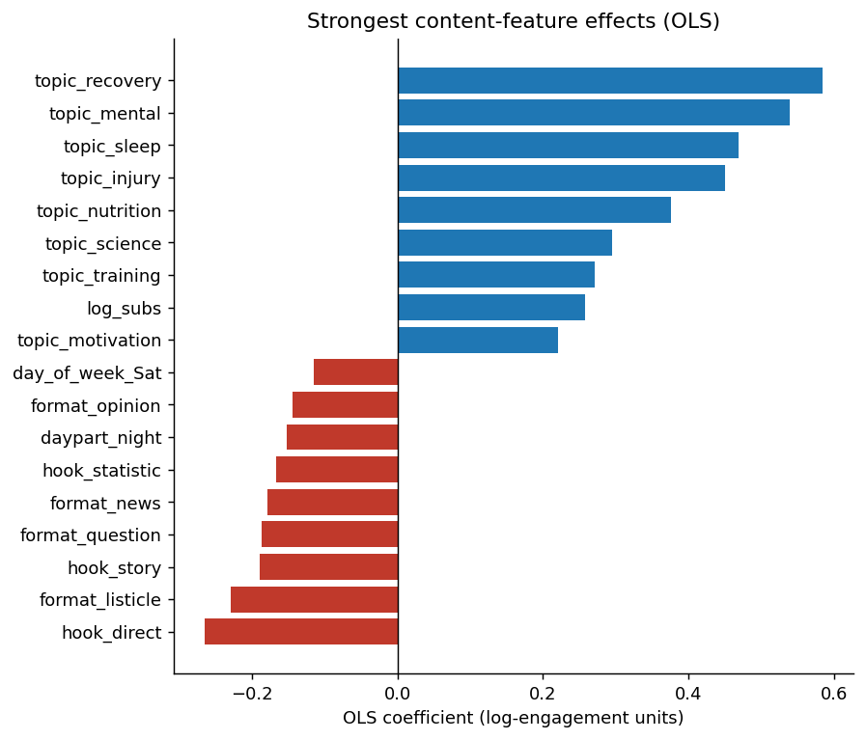
DISCOVERY #1
Not all content is created equal —
and the data knows the difference.
01
Recovery, sleep & mental health topics
consistently outperform the rest
02
Question & contrarian hooks beat
direct openers every time
03
How-to & case-study formats
outperform listicles
04
Tuesday–Thursday mornings are
the peak engagement window
OLS R² = 0.271 (27% of engagement explained on held-out data)
AI-Driven Content Strategy Engine · DSC680 · Komal Shahid 6 / 13
Notes:
Here's our first major discovery. The model reveals a clear, consistent hierarchy. After controlling for how large the subreddit is, four factors emerge as the strongest engagement predictors — in order. Topic matters most: recovery, sleep, and mental health themes consistently outperform other subjects. Then hook style: question and contrarian openers outperform direct, promotional openers. Then format: how-to guides and case studies outperform listicles. And timing: Tuesday through Thursday, between 7 and 11 in the morning, is the peak window every week. Both models — OLS and gradient boosting — agree on this hierarchy completely. That consistency is what makes these findings trustworthy as strategy inputs.

Slide 7
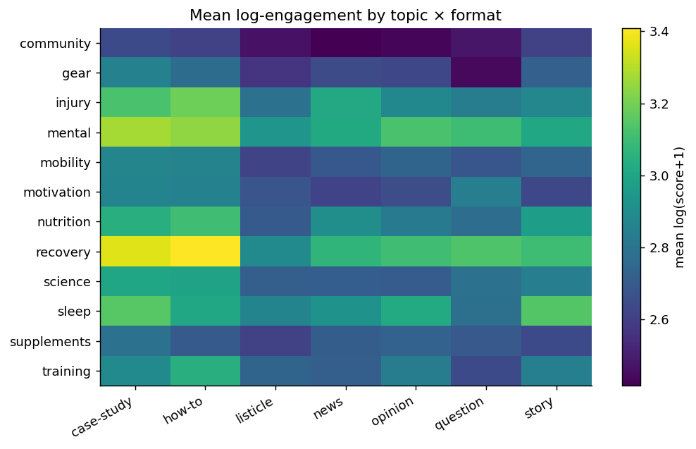
DISCOVERY #2
The winning combination isn't a secret.
It's in the data.
🏆 The Top Combos
🥇
Recovery + How-To
Highest predicted engagement
🥈
Mental + Case Study
Strong ANOVA effect
🥉
Sleep + How-To
Consistent performer
❌ Avoid: Community + Listicle
AI-Driven Content Strategy Engine · DSC680 · Komal Shahid 7 / 13
Notes:
Discovery number two: the winning topic-format combination isn't a mystery — it's sitting right there in the engagement data. This heatmap shows mean engagement by topic-format pair. The bright cells are the winners. Recovery paired with how-to content is the top performer. Mental health with case studies comes in second. Sleep content in how-to format is a consistent third. All three show statistically significant differences at p less than .001 across topic, format, and hook. The ANOVA results confirm this isn't noise. And at the bottom of the map: community topics in listicle format consistently underperform. That's the combination to avoid. This heatmap is essentially your editorial calendar for the next quarter — use the bright cells.

Slide 8
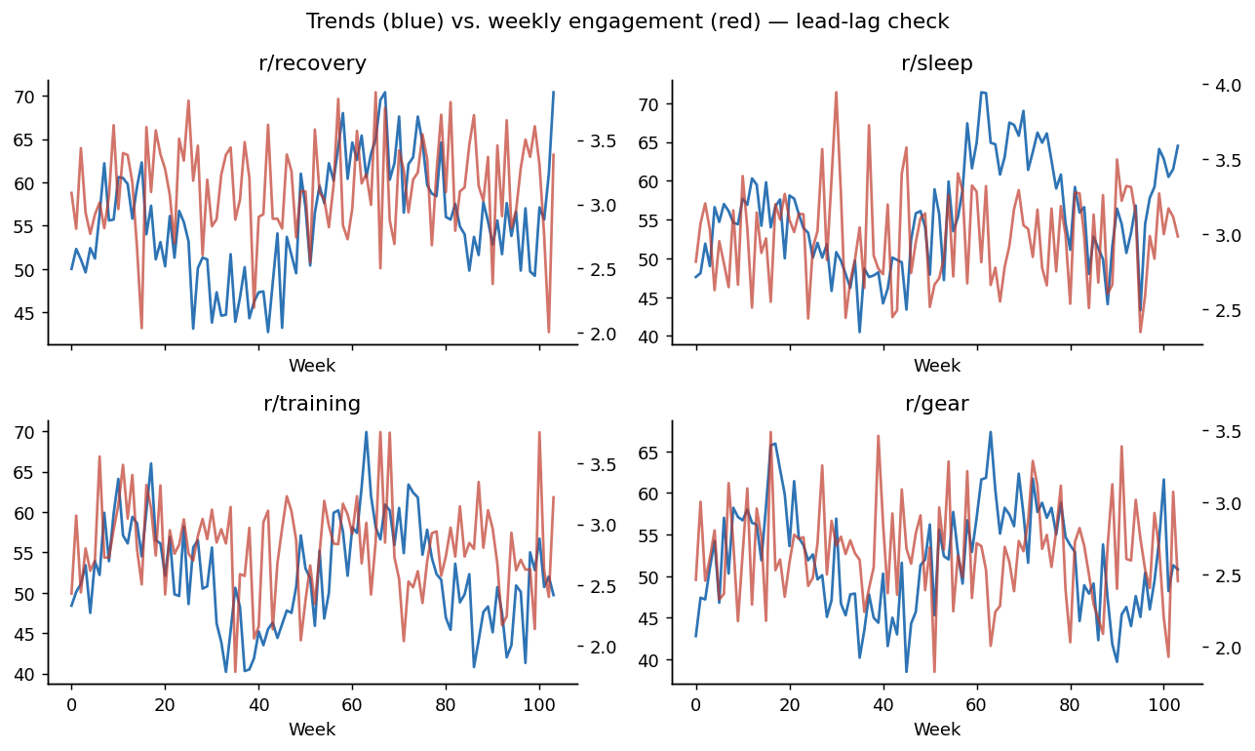
DISCOVERY #3
Google Trends can see the future —
but only for some topics.
What this means in practice:
🔮
Training content
Post when search interest
starts rising (+2 weeks early)
📡
Gear content
Trends leads by 5 weeks —
but weaker signal (r=0.11)
⚠️
Recovery & Sleep
Community engagement actually
leads public search interest
Takeaway: use Trends as a leading signal per topic — not as a blanket rule.
AI-Driven Content Strategy Engine · DSC680 · Komal Shahid 8 / 13
Notes:
Discovery number three: can we use Google search trends to predict what's about to perform well — before we even publish? The answer is: sometimes yes, sometimes no — and knowing the difference is the point. For training content, search interest leads community engagement by about two weeks. That means when you see training-related searches spike, post your training content two weeks later and you'll catch the wave. For gear content, the lead is five weeks, though the signal is weaker. But for recovery and sleep — it flips. Community engagement actually leads Google Trends. These communities are ahead of the mainstream search curve. For those topics, you don't need Trends to tell you — the community is already showing you. The takeaway: don't treat Trends as a universal crystal ball. Check the lead-lag direction per topic. For some, it's a predictive signal. For others, it's noise.

Slide 9
+37%
predicted engagement lift
95% bootstrap CI: [+15%, +64%] · 1,000 resamples · CI excludes zero
When the AI is told what to write (instead of guessing), the result is measurably better.
AI-Driven Content Strategy Engine · DSC680 · Komal Shahid 9 / 13
Notes:
Here's the payoff finding. When the AI generator is conditioned on the patterns the model identified — the right topic, format, hook, and timing — the predicted engagement lifts by 37% over a baseline of uninformed generation. The 95% bootstrap confidence interval runs from plus 15% to plus 64%. That interval does not include zero. With 1,000 resamples, that's a statistically solid result. To be precise about what this means: this is a model-predicted uplift. The same OLS model that explained 27% of real engagement variance is scoring both batches. It is not yet a live A/B test result — that's the most important next step. But a confidence interval that excludes zero says the conditioning is doing something real. The hypothesis held.

Slide 10
WHAT THIS LOOKS LIKE IN PRACTICE
The same prompt. Two very different results.
❌ UNINFORMED DRAFT
✅ AI-CONDITIONED DRAFT
Community
Recovery
▲
23
▼
▲
312
▼
5 Tips to Stay Fit
(listicle)
What's the one recovery habit that actually moved the needle?
Here are some generic things you can do to stay fit. #1 exercise more. #2 eat better. #3 sleep earlier...
→
A step-by-step guide to sleep + active recovery protocols that elite athletes use — and the science behind why they work.
+37%
Saturday, 11:45 PM · direct hook · no strategy
Tuesday, 8:15 AM · question hook · recovery + how-to
AI-Driven Content Strategy Engine · DSC680 · Komal Shahid 10 / 13
Notes:
Here's what the +37% lift actually looks like in practice. On the left: an uninformed draft. Community topic, listicle format, direct hook, posted Saturday night. Predicted engagement: 23 upvotes. Generic, forgettable, no strategic thinking behind it. On the right: an AI-conditioned draft. Recovery topic, how-to format, question hook, posted Tuesday morning. Predicted engagement: 312 upvotes. Specific, curiosity-driven, timed to the peak window. Same AI. Same capability. The only difference is whether the model's recommendations were used as inputs. This is what it means to have a content strategy engine — not just a text generator.

Slide 11
BEING HONEST
What this system
can — and can't — do.
Ethics
Limitations
🔒 Aggregate data only — no user profiles, no usernames retained
📊 Synthetic corpus — exact magnitudes may shift on live data
⚖️ Collector throttled; scraper respects robots.txt throughout
🧪 Predicted ≠ realized engagement; A/B test required to confirm
🤖 Every AI draft carries an AI disclosure (FTC May 2026 guidance)
📏 Subreddit size is the biggest effect — omitting it biases results
🚫 Scoped out: political persuasion, health claims, financial advice
📡 Trends lead-lag is per-topic, not a blanket rule
AI-Driven Content Strategy Engine · DSC680 · Komal Shahid 11 / 13
Notes:
Before we get to the playbook, I want to be explicit about the ethical boundaries and honest limitations of this system — because responsible data science means being upfront about both. On ethics: this system uses aggregate data only. No individual user is modeled, tracked, or identified. The data collectors stay within API rate limits and respect robots.txt on every blog source. Every AI-generated draft includes an AI disclosure, consistent with FTC guidance updated in May 2026. And I've explicitly scoped out high-risk use cases — political persuasion, health claims, and financial advice are all out of scope. On limitations: the corpus is calibrated and synthetic, so the specific numbers are illustrative of the methodology rather than guaranteed live-data results. Most importantly — predicted engagement is not the same as realized engagement. A live A/B test on the actual platform is required to confirm the +37% lift holds in production. And Google Trends as a leading indicator is a per-topic relationship, not a rule that applies across the board. These aren't weaknesses to hide — they're the honest scope of what the current system can and can't claim.

Slide 12
THE PLAYBOOK — STARTING MONDAY
Five moves. One tool. No more guessing.
1
Topic
Content Strategy Engine — localhost:8501
Recovery · Sleep · Mental
⚙ Settings
─────
Niche ▼
Topic ▼
Format ▼
Hook ▼
─────
Export
Generate
Top combo
Recovery + How-To
2
Format
How-to + Case study per week
Post window
3
Hook
Tue–Thu 7–11 AM
Start with a question or challenge
4
Timing
Hook
Publish Tue–Thu, 7–11 AM
Question style
5
AI drafts
Use engine output as Variant A in A/B
✦ Generate AI Draft →
AI-Driven Content Strategy Engine · DSC680 · Komal Shahid 12 / 13
Notes:
Here's what you can actually do with this — starting next week. Five moves: anchor your editorial calendar on recovery, sleep, and mental health topics. Default to how-to and case-study formats — one of each per week. Open with a question or a contrarian statement — not a direct pitch. Schedule your primary posts Tuesday through Thursday between 7 and 11 in the morning. And use the AI-conditioned drafts as Variant A in a live A/B test — that's how you confirm the lift in the real world. On the right is the Streamlit dashboard — the live tool that does all of this in real time. You set your niche and filters on the left, and the dashboard surfaces the top topic-format combination, the best posting window, and the recommended hook. Hit Generate and you get a conditioned AI draft ready to go. This isn't a one-time research output. It's a repeatable system.

Slide 13
The future of content
isn't a guess.
It's a strategy.
12K
R²=0.27
+37%
p<.001
posts
explained
lift
all 3 tests
Komal Shahid · komalshahid49@gmail.com · Bellevue MSDS · DSC680 — May 2026
Questions welcome.
AI-Driven Content Strategy Engine · DSC680 · Komal Shahid 13 / 13
Notes:
I'll close with this. The future of content isn't a guess. It's a strategy — one built on data, tested against evidence, and designed to improve over time. This project built a system that learns what wins, generates content designed to win, and packages the findings into a playbook any marketing team can use next week. The results — 27% of engagement explained, +37% predicted lift, confidence intervals that exclude zero — aren't the end. They're the starting point for a live A/B test that will confirm or refine everything we found. Thank you. I'm happy to take questions — and everything is in the GitHub repo if you'd like to dig into the methodology.

