Slide 1
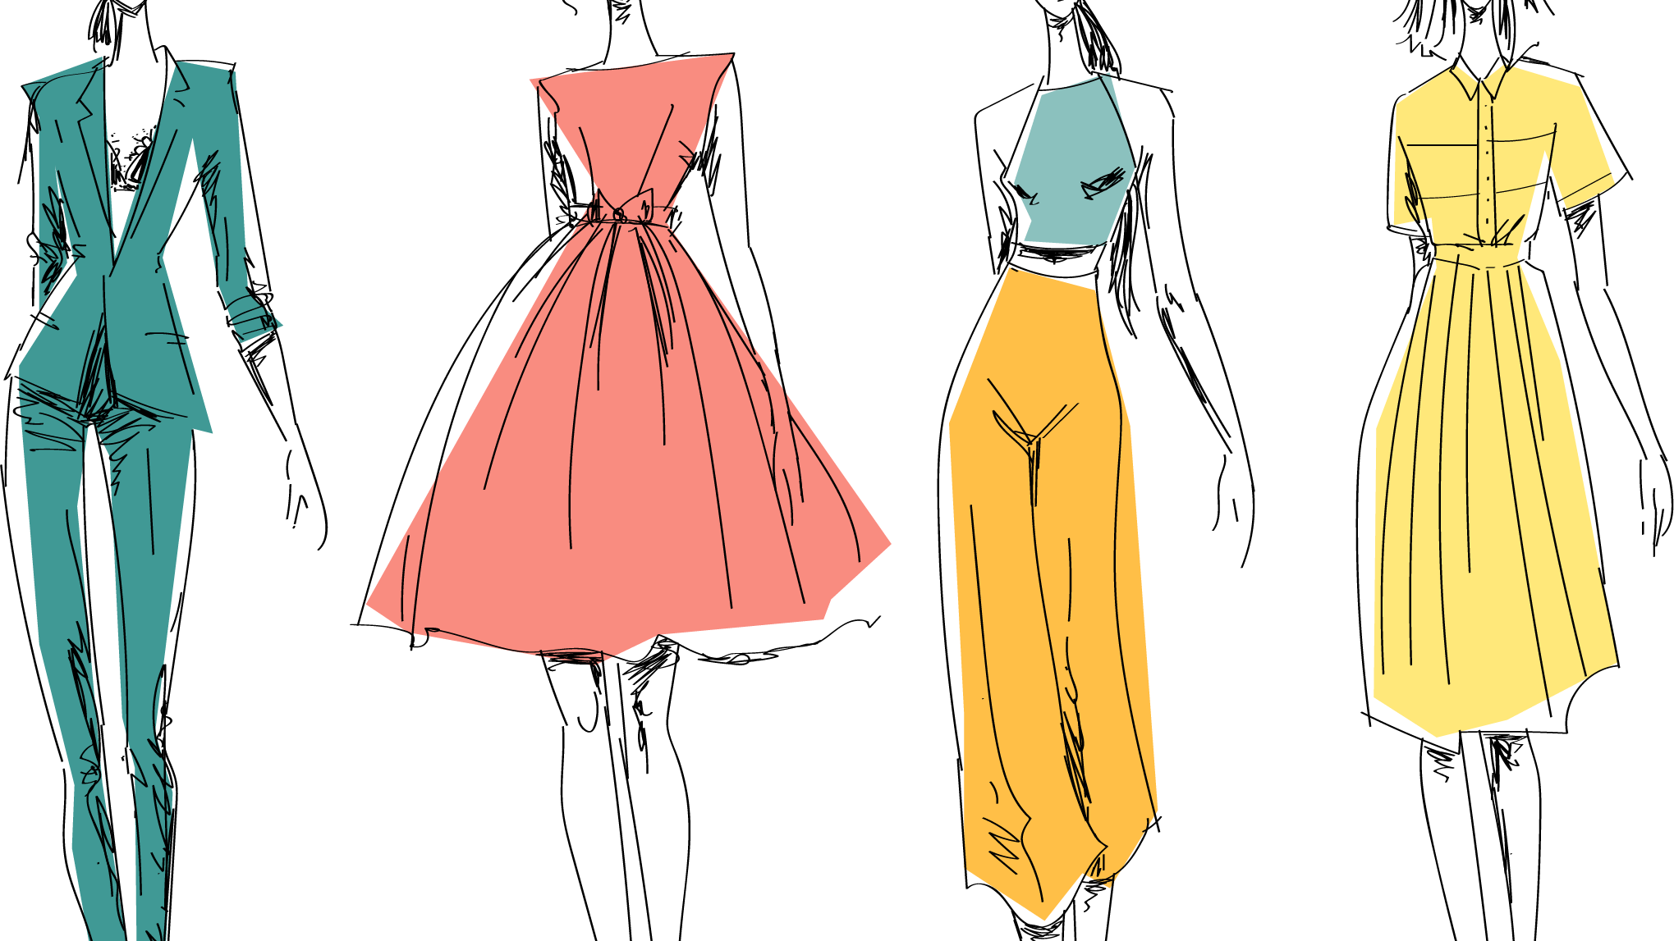
ARIMA Model for Sales Forecasting
Key Insights and Results
Komal Shahid
Aug 10, 2024
Notes:
Good evening everyone. My name is Komal Shahid. Today, I'll be presenting a project on dress sales forecast prediction and data animation using machine learning. We'll explore how data analysis techniques can be utilized to gain insights into dress sales trends and predict future sales.

Slide 2
Project Details
Objective:
Develop a machine learning model to forecast future sales.
Create an animation to visualize the predicted sales trends.
Data Source: Kaggle dataset containing dress attributes and sales information.
Software Used: Python libraries like pandas, NumPy, scikit-learn, statsmodels and Plotly.
Analyze historical dress sales data.
Notes:
This project aims to achieve three main objectives. First, we'll analyze historical dress sales data to identify patterns and trends. Second, we'll develop a machine learning model to predict future sales based on the historical data. Finally, we'll create an animation to visualize the predicted sales trends, enabling us to see how sales are expected to change over time.
The data used for this project comes from a Kaggle dataset that contains information about various dress attributes, such as style, price, and material, alongside historical sales data. We'll use Python libraries like pandas for data manipulation,NumPy for numerical computations, scikit-learn for building the machine learning model, and Plotly for creating the animation.

Slide 3
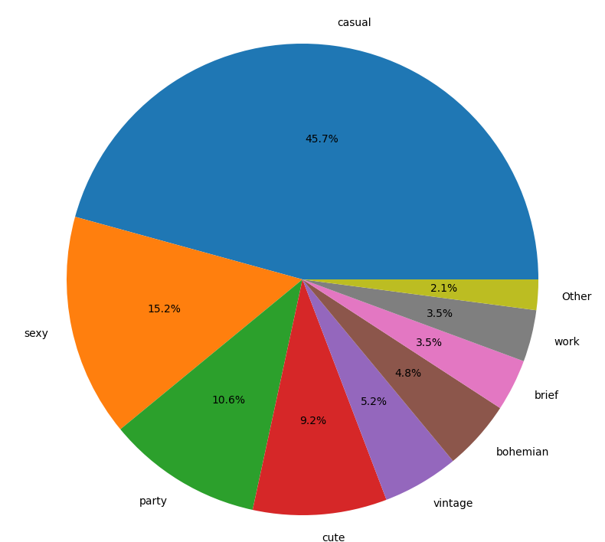
Data Exploration
Explored attributes data: style, price, rating, size, seasons, etc.
Identified data types (numeric, categorical) and missing values.
Analyzed sales data across different seasons (summer, autumn, winter, spring).
Notes:
In the data exploration phase, we examined the attributes data, which includes details like dress style, price,rating, size, season, and more. We identified the data types, such as numeric and categorical variables, and checked for missing values. Additionally, we analyzed the sales data across different seasons to understand how seasonality might influence sales.

Slide 4
Data Preprocessing
Handled missing values using imputation techniques like mean/median filling.
Corrected spelling mistakes and inconsistencies in categorical data.
Transformed categorical data using encoding techniques like one-hot encoding.
Created additional features like lagged sales data and cyclic features for month.
Notes:
Data preprocessing is crucial for machine learning models to function effectively. We addressed missing values in the data using imputation techniques like filling with the mean or median for numerical data. For categorical data, we corrected spelling mistakes and inconsistencies to ensure consistency. Additionally, we transformed categorical data into numerical representations using one-hot encoding. We also created additional features, such as lagged sales data (past sales influencing future sales) and cyclic features for the month (to capture seasonal trends).

Slide 5

Results and Visualization
ARIMA (Autoregressive Integrated Moving Average) model for time series forecasting.
Performed stationarity check on the data to ensure model suitability.
Identified optimal ARIMA parameters using techniques like AIC and BIC.
Trained and evaluated the ARIMA model on the training data.
Results and Visualization
Predicted future dress sales using the trained ARIMA model.
Create an animation using Plotly to visualize the predicted sales trends.
Analyze the results to identify potential sales patterns and trends.
Notes:
We employed the ARIMA (Autoregressive Integrated Moving Average) model for time series forecasting.ARIMA models are well-suited for analyzing and predicting time-dependent data like sales. We first checked if the data was stationary, a crucial requirement for ARIMA models. Then, we identified the optimal ARIMA parameters, such as the order of autoregression (p), integration (d), and moving average (q), using techniques like AIC (Akaike Information Criterion) and BIC (Bayesian Information Criterion). Finally, we trained and evaluated the ARIMA model on the training data portion of the dataset.Once the ARIMA model was trained, we used it to predict future dress sales. We then created an animation using Plotly to visualize the predicted sales trends over time. This animation allows us to see how sales are expected to fluctuate throughout a specific period. Finally, we analyzed the results to identify potential sales patterns and trends, such as high sales periods associated with certain seasons or styles.

