Slide 1
BusAlert
David Pennington Alex Henry
Robert Burrus

Slide 2
The Problem
There are a lot of buses and a lot of routes in Lexington.
No easy way to find information on the buses and routes.
Missed buses
Missed opportunities to use public transportation.

Slide 3
Our Solution
Create a Mobile App that allows users to…
Get Route Information
Get current bus locations
Schedule Bus Stops so they don’t miss the bus

Slide 4
Tools
Lextran API
Route Maps
Stop Locations
Bus GPS tracking
Eclipse
Android
Google Maps V2 API
Xcode
IOS 7

Slide 5
User Interaction
User is shown a map with a route to select a stop from
User can change the route
User can set a notification for a bus stop

Slide 6
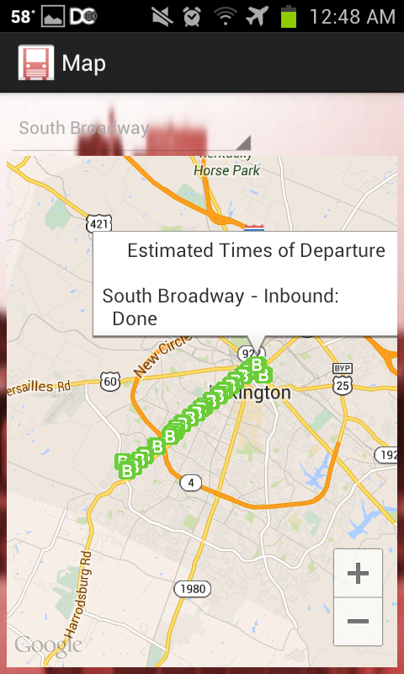
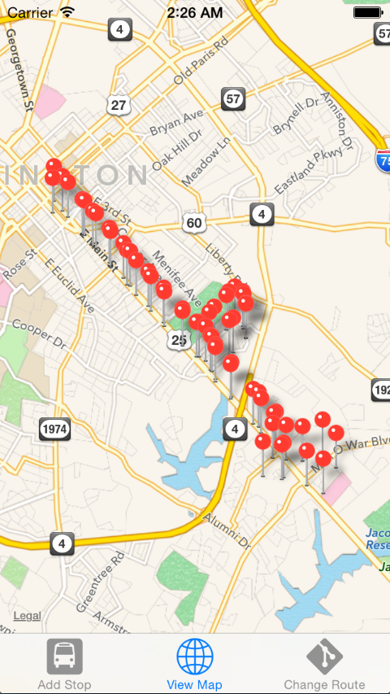

Slide 7
Problems Encountered
Lextran data was not clean.
3 different types of KML
Routes were not in order
Routes were non-consecutive
Lextran released an iOS beta app which has similar usage to our app.

Slide 8
Lessons Learned
Coordination is key
The finalized design never looks like the original concept
Important not to have chains of dependency

Slide 9
Initial Assumptions
Notes:
For the rest of the slides, we are just going to talk about it with the audience, no need to put stuff on here

Slide 10
Our Customer

Slide 11
Future Enhancements

Slide 12
Thank you Questions?

