Slide 1
BusAlert
David Pennington Alex Henry
Robert Burrus

Slide 2
The Problem
There are a lot of buses and a lot of routes in Lexington.
No easy way to find information on the buses and routes.
Missed buses
Missed opportunities to use public transportation.

Slide 3
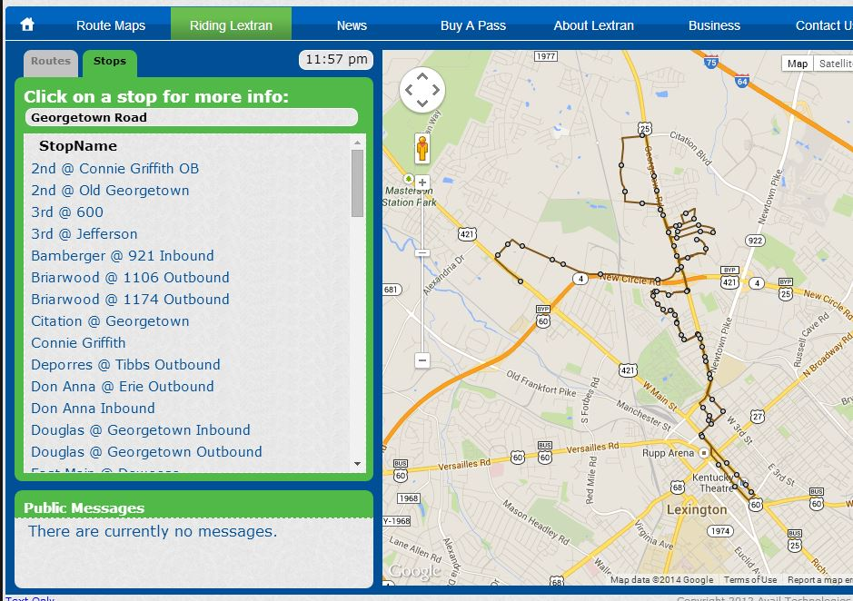
Our Solution
Create a Mobile App that allows users to…
Get Route Information
Get current bus locations
Schedule Bus Stops so
they don’t miss the bus

Slide 4
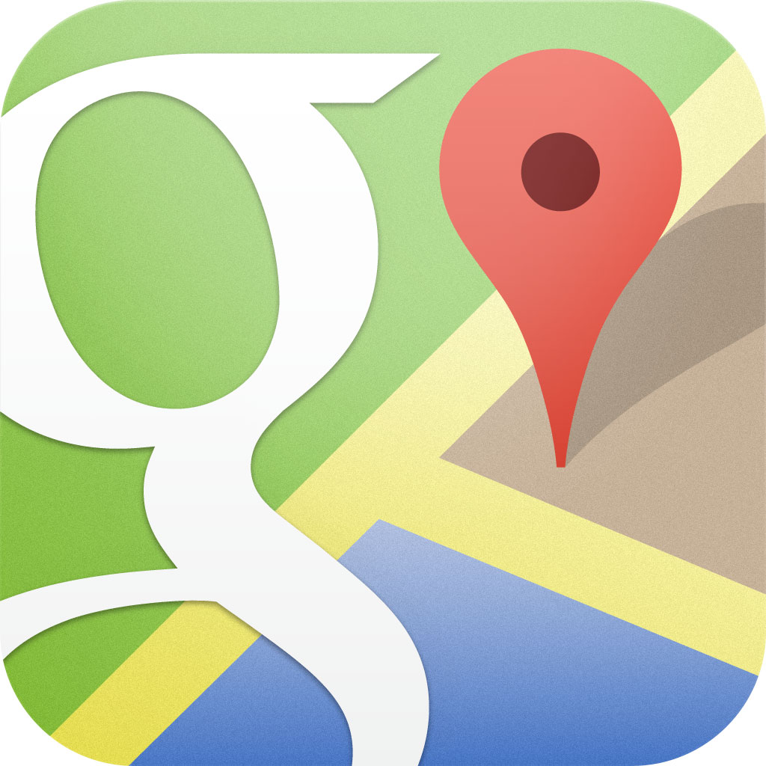
Tools
Lextran API
Route Maps
Stop Locations
Bus GPS tracking
Eclipse
Android
Google Maps V2 API
Xcode
IOS 7

Slide 5
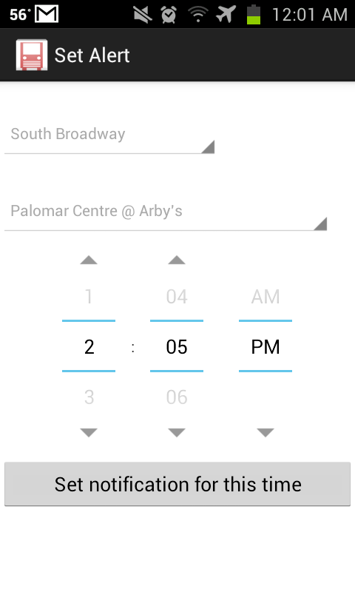
User Interaction
User is shown a map with a route to select a stop from
User can change the route
User can set a notification for a bus stop

Slide 6
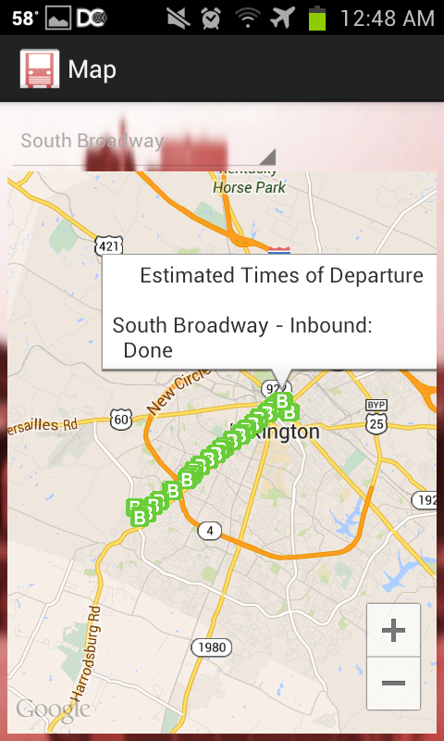
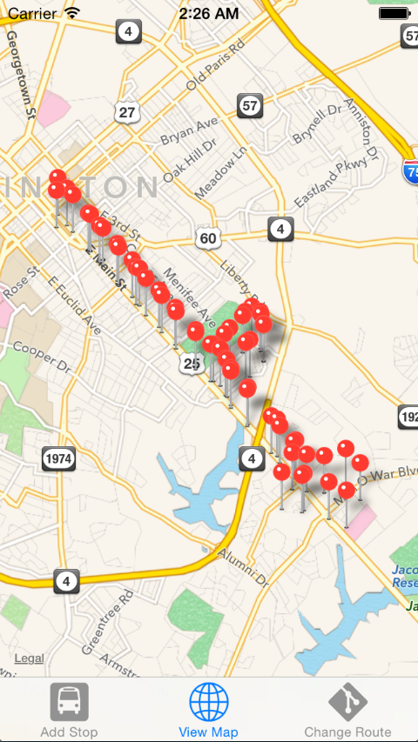

Slide 7
Problems Encountered
Lextran data was not clean.
3 different types of KML
Routes were not in order
Routes were non-consecutive
Lextran released an iOS beta app which has similar usage to our app.
Discontinued the iOS app

Slide 8

Lessons Learned
Coordination is key
The finalized design never looks like the original concept
Important not to have chains of dependency

Slide 9
Initial Assumptions
KML would play nice with Maps and Android
Lextran would provide consistent data
A similar app was not in development
Notes:
For the rest of the slides, we are just going to talk about it with the audience, no need to put stuff on here

Slide 10
Our Customer
Nick Such – Awesome Inc.
Chase Southard – Open Lexington
Code For America
…Lexingtonians!

Slide 11
Future Enhancements
Recurring notification
Streamlined Android Layout

Slide 12
Thank you Questions?

