Slide 1
ROCKETRY 101

Slide 2
WARNING
ROCKETS ARE NOT TOYS, THEY ARE MODELS
IF YOU MISUSE ROCKETS OR MOTORS YOU MAY INJURE YOURSELF OR OTHERS

Slide 3
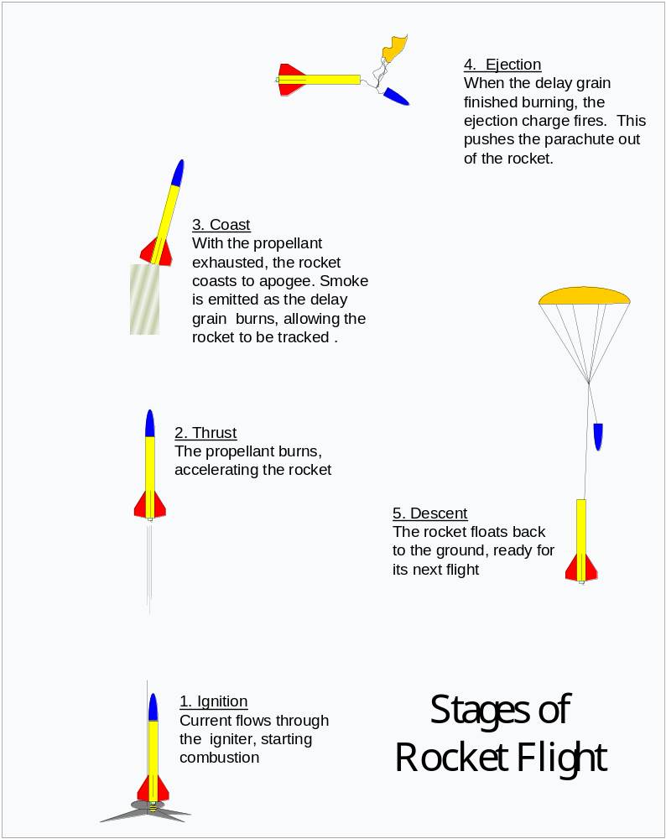
Task 1 – Rocket Flight Profile

Slide 4
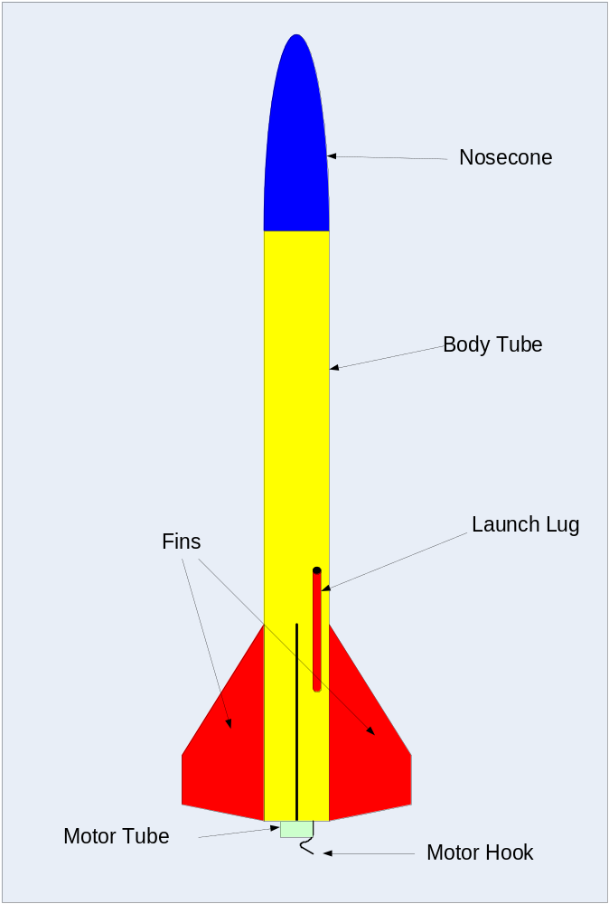
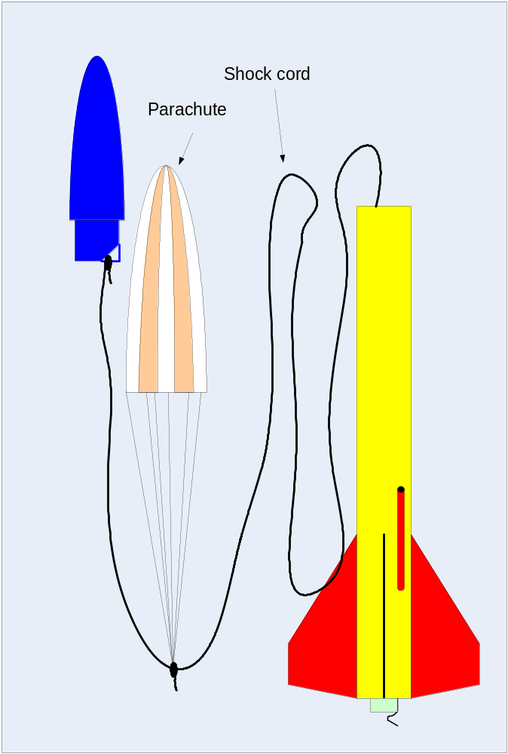
Task 2 – Parts of a Rocket

Slide 5
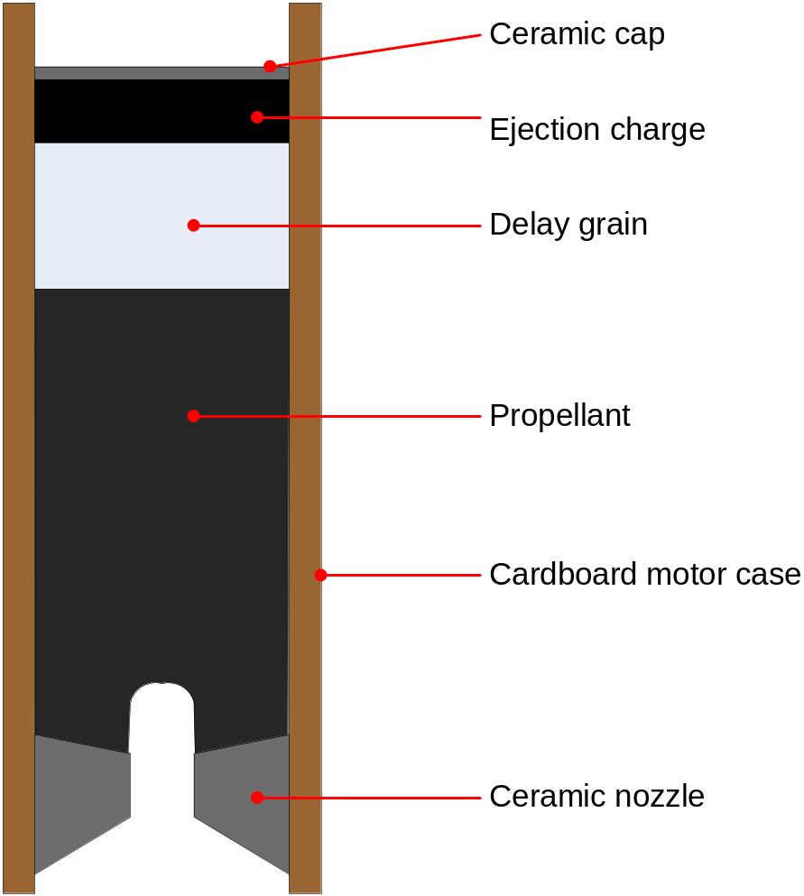
Task 3 – Parts of a Motor
Pyrogen coated wire
Card
Terminals

Slide 6
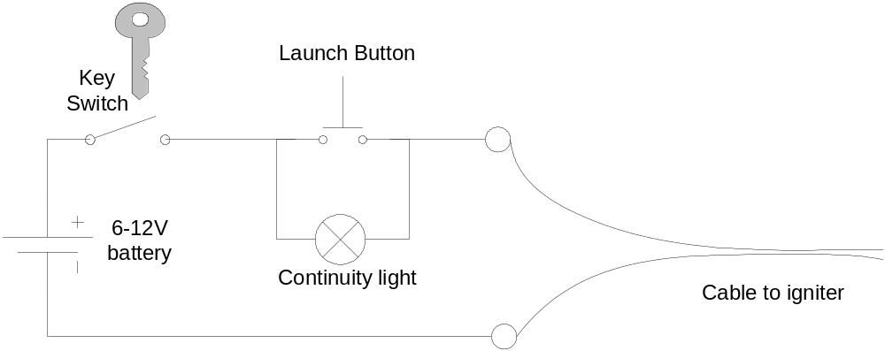
Launch Controller

Slide 7
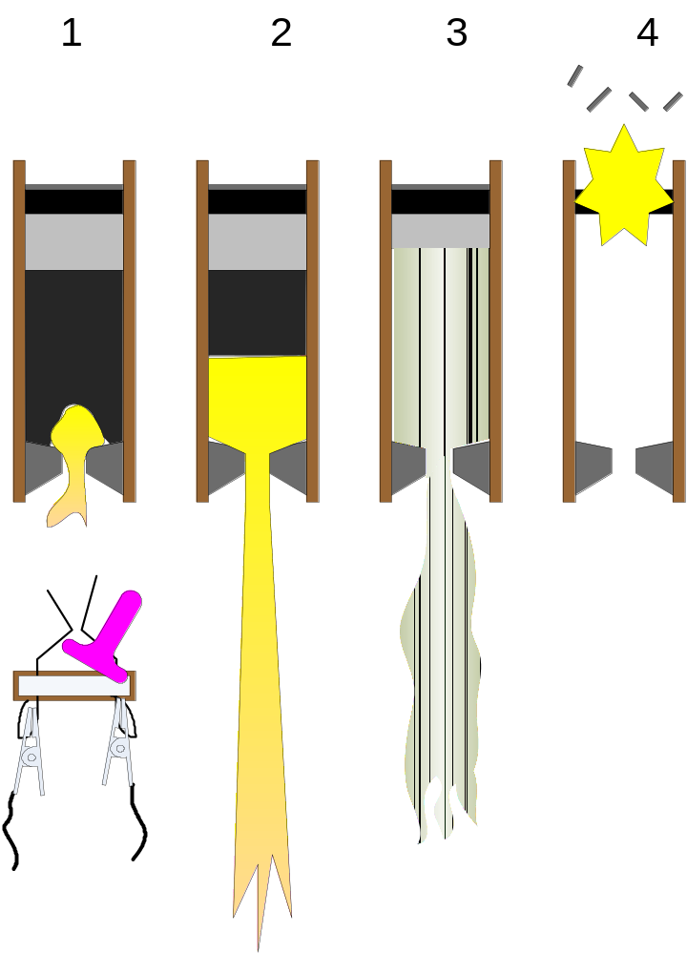
Task 4 – Motors
Ignition
Thrust
Coast
Ejection

Slide 8
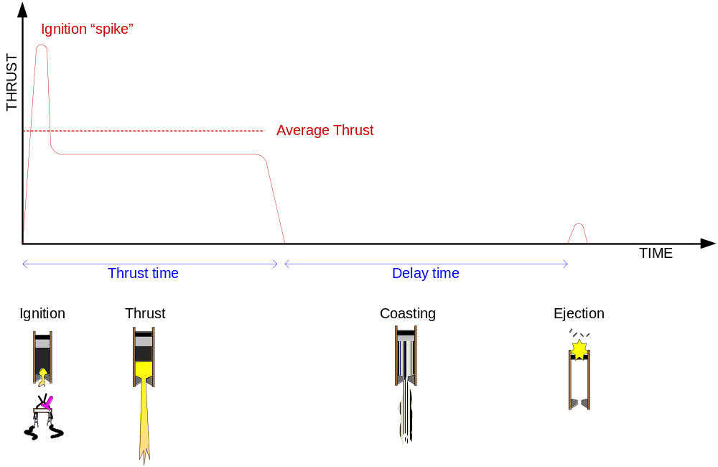
Thrust curve

Slide 9
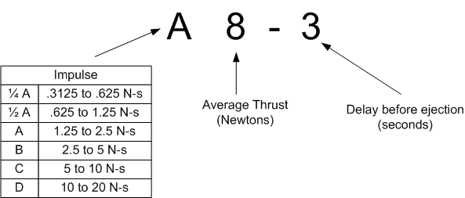
Motor Codes

Slide 10
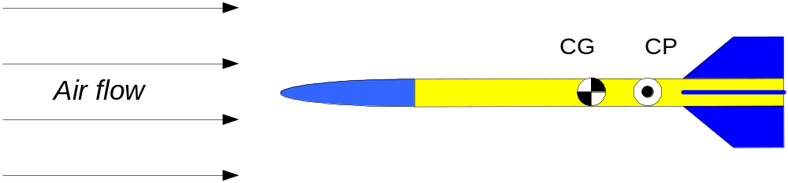
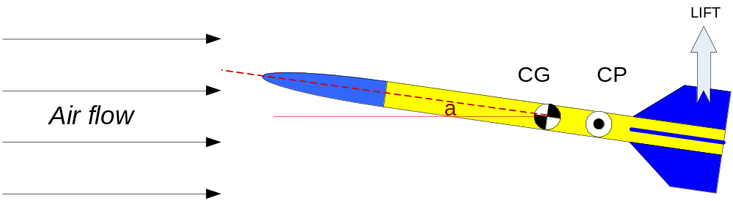
Task 5 - Stability

Slide 11
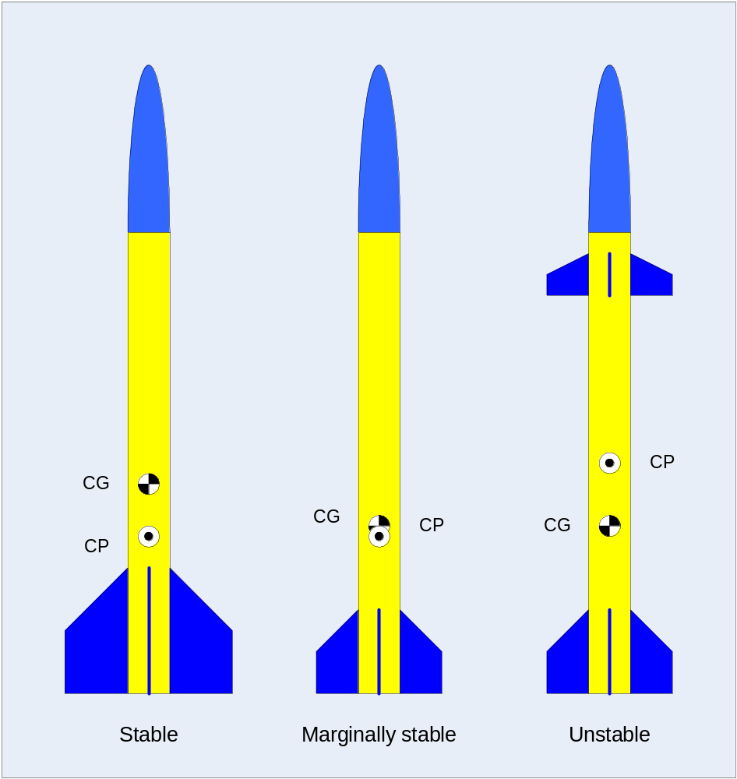
Stability examples

Slide 12
Task 6 – Safe Distances
Motor Impulse | Safe Distance (Rockets with single motors) | Safe Distance (Rockets with multiple motors)
¼A ½A | 2 meters | 3 meters
A | 2 meters | 3 meters
B | 3 meters | 6 meters
C | 3 meters | 6 meters
D | 5 meters | 10 meters

Slide 13
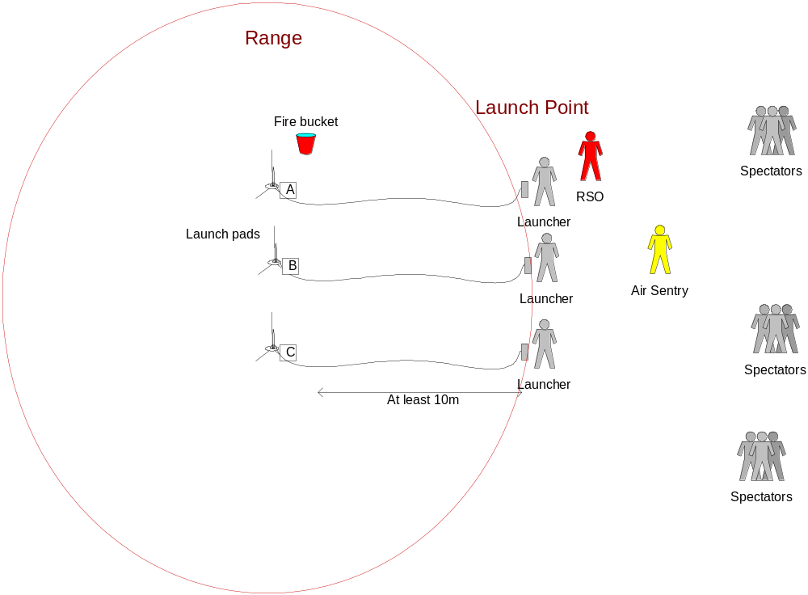
Task 7 – Range Procedures

Slide 14
Safety Messages
“RANGE OPEN”
You may enter the range and put your rocket on the launch pad, or go and retrieve your rocket
“RANGE CLOSED”
Everyone must leave the range immediately as we are about to launch.
“HOLD”
Stop your countdown and remove the safety key. Do nothing until the RSO allows it
“HEADS UP”
Look up immediately. A rocket is heading for someone, and it might be you.

Slide 15
Countdown & Problems
Countdown
“5 – 4 – 3 – 2 - 1 – LAUNCH”
Misfire
Remove the safety key and wait one minute.
Go with the RSO to check you rocket.

