Slide 1
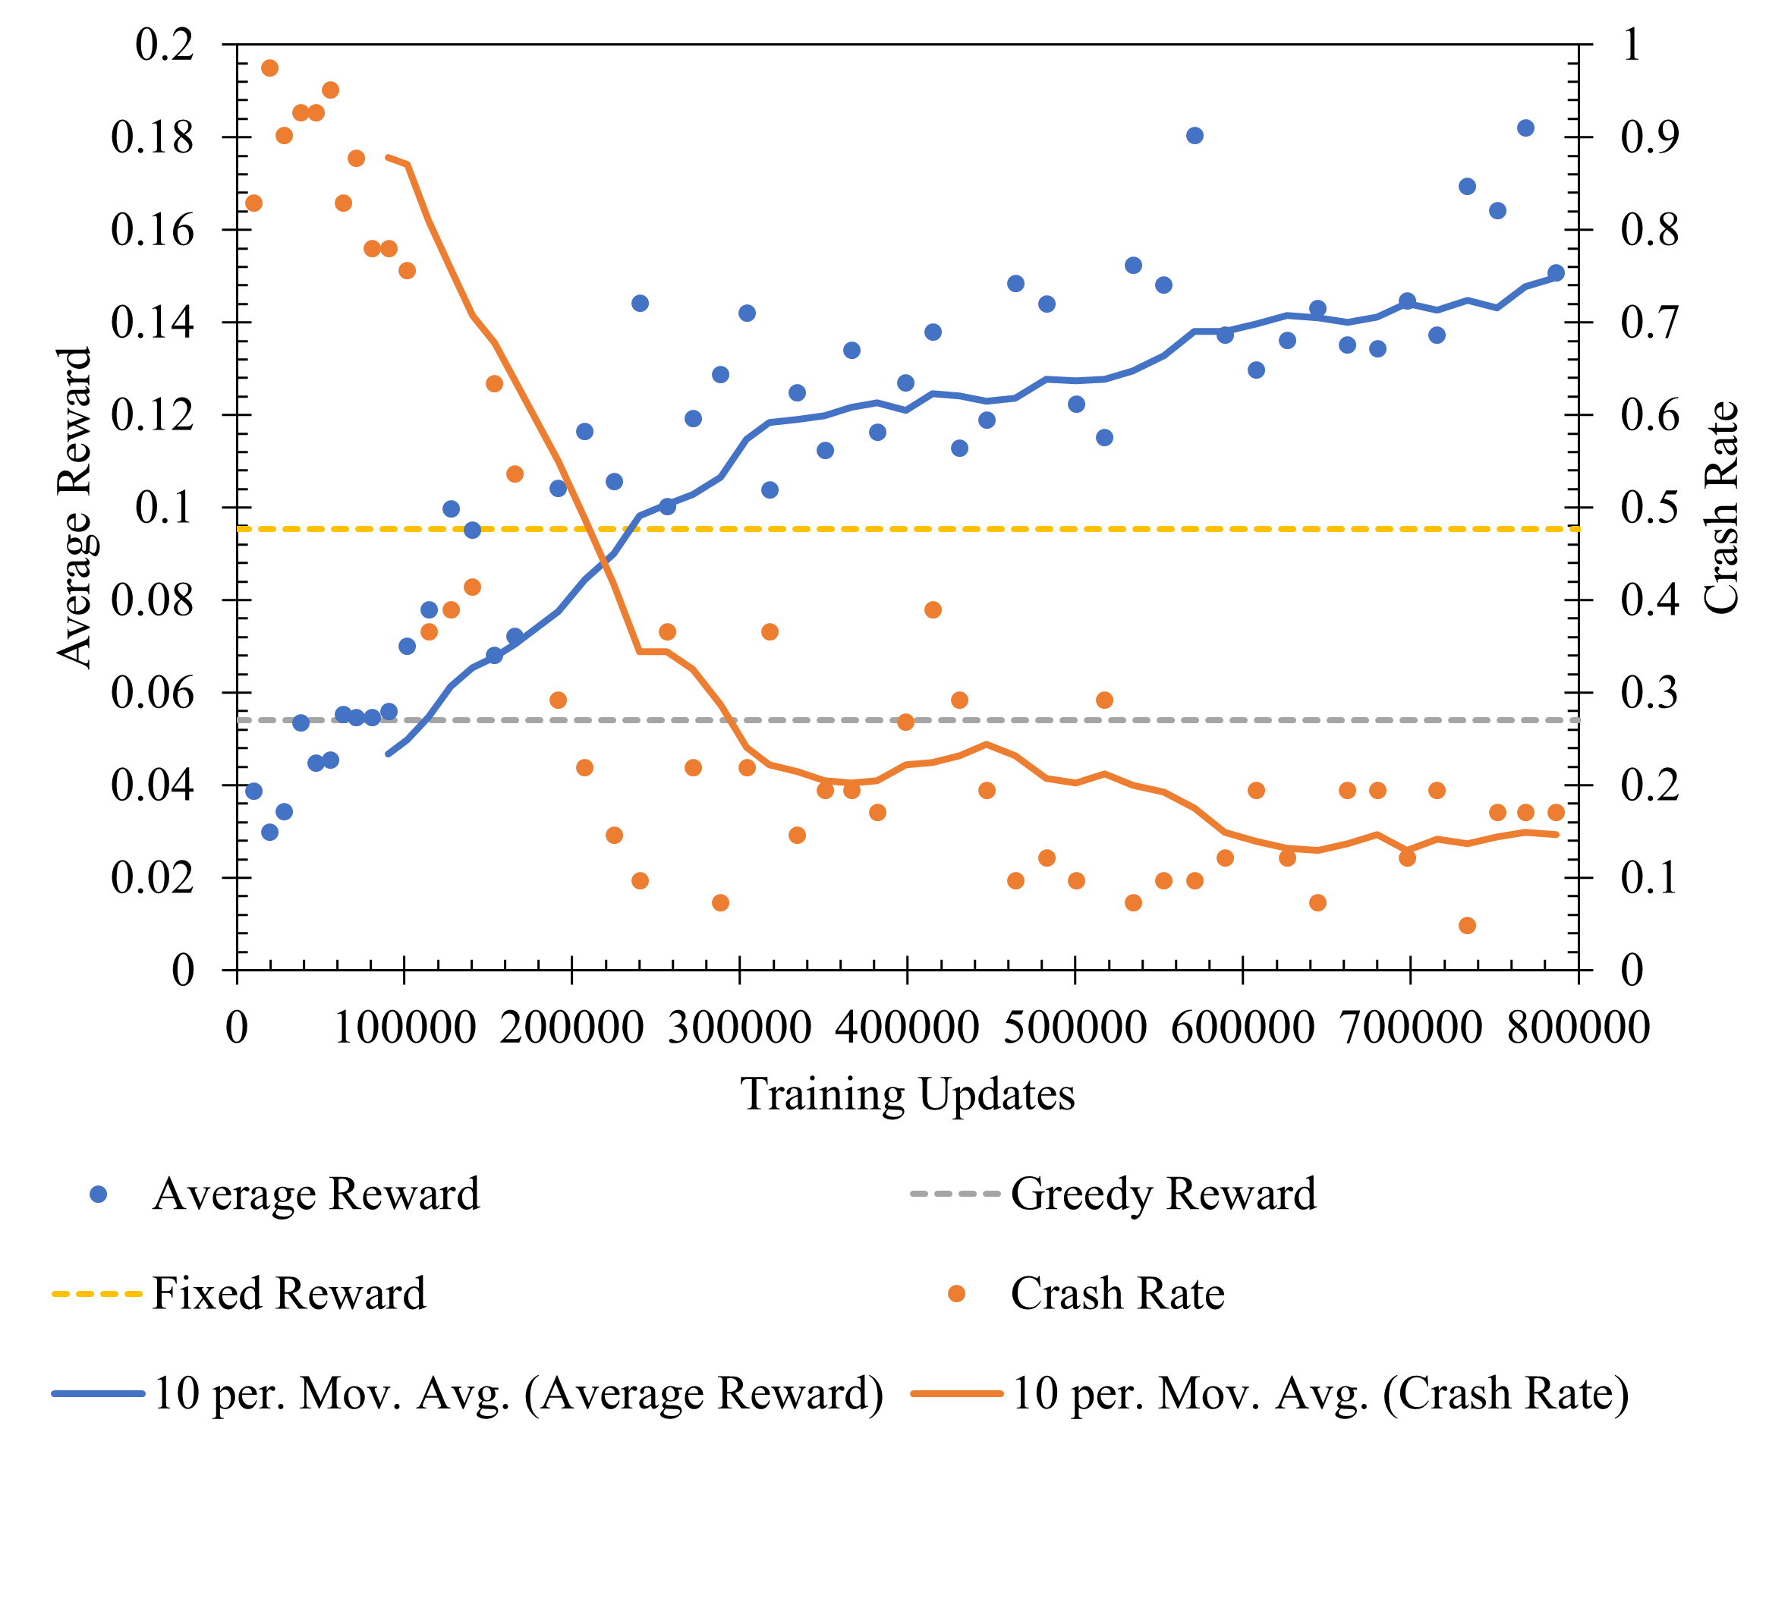

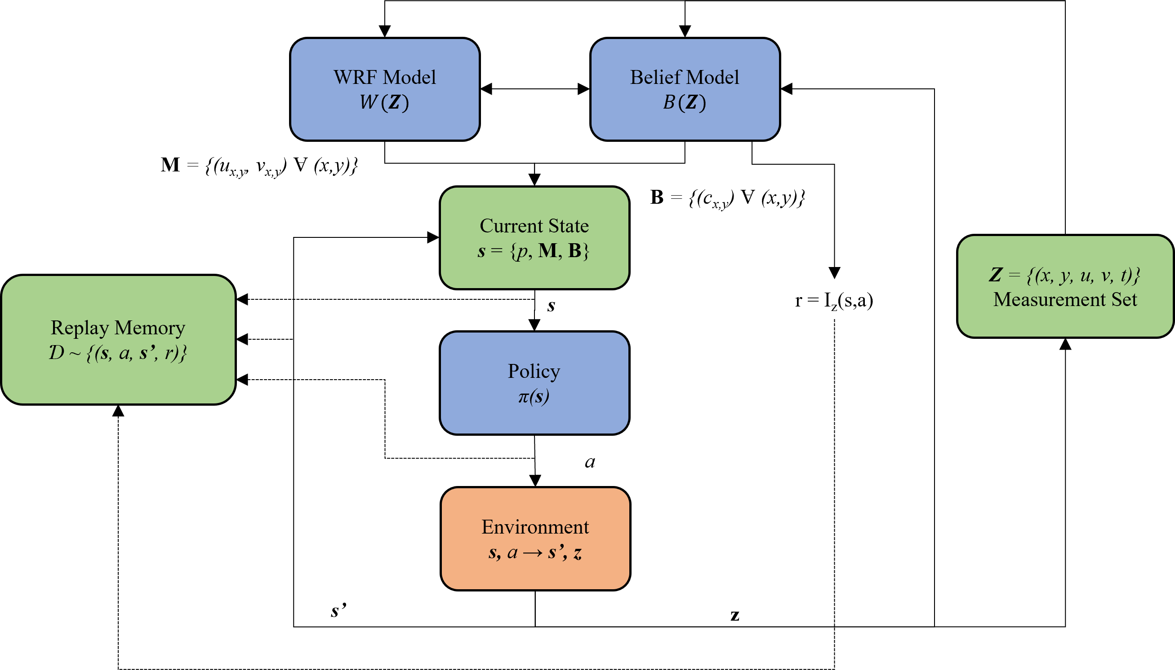
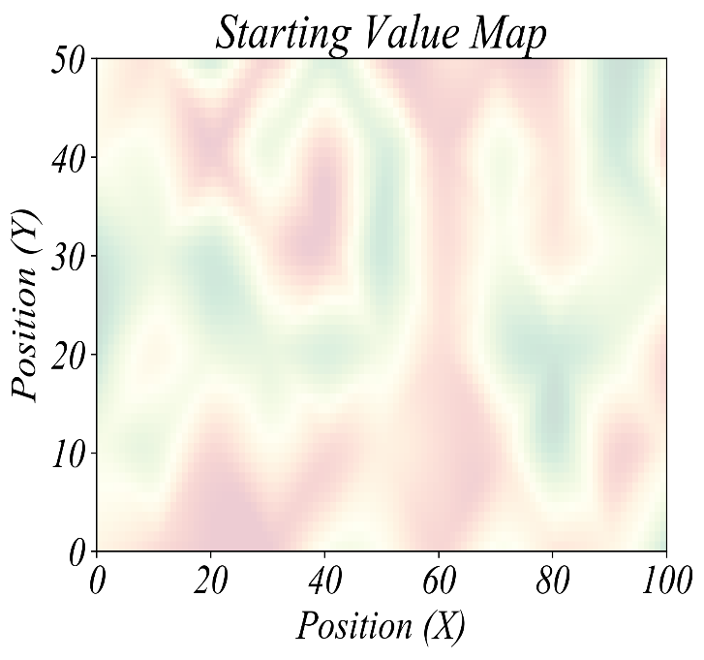
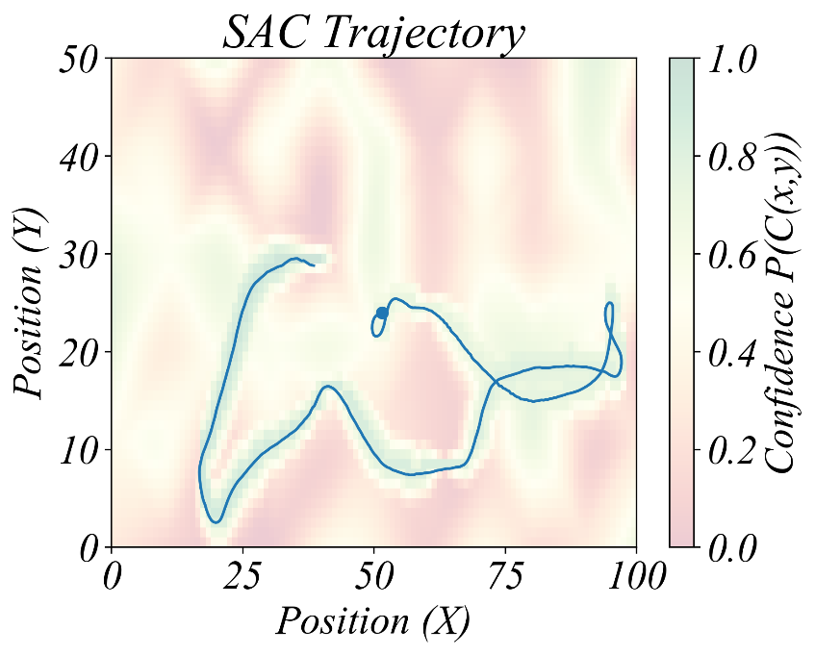
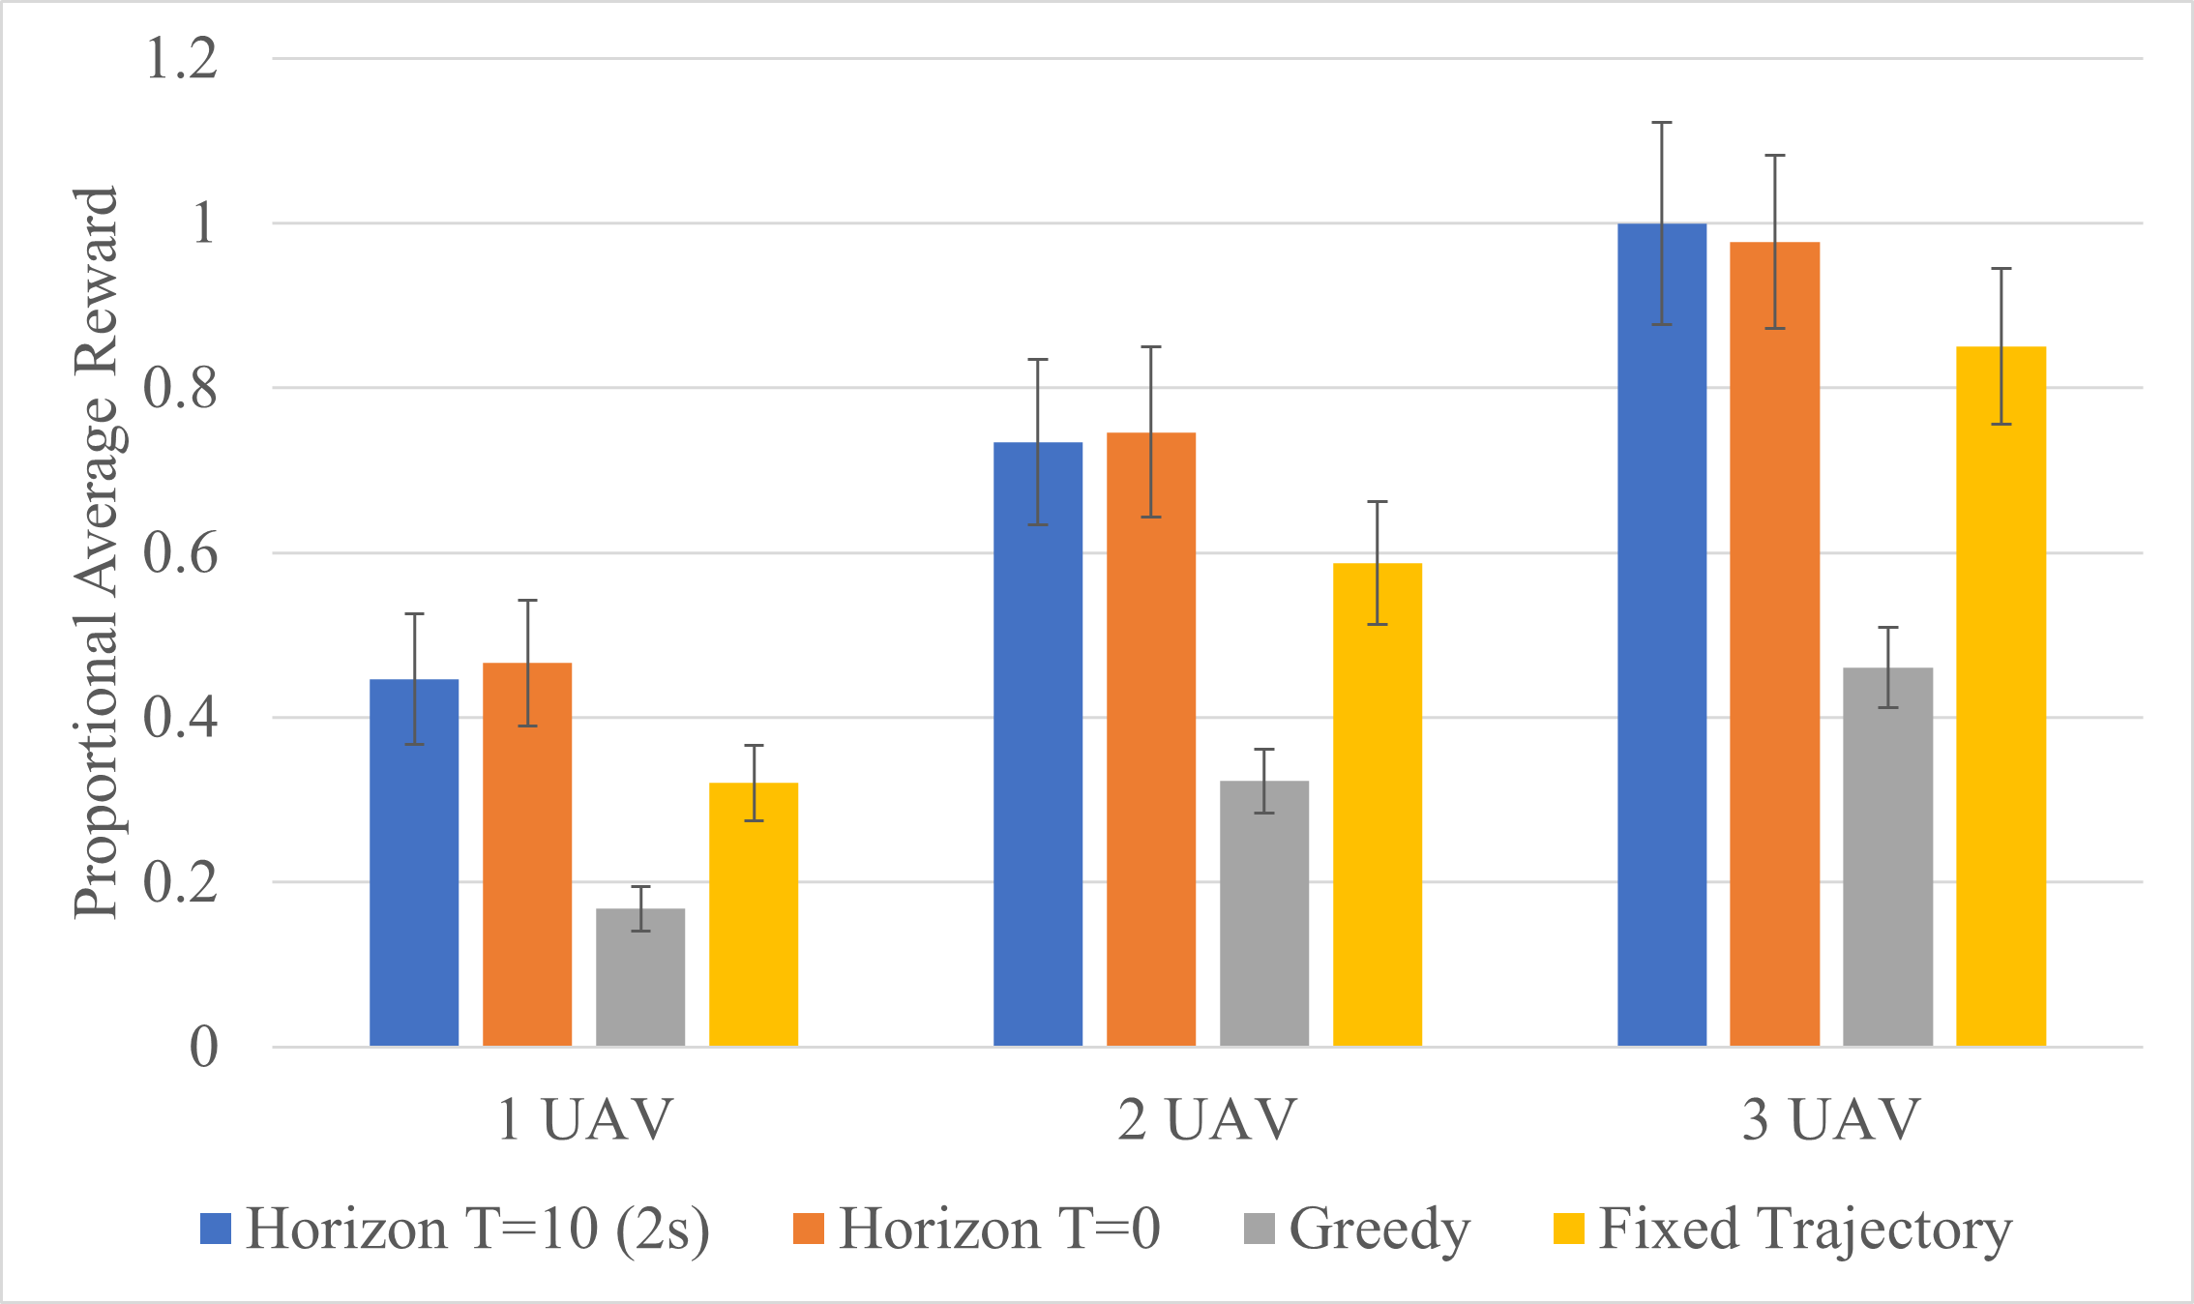
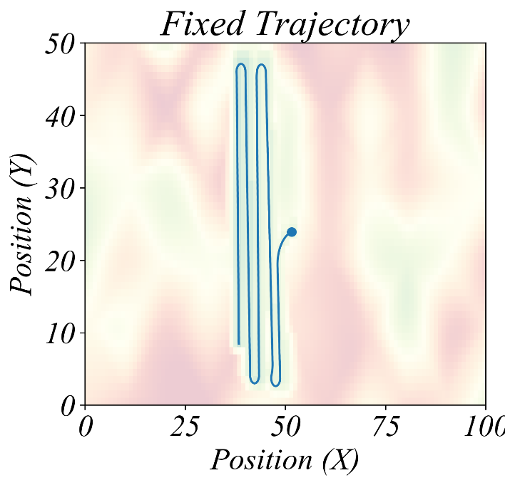
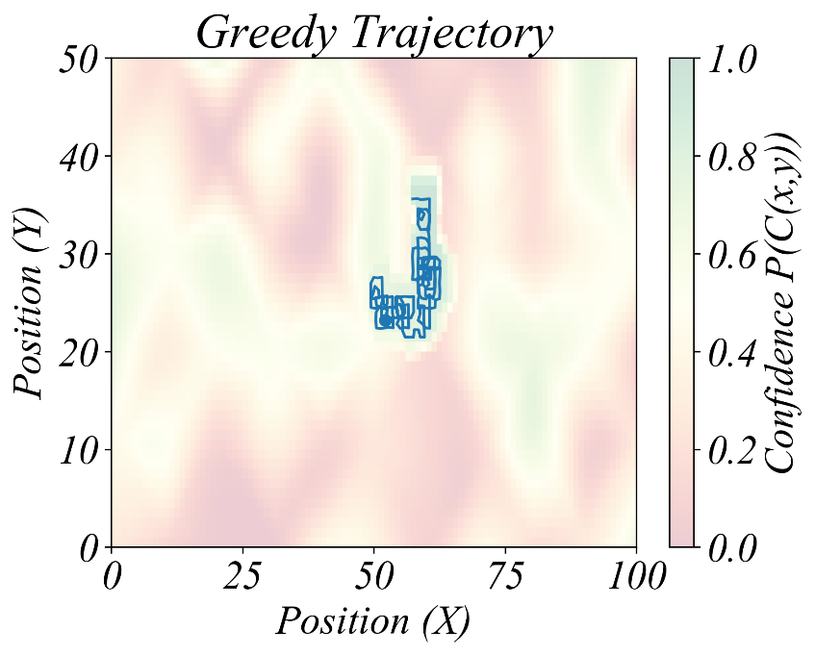
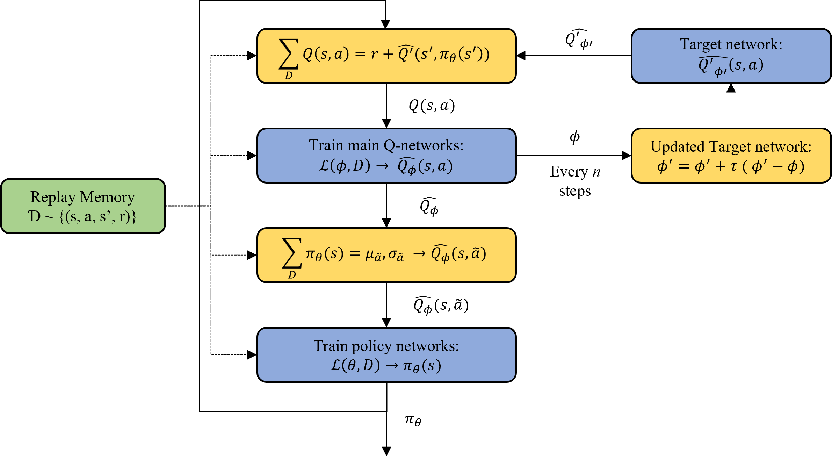
Designing and Applying Sensor-Driven Flight Systems for Multi-UAV Environment Exploration
Joshua Ashley, Biyun Xie Ph.D, Michael Sama Ph.D.
University of Kentucky College of Engineering
ABSTRACT
This focus of this research is to design a sensor-driven trajectory planning algorithm for fixed-wing aircraft to map the local atmospheric environment in real-time. The proposed application of this work is to be used in the event of a hazardous contaminant leak into the atmosphere as a fleet of sensing Unmanned aerial systems (UASs) could provide information for evacuation measures. The problem of creating optimal trajectory planning for exploration has been modelled accurately using partially-observable Markov decision processes (POMDP). Reinforcement learning (RL) is commonly applied to approximate optimal solutions within a POMDP as it can of be analytically intractable. This research produces a POMDP that describes this exploration problem and applies the state-of-the-art soft actor-critic (SAC) reinforcement learning algorithm to create a policy that produces near-optimal trajectories within this new POMDP. A turn-taking strategy for using multiple UAVs is also proposed to help solve scalability problems with multi-UAV coordination. The learned policy from SAC can outperform a greedy and fixed trajectory on 1, 2, and 3 UAVs by a significant margin. The turn-talking strategy provides small, but repeatable scaling benefits. Overall, the proposed algorithm is effective in dynamic map exploration and has the potential to drastically increase UAV effectiveness as it is integrated into the larger project on real-world UAVs.
Measuring information gain from the belief space is to quantify the entropy of a given belief space and compare the change in entropy from taking an action in each state. A confidence, c(x,y), is assigned to each point in M creating the set B = {c(x,y) ∀ (x, y)} which describes the confidence that the simulation has correctly predicted the measurement at each point. Therefore, event C(x,y) is the event that the simulation has predicted correctly at the location of (x, y), thus P(C(x,y) = correct) = c(x,y) and P(C(x,y) = incorrect) = 1 − c(x,y). P (C(x,y)|Z) is the effect the measurement has on the confidence at the point (x, y). The information gain can then be derived by taking the change in entropy of P(C(x,y)|Z) at all points of x and y.
The full dataflow of the algorithm to establish and improve this belief map is shown below. The measurement set, Z, is what each model forms its maps from which is then combined into a current state that the policy attempts to explore within the environment.
INTRODUCTION
The overall goal of this work is to develop a real-time, sensor-driven flight system that can efficiently and accurately map the surrounding environment in the event of a major contaminant being introduced into the atmosphere [1]. The focus of this paper is to address the problem of creating a sensor-driven flight planner that makes substantial improvements to predetermined flight plans at providing data to assist in real-time modeling of local atmospheric properties. Exploring the local weather environment can be thought of as a map exploration problem which is accurately described as a partially-observable Markov decision process (POMDP) [3]. Optimizing over a reward that is governed by a POMDP is a notoriously intractable problem for complex state and action spaces. Paull L. et al. proposed a hexagonal map with a directed asynchronous graph (DAG) which drastically simplifies state and action space through discretization [4]. It is noted that this method requires relatively high online computation which reduces scalability. For multi-UAV systems reinforcement learning (RL) has been used to solve the problem with offline computation. Julian K. and Kochenderfer M. show the application of deep-Q networks (DQNs) in monitoring wildfires [5]. The proposed algorithm utilizes the POMDP model of exploration in conjunction with the Weather Research and Forecasting (WRF) model to accurately map a surrounding atmospheric environment. Multiple UAVs will be introduced to the simulation by having each UAV act atomically and in-sequence. Each UAV will choose a sequence of actions through the environment and then simulate the effect those actions may have on the map’s accuracy. This new simulated accuracy will be used for the next UAV to take its actions and then repeat the process, essentially implementing a turn-taking strategy. The proposed algorithm contributes three unique concepts to solving this trajectory planning problem:
Contributions:
The use of the WRF model and reinforcement learning in a positive feedback system to increase atmospheric map accuracy.
The application of the preexisting Soft Actor-Critic (SAC) algorithm [] as an enhancement to RL in the UAV exploration and mapping problem.
The implementation of a turn-taking strategy for multi-UAV coordination for problem scalability.
Additionally, an in-flight data distribution system was designed for the project to communicate sensor information and flight plans to and from the UAVs in real time. This system will be discussed in the final portion of the paper to highlight the efficacy of this algorithm towards the real-world application.
METHODOLOGY
The RL training algorithm SAC was used to generate a policy network for the prior described model. SAC trains 3 networks, one policy network and two deep-Q networks. The deep-Q networks approximate future potential rewards using mean squared Bellman error (MSBE) as a loss function [11]. These approximated Q-values are what is used in the loss function for the policy network as well as an entropy term such that the resulting stochastic policy also allows for sufficient exploration. SAC also employs the strategies dual-clipped Q networks, target networks with Polyak averaging, replay memory, and entropy regularization which is shown on the following figure describing the dataflow during training in SAC [9].
CONCLUSION AND FUTURE WORK
Using a learned probabilistic model that collaborates with the behavior of the WRF model gives much more information about the surrounding weather environment than any static set of measurements could give on its own. This drastically reduces the amount of work and UAVs needed to create an accurate map.
Future work:
Increase UAV simulation complexity.
Integrate with real-time WRF estimations.
Refine model training and turn-taking strategy.
PROBLEM MODEL
The input to the system is a map relating wind vectors to spatial points, M = (x, y, u, v), generated by the WRF model from recorded sensor data so far. WRF generates this information using complex atmospheric simulation. The belief space, B, quantifies the prediction of the WRF model based on known measurement accuracies and their role in the model’s prediction. The aircraft model establishes the observer’s interaction with its environment and creates the action space. The POMDP model creates the relationship between the environment states and UAV actions, M(s, a), as well as the associated rewards. The rewards in exploration relate to the change in belief, b_{x}, of our environment, known as information gain I_{Z} .
RESULTS
Add your information, graphs and images to this section.
Acknowledgements
This research has been supported by the Nation Science Foundation and the University of Kentucky.

Slide 2
REFERENCES
1. S. Devarakonda, P. Sevusu, H. Liu, R. Liu, L. Iftode, and B. Nath, “Real-time air quality monitoring through mobile sensing in metropolitan areas,” in Proceedings of the 2nd ACM SIGKDD international workshop on urban computing, pp. 1–8, 2013.
3. S. Thrun, W. Burgard, and D. Fox, “Probalistic robotics,” Kybernetes, 2006.
4. K. D. Julian and M. J. Kochenderfer, “Distributed wildfire surveillance with autonomous aircraft using deep reinforcement learning,” Journal of Guidance, Control, and Dynamics, vol. 42, no. 8, pp. 1768–1778, 2019.
5. L. Paull, C. Thibault, A. Nagaty, M. Seto, and H. Li, “Sensor-driven area coverage for an autonomous fixed-wing unmanned aerial vehicle,” IEEE Transactions on Cybernetics, vol. 44, no. 9, pp. 1605–1618, 2014
9. T. Haarnoja, A. Zhou, P. Abbeel, and S. Levine, “Soft actor-critic: Off-policy maximum entropy deep reinforcement learning with a stochastic actor,” in Proceedings of the 35th International Conference on Machine Learning (J. Dy and A. Krause, eds.), vol. 80 of Proceedings of Machine Learning Research, pp. 1861–1870, PMLR, 10–15 Jul 2018
11. R. S. Sutton and A. G. Barto, Reinforcement Learning: An Introduction. The MIT Press, second ed., 2018.

Slide 3

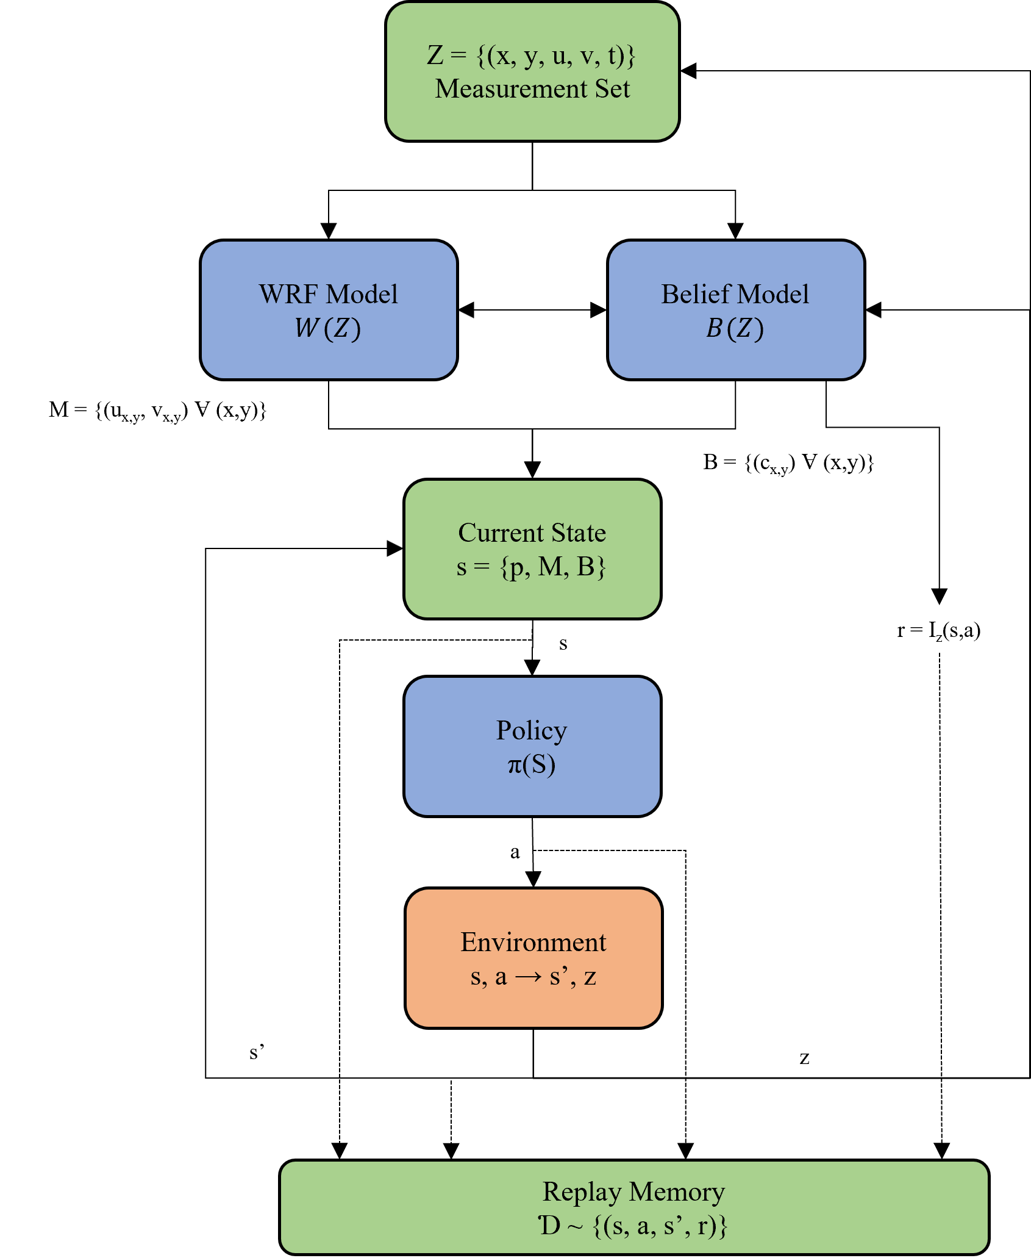
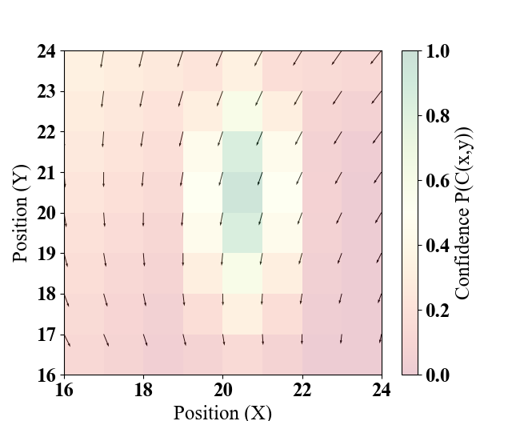


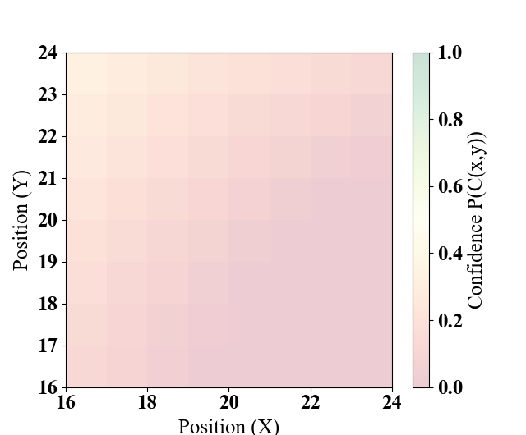
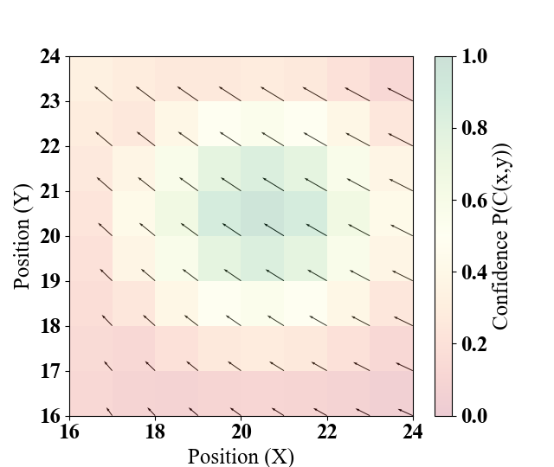
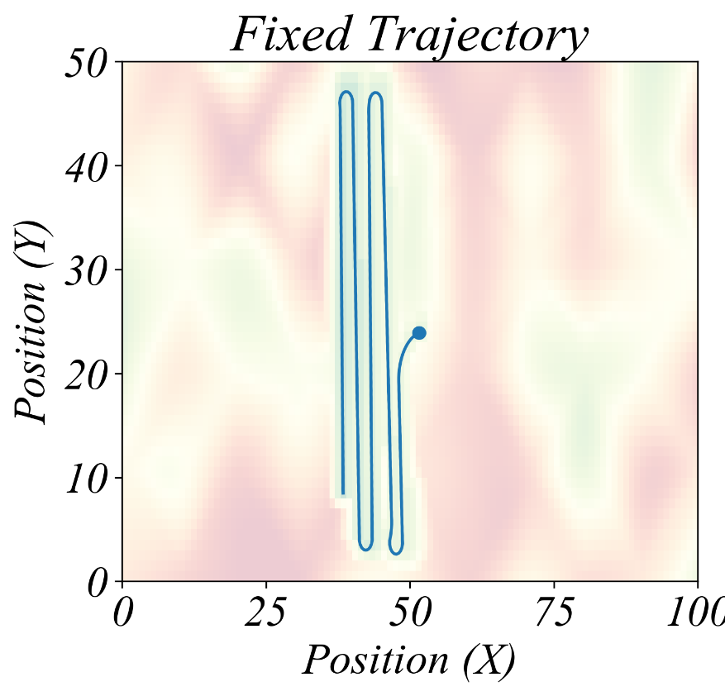

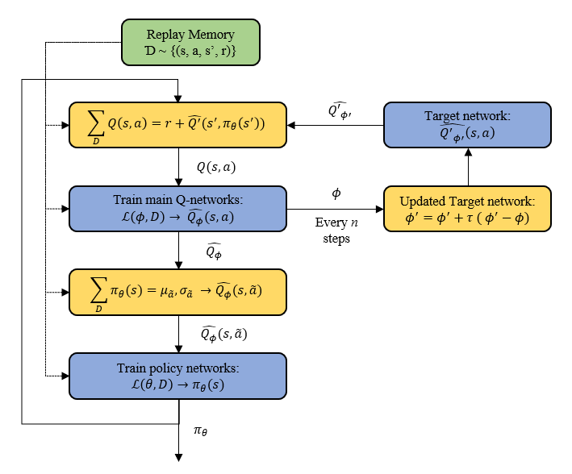
Measurement
Taken

