Slide 1
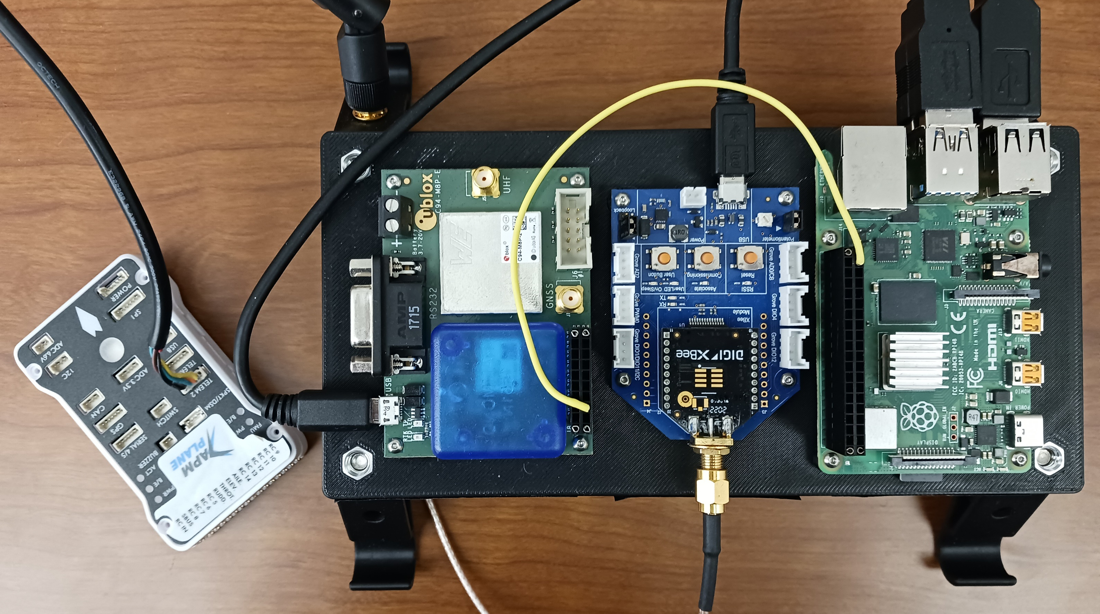
Raspberry Pi (Ubuntu 20.04, ROS2)
Neo-M8P RTK GPS
Pixhawk PX4 Flight Controller + Telemetry
DigiMesh radio

Slide 2
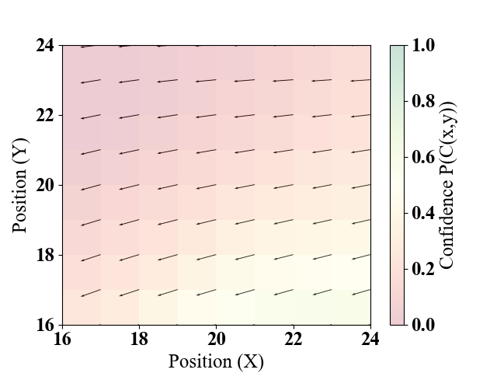
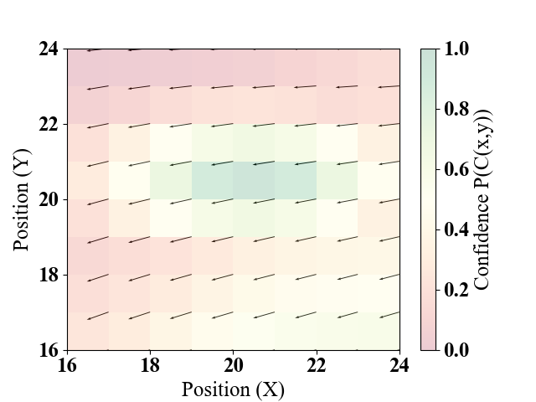
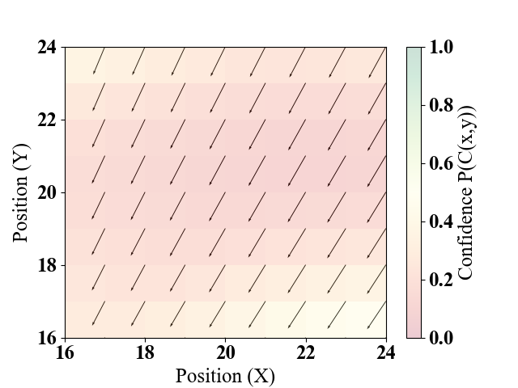
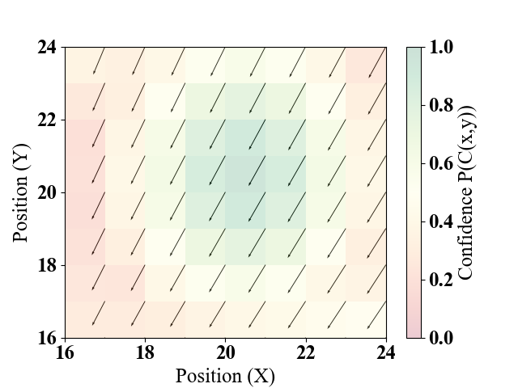
Before Observation
After Observation

Slide 3

Flowfield + Belief Image (3 channel)
$$x_{p}{ y}_{p} ψ_{p} t$$
Conv. Layer:
64 kernels, 3x3 window size
Dense Layer: 256 biases
Avg. Pooling Layer:
3x3 window size
Conv. Layer:
64 kernels, 3x3 window size
Avg. Pooling Layer:
3x3 window size
Dense Layer: 256 biases
Dropout Layer: 0.2
Dense Layer: 512 biases
Dense Layer: 256 biases
Dense Layer: 256 biases
Dense Layer: 512 biases
Dense Layer: 256 biases
Output Layer: 2 outputs
$$μ_{a}$$
$$σ_{a}$$

Slide 4
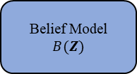
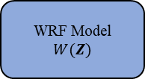
Z = {(x, y, u, v, t)}
Measurement Set
models = light blue
Datasets = light green
Environment = light orange
WRF Model
$$W(Z)$$
Belief Model
$$B(Z)$$
M = {(u_{x,y}, v_{x,y}) Ɐ (x,y)}
B = {(c_{x,y}) Ɐ (x,y)}
Current State
s = {p, M, B}
s
r = I_{z}(s,a)
Policy
π(s)
a
Environment
s, a → s’, z
s’
z
Replay Memory
Ɗ ~ {(s, a, s’, r)}

Slide 5
WRF Model
$$W(Z)$$
Belief Model
$$B(Z)$$
M = {(u_{x,y}, v_{x,y}) Ɐ (x,y)}
Current State
s = {p, M, B}
B = {(c_{x,y}) Ɐ (x,y)}
Z = {(x, y, u, v, t)}
Measurement Set
Replay Memory
Ɗ ~ {(s, a, s’, r)}
s
r = I_{z}(s,a)
Policy
π(s)
a
Environment
s, a → s’, z
s’
z

Slide 6


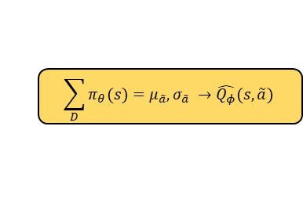









Replay Memory
Ɗ ~ {(s, a, s’, r)}
models = light blue
Datasets = light green
formulas = light yellow
$$\sum_{D}{Q\left(s,a\right)}=r+\hat{Q^{′}}(s^{′},π_{θ}\left(s^{′}\right))$$
$$\hat{{Q′}_{φ′}}$$
Target network:
$$\hat{{Q^{′}}_{φ′}}\left(s,a\right)$$
$$Q(s,a)$$
Train main Q-networks:
$$ℒ\left(φ,D\right)→ \hat{Q_{φ}}(s,a)$$
$$φ$$
Updated Target network:
$$φ^{′}=φ^{′}+τ ( φ^{′}−φ)$$
Every n steps
$$\hat{Q_{φ}}$$
$$\sum_{D}{π_{θ}(s)}=μ_{\tilde{a}}, σ_{\tilde{a}} →\hat{Q_{φ}}(s,\tilde{a})$$
$$\hat{Q_{φ}}(s,\tilde{a})$$
Train policy networks:
$$ℒ\left(θ,D\right)→π_{θ}(s)$$
$$π_{θ}$$

Slide 7
$$\sum_{D}{Q\left(s,a\right)}=r+\hat{Q^{′}}(s^{′},π_{θ}\left(s^{′}\right))$$
$$\hat{{Q′}_{φ′}}$$
Target network:
$$\hat{{Q^{′}}_{φ′}}\left(s,a\right)$$
$$Q(s,a)$$
Train main Q-networks:
$$ℒ\left(φ,D\right)→ \hat{Q_{φ}}(s,a)$$
$$φ$$
Updated Target network:
$$φ^{′}=φ^{′}+τ ( φ^{′}−φ)$$
Every n steps
Replay Memory
Ɗ ~ {(s, a, s’, r)}
$$\hat{Q_{φ}}$$
$$\sum_{D}{π_{θ}(s)}=μ_{\tilde{a}}, σ_{\tilde{a}} →\hat{Q_{φ}}(s,\tilde{a})$$
$$\hat{Q_{φ}}(s,\tilde{a})$$
Train policy networks:
$$ℒ\left(θ,D\right)→π_{θ}(s)$$
$$π_{θ}$$

Slide 8
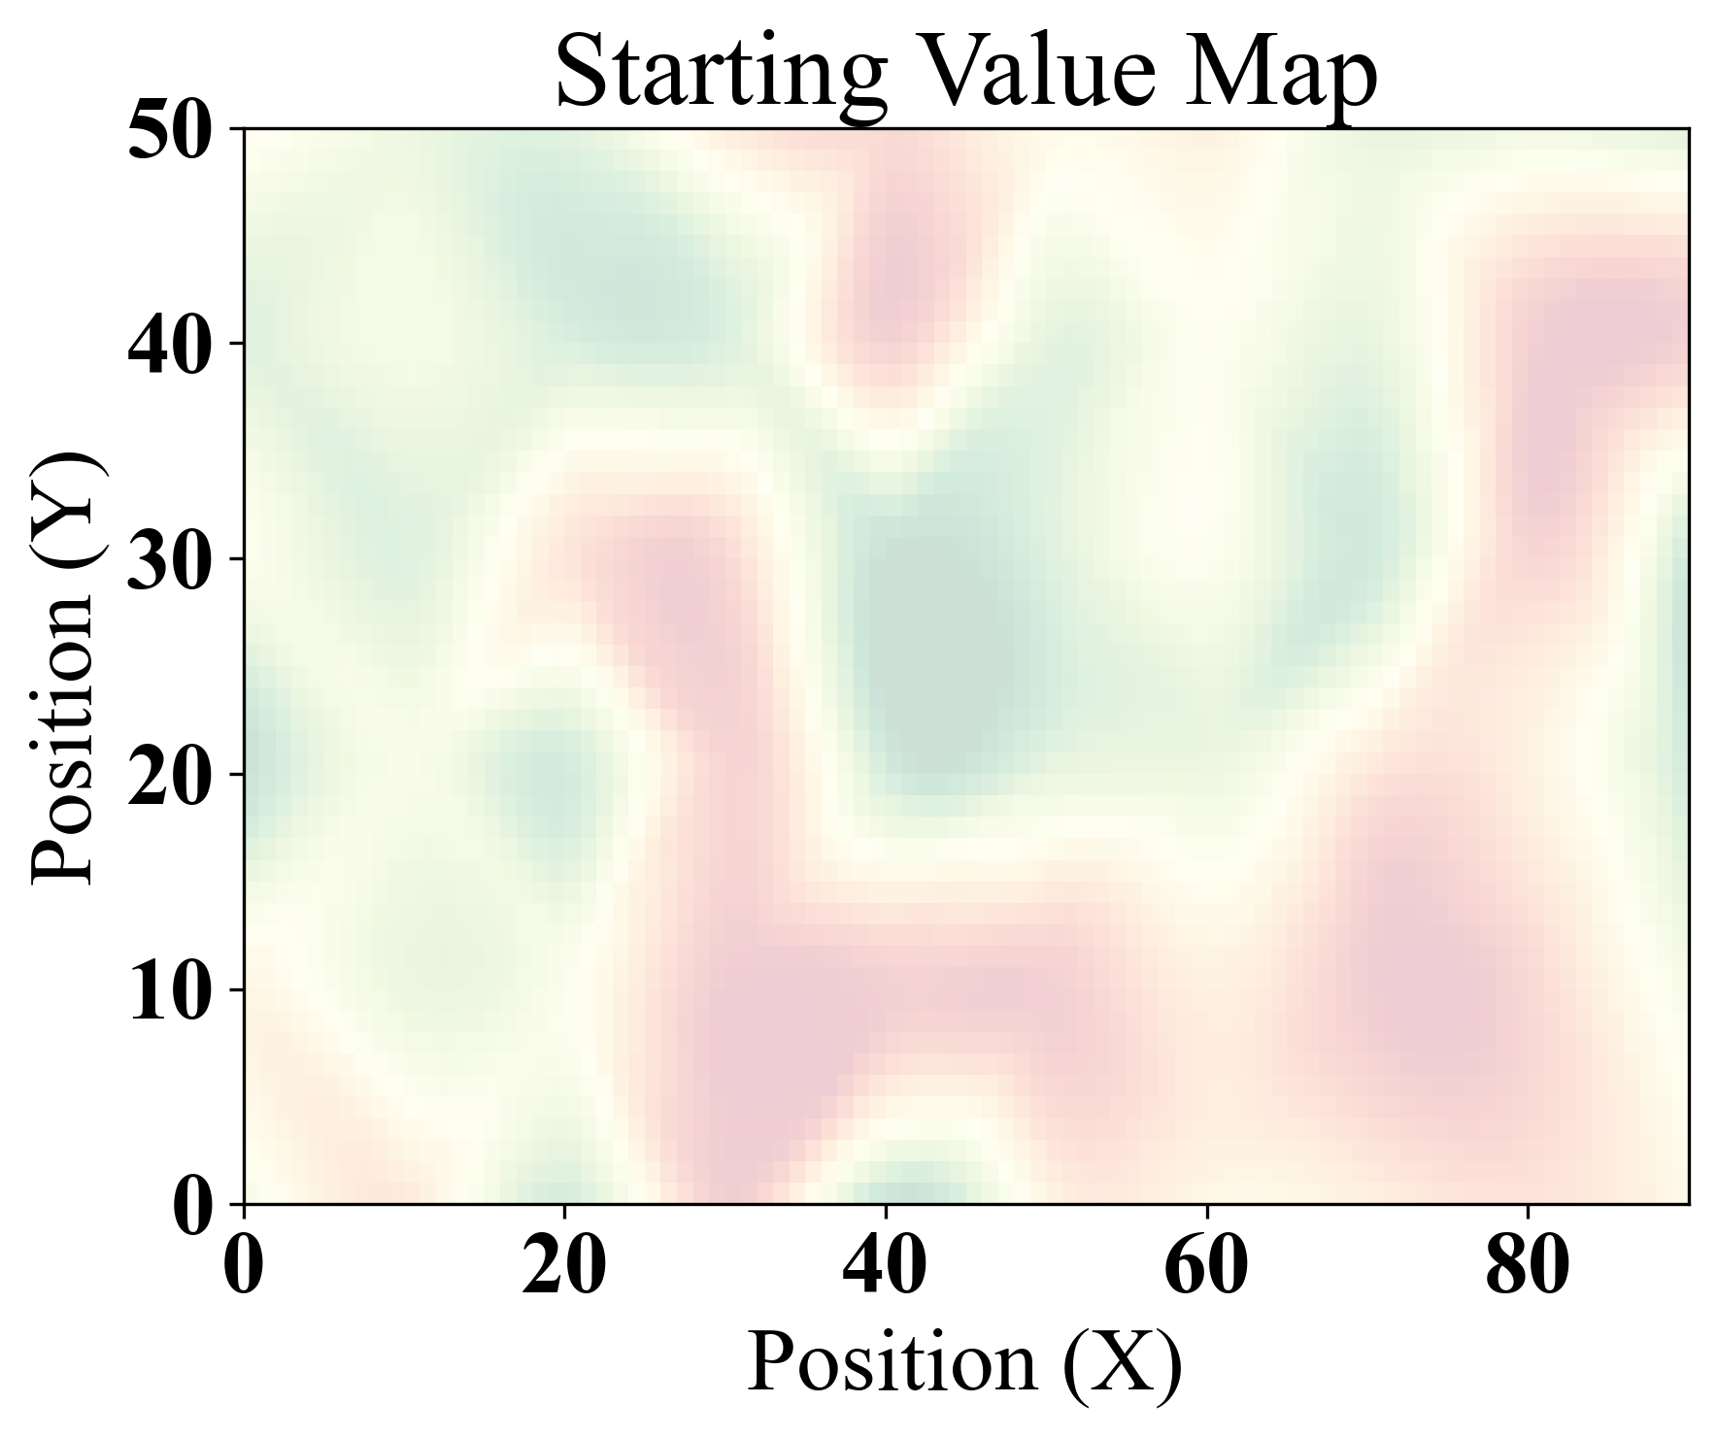
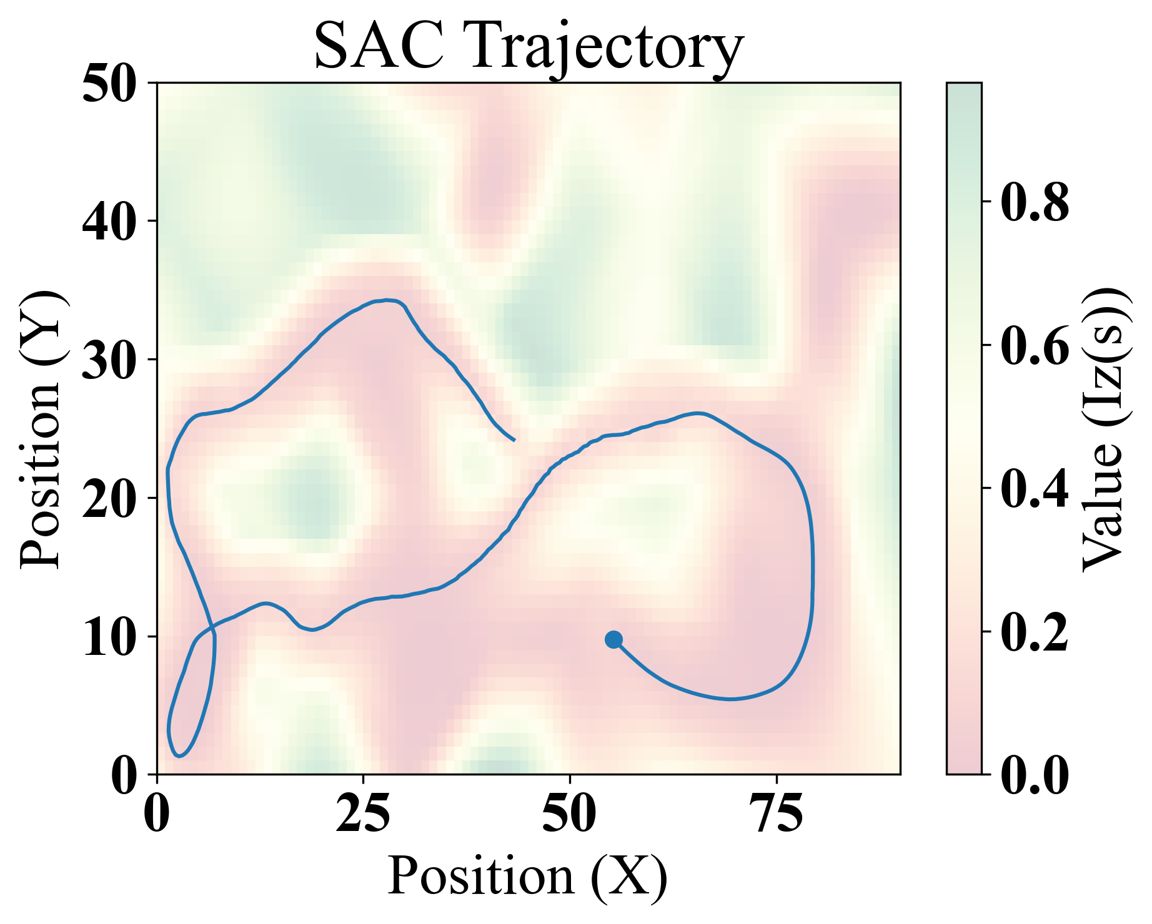
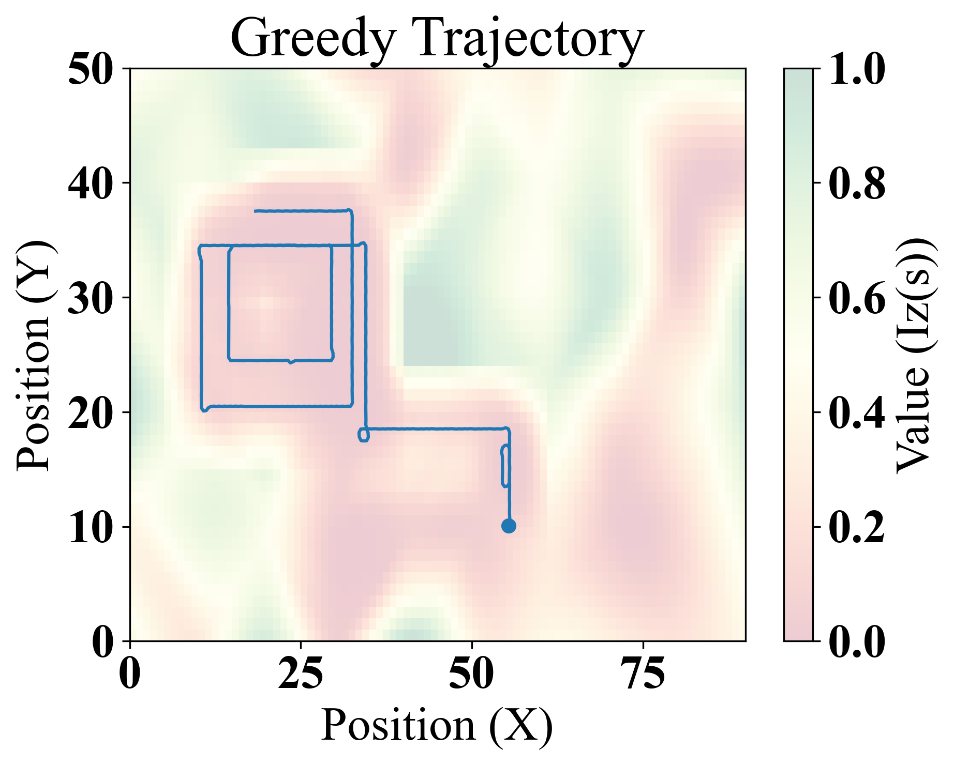
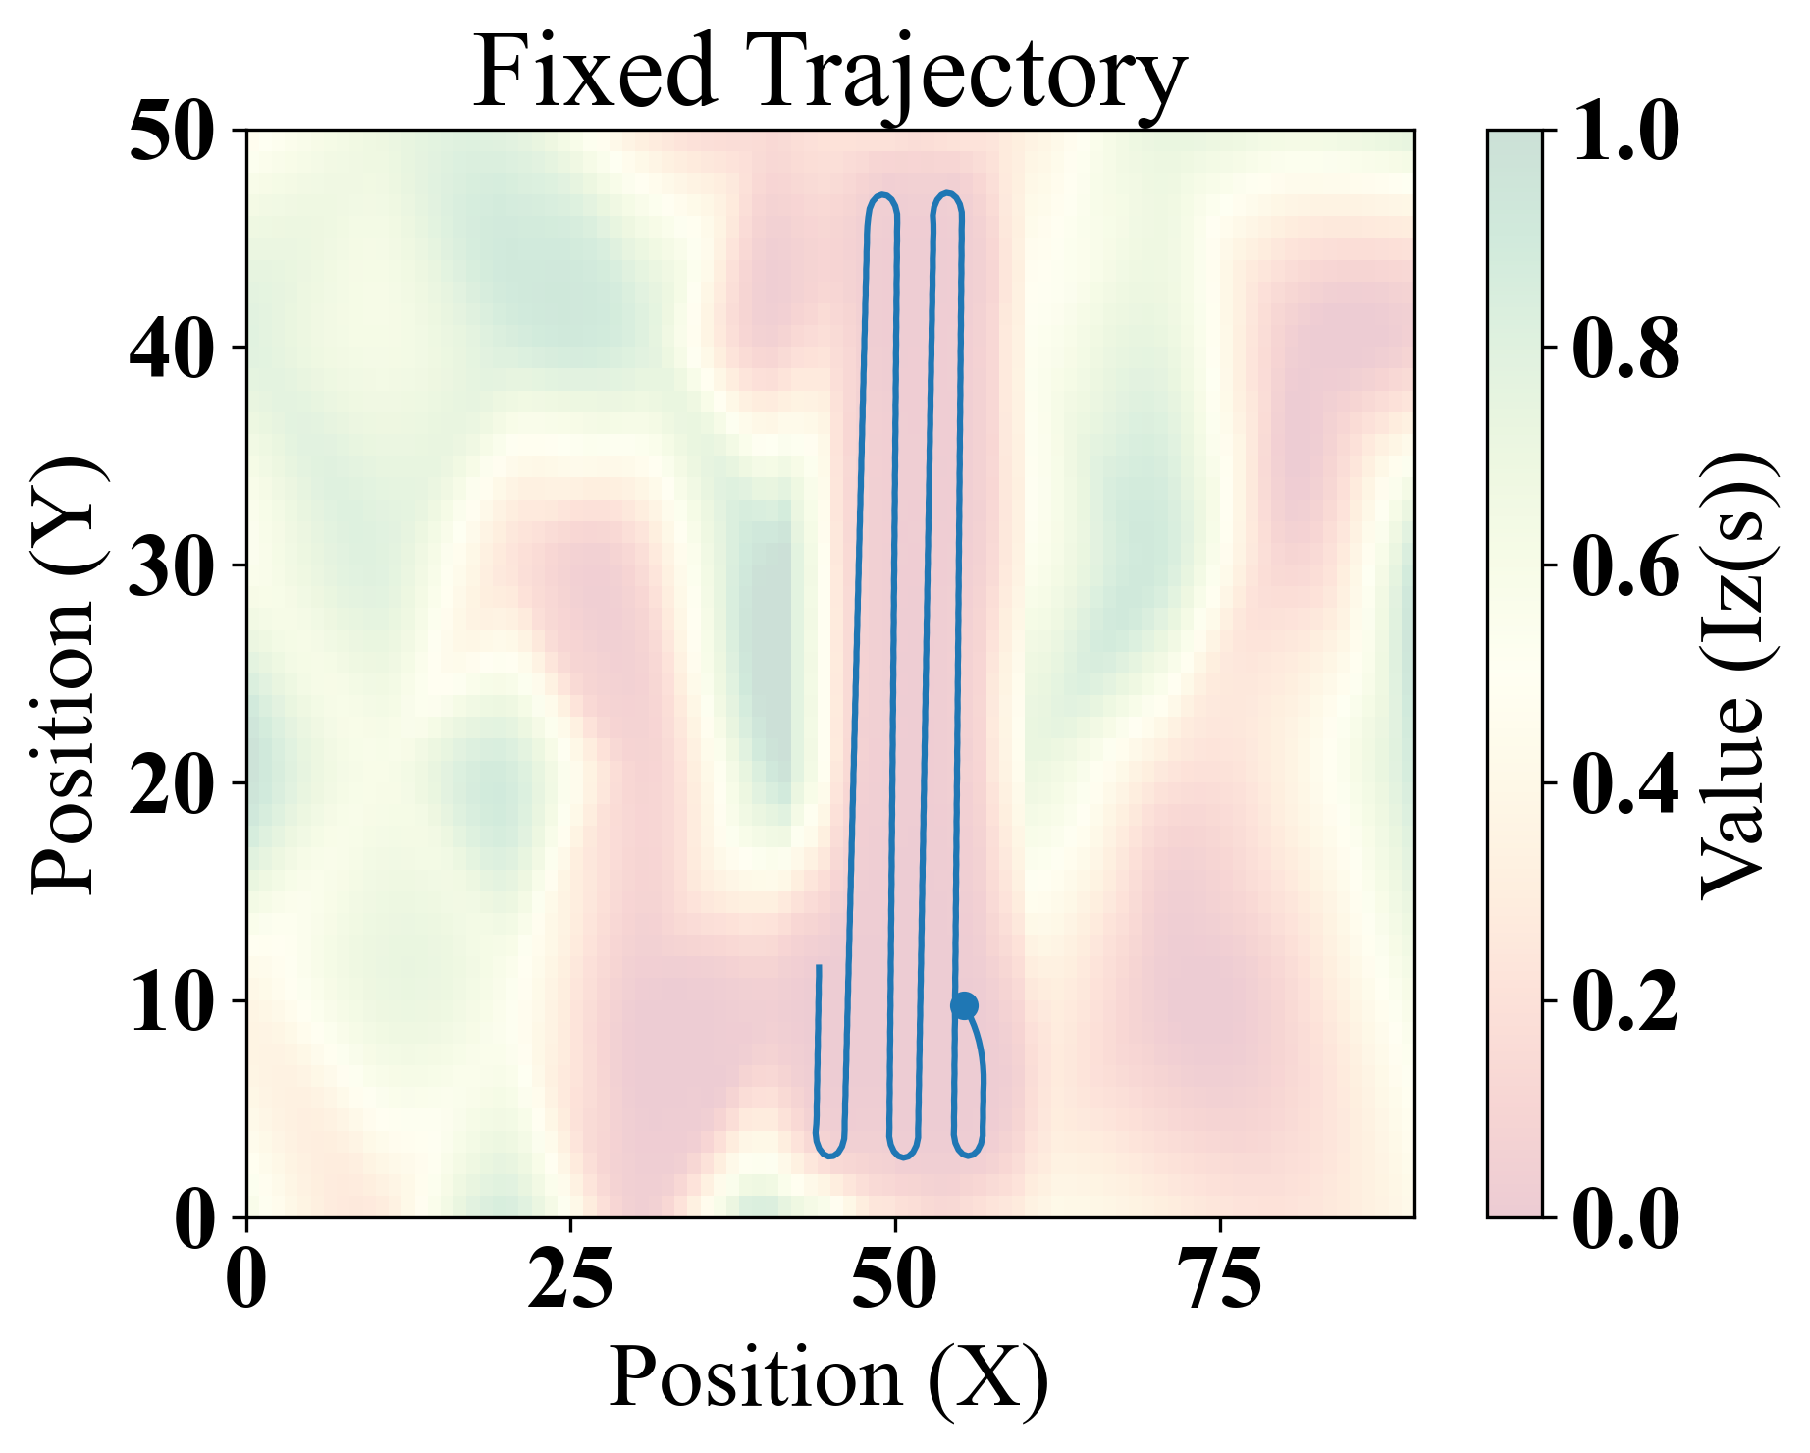

Slide 9
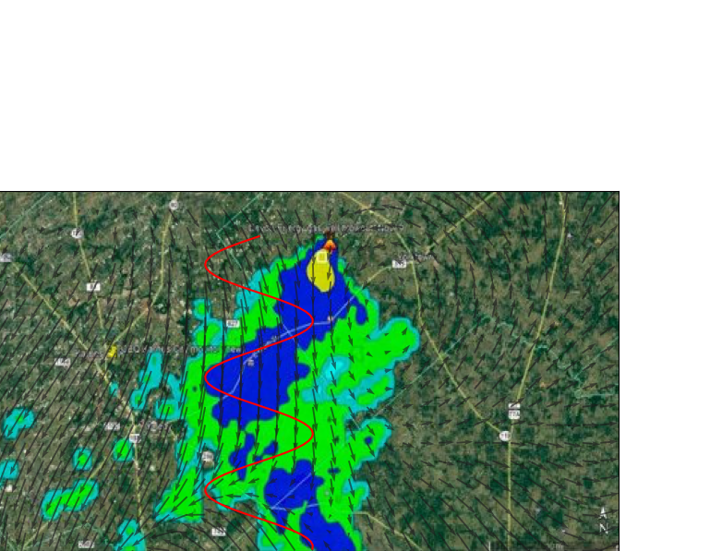
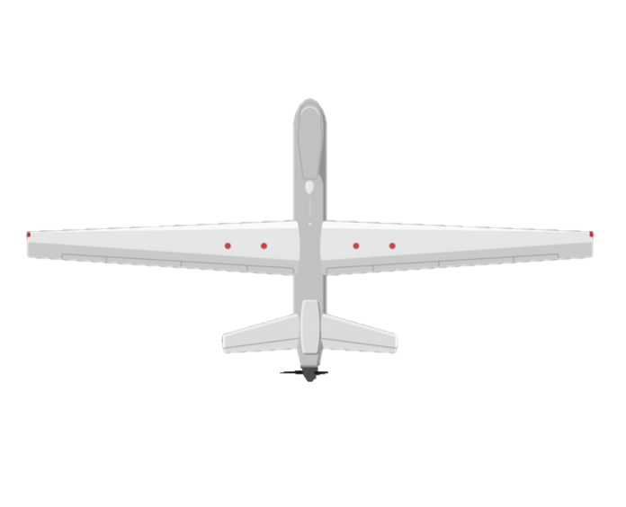
Legend:
10 C₂H₆ PPB
100 C₂H₆ PPB
1,000 C₂H₆ PPB
10,000 C₂H₆ PPB
UAV Trajectory
Wind Vectors
Credit: https://www.mdpi.com/2073-4433/13/3/486/htm

