Slide 1
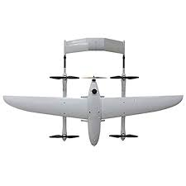
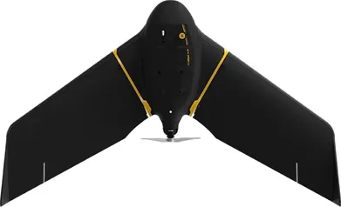
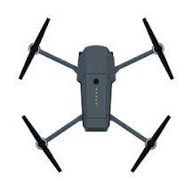

FixedWing1
VTOL2
FixedWing4
Quad3
Quad2
FixedWing2
Quad1
VTOL1
FixedWing3

Slide 2
Byte Offset
0
1
2
3
4
5
6
7
Sensor Code | , | GPS Timestamp
GPS Timestamp |  | Message primitive 1 |  | Message primitive 2
Message primitive 2
Message primitive 3 |  |  | Message primitive 4

Slide 3
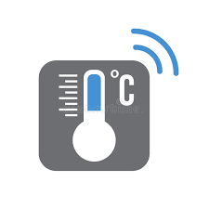
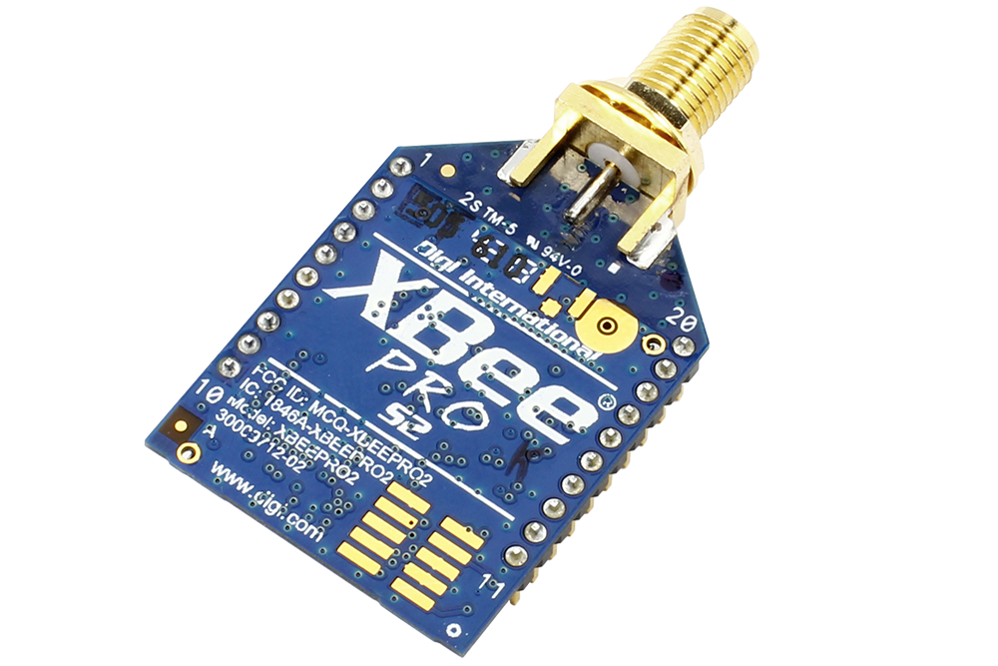




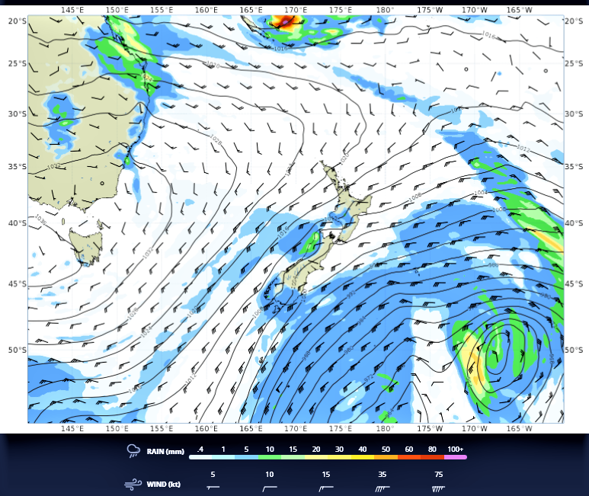
Sensor
Publisher
Radio
Serializer
UAV
Deserializer
Radio
Ground
Station
Database
Application
Ground Station

Slide 4
From GSU:
0,4 | Acknowledge sensor code 4
1,4 | Unknown sensor code 4
3 | Unknown plane hostname
From UAV:
0,4,environ_msgs.Pth,pth_msg | Sensor code 4 is a PTH message
2,plane1 | This UAV’s hostname is ‘plane1’
4,\x02\x88\x91\x0b\xfb\x1a\xb4\xd8A\x00\x00\xa0A\x9a\x99\x99A\xcd\xcc\x9cAff\xaaB\x00\x00\xa0A | Sensor data for sensor code 4
serial: 2
time: July 14, 2022 3:19PM
temp1: 20.
temp2: 19.2
temp3: 19.6
pressure: 85.2 kPa
humidity: 20%

