Slide 2

Belief Image
$$x_{p}{ y}_{p} ψ_{p} t$$
Conv. Layer:
64 kernels, 3x3 window size
Dense Layer: 256 biases
Avg. Pooling Layer:
3x3 window size
Conv. Layer:
64 kernels, 3x3 window size
Avg. Pooling Layer:
3x3 window size
Dense Layer: 256 biases
Dropout Layer: 0.2
Dense Layer: 512 biases
Dense Layer: 256 biases
Dense Layer: 256 biases
Dense Layer: 512 biases
Dense Layer: 256 biases
Output Layer: 2 outputs
$$μ_{a}$$
$$σ_{a}$$

Slide 3
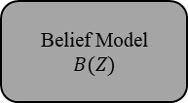
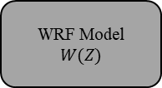
Z = {(x, y, u, v, t)}
Measurement Set
WRF Model
$$W(Z)$$
Belief Model
$$B(Z)$$
M = {(u_{x,y}, v_{x,y}) Ɐ (x,y)}
B = {(c_{x,y}) Ɐ (x,y)}
Current State
S = {s, M, B}
r = I_{z}(s,a)
Policy
π(S)
a
Environment
s, a → s’, z(s, a)
s’
z(s, a)

Slide 4
