Slide 1
Programming Fundamentals
Lecture 10
Passing Arrays to Function | Two dimensional Arrays, Strings
Lecturer: Mr. Umar Khayyam

Slide 2
Lecture Outlines
Today, we’ll explore key concepts in C++ related to arrays and strings:
Passing arrays to functions
Two-dimensional arrays
Strings, character arrays, and arrays of strings
String manipulation functions (using both C-style and C++ approaches)

Slide 3
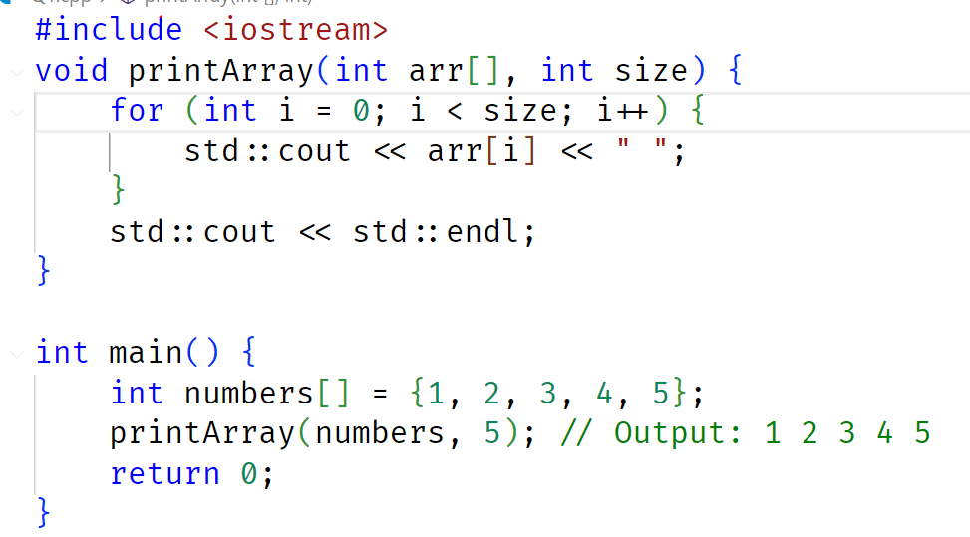
Passing Arrays to Function
To perform operations on multiple elements efficiently.
Reduces redundancy by reusing the same logic for different datasets.

Slide 4
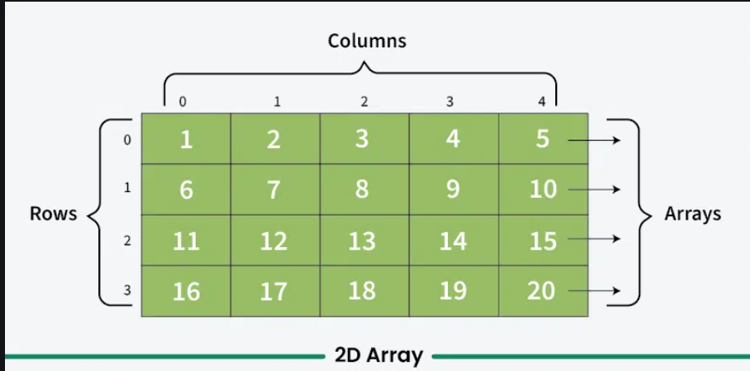
Two Dimensional Arrays
A 2D array stores elements in a matrix-like format.

Slide 5
Two Dimensional Arrays
A 2D array stores elements in a matrix-like format. A two-dimensional array in C++ is a collection of elements organized the form of rows and columns. It can be visualized as a table or a grid, where each element is accessed using two indices: one for the row and one for the column. Like a one-dimensional array, two-dimensional array indices also range from 0 to size-1 for both rows and columns.

Slide 6
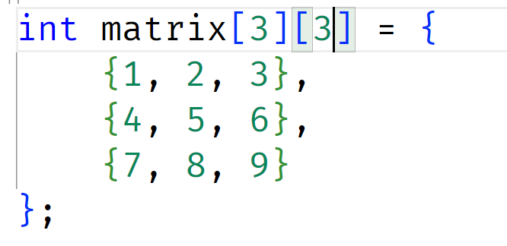
Two Dimensional Arrays
Declaration:
datatype array[row][col];

Slide 7
Two Dimensional Arrays
Accessing Element:
cout << matrix[1][2];

Slide 8
Applications of 2D Arrays
Representing matrices in mathematics
Storing tables of values
Image processing and board games (like chess, tic-tac-toe)

Slide 9
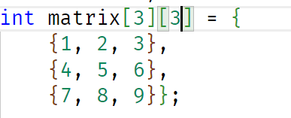

Two Dimensional Arrays
Practice Question Print this using 2D array:

Slide 10
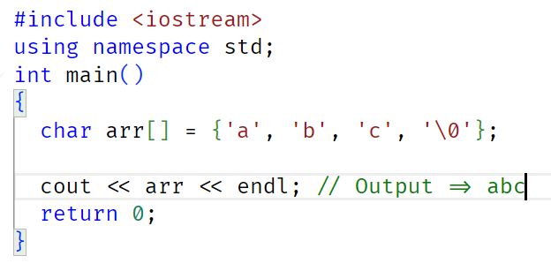
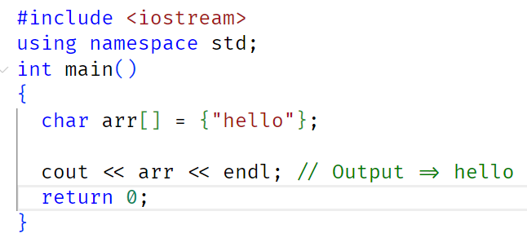
Strings and Character Arrays
A character array is a sequence of characters stored in contiguous memory locations. It is commonly used to represent strings in C and C++.

Slide 11
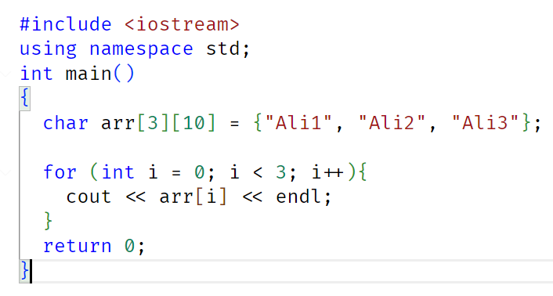

Arrays of String

Slide 12
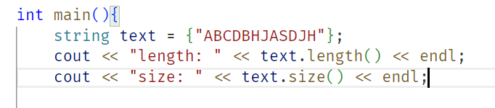
String Manipulation Functions
String Length It will return the length of the string

Slide 13
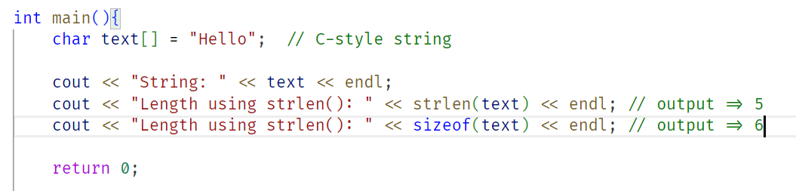
String Manipulation Functions
Strlen() it count size of string but it stops counting when ‘/0’.

Slide 14
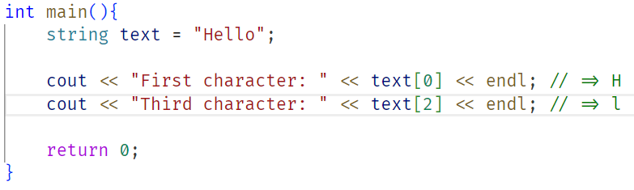
String Manipulation Functions
Accessing Character To access individual characters using array index.

Slide 15
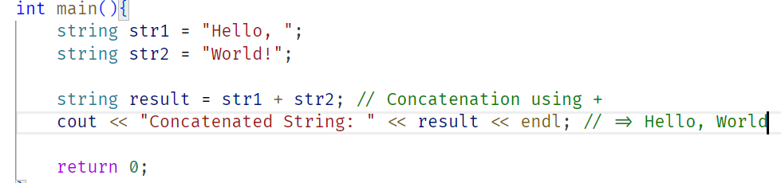
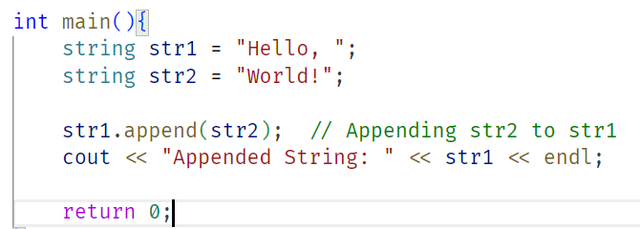
String Manipulation Functions
+Operator and Append() It is used to concatenate two strings

Slide 16
String Manipulation Functions
+Operator It is used to concatenate two strings

Slide 17
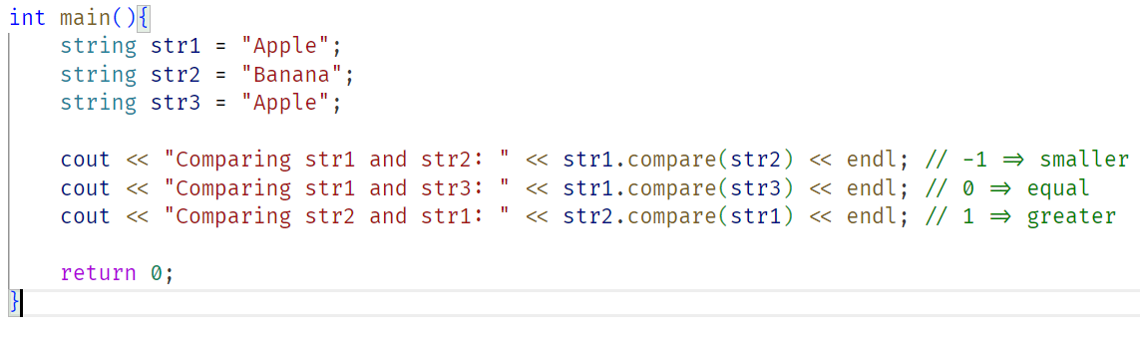
String Manipulation Functions
Compare() The compare() function returns an integer value indicating the comparison result.

Slide 18
Lecture Completed!
Thank You

