Slide 1
Programming Fundamentals
Lecture 06
For Loop, Difference Between For & While
Teacher: Umar Khayyam

Slide 2
For Loop
Introduction
A For Loop in programming allows you to execute a Block of Code repeatedly based on a specific condition.
It is commonly used when you know how many times you want to execute a block of code.

Slide 3
For Loop
for (initialization, condition, increment/decrement)
{
//Code to be executed
}
Initialization:
In this part you need to initialize a variable that controls the loop.
It typically occurs before the loop starts and is executed only once.

Slide 4
For Loop
Condition:
Condition is a Boolean expression that determines whether the loop should continue executing or not.
If the condition evaluates to true, the loop body is executed. If it evaluates to false, the loop terminates.
Increment/Decrement:
This part of the loop is responsible for updating the loop control variable after each iteration.

Slide 5
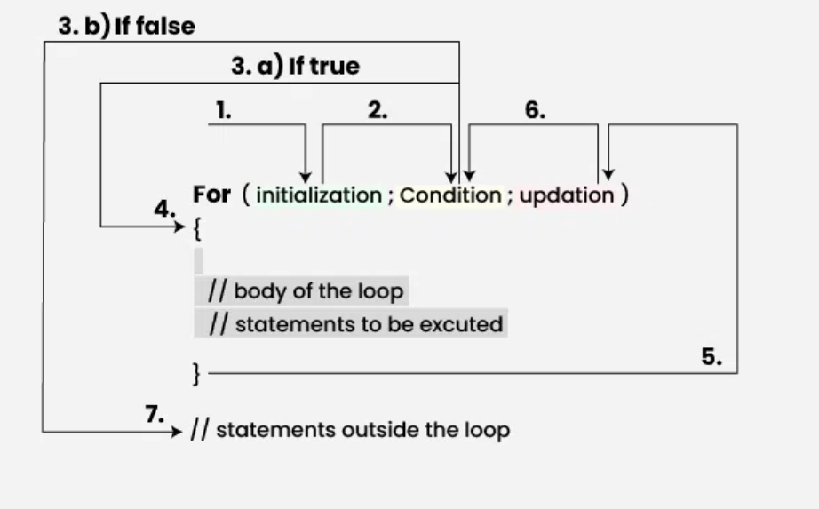
For Loop Execution

Slide 6
Difference Between While, For, Do While
While:
Executes as long as the condition is true. Condition is checked before executing the loop body.
Do While:
Executes at least once, as the condition is checked after the loop body.
For Loop:
Designed for fixed number of iteration, with initialization, condition & increment/decrement in single statement.

Slide 7
Difference Between While, For, Do While
While:
Executes as long as the condition is true. Condition is checked before executing the loop body.
Do While:
Executes at least once, as the condition is checked after the loop body.
For Loop:
Designed for fixed number of iteration, with initialization, condition & increment/decrement in single statement.

Slide 8
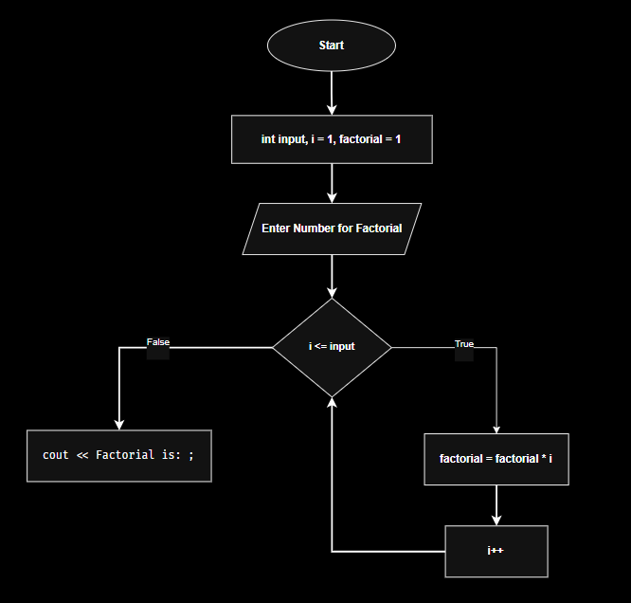
Flow Chart Example Of Loop

Slide 9
Assignment 03
Research and summarize the key features of For loop and while loop. Create a comparison between the two, highlighting their differences, similarities, and use cases
Solve the previous (lab 07) questions with FOR Loop.
Create a flowchart diagram of 1st Question from lab 07.
Deadline: 13th January, 2025
Note: Late Submission will result in marks deduction.

Slide 10
Lecture Completed!
Thank You

