Slide 1
Programming Fundamentals
Lecture 05
While Loops, While with Multiple Conditions, & Do-While Loops
Teacher: Umar Khayyam

Slide 2
Loops
Introduction
Loops are a fundamentals concept in programming that allows us to execute a BLOCK OF CODE repeatedly based on condition.
Today we will explore,
While Loops
While Loops with Multiple Conditions
Do-While Loops

Slide 3
While Loop
A while loop executes a statement as long as the condition specified is true.
Executes from zero to many times, depending on expression
Syntax:
while (expression) {
//Statement
}
Statement execute if expression evaluates to true.
Loops condition reevaluated
Statement continue to execute until expression is false.

Slide 4
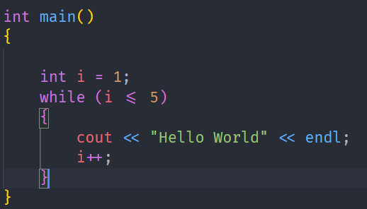
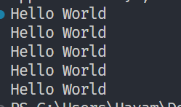
Example While Loop
Output

Slide 5
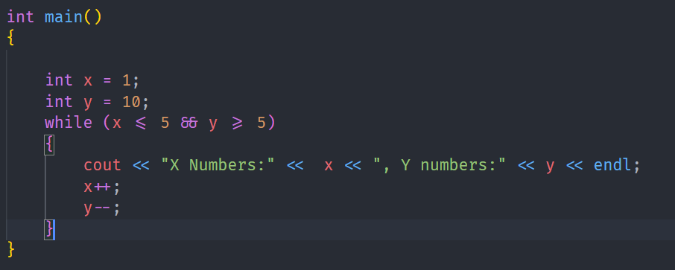
While Loop with Multiple Condition
A While Loop can handle multiple conditions using LOGICAL OPERATORS such as &&, ||, !.

Slide 6
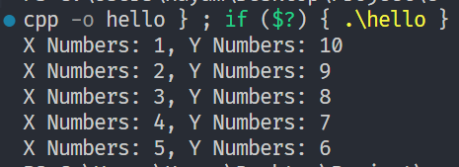
While Loop with Multiple Condition
Output

Slide 7
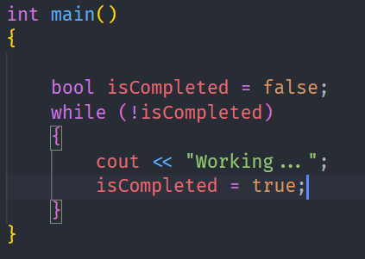
Example With (!) Operator

Slide 8
Do-While Loop
A do-while loop ensures the loop body executes at least once, regardless of the condition.
Syntax
do{
//Code Statements
} while (condition);
Note: The condition is evaluated after the loop body executes.

Slide 9
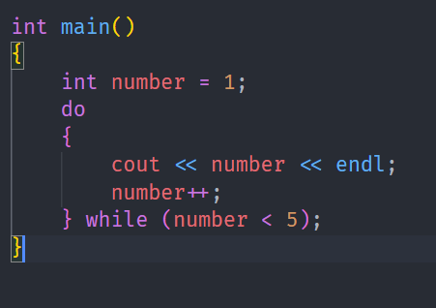
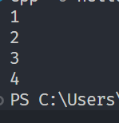
Do-While EXAMPLE
Output

Slide 10
Difference Between While vs Do-While
Feature | While Loop | Do-While Loop
Condition Check | Before Loop Body | After Loop Body
Executes at least once? | No | Yes

Slide 11
Key points
While Loops execute as long as the condition is true
Do-While Loops ensure the body runs at least once.

Slide 12
Lecture Completed!
Thank You

