Slide 1
Programming Fundamentals
Lecture 07
Nested Loops, Switch Statement, Break, and Continue Statements in C++
Teacher: Umar Khayyam

Slide 2
Outlines
In this lecture, we will cover:
Nested Loops: Using loops inside loops.
Switch Statement: A structured way to handle multiple conditions.
Break Statement: Exiting loops or switch cases early.
Continue Statement: Skipping an iteration in loops.

Slide 3
Nested Loop
A Nested Loop is a loop inside another loop.
The inner loop completes all its iterations for each iteration of the outer loop.
for (initialization; condition; increment) // Outer Loop
{
// Outer Loop Body
for (initialization; condition; increment) // Inner Loop
{
// Inner Loop Body
}
}

Slide 4
Example Nested Loop
int main()
{
for (int i = 1; i <= 3; i++) // Outer Loop
{
// Outer Loop Body
cout << "Outer Loop : " << i << endl;
for (int j = 1; j <= 3; j++) // Inner Loop
{
//Inner Loop Body
cout << "Inner: j=" << j << endl;
}
}
}

Slide 5
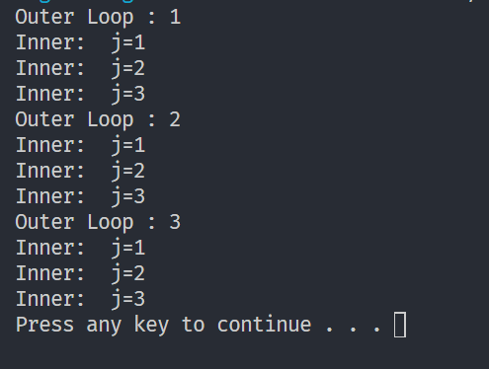
Example Nested Loop Output

Slide 6
Nested IF Statements
A Nested IF Statement is an if statement inside another if statement.
It allows checking multiple conditions in a hierarchical manner.
if (condition1)
{
if (condition2)
{
// Code executes if both conditions are true
}
}

Slide 7
Nested IF Statements Example
int main()
{
int marks;
cout << "Enter marks: ";
cin >> marks;
if (marks >= 50)
{
// Outer if
cout << "Passed!" << endl;
if (marks >= 90)
{
// Inner if
cout << "Excellent Grade!" << endl;
}
}
else
{
cout << "Failed!" << endl;
}
}

Slide 8
Switch Statement
You can use the Switch statement to select one of many code of blocks to be executed.
switch(expression) { case x: // code block break; case y: // code block break; default: // code block }
A Switch Statement is an alternative to multiple if-else, else-if conditions.
It used when checking a single variable against multiple values.

Slide 9
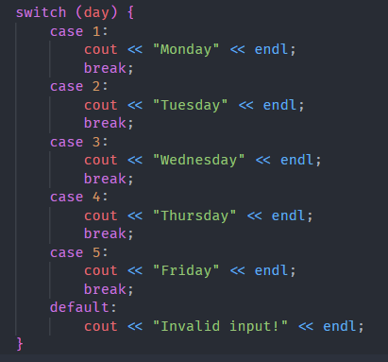
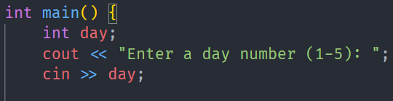


Switch Statement Example
Output

Slide 10
Why Use Switch
Cleaner than multiple if-else statements.
Faster when checking a single variable against multiple values.

Slide 11
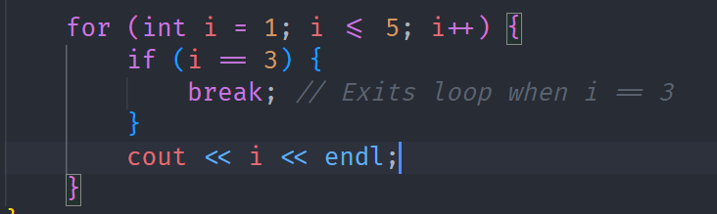

Break Statement
The break statement stops execution of a loop or exits a switch statement.
Output

Slide 12
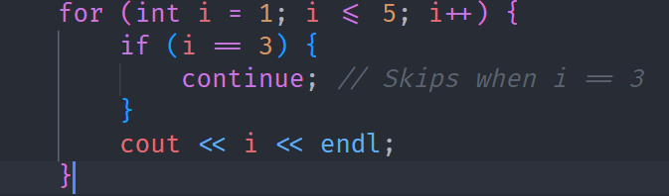

Continue Statement
The continue statement skips the current iteration and moves to the next loop iteration.
Output

Slide 13
Conclusion
Nested loops allow repeated execution inside another loop.
Switch Statement provide a cleaner alternative to multiple if-else conditions.
Break exits a loop or switch case early.
Continue skips the current iteration and moves to the next.

Slide 14
Practice Question
Use a switch statement to check the month number and print the month name.

Slide 15
Lecture Completed!
Thank You

