Slide 1
Programming Fundamentals
Lecture 08
Functions in C++
Teacher: Umar Khayyam

Slide 2
Outlines
Introduction to Functions
Role of Functions
Function Call and Return
Library Functions (Math)
User-Defined Functions
Function Definition
Function Prototype
Function Call
Passing Arguments to Functions
Returning Values from Functions

Slide 3
Function
Definition from Textbook
A Function is a subprogram, or module, to which any amount of data can be sent, but which returns only one value.
Every C++ program has at least one function.
Any Guesses Which One Function I am Talking About ❓
main(), which is automatically called when you execute the C++ Program i.e. program execution always begins with main().

Slide 4
Function
A function is a block of code which only runs when it is called.
You can pass data, known as parameters, into a function.
Functions are used to perform certain actions, and they are important for reusing code: Define the code once, and use it many times.
It helps in breaking down complex programs into smaller, manageable parts.
Functions improve code reusability and readability.

Slide 5
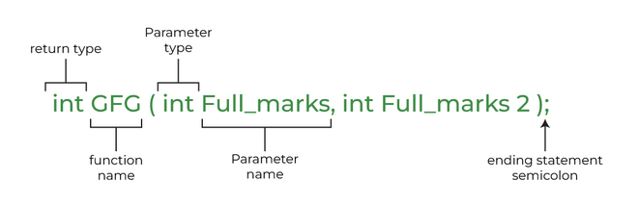
Function Prototype

Slide 6
User Define Function
A function must be defined before it is used.
In C++, a user-defined function is a function created by the programmer to perform a specific task.
A C++ function consist of two parts:
Declaration: the return type, the name of the function, and parameters (if any)
Definition: the body of the function (code to be executed)

Slide 7
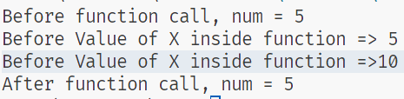
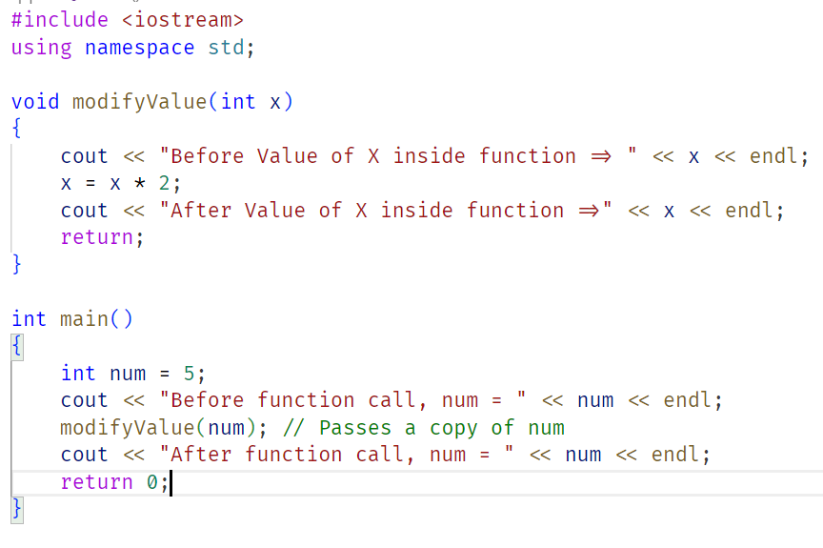
User Define Function

Slide 8
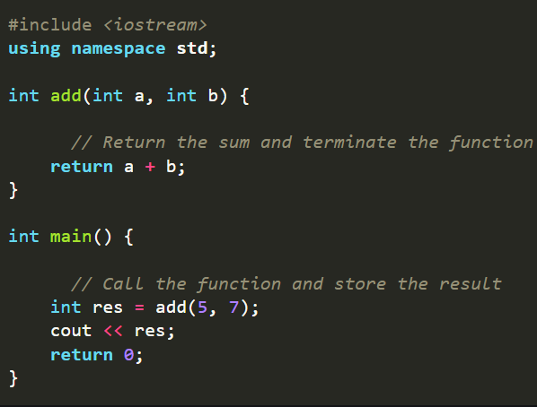
Call & Return
Each function has its own name and when the name is encountered, the function gets called.
It can return a value or perform an action without returning any value. Function Call:
We tell the computer to use the function.
Return Statement:
The function can give back a
result.

Slide 9
Library Functions (Math Library)
C++ provides built-in functions in different libraries (e.g. <cmath> for math functions). Commonly used math functions:
sqrt(x): Returns the square root of x.
Pow(x, y): Returns x raised to the power of y.
Sin(x), cos(x), tan(x): Trigonometric functions.

Slide 10
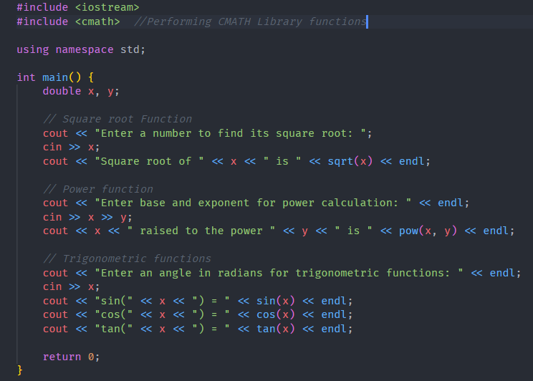

Slide 11
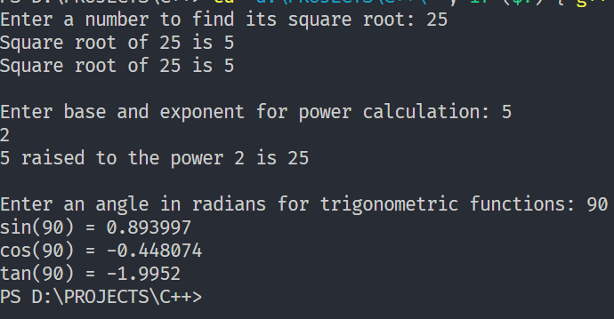
Output of Previous Code Example (CMATH)

Slide 12
Returning Values From Function
In C++, a function can "return" a value back to the part of the program that called it.
This means the function can calculate or process something and then send that result back to where it was needed

Slide 13
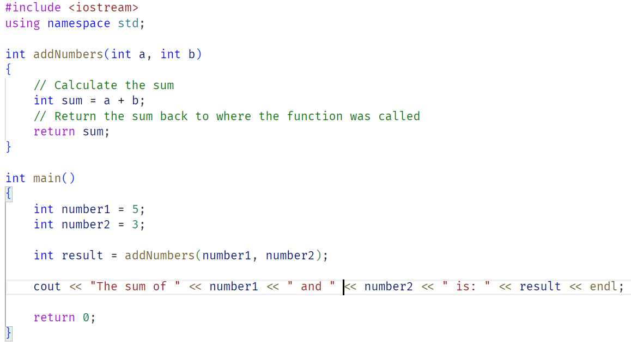
Returning Values From Function

Slide 14
Variable Scope Rules
Scope: Where a variable can be used in your program.
Think of it like “Variable visibility”
Three types we’ll cover:
Global Variables
Local Variables
Static Variables

Slide 15
Global Variables
Definition: Variables declared outside all functions.
Scope: Usable anywhere in the program.
Lifetime: Lives as long as the program runs.
Caution: Overusing globals can make code messy!

Slide 16

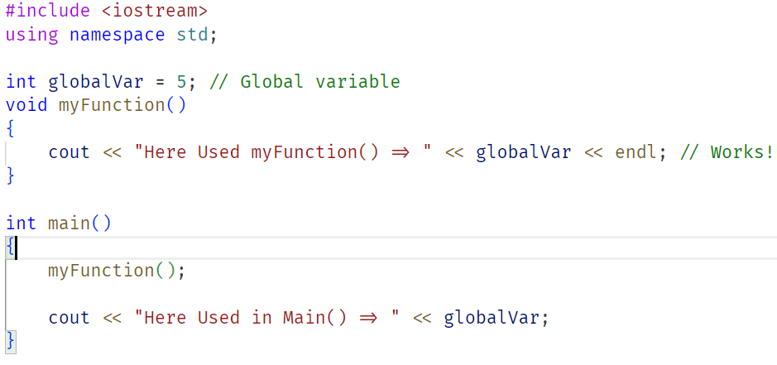
Global Variables Example

Slide 17
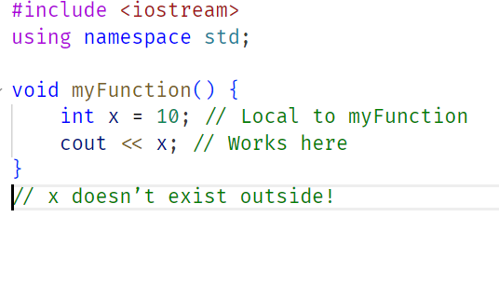
Local Variables
Definition: Variables declared inside a function.
Scope: Only usable within that function.
Lifetime: Born when the function starts, dies when it ends.

Slide 18
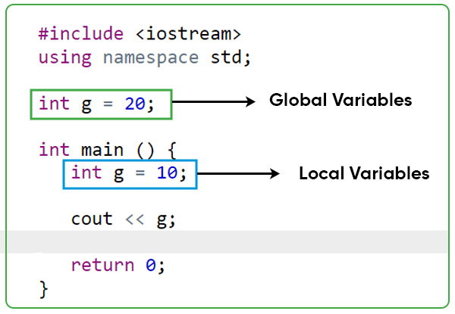
Local Variables

Slide 19
Static Variables
Definition: Retains its value across multiple function calls and persists throughout the program's execution.
Scope:
Static Local Variable: Only usable within that function.
Static Global Variable: Usable anywhere in the program.
Lifetime: Exists throughout the program's execution, even if declared inside a function.

Slide 20

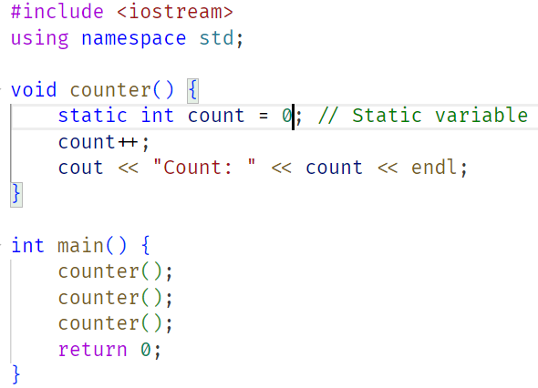
Static Variables

Slide 21
Short Comparison
Local: Only Inside its Block/function (super restricted).
Global: Accessible anywhere in program (wide open).
Static: space for it gets allocated for the lifetime of the program (it remember it’s value).

Slide 22
Passing Data To Functions
Functions often need data to work with.
Two main ways to pass data in C++:
Call by Value: Send a copy of the data.
Call by Reference: Send the address or reference to the data.
Confused 💭😕
Let’s break these down!

Slide 23
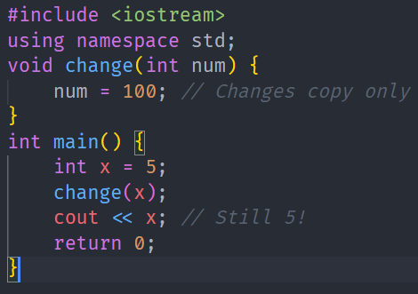
Passing Data To Functions
Call by Value Function gets a copy
Key Point: Changes inside the function don’t affect the original. Use Case: Protect original data

Slide 24
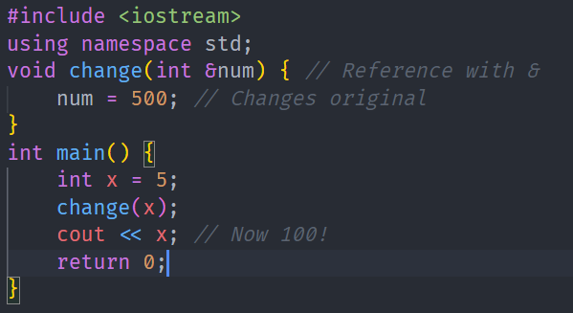
Passing Data To Functions
Call by Reference Function gets a reference (or pointer) to the variable.
Key Point: Changes do affect the original. Pointers work too (Will cover that in last lecture)

Slide 25
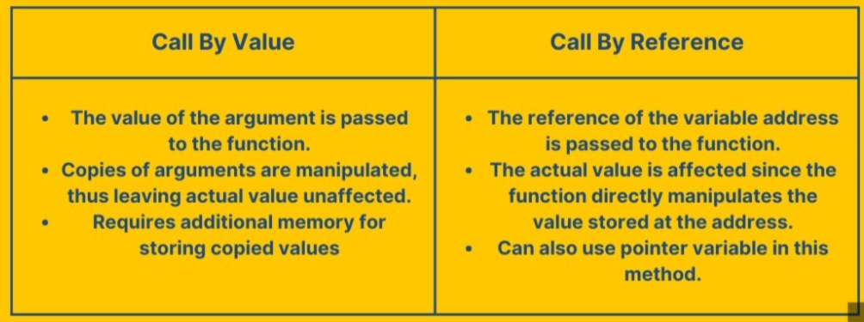

Slide 26
Lecture Completed!
Thank You

