Slide 1
Programming Fundamentals
Lecture 01
Mr. Umar Khayyam

Slide 2
Rules & Regulations
Late comers more than 10 minutes will suffer from deduction of internal marks.
Misbehavior in the class will be PENALIZED.
Minimum attendance will lead you to lower grade. I will not sign any attendance compensation application (SORRY FOR THAT).

Slide 3
Pre-Requisite
No prior programming experience is required!
Course Outline
Course outline is shared in PDF File

Slide 4
Course Goals
Enable students to analyze problem statement and enhance their problem solving ability
Introduce basic concepts and tools of computer programming
Using libraries (code written by others) to read and understand and to include in your program to avoid writing it from scratch
To have focus on general programming principles / techniques and concepts with the help of C / C++ as a tool for implementing these concepts.
Enable the students to deal with provided problems and produce the computational (numerical & algorithms) and analytical solution (actual solution) for the problem.

Slide 5
Computational Solution
A method that uses algorithms and numerical approximations, often performed by computers, to find an approximate solution to complex problems.
Analytical Solution
A method that finds an exact solution to a problem using mathematical expressions and formulas, providing a precise answer if possible.

Slide 6
First Programmer
From the Wikipedia for Ada Lovelace:
Ada Lovelace, was an English mathematician and writer chiefly known for her work on Charles Babbage's early mechanical general-purpose computer, the Analytical Engine. Her notes on the engine include what is recognized as the first algorithm intended to be carried out by a machine. Because of this, she is often described as the world's first computer programmer.

Slide 7
Bad Approach for Programming
First Code and then think!
Good Approach for Programming
Think , Analyze, Brainstorm & then Code.
Key to Success!
Consistent

Slide 8
Program
To describe the sequence of instructions to computer we need a program.
It can be executed by a machine (eg. Calculator, computer).
It can be executed several times, every time with different inputs (like Printing Program).

Slide 9
C++
C++ is general purpose programming language that supports both low-level & High level programming features.
It was developed to provide the power and efficiency of C with additional features that allow for object-oriented programming.
Developed by Bjarne Stroustrup in 1980 and then officially released in 1985.
C++ is commonly used for writing operating systems, device drivers, Game development, Software Engineering (Financial Systems, Desktop Applications, Database Systems).

Slide 10
IDE & Compilers
Integrated Development Environment.
An IDE (Integrated Development Environment) is software that provides tools like a code editor, debugger, and compiler to help developers write, test, and manage code efficiently.

Slide 11
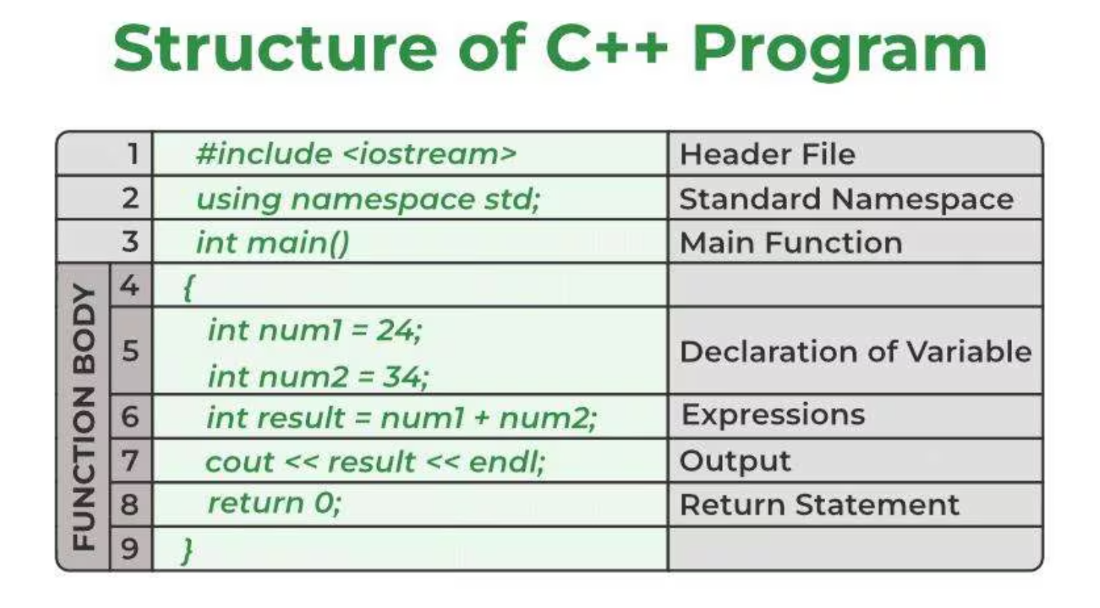

Slide 12
Lecture Completed!
Thank You

