Slide 1
Programming Fundamentals
Lecture 03
Mr. Umar Khayyam

Slide 2
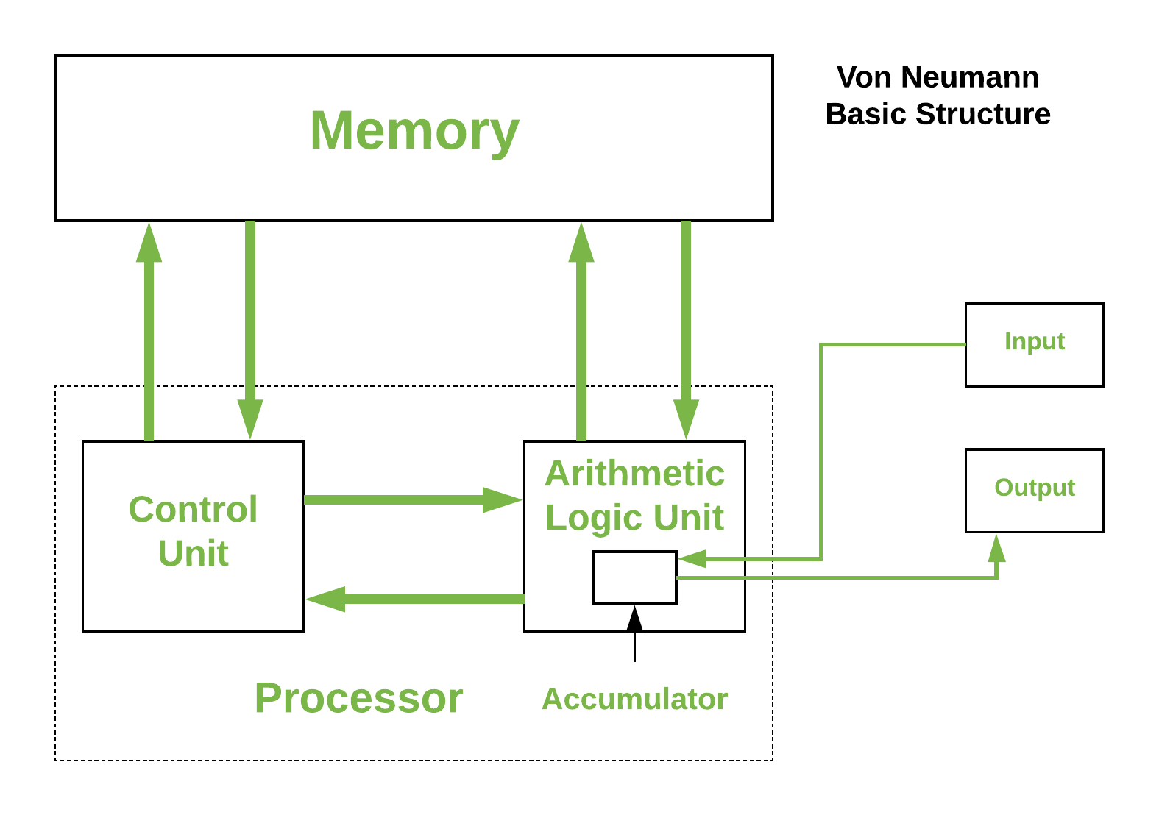
Ven-Neuman Architecture

Slide 3
Ven-Neuman Architecture
Von-Neumann computer architecture design was proposed in 1945.
It defines the structure where a single memory space holds the data and instruction, and processing through a central processing unit.
Historically there have been 2 types of Computers:
Fixed Program Computers – Their function is very specific and they couldn’t be reprogrammed, e.g. Calculators.
Stored Program Computers – These can be programmed to carry out many different tasks, applications are stored on them.
Modern computers are based on a stored-program concept introduced by John Von Neumann.

Slide 4
Ven-Neuman Architecture
It is based on three basic units.
1. Central Processing Unit (CPU)
It is an electrical circuit used for executing instructions of computer program.
Major Components
Control Unit: It handles all processor control signals. It direct all input and output flow.
Arithmetic and Logic Unit: It handles all the calculations the CPU may need. E.g. Addition, Subtraction etc.

Slide 5
Ven-Neuman Architecture
Registers: It refer to high-speed storages areas in the CPU.
2. The Main Memory
Store both data and program instructions.
3. The Input/Output device
Provide means for interaction between the computer and external world.
All the major internal components to the CPU and memory, by the means of Buses.

Slide 6
Flow Charts
Flowchart is a diagram that represents a process or algorithm using different shapes & symbols to denote steps, decisions, & flows.
A flowchart is a diagrammatic representation of an algorithm. A flowchart can be helpful for both writing programs and explaining the program to others.

Slide 7
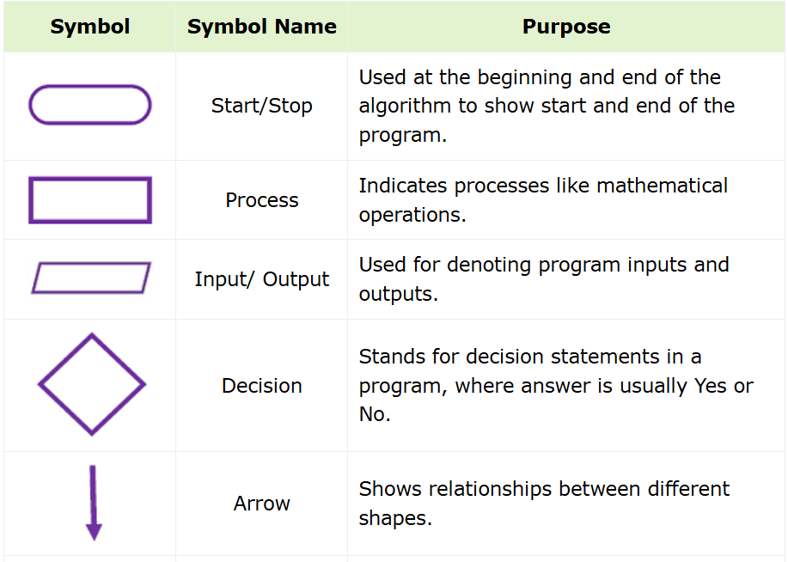
Flow Chart Symbols

Slide 8
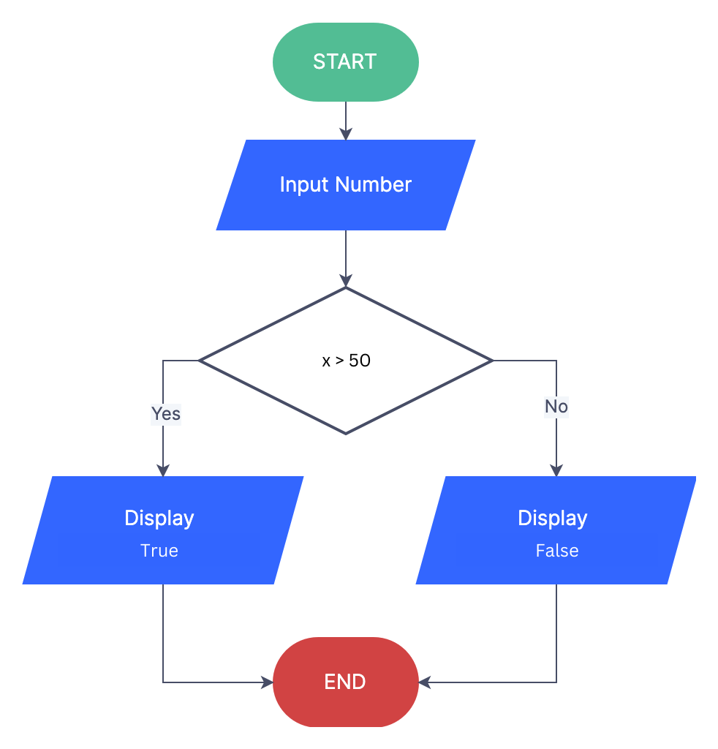
Example

Slide 9
Pseudo Code
Pseudo Code is term which is often used in programming and algorithm based fields.
It is methodology that allows programmer to represent the implementation of an algorithm.
A simplified, high level representation of an algorithm.
Written in plain language that resembles programming logic.

Slide 10
Why Use Pseudo Code
Focuses on Logic rather than syntax.
Easy to understand and write.
Improves the readability of any approach.
It’s one of the best approaches to start implementation of an algorithm.

Slide 11
Example
START
Input x
logic ← (x > 50)
Output "Is x greater than 50: ", logic (with boolalpha)
END
START
Input radius
area ← 3.14159 * radius * radius
Output "The area of the circle is:", area
END

Slide 12
Dry Run Program
A manual simulation of the program to check its flow and behavior.
Assignment 03
1. What is Dry Run Program.
2. Why it used?
3. 1 Example.

Slide 13
Compilation
The process of converting C++ code into machine readable instructions.
The C++ compiler translates source code (.CPP) into executable files (exe).
Types of Program Errors
Syntax Errors:
Occurs when code violates the rule of C++ language.
Missing semicolon, misspelled keywords

Slide 14
Types of Program Errors
Runtime Errors:
Occurs during program execution.
Division by zero. cout array directly.
Detected when the program crashes or behave unexpectedly.
Logic Errors:
Occur when the program produces incorrect output despite running without crashing.
Using Wrong Formulas or Conditions

Slide 15
Lecture Completed!
Thank You

