Slide 1
Programming Fundamentals
Lecture 04
Teacher: Umar Khayyam

Slide 2
Type Casting
Type casting is the process of converting a variable from one datatype to another data type.
Type Casting can be of two type,
It can be explicit (manually by programmer (int)x)
OR
It can implicit (automatically handled by the compiler)

Slide 3
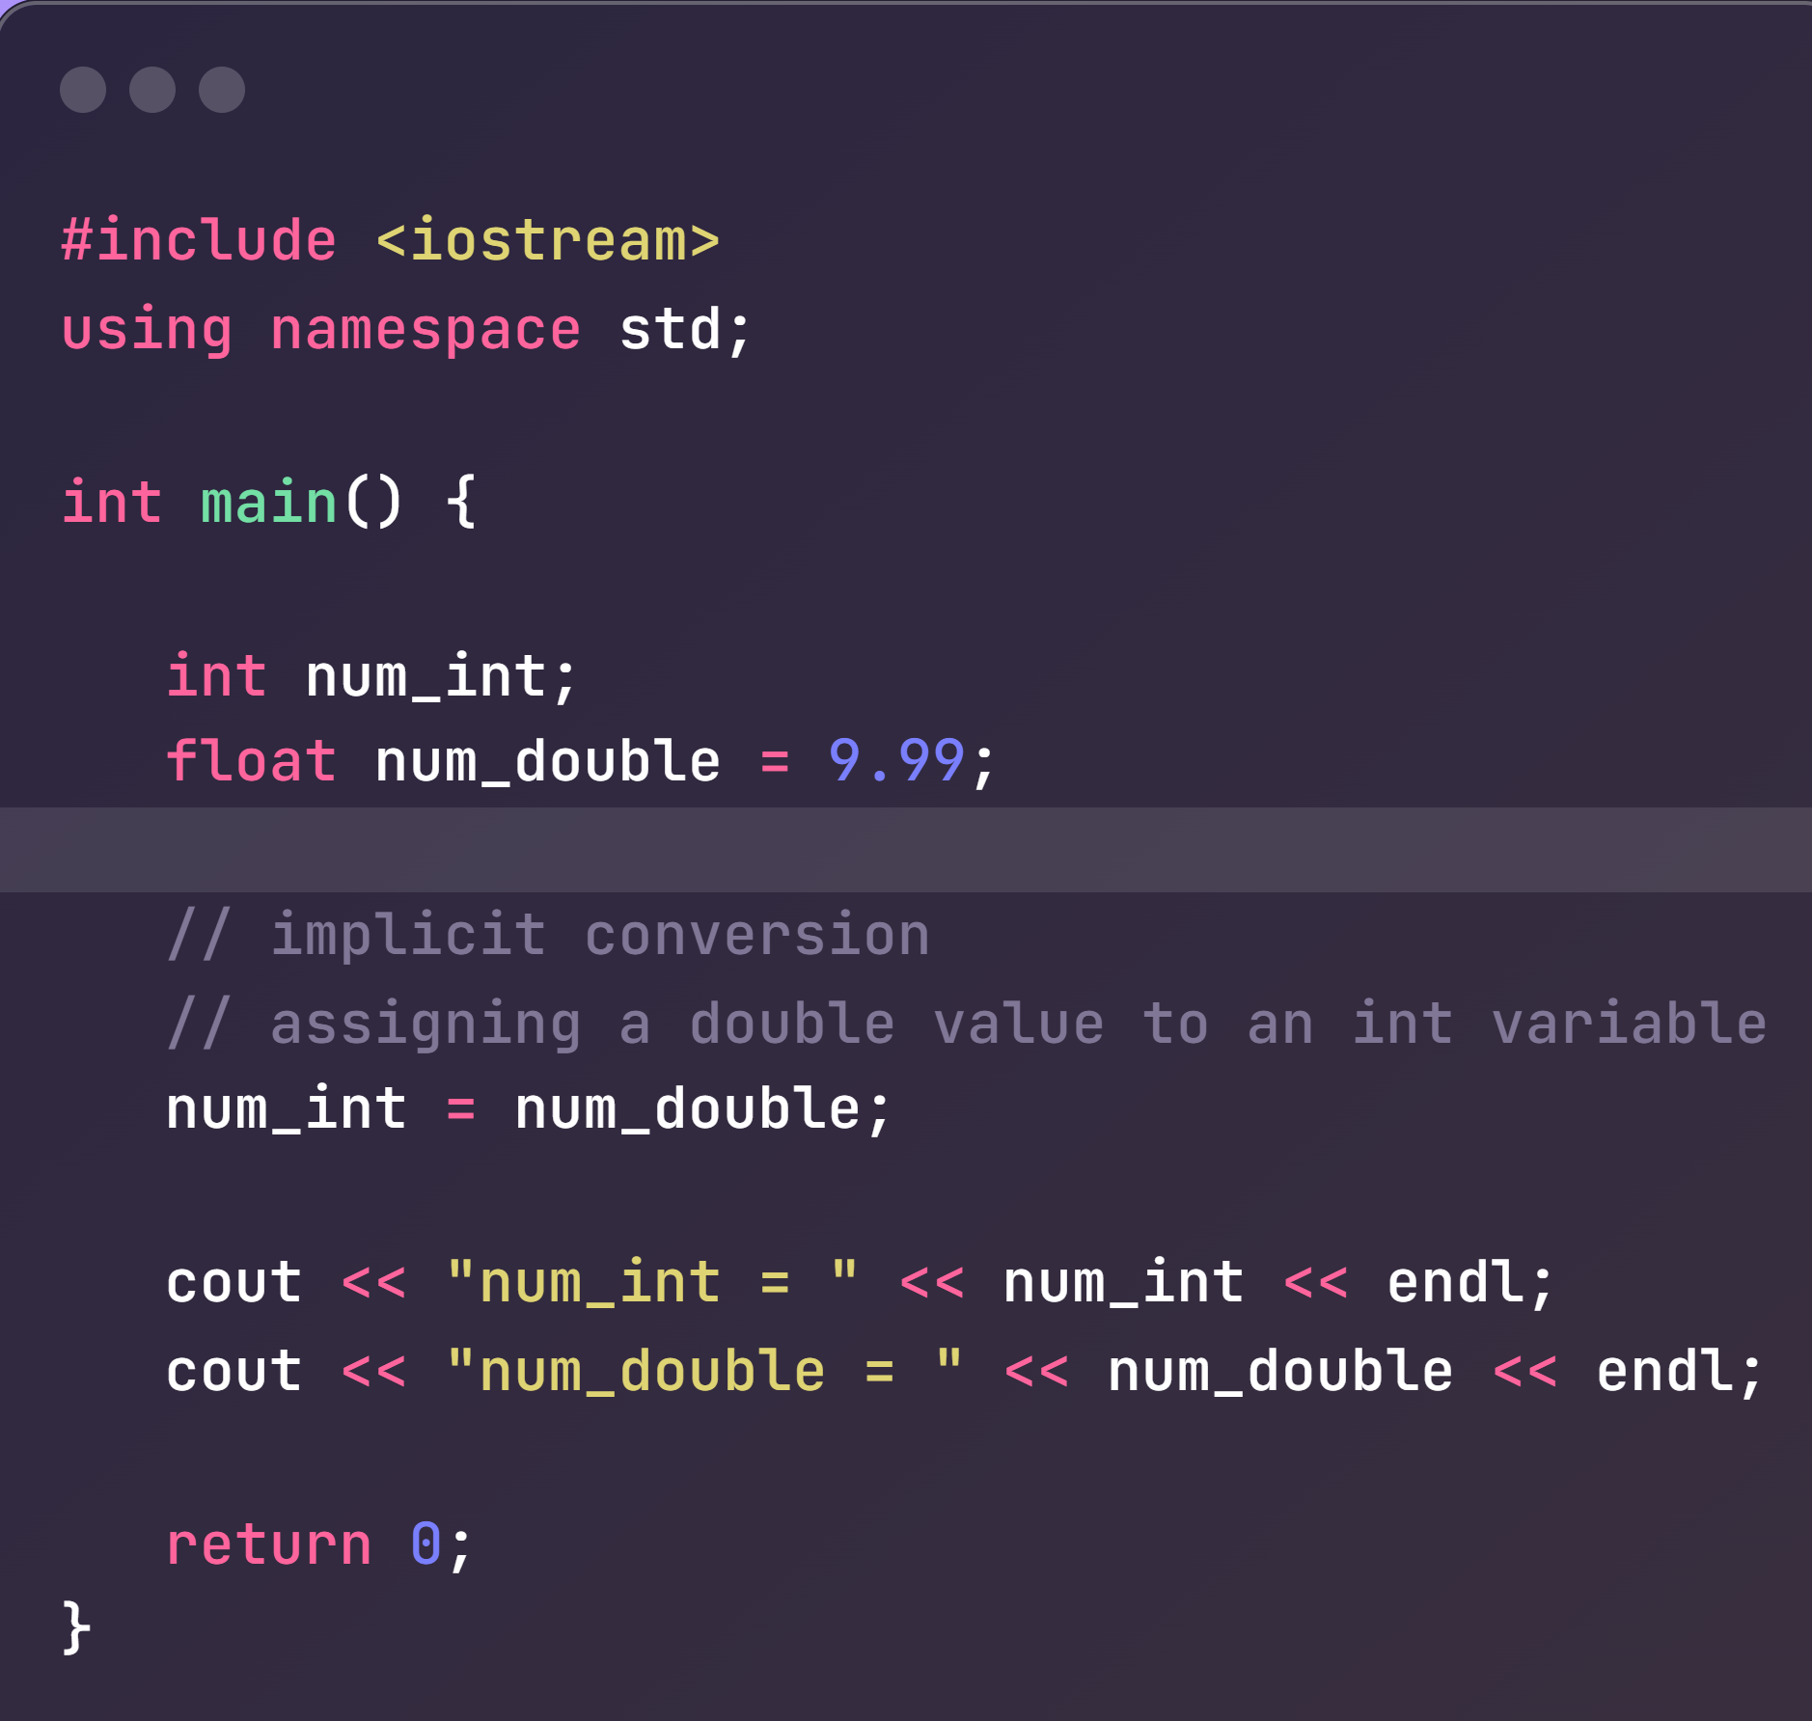
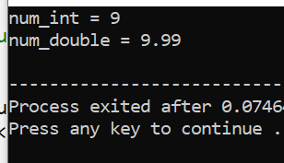
Example
double

Slide 4
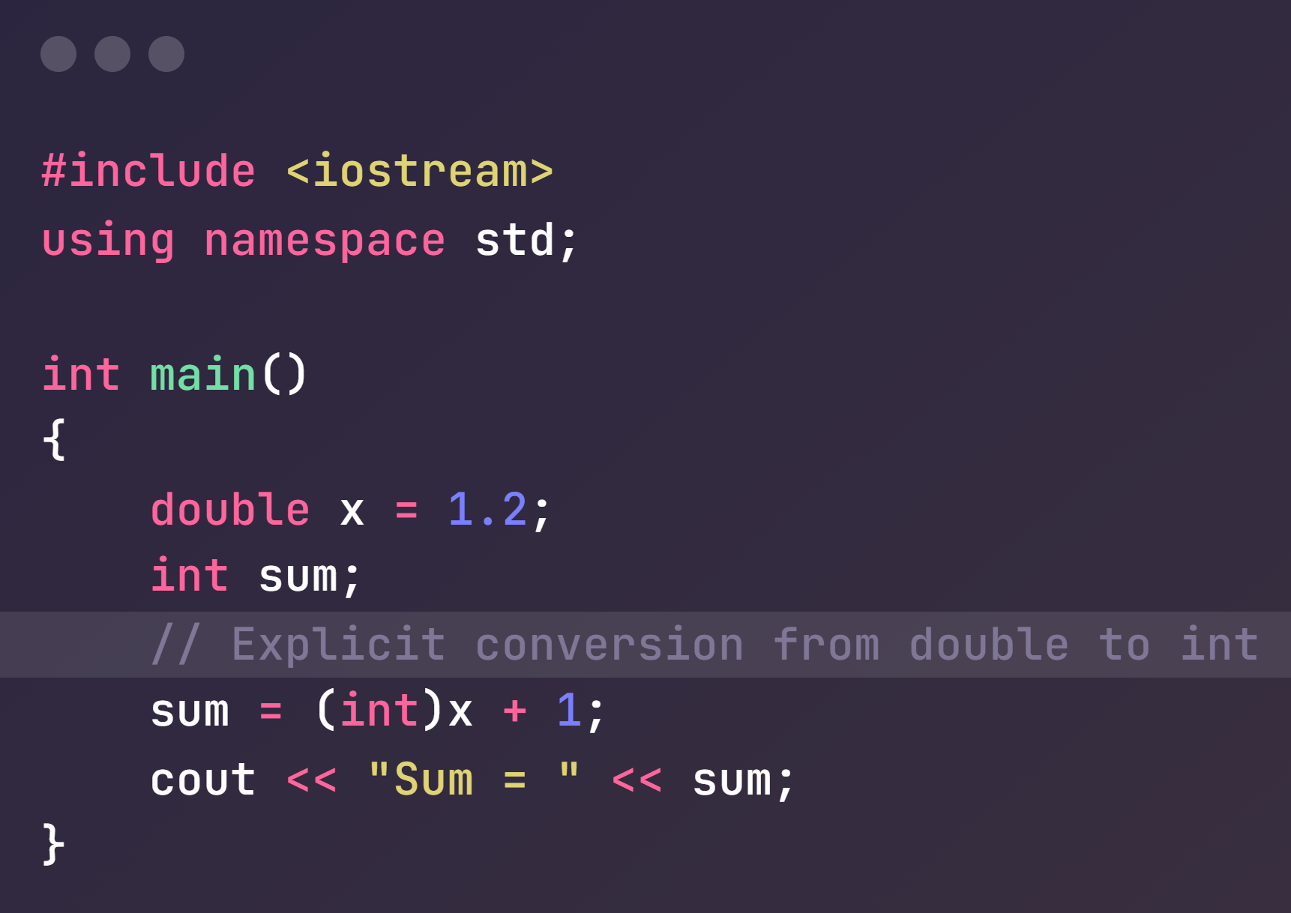
Example
Output:
Sum = 2

Slide 5
IF Statements
IF Statement is used to specify a block of C++ Code to be executed if a condition is true.
If (condition) {
// Block of Code to be executed if condition is true
}
int x = 20;
Int y = 18;
If (x > y) {
cout << “x is greater than y”;
}

Slide 6
Else Statements
Else Statement is used to specify a block of code to be executed if the condition is false.
If (condition) {
// Block of Code to be executed if condition is True
}
else
{
// Block of Code to be executed if condition is False
}

Slide 7
Else-IF Statements
Else-IF Statement is used to specify a New Condition if the first condition is False.
If (condition) {
// Block of Code to be executed if condition is True
}
else if (condition 2)
{
// Block of Code to be executed if condition is True
}
else
{
// Block of Code to be executed if condition is False
}

Slide 8
Conditional Operator (Ternary Operator)
There is also a short-hand if else, which known as the ternary operator.
It can be used to replace multiple lines of code with a single line, and is often used to replace simple if else statement.
Syntax
Variable = (condition) ? expressionTrue : expressionFalse;

Slide 9
Conditional Operator (Ternary Operator)
Simple If Else Example
Int age = 15;
If (age > 18) {
cout << “Eligible to Apply for Admission”;
} else {
cout << “Not Eligible to apply”;
}
Using Conditional Operator (Ternary Operator)
int age = 15;
String result = (age > 18) ? “Eligible” : “Not Eligible”;
cout << result;

Slide 10
Lecture Completed!
Thank You

