Slide 1
Web Design & Programming
Lecture 01
Mr. Umar Khayyam

Slide 2
Introduction
We are going to get combine classes for web design & development.
Course Goals
After this course students will have hand on experience in web design using different tools and web programming in JavaScript.
Students will gain hands on experience on HTML, CSS, JavaScript, Joomla, Maya for Animations and much more.

Slide 3
Internet
The Internet is a global network of interconnected computers that enables the exchange of information, communication, and access to services and resources through protocols like HTTP, TCP/IP, and others.
TCP/IP (Transmission Control Protocol)
Transmission Protocol is a protocol that organizes and sorts data. It’s responsible for breaking down data into packets, & sending them.
It is developed by the U.S. Department of Defense to support the construction of the internet.
Unique identifiers for devices on a network.

Slide 4
HTTP (Hyper Text Transfer Protocol)
An application-layer protocol for transmitting hypermedia (HTML) documents over the Internet.
Methods: GET, POST, PUT, DELETE, etc.
Tier 3 Architecture
Presentation Layer
User Interface (UI) that interacts with users.
Business Logic Layer
Process & handles application logics (e.g. API’s, servers).
Data Layer
Store & retrieves data (e.g. databases).

Slide 5
Types of Web Pages
Static Web Pages
Pre-built content is displayed as-is.
No user interaction or dynamic changes.
Example, Portfolio website, informational websites.
Dynamic Web Pages
Content generated in real-time based on user inputs or server data.
Data dynamically data changes. e.g (forms, likes, comments.)
Example: E-commerce sites, social media platforms.
Technology: JavaScript, server-side scripting (Php, Node.Js)

Slide 6
Responsive Web Page
Adapt to different screen sizes and devices.
Technologies: CSS media queries, frameworks like tailwind css, bootstrap.
Single Page Application
Dynamic updated without full reloads.
Technologies: React, Next Js, Angular
Example: Gmail, Trello

Slide 7
HTML
HTML (Hyper Text Markup Language) is the standard language for creating web & web applications.
Purpose
It describes the structure of a Web Page.
Uses “tags” to describe content & layout.

Slide 8
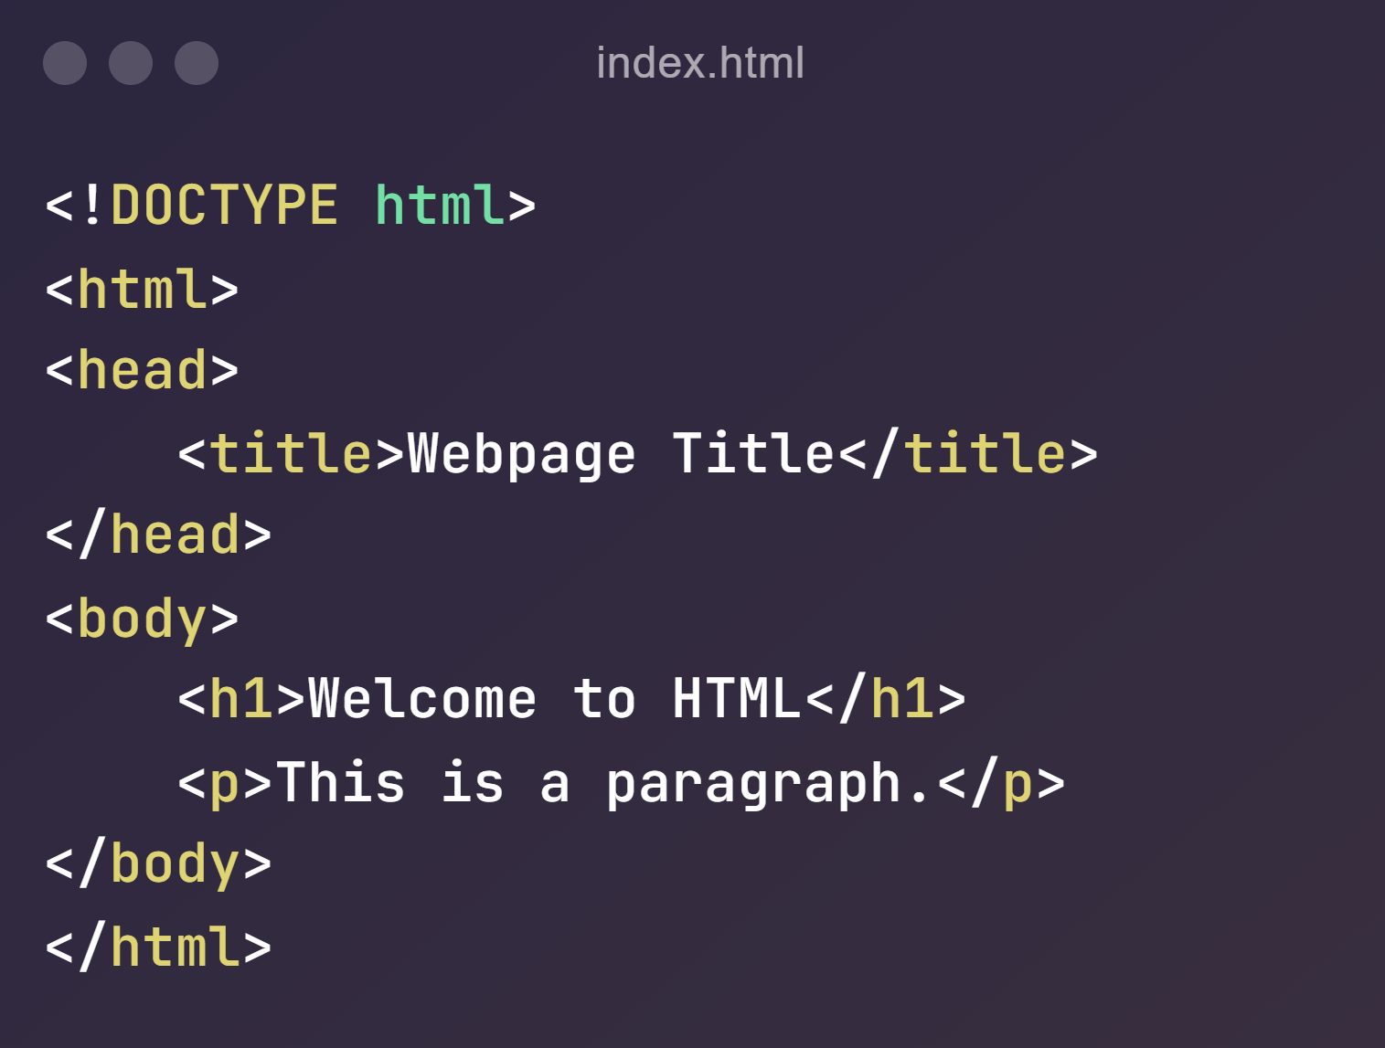
Basic Structure of HTML Document

Slide 9
Key Elements
<!DOCTYPE html>
Declare the document type (HTML5)
<html>
Root element containing all HTML content
<head>
Meta data & resources (e.g. title, styles, scripts)
<body>
Visible content of the web page.

Slide 10
HTML
HTML (Hyper Text Markup Language) is the standard language for creating web & web applications.
Purpose
It describes the structure of a Web Page.
Uses “tags” to describe content & layout.

Slide 11
HTML Tags
<h1> to <h6>: Used for Headings .
<p>: Defines a paragraph.
<ul> : Create an unorder list.
<ol> : Create an Ordered list.
<a>: Create a hyperlinks
<img>: Embeds an Image

Slide 12
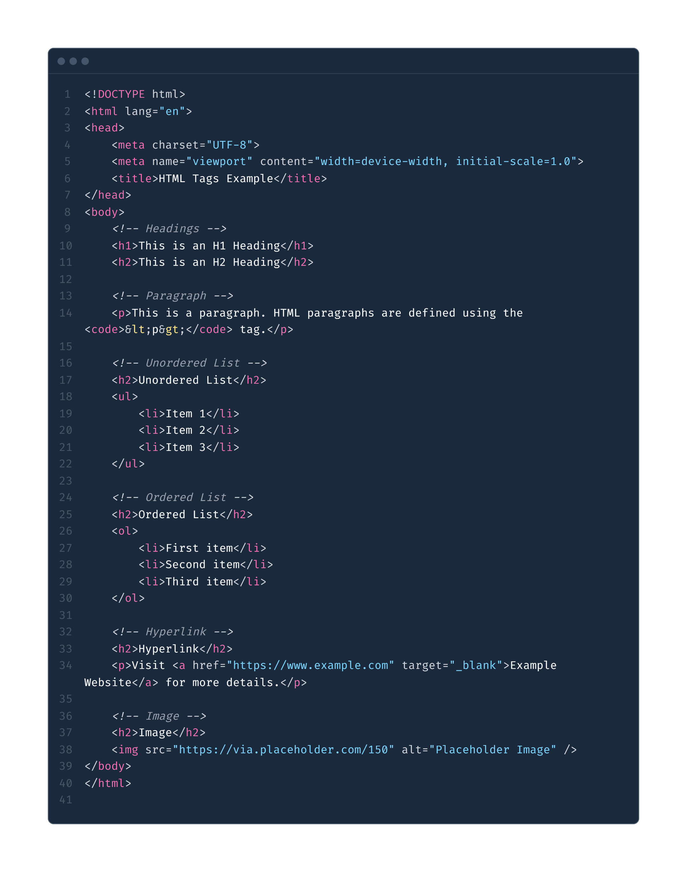

Slide 13
Lecture Completed!
Thank You

