Slide 1
Web Design & Programming
Lecture 02
Mr. Umar Khayyam

Slide 2
What is CSS?
CSS stands for Cascading Style Sheets.
Purpose:
Style & layout HTML content (e.g. colors, fonts, spacing)
Works alongside HTML to enhance web pages visually.
Why Use CSS?
CSS is mainly used to define styles your web pages, layout in display for different devices and screen sizes.

Slide 3
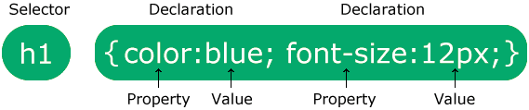
CSS Syntax
The selector is normally the HTML Elements you want to style.
Each declaration consists of a property and a value.
W3Schools: http://www.w3schools.com/css/

Slide 4
Applying CSS
There are 3 main ways to CSS style can be applied:
Inline:
Inline with HTML
You can write CSS directly into an HTML tag using “style” attribute.
Internal: Is to define your styles once in the document (<head>) section.
External:
The ideal way to define styles for your HTML elements is to put the definitions in a separate style sheet document.
Then any page that includes the CSS file will inherit the same styles.

Slide 5
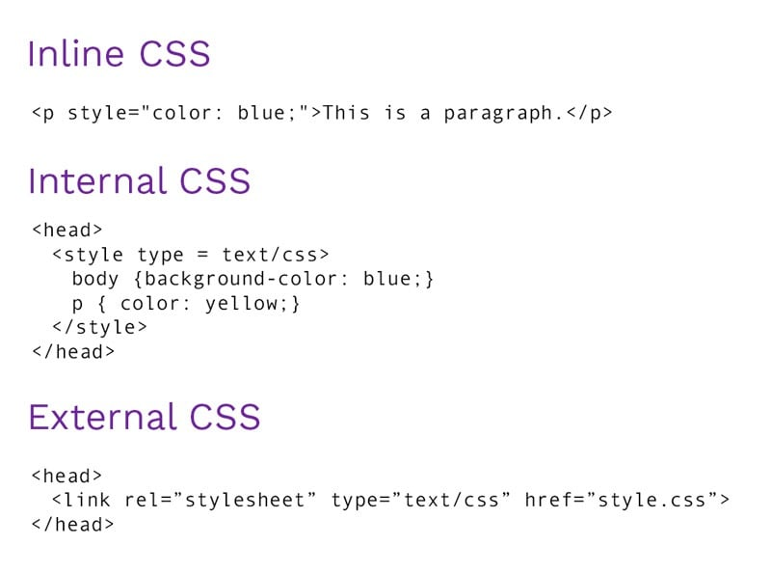
Applying CSS

Slide 6
Advantage of Separate Style Sheets
Reduce File Size: Each CSS definition is written only once.
Easier Updating: You only have to change styles in one place for them to change site-wide.
Separates the work of styling & creating content: You can create all your HTML pages first, applying sensible semantic markup, classes names and IDs, and then do all your design work later on your style sheet.

Slide 7
CSS “id” Selectors
CSS allows you to specify your own selectors called “id” & “class”.
The id selector is used to specify a style for a single, unique element.
The id selector uses the id attribute of the HTML element, and is defined with a ‘#’.
HTML <p id=“intro”>some text here</p>
CSS #intro { color:red; }

Slide 8
CSS “class” Selectors
The class selector is used to specify a style for a group of elements.
This allow you to set a particular style for many HTML elements with the same class.
The class selector uses the HTML class attribute, and is defined with a “.”.
Example:
HTML
<p class=“center”>some text here</p>
<p class=“center”>some text here</p>
CSS .center {text-align:center;}

Slide 9
What is Difference Between “id” & “Class
ID’s and classes functions the same way – they can both provide the same styling functionality to an HTML element, however…
IDs are unique, each element can only have one ID, and that ID can only be on the page once.
Classes are not unique, multiple HTML elements can have the same class.
IDs can be used to style elements that are different from anything else on the page.
Classes can be used to style multiple elements on a single page that have things in common, like font size, color, or style.

Slide 10
Before CSS
In the old days, when you wanted to change font of your HTML, you would use a <font> tag, like
<font face = “Times”> …
Problem with Old Approach
Because your styles are embedded into your content, it’s laborious to write.
You have to repeat the same styles over and over again, wherever they appear on the page and across whole site.

Slide 11
Some CSS Selectors
You can apply CSS by HTML elements name.
p {...}
h1 {...}
You can apply CSS using id and class selector
#menu {...}
.item {...}
You can apply css to all selector using *
*{...}
You can select multiple selectors for same style.
p,h4,#menu {...}
You can apply css to body
body{...}

Slide 12
Mainly CSS used Properties
Margin:
Margins are used to create space around elements, outside any defined borders.
Padding:
Padding is used to create space around an elements, inside of any defined borders.
Colors:
Colors are specified using predefined color names, or RGB, HEX, Color codes.
Width/Height:
Defines the dimensions of an element.
Values : auto, px, %, rem, etc.

Slide 13
Mainly CSS used Properties
Display:
Define the type of rendering box used for an element.
Values: flex, grid, block, inline, none etc.
Property | Use Case
Block | Basic Container for layout sections
Inline | Styling text and inline elements
Flex | Aligning items dynamically in one line or columns
Grid | Structuring layouts with rows/columns

Slide 14
Mainly CSS used Properties
Border:
Sets the border of the element.
Syntax: border: 1px solid black;
Font-size:
Specifies the size of the text.
Values: px, rem, % etc.
Font-family:
Sets the fonts of the text.
Values: font-family: Arial, sans-serif.

Slide 15
Lecture Completed!
Thank You

