Slide 1
Web Design & Programming
Lecture 03
Mr. Umar Khayyam

Slide 2
HTML Tables
HTML table allow web developers to arrange data into rows and columns.
Used to organize and display data in tabular format.
Purpose:
Display structured data like reports, schedules, and pricing.
Ensure clear data representation for reading it easily.

Slide 3
Tables Basic Tags
<table>
Define the table structure.
<tr>
Represent a table row.
<th>
Represent Header cells.
<td>
Standard Data cells.

Slide 4
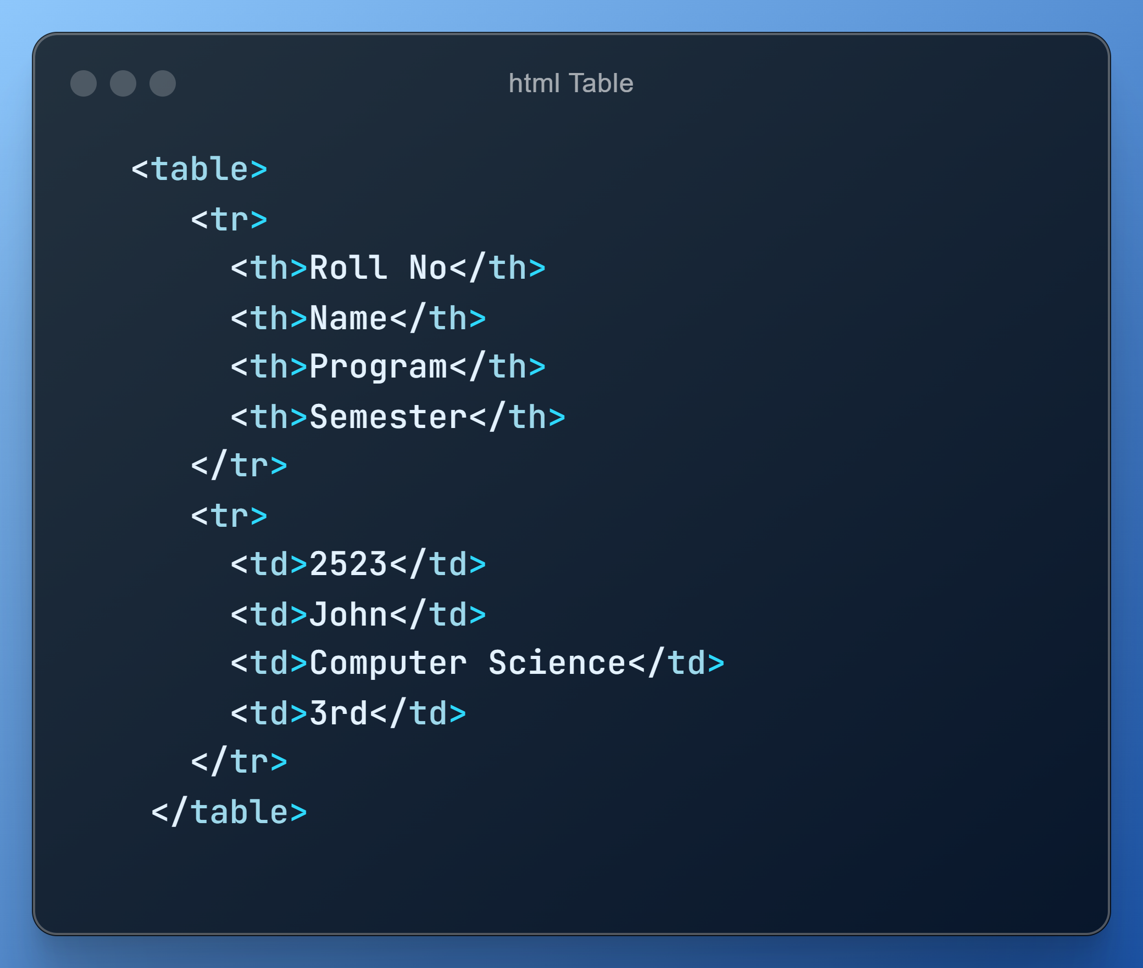

Slide 5
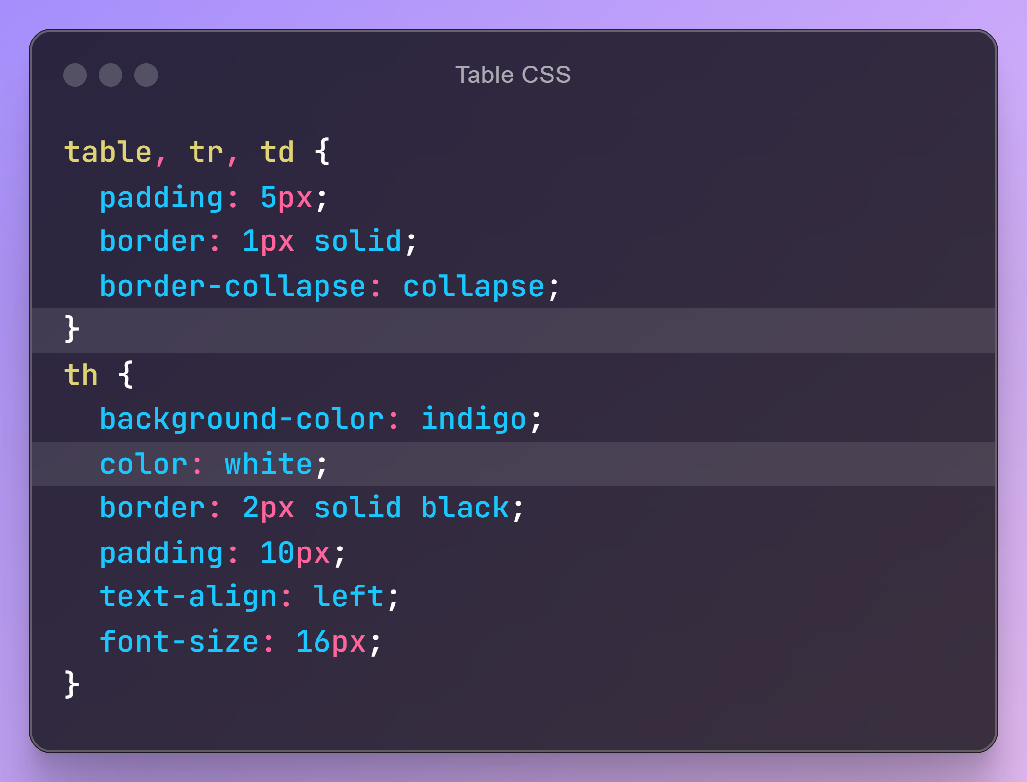

Slide 6
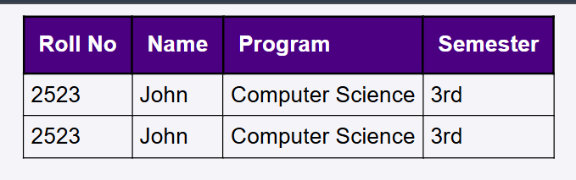

Slide 7
Complex Style Sheet
Advanced CSS implementations with rules, selectors, and properties.
Purpose:
Achieve modern interactive and responsive web apps.
Handle diverse devices and user interactions.
Example:
Custom animations & transitions.
Media queries for responsive designs.

Slide 8
Complex Style Sheet
Pseudo Classes:
It is used to define a special state of an element.
For Example:
Style an element when the user moves the mouse over it.
Style an element when it gets focus.
div : hover {
background-color: blue;
}

Slide 9
Complex Style Sheet
Pseudo Element:
It is used to style a specific parts of an element.
For Example:
Style the first letter or line, of an element.
p::before { content: “Paragraph: "; font-size: 18px; color: green; }

Slide 10
Complex Style Sheet
CSS Transition:
CSS transition allows you to change property values smoothly, over a given duration.
.submit-btn{
transition: background-color 0.9s;
} .submit-btn:hover {
background-color: red;
transform: scale(1.1);
}

Slide 11
Complex Style Sheet
CSS Animations:
CSS allows animations of HTML elements without using JavaScript.
CSS animations allow elements to transition between various styles over a set duration.
/* The animation code */
@keyframes example {
from {background-color: green;}
to {background-color: black;}
} /* The element to apply the animation to */
div {width: 100px; height: 100px; background-color: red; animation-name: example; animation-duration: 4s;
}

Slide 12
Complex Style Sheet
Media Queries:
These are a feature of CSS used to apply styles based on the characteristics of the user's device, such as screen size, resolution, orientation, or other properties.
It’s allow a webpage to adapt to different screen sizes (like desktops, tablets, and mobile devices).

Slide 13
Complex Style Sheet
Media Queries:
@media (condition)
{
/* CSS rules for this condition */
}
@media (min-width: 600px)
{
body {
background-color: lightgreen;
}
}

Slide 14
Lecture Completed!
Q & A

