Slide 1
Web Design & Web Programming
Lecture 08
JavaScript Functions and Objects
Mr. Umar Khayyam

Slide 2
Introduction
Two fundamental concepts in JavaScript are functions and objects, which enable developers to write reusable and efficient code.
Function
Function in JavaScript is reusable code designed to perform particular task. Functions help in structuring and organizing code efficiently.

Slide 3
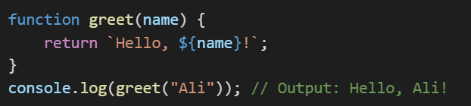
Declaring Function
The Function greet takes a parameter name and return greeting message.
The function can be called before its declaration due to hoisting.

Slide 4
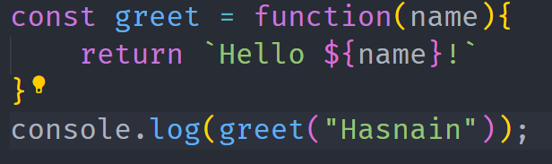
Function Expression
In this case, the function is stored in a variable.
Function expressions are not hoisted, meaning they cannot be called before they are defined or declared.

Slide 5
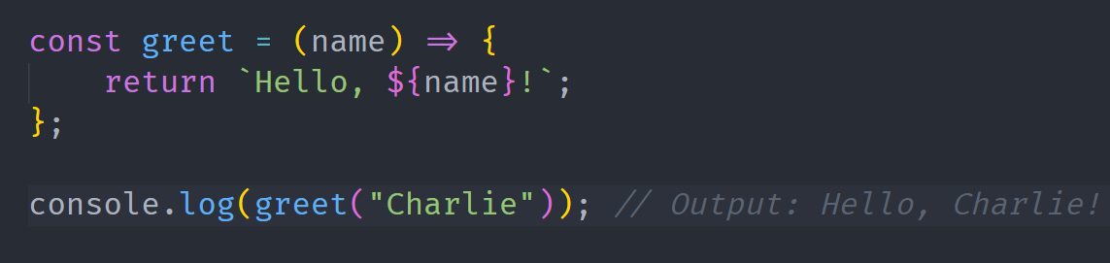
Function Expression
Arrows functions provide more concise syntax & don’t have their own “this” context.

Slide 6
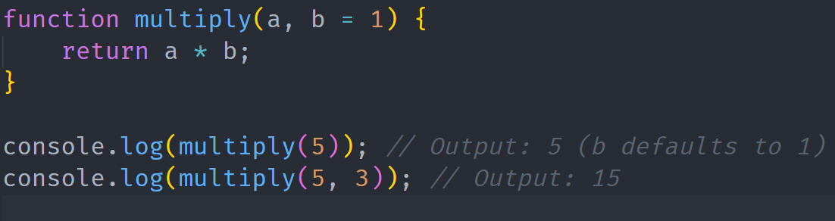
Function Parameter & Default Values

Slide 7
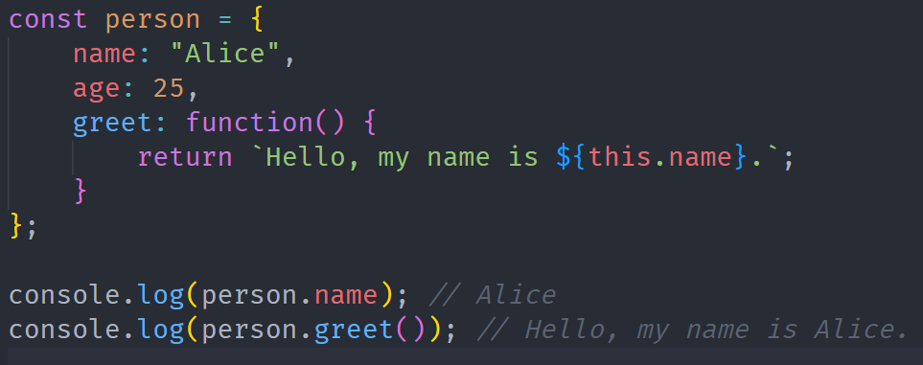
Objects In JavaScript
An Object is a collection of key-value pairs, where keys are called properties.
Objects help store relevant data together.

Slide 8
Lecture Completed!
Q & A

