Slide 1
Web Design & Web Programming
Lecture 09
Introduction to Maya & Modeling Basic in Maya
Mr. Umar Khayyam

Slide 2
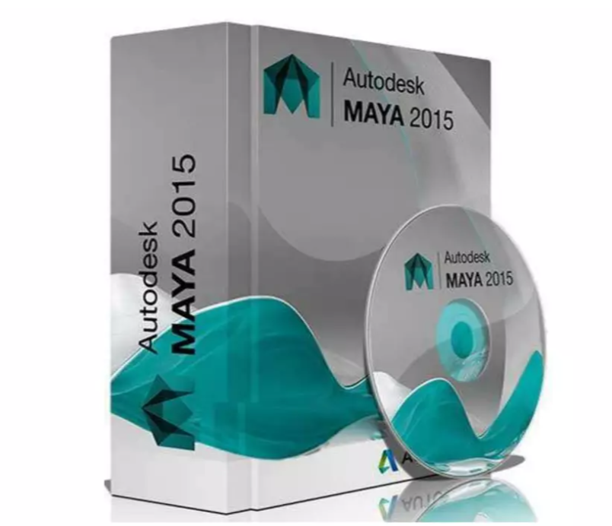
Maya
Web Link:
https://www.autodesk.com/products/maya/overview

Slide 3

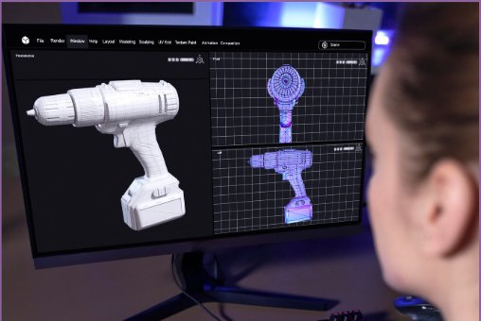
What is Maya?
Maya is a powerful 3D computer graphics software
used for creating 3D models, animations, simulations, and rendering.
Maya is professional 3D software for creating realistic
characters and blockbuster-worthy effects. (From Maya Web Page)
Where it is Used?
It is commonly used in industries like film, video games, and virtual reality (VR), 3D Web Apps to create lifelike models and environments.

Slide 4

Why It is Important for Web Dev!
Web developers increasingly use 3D models and animations for immersive experiences in websites, games, and interactive applications.
Web-Based 3D Experiences
Maya helps in creating these elements to enhance user engagement.

Slide 5
Web-Based 3D Experiences
With Three.js, web developers can integrate 3D models from Maya into interactive websites.
UI/UX Enhancements
3D animations and effects enhance user engagement.
E-Commerce & Product Visualization
Maya helps create photorealistic product models that can be embedded in websites.
Motion Graphics for Websites
Using Maya for pre-rendered animations that can be incorporated into web design (e.g., intro sequences, background animations).

Slide 6
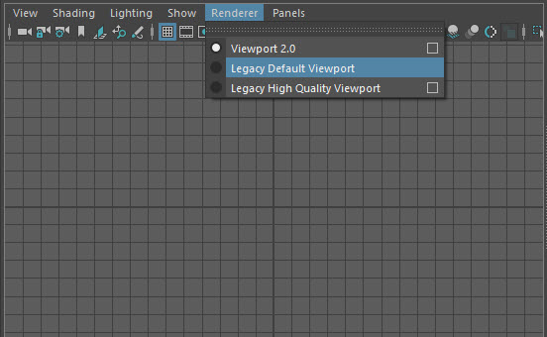
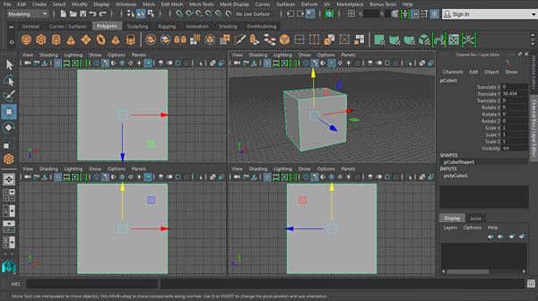
User Interface Overview
Viewport
It display your 3D scene.

Slide 7
Outliner
Shows the hierarchy of objects in your scene.

Slide 8
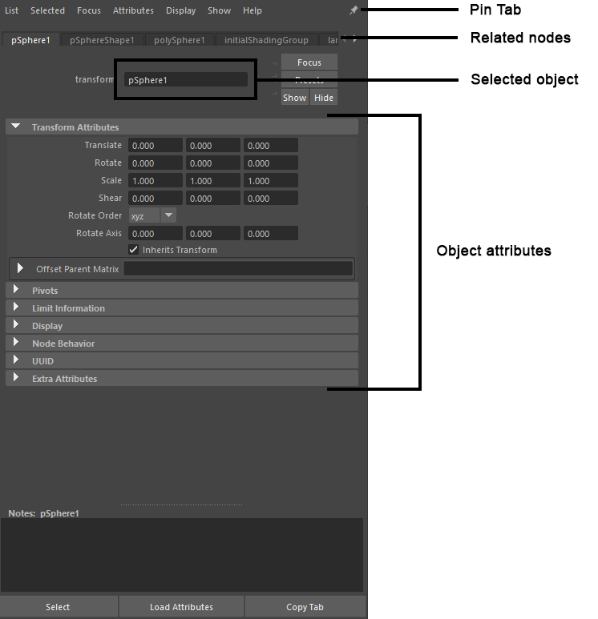
Attribute Editor
It controls the Object Properties.

Slide 9
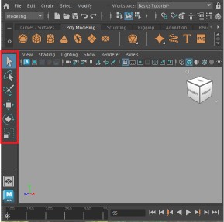
Tool Box
Provides access to various tools for modeling, animation, and rendering..

Slide 10
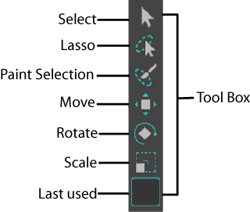
Tool Box

Slide 11
Basic Modeling in Maya
Polygonal Modeling
The most common method for creating 3D models, using vertices, edges, and faces to form shapes.
NURBS Modeling
It stands for Non-Uniform Rational B-Splines Uses curves and surfaces to create smooth, high-quality shapes.

Slide 12
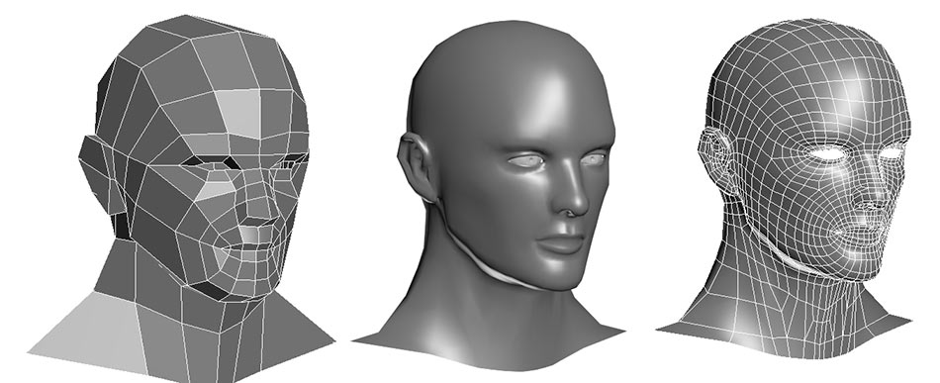
Polygonal Modeling

Slide 13
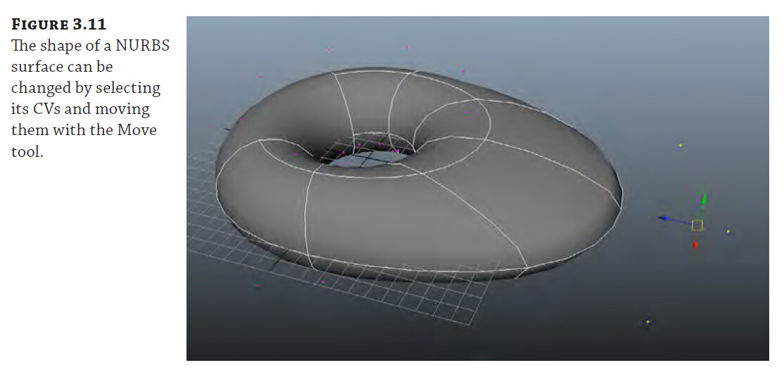
NURBS Modeling

Slide 14
Using 3D Models in Web Development
WebGL
A JavaScript API for rendering interactive 3D models within web browsers.
Three JS
A popular JavaScript library that simplifies working with WebGL and 3D models.

Slide 15

Should All Web Developers Learn Maya?
Not necessarily.
Maya is mainly useful for specialized web applications involving 3D graphics, interactive design, and gaming.
However, web developers working on traditional websites or web apps might not need it unless they deal with 3D content regularly.

Slide 16
Conclusion
Maya is a powerful tool for creating high-quality 3D models and animations.
As a web developer, you can use Maya to bring interactive 3D content to your websites and applications, providing richer and more immersive user experiences.

Slide 17
Lecture Completed!
Q & A

