Slide 1
Web Design & Web Programming
Lecture 10
JavaScript Switch Statement & Control Statements (Break and Continue)
Mr. Umar Khayyam

Slide 2
Introduction
JavaScript provides various control structures to handle decision-making and loops.
Among them, the switch statement allows multiple selection logic, offering an alternative to lengthy if-else statements.
Additionally, the break and continue statements control the flow of execution, and labeled versions provide even finer control.

Slide 3
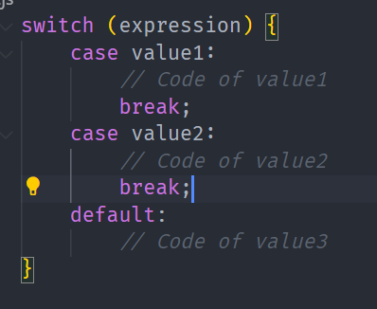
Switch Statement in JavaScript
The Switch statement is used to perform different actions based on different conditions.
It is an alternative to multiple if-else statements when testing a single variable against multiple values.

Slide 4
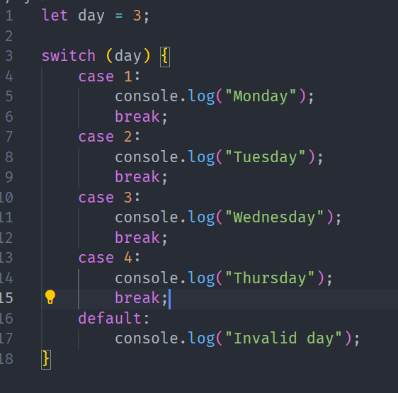
Switch Statement Example
Key Point:
Each case should have a break to prevent fall-through to the next case.

Slide 5
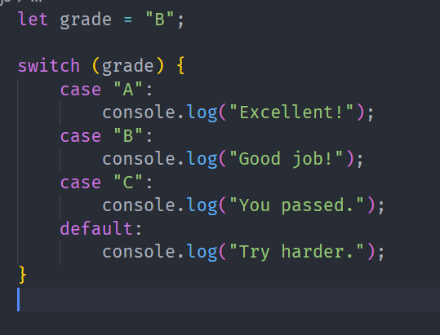
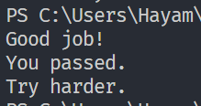
Switch Statement Example

Slide 6
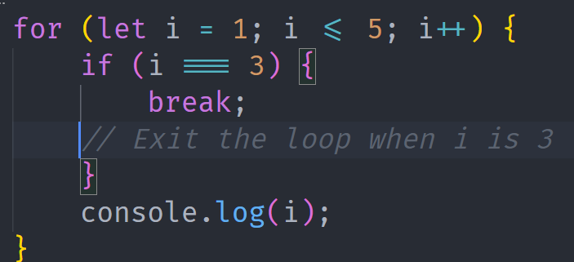

Break & Continue Statements
Both break & continue alter the flow of loops and switch statements.
Break Statements
The break statement terminates the loop or switch and jumps to the next statement outside the block.

Slide 7
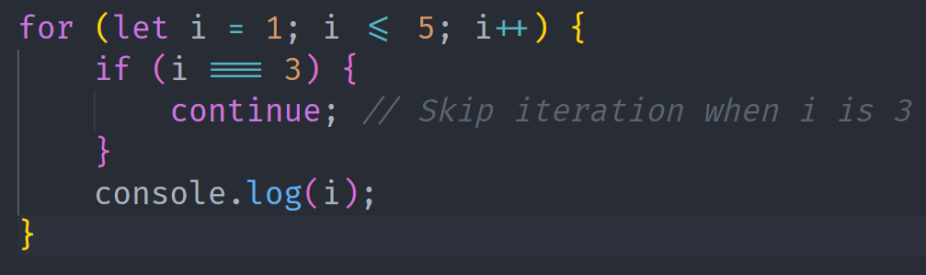
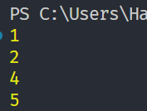
Continue Statements
The continue statement skips the current iteration and moves to the next iteration of the loop.

Slide 8
Lecture Completed!
Q & A

