Slide 1
Web Design & Web Programming
Lecture 06
Introduction to Client-Side Programming (JavaScript)
Mr. Umar Khayyam

Slide 2
What is Client-Side Programming
It is the program that runs on the client machine (browser) and deals the user interface & other processing that can happen on client machine.
OR Program or Block of Code executed in the browser to handle user interactions.
Key Characteristics
Runs on the user device not on the server.
Improves performance by reducing server load.

Slide 3
Client-Side Programming
Key Characteristics
Interact with local storage.
Sending request for data to server.
Send request to server.
Example
Form Validation, Animations & Dynamic content updates.

Slide 4
Importance of Client-Side Programming
User Experience
Immediate feedback (e.g. form validations, errors)
Efficiency
Reduces the need for server requests.
Interactive Features
Dropdown menus, sliders, & modals
Popular Technologies
HTML, CSS, JavaScript, Ajax, VBScript

Slide 5
What is Validation
Ensuring user input meets predefined rules before submission.
Common Issues
Missing Fields.
Incorrect formats (e.g. invalid email address).
Impact of Poor Validation
Security risks.
Frustrating user experience.

Slide 6
What is Validation
Ensuring user input meets predefined rules before submission.
Common Issues
Missing Fields.
Incorrect formats (e.g. invalid email address).
Impact of Poor Validation
Security risks.
Frustrating user experience.

Slide 7
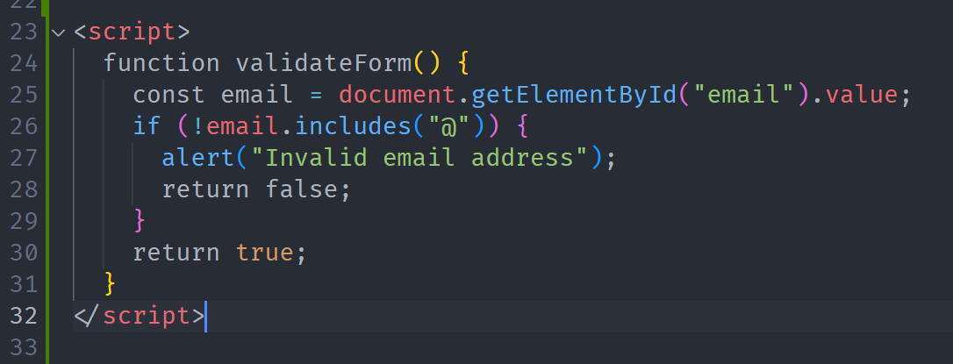
Example of Form Validation

Slide 8
Key Points of JavaScript Validation
Client-side validation enhances performance.
Always combine with server-side validation for security.
Summary
Client-side programming enriches interactivity.
Validation prevents errors and improves security.
JavaScript is a versatile tool for both tasks.

Slide 9
Lecture Completed!
Q & A

