Slide 1
ULI101: Introduction to Unix / Linux and the Internet Week 4: Lesson 2 file permissions
Photos and icons used in this slide show are licensed under CC BY-SA

Slide 2
Lesson 2 topics
File Permissions
Purpose
Directory vs. Regular File Permissions
Changing File Permissions (chmod)
Setting File Permissions for Newly Created Directories and Regular Files (umask)
Demonstration
Perform Week 4 Tutorial
Investigation 2
Review Questions (Questions 6 – 12)

Slide 3


File permissions
File Permissions
Since Unix / Linux operating systems allow for multiple user accounts, it is essential to have a system to share or limit access to directories and files contained in those file systems.
When directories and regular files are created, they are assigned to an owner (typically the username of the creator).
To allow or limit access to those files and directories, those files and directories are assigned to an initial group referred to as a "primary group".
Users that own those directories and regular files are referred to as users, users that belong within that same primary group are referred to as same group members, and those users are do NOT belong to a particular group are referred to as other group members.

Slide 4
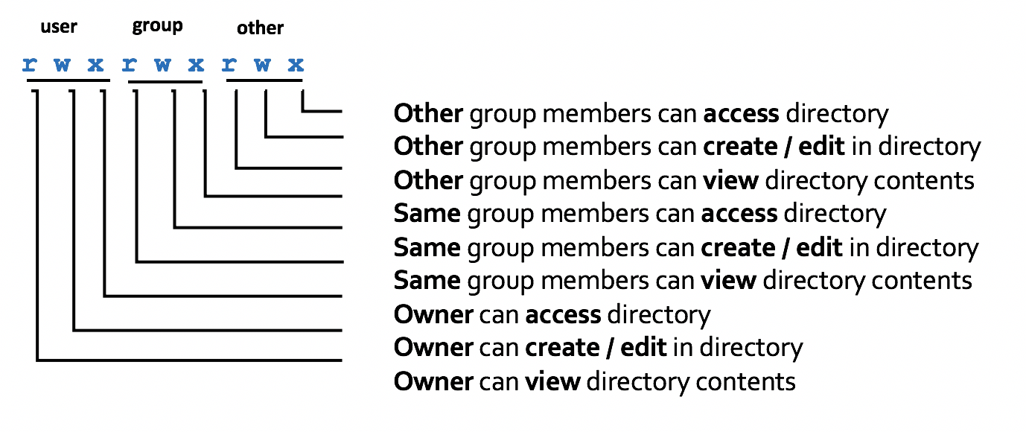
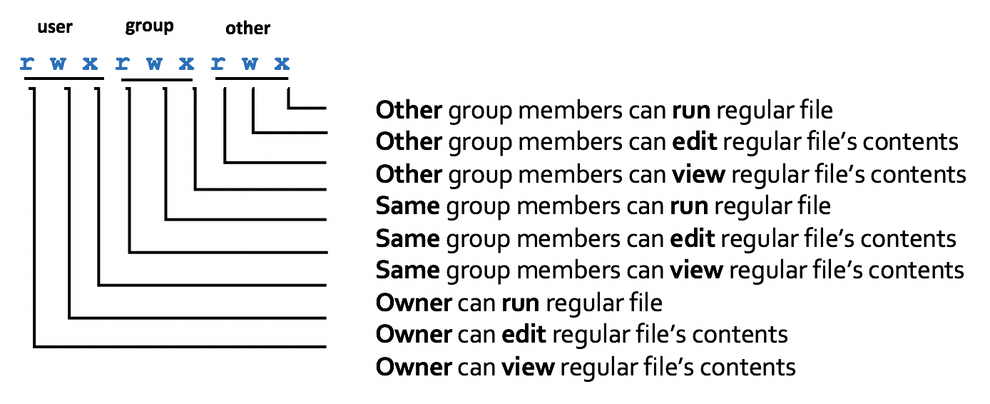
File permissions
File permissions consist of two-layers:
First, the permissions relating to a directory.
Second, the permissions relating to the regular files contained within a directory.
NOTE: Permissions for directories have a different meaning than permissions for regular files.
NOTE: A symbol dash "-" indicates that the permission is NOT granted.

Slide 5
File permissions
Changing File Permissions with chmod command - Symbolic Method:
The chmod command can use symbols to add, remove, and set rwx permissions for user, same group members, other group members or ALL categories:
NOTE: You can use the -R option to set permissions for directory, subdirectory and directory contents recursively.
Command | Description
chmod ugo+x script.bash | Add execute permissions to the file script.bash so it can be run.
chmod u=rwx,go=x ~ | Set "pass-thru" permissions of your home directory for same group members and other group members to navigate to other subdirectories (that may have access / view permissions).
chmod go-w ~/shared | Remove write permissions for same group members and other group members for the directory ~/shared
chmod a=rx myfile.txt | Set read and execute permissions for the directory myfile.txt

Slide 6

File permissions
Instructor Demonstration
Your instructor will now demonstrate how to add, remove and set permissions with the chmod command the Symbolic method

Slide 7
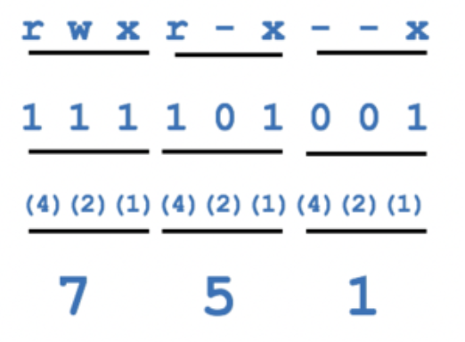
File permissions
Changing File Permissions with chmod command - Absolute (Octal) Method:
You can also use octal numbers to set permissions.
This method is a shortcut and may require less typing than using the symbolic method.
First, write permissions for user, group and others that you want to set. If permission is granted, write 1 and if not granted, write 0.
Second, perform a binary to octal conversion, for each group of three (user, group, other) and then issue the chmod command using the absolute (octal) method.
You can only use this method to set file permissions (as opposed to adding or removing permissions).

Slide 8
File permissions
Changing File Permissions with chmod command: Absolute (Octal) Method
Below is a table that displays common chmod commands (using the Absolute / Octal method) for common purposes.
Command | Description
chmod 500 script.bash | Set read and execute permissions for only the user for the file script.bash so it can be run.
chmod 711 ~ | Set "pass-thru" permissions of your home directory.
chmod 750 ~/shared | Set full permissions for user, read and access permissions for some group members and no permissions for other group members for the directory ~/shared
chmod 555 myfile.txt | Set read and execute permissions for the directory myfile.txt

Slide 9
File permissions
Instructor Demonstration
Your instructor will now demonstrate how to set permissions with the chmod command using the Absolute / Octal method.

Slide 10
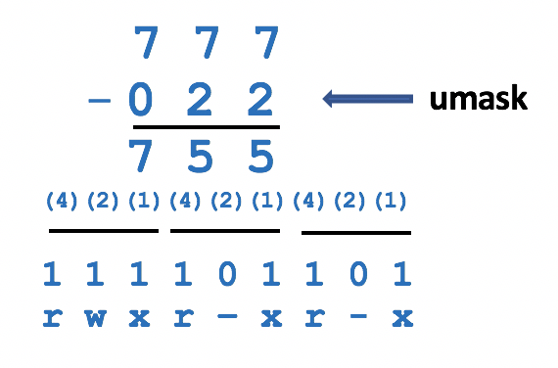
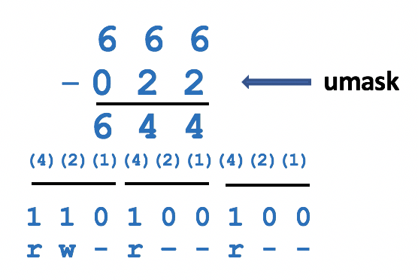
File permissions
Setting Permissions for Newly-Created Directories and Regular Files (umask):
The umask command is used to set the permissions of newly-created directories and regular files. Issuing the umask command without arguments will display the current umask value.
The diagram on the above right shows how to calculate permissions for newly-created directories using the umask command.
The diagram on the below right shows how to calculate permissions for newly-created regular files using the umask command.
Setting the umask value works only in the current shell session unless the umask command is contained in a start-up file (e.g. .profile, .bash_profile, or .bashrc). Start-up files are discussed at the end of this course.

Slide 11
File permissions
Instructor Demonstration
Your instructor will now demonstrate how to set / confirm permissions of newly-created directories and regular files using the umask command.

Slide 12
HOMEWORK
Getting Practice
Perform the online tutorial Tutorial2: Unix / Linux File Management (Due: Friday Week 5 @ midnight for a 2% grade):
INVESTIGATION 2: FILE PERMISSIONS
LINUX PRACTICE QUESTIONS (Questions 6 – 12)

