Slide 1
ULI101: Introduction to Unix / Linux and the Internet
Week1: lesson 2
Issuing Linux Commands / Linux Command Help Command LINE EDITING / Online Tutorials / SLGs
Photos and icons used in this slide show are licensed under CC BY-SA

Slide 2
Lesson 2 topics
Using Your Matrix Account
Issuing Linux Commands / Arguments / Options
Command Help / Command Line Editing
General Linux Commands
Getting Practice Issuing Linux Commands
Performing Weekly Tutorials For Marks
Linux Practice Questions
Getting Help / SLGs (Student Learning Groups)
Homework
Perform Tutorial 1 – Investigation #2

Slide 3

Using your matrix account
Linux Command Structure
command argument1 argument2 ...
Some Linux commands can be issued by entering the Linux command line without arguments (e.g. pwd, date, ls, cal), but some Linux commands can be issued with arguments (e.g. cal 2002, cd /bin, ls -la ).
An argument can be a file pathname, text, or an option.
Examples:
The ls command displays a listing of just filenames in the current directory
The ls /etc command displays a listing of filenames in the /etc directory (as opposed to your current directory)
The ls -l command displays a detailed listing of filenames in the current directory
The ls -l /etc command displays a detailed listing of files in the /etc directory

Slide 4

Using your matrix account
Getting Help with Linux Commands
With the Linux OS containing over 2500 commands and utilities, it is good for a Linux user or Linux System Administrator (i.e. sysadmin) to learn about how to use commands “on-the-fly”.
The man command can provide information on how to use a command (i.e. usage, arguments, options, examples). The commands are classified into sections or “volumes”. Example: man ls
If you do not know the name of a Linux command, the man utility can be used with the -k option to help list Linux commands that match a text pattern that is contained within the help screen for a Linux command. Example: man –k copy

Slide 5
Using your matrix account
Getting Help with Linux Commands / Continued…
You can use the following short-cut keys within the man command to help navigate throughout this utility to get help with the specific command.
Keyboard Shortcut | Purpose
ENTER | Move down one line
SPACEBAR | Move one screen down
<ctrl><b> | Move one screen up
/pattern | Search for Pattern
q | quit man utility

Slide 6

Managing Directories
Instructor Demonstration
Your instructor will demonstrate how to use the man pages.

Slide 7
Using your matrix account
General Linux Commands
Your instructor will demonstrate several basic Linux commands to get practice how to issue Linux commands and using arguments and options.
Shortcut Key(s) | Arguments / Options | Purpose
pwd |  | Display Current Working Directory
cd | dir-pathname | Change Directory
ls | -l, -a, -R, -d, dir-pathname | List Files of Directory
cal | month, year | Display calendar
date |  | Display date and time
who |  | List users logged into server
whoami |  | Display username of user logged in
clear |  | Clear Screen
passwd | username | Change user’s password

Slide 8
Managing Directories
Instructor Demonstration
Your instructor will demonstrate how to issue general Linux commands.

Slide 9

Using your matrix account
Command Line Editing
Learning shortcut keys in any OS terminal will allow you to be more productive as a sysadmin. We will only focus on a few command line editing keyboard shortcut keys.
Shortcut Key(s) | Purpose
<ctrl><l> | Clear Screen
<ctrl><u> | Clear Command Line
<Up Arrow> , <Down Arrow> | Scroll Up / Down Command History
<backspace> , <ctrl><backspace> , <ctrl><h> | Delete character before the cursor
<ctrl><w> | Delete word before the cursor
<ctrl><a> | Move cursor to beginning of command line
<ctrl><e> | Move cursor to end of command line
<alt>f/<alt>b (Mac: OPTION+Right/Left-Arrow) | Move Forward/Backward one word
NOTE: If you are using a Graphical SSH application, you may need to configure the application (META settings) to NOT bring up menus by mistake when you issue some of these shortcuts.

Slide 10
Managing Directories
Instructor Demonstration
Your instructor will demonstrate how to perform command line editing.

Slide 11

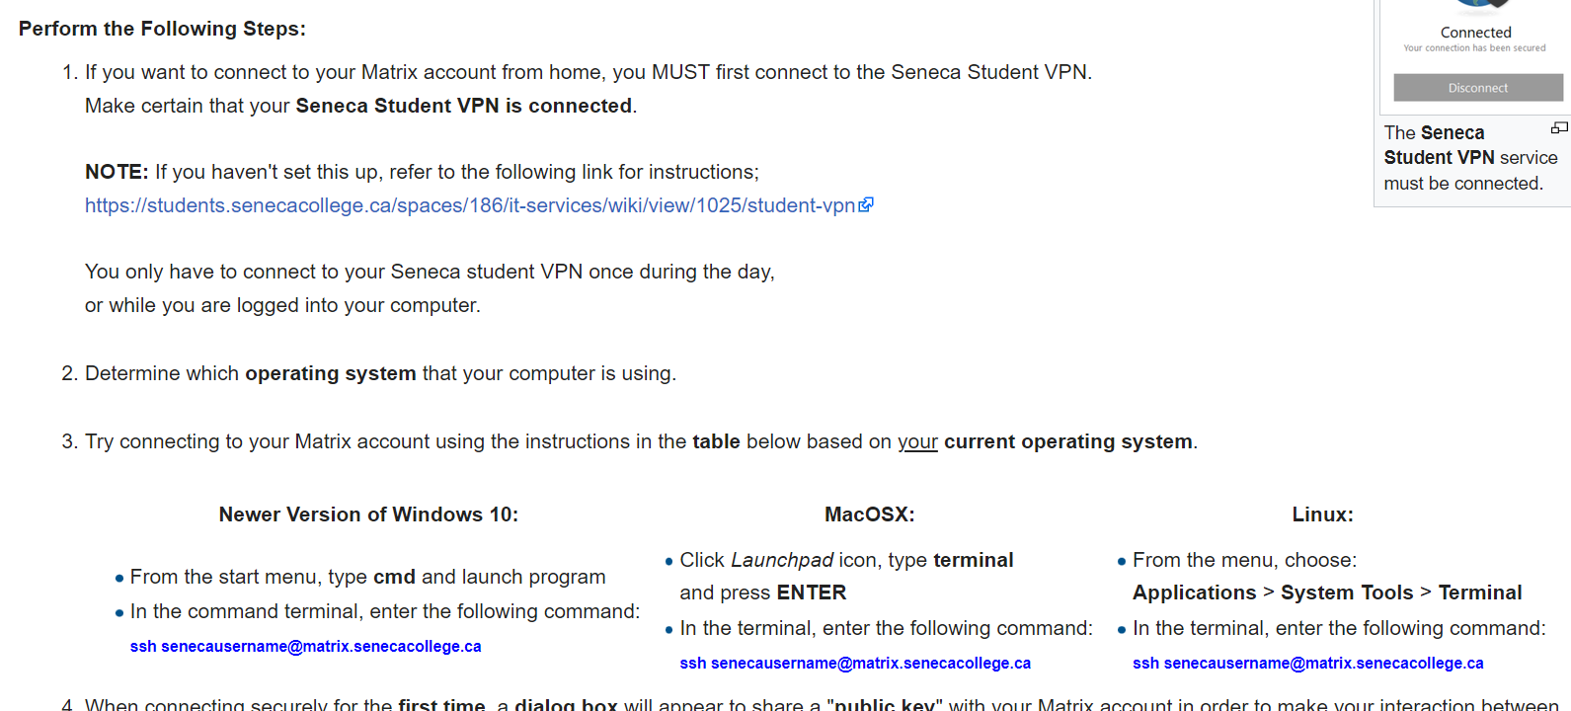
Getting practice issuing linux commands
Weekly Tutorials / Linux Practice Questions
There are Weekly tutorials that are required to be completed by students for a 2% grade for each tutorial. These tutorials are usually due by the following week by Friday @ midnight.
These tutorials are designed to provide you guided hands-on practice with Linux commands and operations that will help you get troubleshooting practice.
NOTE: Students that do NOT complete ALL parts of each weekly tutorial will NOT obtain the full 2% grade.
Linux Practice Questions are at the end of each weekly tutorial. Although these practice Linux questions are NOT for marks, they are useful for studying for quizzes and tests.

Slide 12
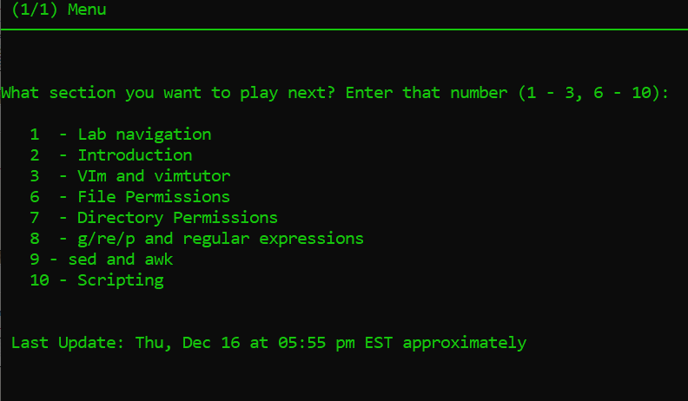
Getting practice issuing linux commands
Review Tutorials
Is a Review Tutorial module that students perform to answer questions to test their Unix/Linux Knowledge. The review tutorial is worth a total of 8% which is broken down into 2 general sections worth 4%.
As students correctly answer questions within a section, they can proceed to the next section. If the student cannot answer a question, they cannot proceed to the next question.
Students will need to successfully complete ALL sections in order to receive the 8% grade. This review tutorial module is due at the end of the semester (refer to the Weekly Schedule for the due date).

Slide 13


Getting practice issuing linux commands
Need Additional Help? Try the Learning Centre: https://library.senecacollege.ca/learningcentre ONE-ON-ONE TUTORING Appointments focused on your individual needs that explain course concepts.
SUPPORTED LEARNING GROUPS (SLG) Student-led and collaborative study sessions that review practical examples based on the course’s content. Link: https://library.senecacollege.ca/learningcentre/slg
ENGLISH LANGUAGE SUPPORT Offered through individual appointments or group learning sessions to focus on grammar, academic writing, conversation, and pronunciation.
STUDY SKILLS Learn time management, exam preparation, critical thinking, note-taking, and reading.

Slide 14
HOMEWORK
Get acquainted with the ULI101 WIKI, notes, tutorials and resources.
Perform the following investigations in Tutorial #1 (Due: Friday Week 2 @ midnight for a 2% grade):
INVESTIGATION 2: USING THE LINUX SHELL / ONLINE ASSIGNMENTS
LINUX PRACTICE QUESTIONS (Questions 1 – 9)

