Slide 1
ULI101: Introduction to Unix / Linux and the Internet Week 2: lesson 1 Unix & Linux file management concepts managing directories
Photos and icons used in this slide show are licensed under CC BY-SA

Slide 2
Lesson 1 topics
Unix / Linux File Management Concepts
Purpose of Directories
Directory Pathnames / Tree Diagrams
Filename Rules
Managing Directories
Creating / Viewing Contents of / Manipulating / Removing Directories: mkdir –p, rmdir, rm -r –i, ls -l -d –R , tree, cp –R, mv
Demonstration
Homework
Perform Tutorial 2: Unix / Linux File Management (Investigation 1) Perform LINUX PRACTICE QUESTIONS (1 – 8)

Slide 3
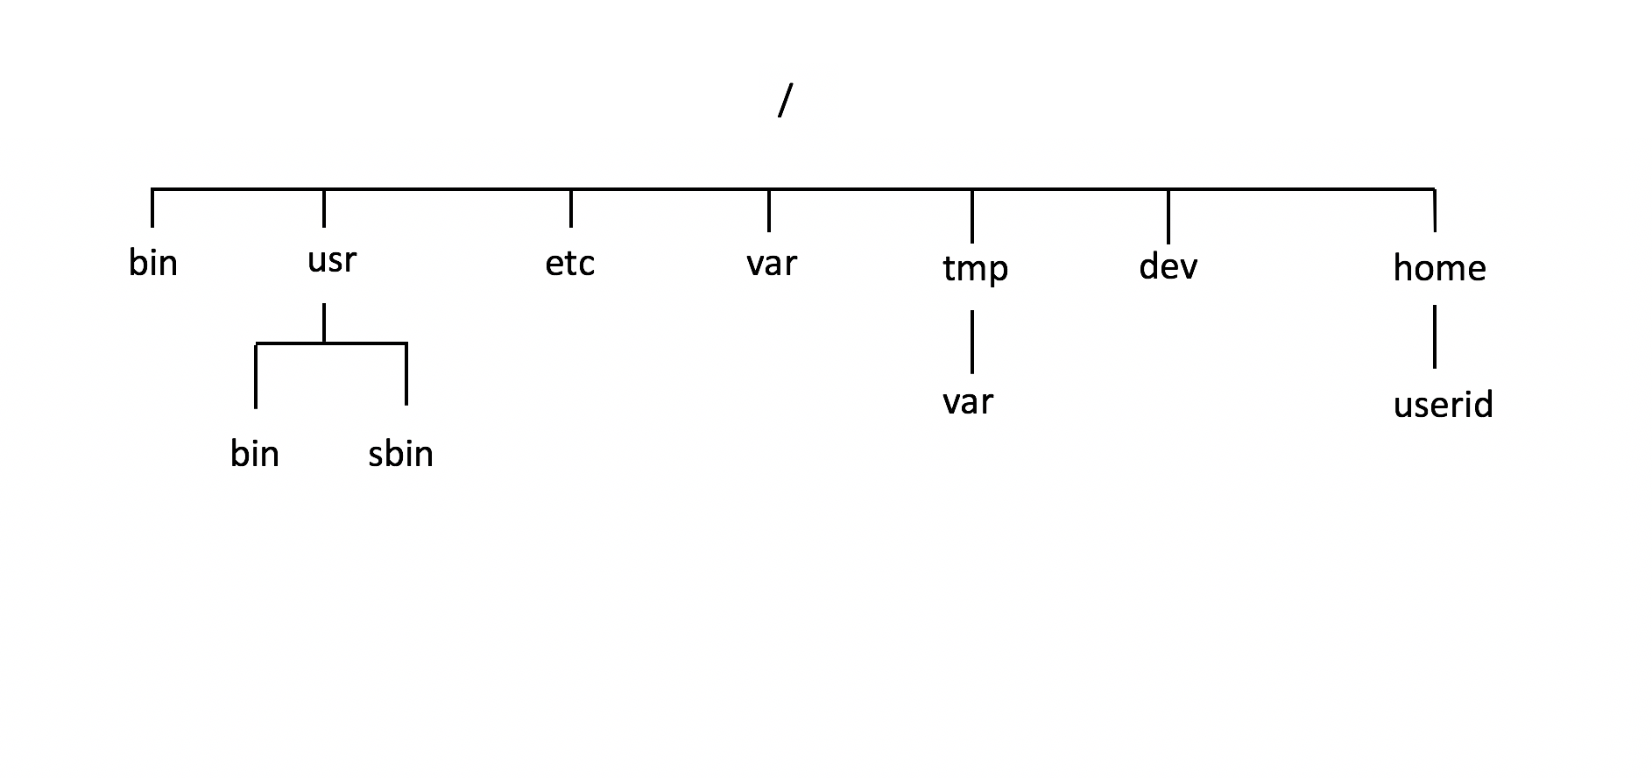
Linux File Management Concepts
Purpose of Unix / Linux Directories
To better organize files (eg. text, images, documents, spreadsheets, programs) within your Matrix account, they should be stored in directories.
To further organize many files, directories may contain sub-directories.
Learning how to issue Linux commands for navigating and manipulating directory and files within the the Linux filesystem are essential skills for Linux users and Linux system administrators (i.e. sysadmins).

Slide 4
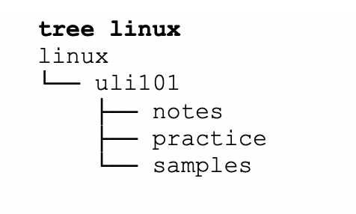
Linux File Management Concepts
Purpose of Unix / Linux Directories
The Unix/Linux file system is hierarchical, like other operating systems such as Windows, macOS, etc. In Unix / Linux (as opposed to Windows), there are no drive letters such as C:, or D:
All files and directories appear under a single ancestor directory called the "root directory".
In the Linux (Unix) OS, the "root directory" / is the starting directory, and other "child directories", "grandchild directories", etc. can be created as required. The hierarchical structure resembles an "upside-down tree". There is actually a command called tree that displays a "directory tree diagram"!

Slide 5

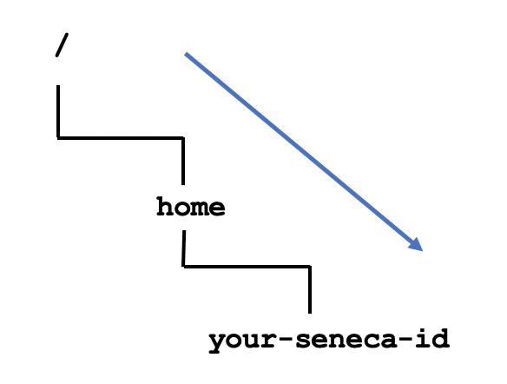
Linux File Management Concepts
Directory Pathnames
A pathname is used to specify the location of a file within the file system.
A pathname points to a file system location by following the directory tree hierarchy expressed in a string of characters in which path components, separated by a delimiting character, represent each directory.
The delimiting character is most commonly the slash character ("/").
Example: /home/your-seneca-id
Reference: https://en.wikipedia.org/wiki/Path_(computing)

Slide 6
Linux File Management Concepts
Common Unix / Linux Directories
Below are several common Unix / Linux Directories and their purpose:
Directory Pathame | Purpose
/ | Root directory (ancestor to all directories)
/home | Used to store users’ home directories
/home/username | A specific User's Home Directory
/bin , /usr/bin | Common system binaries (commands)
/usr/sbin | Common utilities for system administration
/etc | System administration files (eg. passwd)
/var | Dynamic files (log and mail files)
/tmp , /var/tmp | Temporary files for programs
/dev | Device driver files (terminals, printers, etc.)

Slide 7
Linux File Management Concepts
Directory File Naming Rules
Before learning to create directories, it is important to understand what represents an appropriate directory filename. Here are some rules:
Unix / Linux File Naming Rules
Unix/Linux characters are case sensitive (e.g. always use lowercase letters)
Adopt a consistent directory naming scheme (this will help you to better navigate within your directory structure)
Make your directory names meaningful (short but descriptive)
Avoid using spaces for directory names (consider periods, hyphens, and underscores instead)
Avoid non-alphanumeric characters, as they may have a special meaning to the system that will make your work more difficult when changing to directories, etc.

Slide 8
Managing Directories
Managing Directories
Below are some common Unix / Linux commands to manage Directories:
Directory Pathame | Purpose
mkdir -p | Creates a directory. The -p option creates parent directories then directory pathnames specified.
rmdir | Removes empty directories.
rm -r -i | Removes files, but when used with -r option, will remove non-empty directories and their contents. The -i option is used to prompt user to confirm deletion of directory contents
ls -l -d –R , tree | List directory contents. Useful to verify if directory was created. The -d option lists the directory itself (not contents) The -R option displays directories and subdirectory contents. The tree command displays diagram of directory structure.
cp -R | Copies directory and its contents (recursive) to a different directory
mv | Moves directory and its contents to a different directory

Slide 9

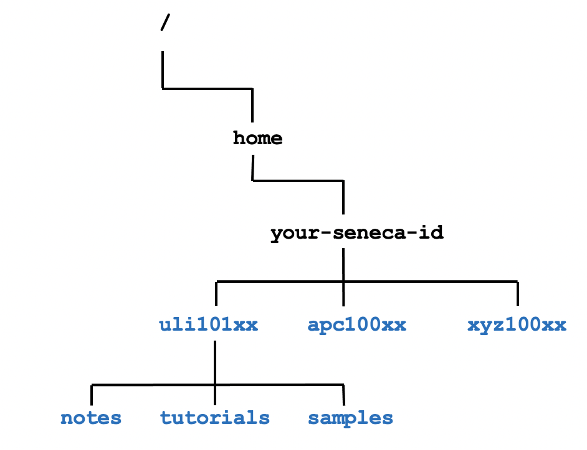
Managing Directories
Managing Directories Demonstration
Your instructor will demonstrate how to manage directories by issuing Unix / Linux commands:
Create directory structure as shown in diagram to the right
View / Verify created directories
Copy directories
Move directories
Remove empty directories
Remove non-empty directories

Slide 10

Managing Directories
Determine Type of File
When issuing the ls command to view the contents of a directory, the –l option can be used to help determine file type.
ls -l
drwxr-xr-x 2 murray.saul users 6 Jan 11 09:42 documents
-rw-r--r-- 1 murray.saul users 0 Jan 11 09:42 file.txt
crw-rw-rw- 1 root root 1, 3 Dec 2 07:25 /dev/null
The first character on the left of the output indicates the type of file:
d: directory file
-: regular file
b or c: device file

Slide 11

Managing Directories
Hidden Files
A file is hidden if its name starts with a period “.” This can hide both regular files and directory files.
Why make files hidden?
To clean up directories
To hide backups
To protect important files from accidental deletion
If you issued the ls command without arguments, hidden files do NOT appear.
The ls command with the -a option will show all files including hidden and non-hidden. Current and Parent directories ( . and ..) are displayed.
The ls command with the -A option will show all files including hidden and non-hidden. Current and Parent directories ( . and ..) are NOT displayed.

Slide 12
HOMEWORK
Getting Practice
Perform the online tutorial Tutorial 2: Unix / Linux File Management (Due: Friday Week 3 @ midnight for a 2% grade):
INVESTIGATION 1: MANAGING DIRECTORIES
LINUX PRACTICE QUESTIONS (Questions 1 – 8)

