Slide 1
TDD + Code Coverage
Lorenzo Gabriel Pérez González alu0101233499
Pablo Pérez González alu0101318318

Slide 2


Team
Pablo Pérez González
alu0101318318
Lorenzo Gabriel Pérez González
alu0101233499

Slide 3
Table of Contents
TDD
Definition
Pros
Cons
Conclusion
2. Code Coverage
Definition
Jest
CodeCov
Conclusion

Slide 4
Before we start…

Slide 5
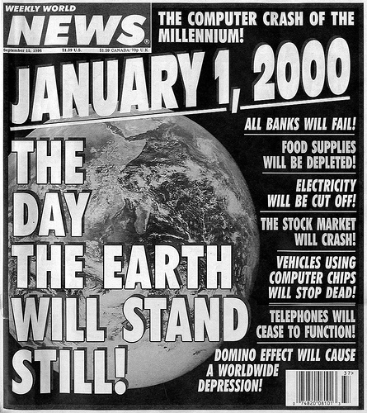
This is really important.

Slide 6
TDD

Slide 7
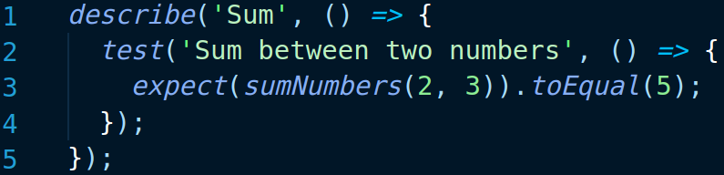
Definition
Test Driven Development is a software development process that starts with the creation of a test and continues with the implementation of the code that makes it work.

Slide 8
TDD’s cycle
Start here
Refactor
Test
Code

Slide 9
Why is TDD better than other software development processes?

Slide 10
“Focus to a single feature at a time.”
Modularity

Slide 11
“Developers naturally produce a cleaner, more readable, and manageable code.”
Maintenance

Slide 12
“Modular improvement.”
Refactoring

Slide 13
“TDD can reduce your time-to-market speed.”
Decreasing costs

Slide 14
“Tests act as documentation and illustrate how the code works.”
Better documentation

Slide 15
“TDD produces a higher overall test coverage”
Less debugging

Slide 16
What about TDD’s cons?

Slide 17
“The team will be busy writing tests first.”
Slow development

Slide 18
“Requires skills, persistence, and discipline.”
Difficulty

Slide 19
“Not every developer can make tests before having the code done”
Strange approach

Slide 20
“Tests could change to adapt.”
Changing tests

Slide 21
TDD is easier and challenging to maintain?

Slide 22
Tests ≠ Implementation
Test maintenance is hard.
Implementation maintenance is easy.

Slide 23
Conclusions

Slide 24
TDD: Conclusions
Code quality.
Difficulty.
Use in companies.
Code coverage.

Slide 25
2. Code Coverage

Slide 26
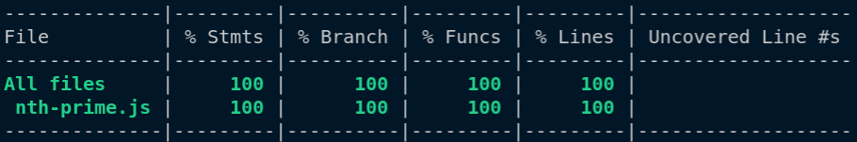
Definition
Represents the percentage of code that has been tested and strongly represents the completeness of our tests.

Slide 27
Criteria
Function Coverage: Has each function been tested?
Statement Coverage: Has each statement been tested?
Edge Coverage: Has the control flow been tested completely?
Condition Coverage: Has every condition been tested?

Slide 28
Why is Code Coverage useful?

Slide 29
“Without code coverage, we don’t know if our tests are useful”
Safety

Slide 30
“Higher code coverage finds more bugs”
Quality

Slide 31
How much Code Coverage is necessary?

Slide 32
Nice Code Coverage
Small projects
Aim to 100%
Large projects
Aim to 70-80%
High risk systems
Aim to the highest possible value.

Slide 33
But, are these numbers absolute?

Slide 34
“Focus your time testing what is important.”
Understand your code

Slide 35
Improvement
Make tests for general cases.
2. Identify critical misses in testing with code coverage.
3. Improve your testing.

Slide 36
Code Coverage in Jest

Slide 37

What is Jest?
Jest is a JavaScript testing framework designed to ensure correctness of any JavaScript codebase.
Jest

Slide 38
“Write tests with an approachable, familiar and feature-rich API that gives you results quickly”
Simplicity

Slide 39
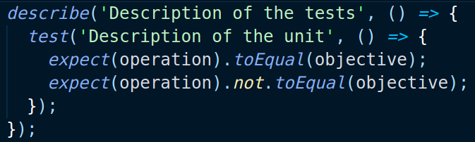
Making a test

Slide 40
Matchers
toBeNull
toBeDefined
toBeUndefined
toBeTruthy
toBeFalsy
toBeGreaterThan
toBeLessThan
toBe
toEqual
toMatch
toContain
toThrow

Slide 41
Now, how to do coverage with Jest?

Slide 42
Noob mode
Just add --coverage

Slide 43
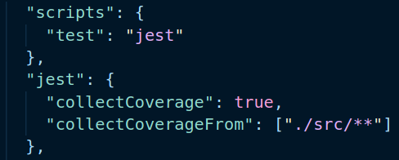
Medium mode
Using a package.json

Slide 44
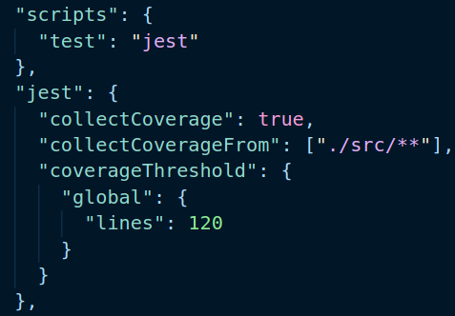
Pro mode
Using a good package.json.

Slide 45
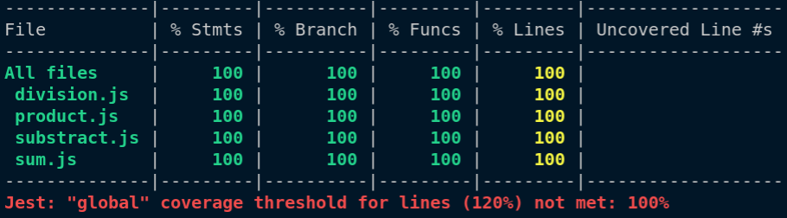
Pro mode
Using a good package.json.

Slide 46
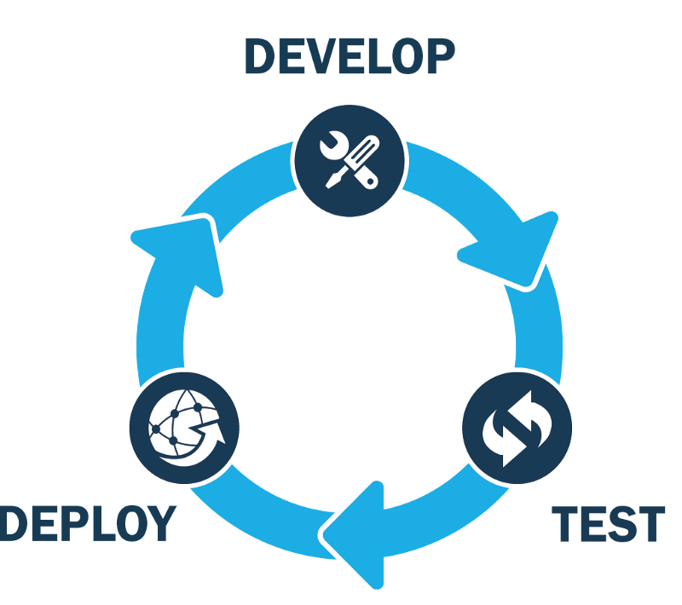
What about continuous integration?

Slide 47
Code Coverage in CodeCov

Slide 48

Definition
Code coverage is one of the most important metrics companies rely on to ship healthier code, faster, and with less risk.

Slide 49
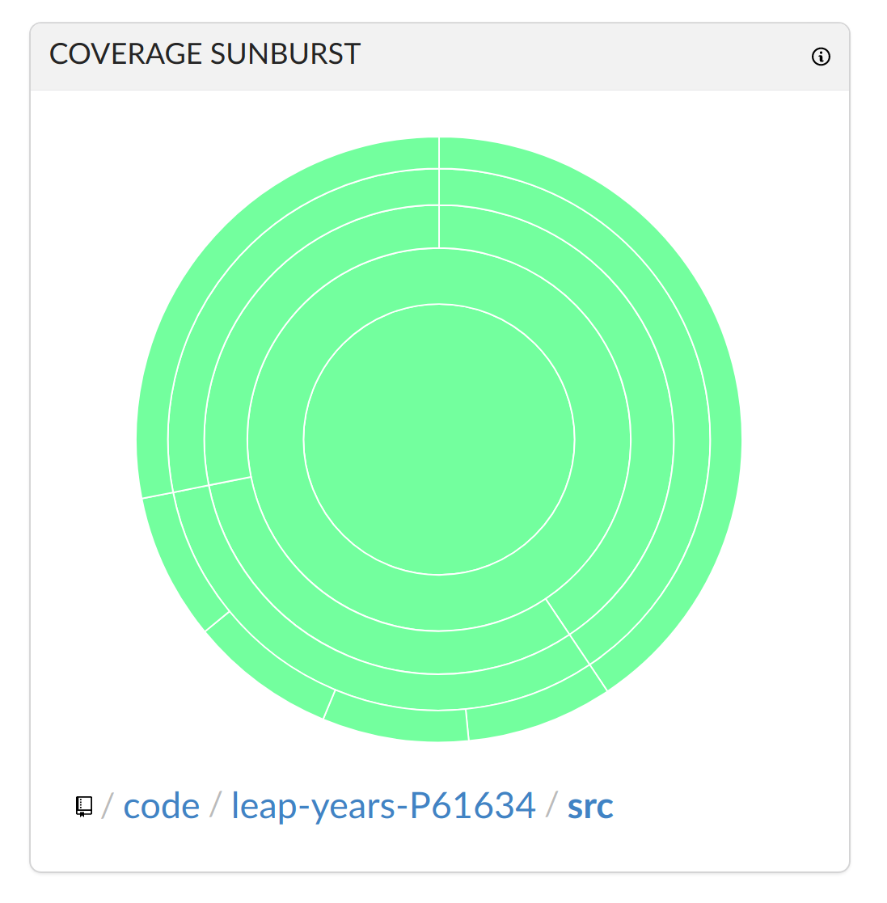
CodeCov benefits
Code coverage in a graphical representation.

Slide 50
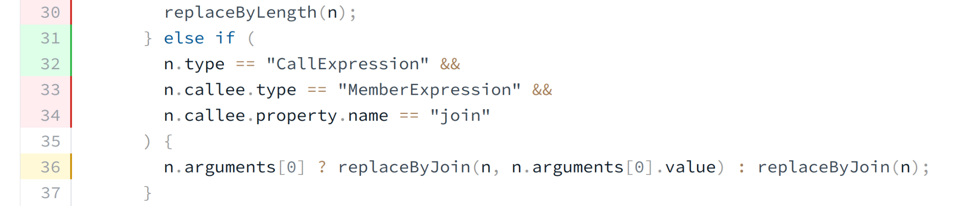
CodeCov benefits
Code coverage in an easy way.

Slide 51
Use CodeCov
Give CodeCov permission to your Github.
2. Choose a repository (Token creation).
https://about.codecov.io/

Slide 52
Use CodeCov
3. Create the coverage directory with Jest.
4. Setup the CI with Github Actions.

Slide 53
Use CodeCov
5. Download the CodeCov Uploader.
6. Upload coverage with ./codecov -t [Token]

Slide 54
Conclusions

Slide 55
CodeCov: Conclusions
Code quality.
Code safety.
Simple code coverage improvement.

Slide 56
Bibliography: TDD
TDD Wikipedia: https://en.wikipedia.org/wiki/Test-driven_development
Learn TDD: https://github.com/dwyl/learn-tdd
Benefits of TDD: https://fortegrp.com/test-driven-development-benefits/#:~:text=Developers%20have%20less%20debugging%20to,quality%20of%20the%20final%20product
Software disasters: https://raygun.com/blog/costly-software-errors-history/
https://www.rankred.com/biggest-software-failures/

Slide 57
Bibliography: Code Coverage
Code Coverage Wikipedia: https://en.wikipedia.org/wiki/Code_coverage
Code Coverage Definition: https://confluence.atlassian.com/clover/about-code-coverage-71599496.html#:~:text=Code%20coverage%20is%20the%20percentage,and%20which%20statements%20have%20not
Code Coverage Criteria: https://www.atlassian.com/continuous-delivery/software-testing/code-coverage
Why is Code Coverage important?: https://about.codecov.io/blog/who-cares-about-code-coverage-and-why/#:~:text=Code%20coverage%20is%20a%20simple,the%20quality%20of%20your%20code
Use Code Coverage with Jest: https://www.valentinog.com/blog/jest-coverage/
Jest’s Code Coverage Documentation: https://jestjs.io/docs/configuration#coveragethreshold-object
CodeCov Quick Start: https://docs.codecov.com/docs

Slide 58
Thanks!
Any questions?
You can find us at:
pablo.perez.gonzalez.23@ull.edu.es
gabriel.perez.10@ull.edu.es

