Slide 1
TDD + Code Coverage
Lorenzo Gabriel Pérez González alu0101233499
Pablo Pérez González alu0101318318

Slide 2


Team
Pablo Pérez González
alu0101318318
Lorenzo Gabriel Pérez González
alu0101233499

Slide 3
Table of Contents
TDD
Definition
Pros
Cons
Conclusion
2. Code Coverage
Definition
Jest
CodeCov
Conclusion

Slide 4
Before we start…

Slide 5

This is really important.

Slide 6
TDD

Slide 7
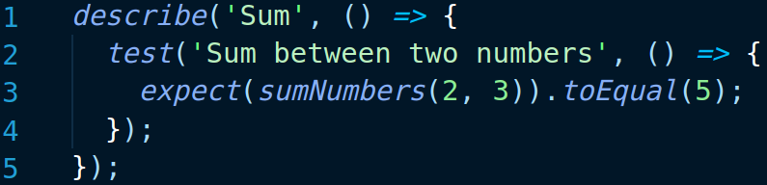
Definition
Test Driven Development is a software development process that starts with the creation of a test and continues with the implementation of the code that makes it work.

Slide 8
TDD’s cycle
Start here
Refactor
Test
Code

Slide 9
Why is TDD better than other software development processes?

Slide 10
“Focus to a single feature at a time.”
Modularity

Slide 11
“Developers naturally produce a cleaner, more readable, and manageable code.”
Maintenance

Slide 12
“Modular improvement.”
Refactoring

Slide 13
“TDD can reduce your time-to-market speed.”
Decreasing costs

Slide 14
“Tests act as documentation and illustrate how the code works.”
Better documentation

Slide 15
“TDD produces a higher overall test coverage”
Less debugging

Slide 16
What about TDD’s cons?

Slide 17
“The team will be busy writing tests first.”
Slow development

Slide 18
“Requires skills, persistence, and discipline.”
Difficulty

Slide 19
“Not every developer can make tests before having the code done”
Strange approach

Slide 20
“Tests could change to adapt.”
Changing tests

Slide 21
TDD is easier and challenging to maintain?

Slide 22
Tests ≠ Implementation
Test maintenance is hard.
Implementation maintenance is easy.

Slide 23
Conclusions

Slide 24
TDD: Conclusions
Code quality.
Difficulty.
Use in companies.
Code coverage.

Slide 25
2. Code Coverage

Slide 26
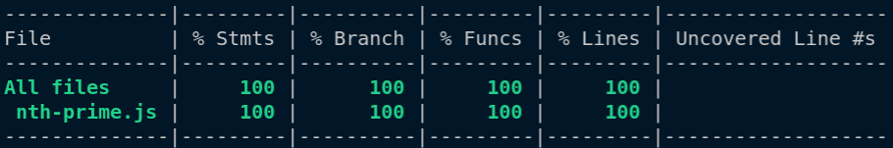
Definition
Represents the percentage of code that has been tested.

Slide 27
Criteria
Function Coverage: Has each function been called?
Statement Coverage: Has each statement been executed?
Edge Coverage: Has the control flow been tested completely?
Condition Coverage: Has every condition been evaluated?

Slide 28
Why is Code Coverage useful?

Slide 29
“Higher code coverage finds more bugs”
Quality

Slide 30
How much Code Coverage is necessary?

Slide 31
Nice Code Coverage
Small projects
Aim to 100%
Large projects
Aim to 70-80%
High risk systems
Aim to the highest possible value.

Slide 32
Code Coverage in Jest

Slide 33

What is Jest?
Jest

Slide 34
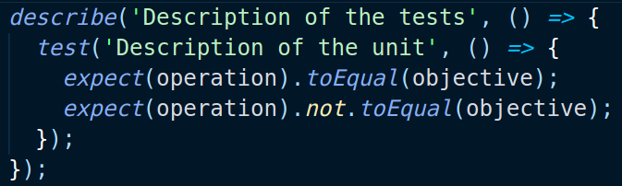
Making a test

Slide 35
Matchers
toBeNull
toBeDefined
toBeUndefined
toBeTruthy
toBeFalsy
toBeGreaterThan
toBeLessThan
toBe
toEqual
toMatch
toContain
toThrow

Slide 36
Now, how to do coverage with Jest?

Slide 37
Noob mode
Just add --coverage

Slide 38
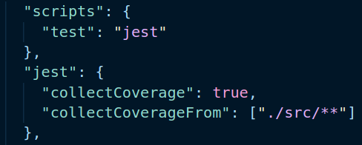
Medium mode
Using a package.json

Slide 39
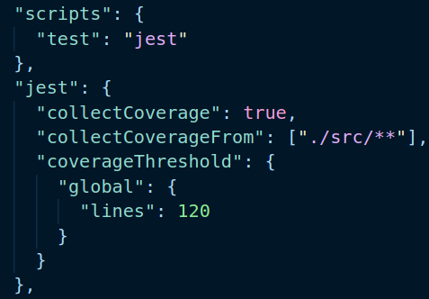
Pro mode
Using a good package.json.

Slide 40
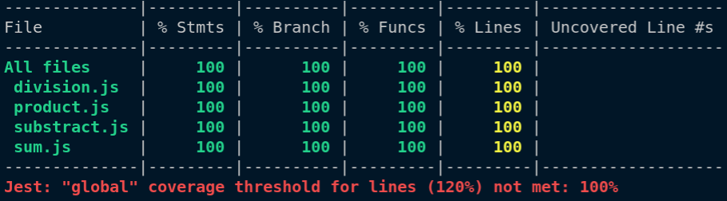
Pro mode
Using a good package.json.

Slide 41
Code Coverage in CodeCov

Slide 42

What is CodeCov?

Slide 43
Use CodeCov
Give CodeCov permission to your Github.
2. Choose a repository (Token creation).

Slide 44
Use CodeCov
3. Create the coverage directory with Jest.
4. Setup the CI with Github Actions.

Slide 45
Use CodeCov
5. Download the CodeCov Uploader.
6. Upload coverage with ./codecov -t [Token]

Slide 46
Conclusions

Slide 47
Code Coverage: Conclusions
Code quality.
Code safety.

Slide 48
Bibliography: TDD
TDD Wikipedia: https://en.wikipedia.org/wiki/Test-driven_development
Learn TDD: https://github.com/dwyl/learn-tdd
Benefits of TDD: https://fortegrp.com/test-driven-development-benefits/#:~:text=Developers%20have%20less%20debugging%20to,quality%20of%20the%20final%20product
Software disasters: https://raygun.com/blog/costly-software-errors-history/
https://www.rankred.com/biggest-software-failures/

Slide 49
Bibliography: Code Coverage
Code Coverage Wikipedia: https://en.wikipedia.org/wiki/Code_coverage
Why is Code Coverage important?: https://about.codecov.io/blog/who-cares-about-code-coverage-and-why/#:~:text=Code%20coverage%20is%20a%20simple,the%20quality%20of%20your%20code
Use Code Coverage with Jest: https://www.valentinog.com/blog/jest-coverage/
Jest’s Code Coverage Documentation: https://jestjs.io/docs/configuration#coveragethreshold-object
CodeCov Quick Start: https://docs.codecov.com/docs

Slide 50
Thanks!
Any questions?
You can find us at:
pablo.perez.gonzalez.23@ull.edu.es
gabriel.perez.10@ull.edu.es

Slide 51
SlidesCarnival icons are editable shapes.
This means that you can:
Resize them without losing quality.
Change line color, width and style.
Isn’t that nice? :)
Examples:

Slide 52
Diagrams and infographics

