Slide 1

TypeScript
Juan Guillermo Zafra Fernández
Jorge Quintana García

Slide 2
Content
1- What is TypeScript?
2- How to get started?
3- Basic use
4- Types
5- Classes
6- Interfaces
7- Extra things
8- Conclusions

Slide 3
Before we get started
We make usage of some lingo:
Extend === Inherit
TS === TypeScript
JS === JavaScript

Slide 4
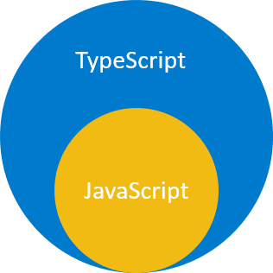
1- What is TypeScript
TypeScript is a super set of JavaScript.
Adds additional syntaxes for supporting Types.
Compiles from TS to JS

Slide 5
2- How to get started?
You will need only a few things:
Node.js.
TypeScript Compiler.
Text Editor.

Slide 6
Installing TypeScript
You will have to enter these commands in the terminal:
$npm install -g typescript
$tsc --v (to check the version installed)
$npm install -g ts-node
In Windows is possible to get an error implying it does not recognise ‘tsc’.
To solve the error, add C:\Users\<user>\AppData\Roaming\npm to the PATH variable.
Is possible to get an error using the keyword console (for example in console.log).
To solve the error, run the following command: $npm install @types/node --save-dev

Slide 7
3- Basic usage
After installation you are ready to code:
Write your TS file
Run $tsc app.ts where app.ts is your file
If everything is correct then it should appear a .js file with the same name
Run $node app.js
You can run it directly running $ts-node app.ts

Slide 8
4- Types
Types are half the story about TS. It lets the programmer specify what type a variable is, and avoids mistakes thanks to a handy compiler.
The friend for hard-typed languages fans.

Slide 9
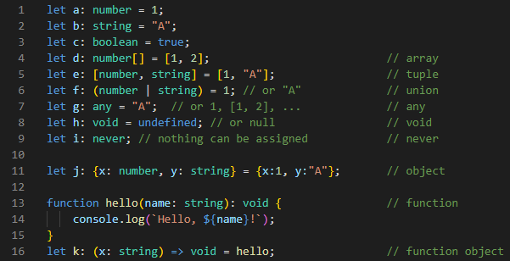
Types overview

Slide 10
Types of types
Primitive
number
string
boolean
Objects
Everything else

Slide 11
Type inference
TS can inference the type of most things for you.
Type inference | Type annotation
TS guesses the type | You specify the type
For the most part, let TS guess. Only specify:
If you want better readability.
If TS can’t infer the type itself.
Declare a variable for later use.

Slide 12
Objects and Tuples
Objects work as expected in TS as a type, but the compiler also checks when you access a property if the object has it.
Tuples are arrays where:
The length can’t be altered.
The type of the elements within is known.
The order matters

Slide 13
Enum
Any
Very much alike Python’s enumerations. It’s a set of values that are related in some way.
They go well with constants.
Any represents a type that can be any type. Simple.

Slide 14
Void & Never
Void denotes the absence of any type.
It’s often used to mark that a function returns nothing.
Never is used to mark that you can’t assign to anything.
It’s used to mark functions that throw errors, or loop indefinitely.

Slide 15

Type joining & Aliases
You can join two types into one using the | operator.
You can make an alias of an existing type (renaming it).

Slide 16
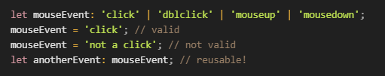
String literals
Instead of a type, forces a variable to only accept assignment of the string literal specified. It’s very handy when paired with type union.

Slide 17

Anatomy of a function
Parameter type
Return type
Function name
Function body

Slide 18
Optional parameters
Rest parameters
Optional parameters can be specified in TS.
To do so, add a ? postfix to the parameter name.
“…” parameters should be noted as an array (use [])

Slide 19
5- Classes
Similar to JS with some interesting things:
Access modifiers
Readonly
Getters and Setters

Slide 20
Access Modifiers
A class can restrict the access to some of their elements using three tags:
private
protected
public (default if not specified)
They can be specified at declaration or in the class’ constructor, even though it’s not recommended whatsoever.

Slide 21
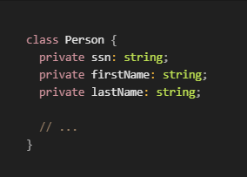
Access modifiers example

Slide 22
ReadOnly
A class can specify if a variable will be immutable. It’s similar to const, and it only can only be initialized in:
The constructor
The own declaration
It is recommended to only use it in classes attributes

Slide 23
Getter and Setter
Use them! The whole Internet (And Google) tell us to use them with purpose.
Google Style Guidelines says to use them with a purpose, not letting them be just a pass-through.

Slide 24
Inheritance, static, abstract
They all work the same as JS.

Slide 25
6- Interfaces
Interfaces are some sort of specific-use objects in the class sense.
Basically, it provides with a set of attributes and it can be used as if it were a new type.
They’re really cool, I swear

Slide 26
But what IS an interface??
Basically, a fancier dictionary.
It helps code be cleaner and set a common ground for classes and functions.
An example shall make this more understandable.

Slide 27
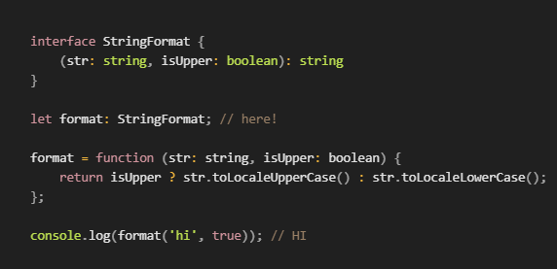
Function interfaces
We can also use an interface to show how a function looks like. What parameters it uses and what type is returns:

Slide 28
Interfaces for classes
A class can implement an interface. Similarly to C# and Java, it forms a contract of use among unrelated classes.
It tells classes how to use a set of functions, for example.
Or what parameters they should take into account.
Don’t worry an example later on will enlighten you.

Slide 29
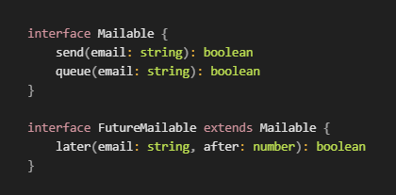
Extending interfaces
Interfaces can extend from other interfaces as objects would do.

Slide 30
Interfaces extending classes
An interface can extend a class. However it won’t inherit the class’ methods or anything, as one would expect from class inheriting.
When an interface extends a class, it makes said interface only usable by said class and their children.

Slide 31
7- Extra Things
We’ll go through several things to bear in mind:
Type intersection
Guards
Type casting
Type Assertion
Generics
Modules

Slide 32
Type Intersection
When you intersect type A with type B, the result will have both types’ properties (all of them).
More interestingly, it also works with interfaces.
Meaning you can build bigger interfaces using smaller ones.

Slide 33
Guards
Guards are very extensive, and we can’t cover them completely.
They can be especially handy to ensure a function returns a certain kind of type to ease conditionals for the compiler.

Slide 34
Type casting
As in most languages, you can cast types in TS.
You may do so using the as keyword, or <>.
We recommend the first one, as it makes the code more readable, and the angles are not compatible with some libraries.

Slide 35
Type assertion
When a function may return a type sometimes or other(s) other times, you can tell the compiler which one you expect.
Use the as keyword as before, at the end of the function call.
It also improves readability of your code!

Slide 36
Generics (a.k.a templates)
One may benefit from using generics:
Checks types in compiling time
Doesn’t need type casting
Allows implementation of algorithms easier
Generics are TS’ templates, which ease making generic algorithms for various data types.

Slide 37

Generic is very flexible
Functions
Classes
Interfaces

Slide 38
Modules
They are used the same as JS’ ES6.
import/export structure.
They work as expected with extensions as well.
You can also export types!

Slide 39
8- Conclusions
The same as JavaScript, but better. Fixes many errors, adds hard typing (that’s where the TypeScript is at), and provides fantastic tools to make some really solid code.
Finally, I don’t have to check argument types on every single function.

Slide 40
References
TS slides
Complete Tutorial (we used this heavily)
Exercism track
Official Web
Official TS programmers
Differences between TS and JS

