Slide 1


GHOUSIA COLLEGE OF ENGINEERING
Anudip Foundation for social welfare
Project seminar on
“Online platform for customized wedding invitations"
Under Guidance OF, submitted by,
Vanisha Nagesh Ullas R Gowda(AF04888146)
Subhash J (AF04888789)
Chandana V S (AF04891705)
Varshitha D D (AF04887076)

Slide 2
INTRODUCTION
Created online platform for customized wedding invitations : By using Front-end
HTML: Structures the content of the website (e.g., form inputs for names, dates, venue, themes, etc.).
CSS: Styles the layout and appearance to make the site visually appealing and reflect wedding aesthetics (elegant, romantic, etc.).
JavaScript: Adds interactivity such as:
Live preview of invitation changes.
Switching between invitation templates.
Saving and downloading custom designs.
Form validation for user inputs.

Slide 3
PROJECT STRUCTURE
Index.html - is a main HTML file.
Style.css - Linked CSS design & styles
Script.js - linked
Collection .html - The collection.html page is used to display a collection or gallery of wedding invitation templates that users can browse and choose from.
Customize .html - The customized.html page is used to allow users to personalize their selected wedding invitation template by entering their own details such as names, dates, venue, and other custom messages.
Contact .html - The contact.html page provides users with a way to get in touch with the platform team—for support, inquiries, or custom design requests.

Slide 4
Responsive Design of the Customized Wedding Invitation Website
To provide a smooth and user-friendly experience across different screen sizes, ensuring:
Easy navigation
Readable content
Proper layout scaling
Usability on phones and tablets
Responsive Design Used:
CSS Media Queries: Adjust layout, font size, and elements based on screen width.
Flexible Layouts : Used percentages, flexbox, or CSS grid instead of fixed pixel widths.
Responsive Images: Images scale according to screen size.
Mobile-Friendly Navigation : Hamburger menu or collapsible navigation on smaller screens.
Scalable Text and Buttons : Ensured text, buttons, and inputs are large enough for touch screens.

Slide 5
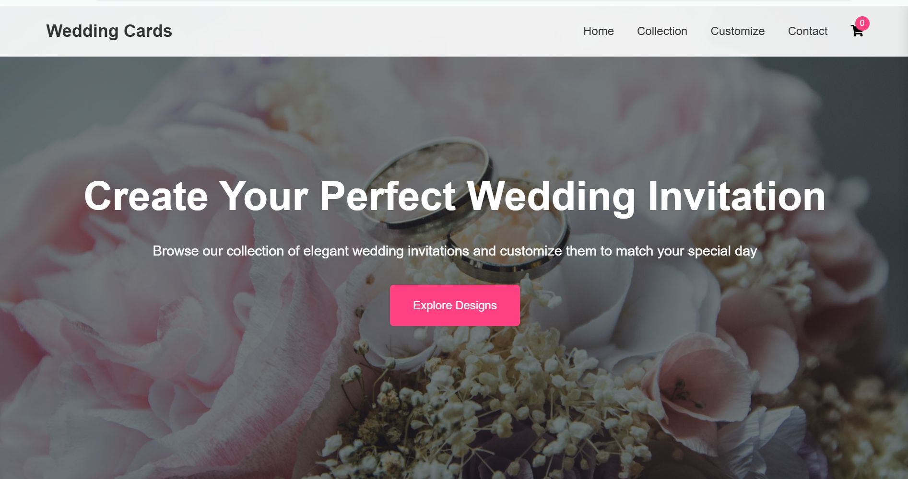
RESULTS
HOME PAGE:

Slide 6
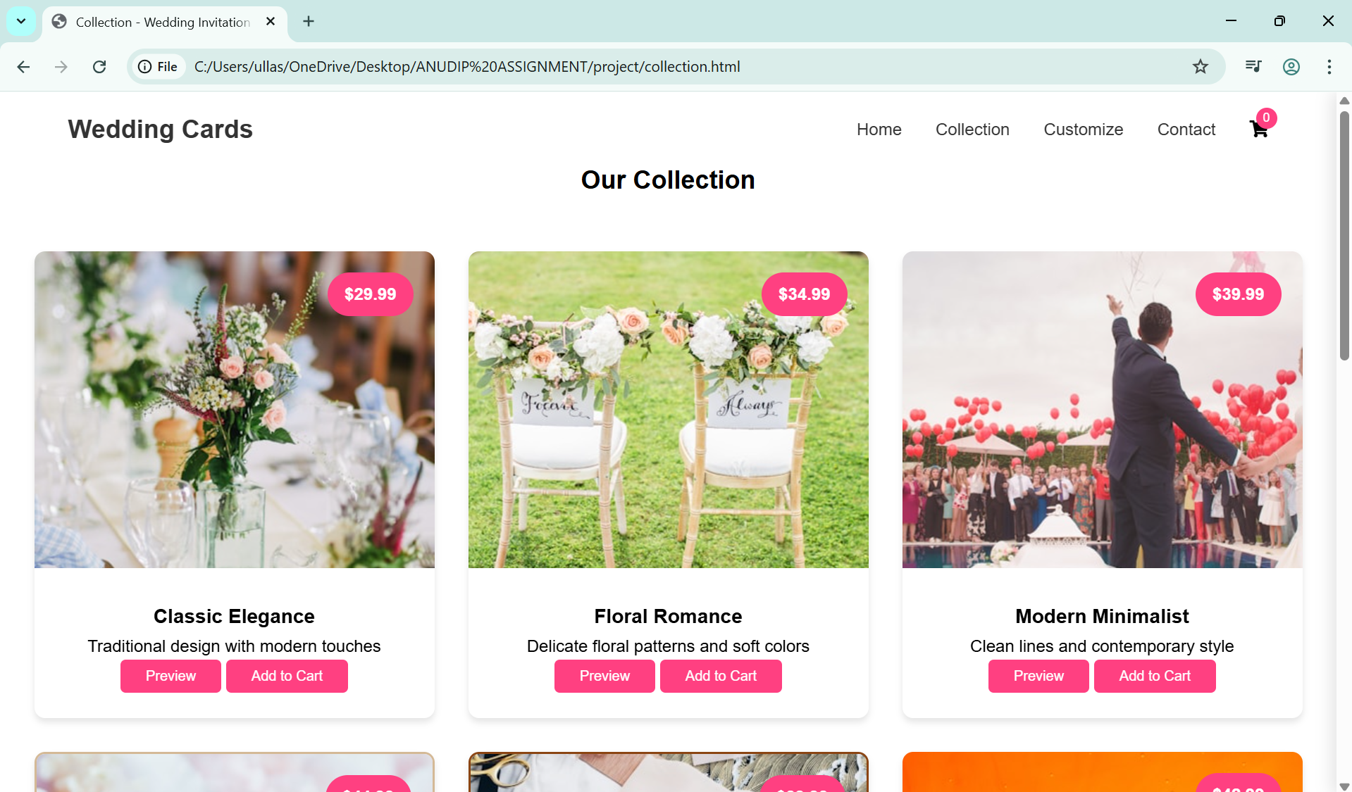
Our Collection PAGE

Slide 7
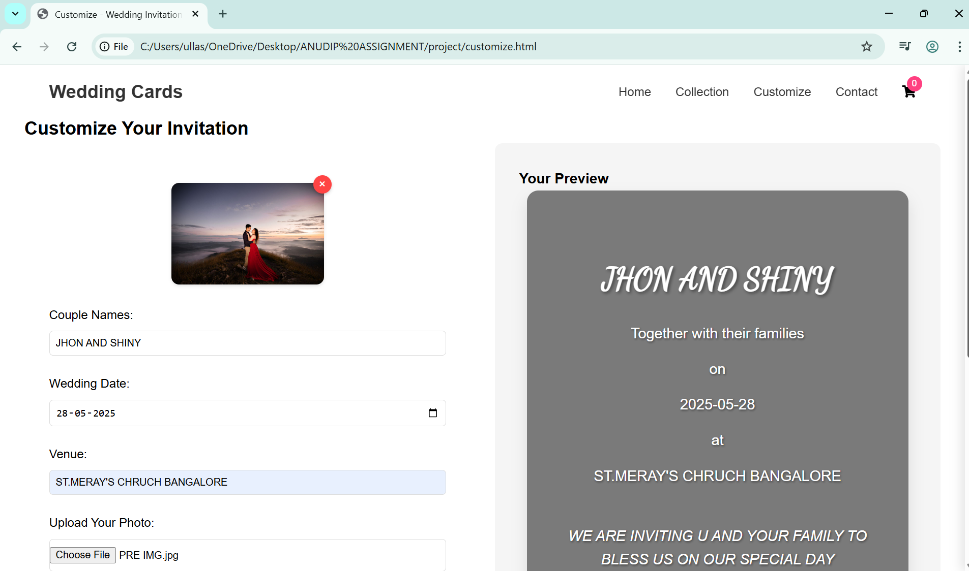
Customize Your Invitation

Slide 8
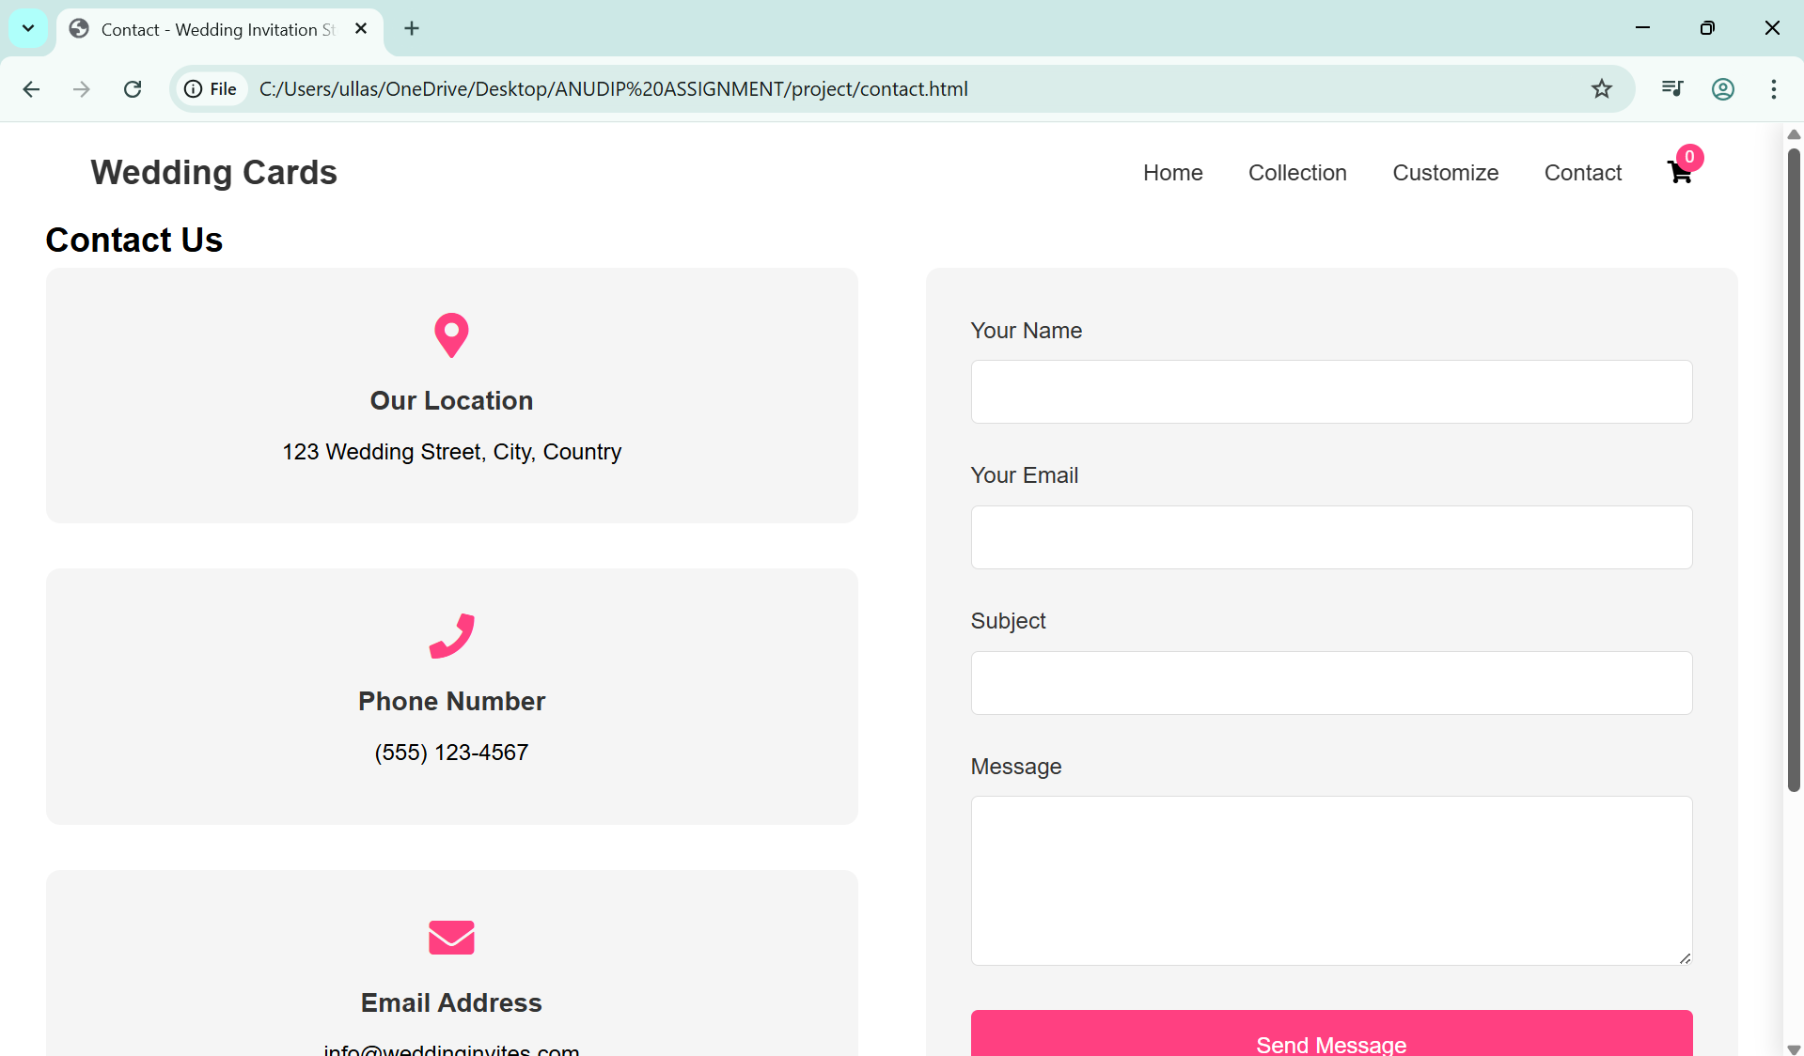
Contact Us

Slide 9
Future Improvements
Add More Templates & Themes: Include a wider variety of invitation styles (e.g., floral, modern, traditional, minimalist).Add filters like "Hindu Wedding", "Christian Wedding", "Destination Wedding", etc.
📱 Add Backend Integration :Use a database (like Firebase or MySQL) to save user designs, allow login/signup, and support multiple sessions.
📥 Enable Invitation Downloads : Allow users to download the customized invitation as a PDF or image file.
📨 Email Sending Feature :Let users email their customized invitations directly from the platform.
🖨️ Print-Ready Designs: Provide print-optimized versions for users who want to print physical cards.
🧠 Use AI for Template Suggestions: Recommend invitation styles based on user inputs (wedding theme, location, etc.).
🛍️ Add E-commerce Functionality: Allow users to purchase premium templates or printed invitation cards.
🌐 Multi-language Support :Offer templates and UI in different regional languages.
📊 Analytics Dashboard (Admin Side): Track user activity, popular templates, and customization trends.
🎨 Drag-and-Drop Customization : Make customization more interactive with drag-and-drop elements like icons, borders, text blocks.

Slide 10


