Slide 1
HOSPITAL FINDER
PIP2001 Capstone Project
Review-3
Batch Number: CSE-G5
Under the Supervision of,
Mr. Md Ziaur Rahman
Assistant Professor
School of Computer Science and Engineering
Presidency University
Roll Number | Student Name
20211CSE0388 | Mohammed Thousif B C
20211CSE0399 | Suresh G
20211CSE0299 | Ullas H R
Name of the Program: CSE
Name of the HoD: Dr.Asif Mohammed H.B
Name of the Program Project Coordinator: Mr. Amarnath J.L & Dr. Jayanthi. K.
Name of the School Project Coordinators: Dr. Sampath A K / Dr. Abdul Khadar A / Mr. Md Ziaur Rahman

Slide 2
Content
Introduction
Literature Review
Proposed Method
Objectives
Methodology
Software Components
Timeline of the Project
Expected Outcomes
Algorithm
OutPut
Conclusion
References

Slide 3
Introduction
The Health Finder app addresses the critical need for timely medical assistance by simplifying the search process during emergencies. By providing essential details about nearby hospitals, including available services, medications, and specialist care, the app empowers users to make quick, informed decisions when every second counts. Ultimately, Health Finder seeks to bridge the gap between individuals in need and accessible healthcare services, ensuring that help is just a tap away.

Slide 4
LITERATURE REVIEW
SL.NO | TITLE OF THE PAPER/AUTHOR/PUBLISHER/YEAR | ADVANTAGES | LIMITATIONS
1 | Amit Kumar Emergency Health Care Services in India: A Strategic Approach. International Journal for Multidisciplinary Research, Volume 6, Issue 1, January-February 2024, Pages 5-10. | Proposes a unified emergency surveillance system that integrates pre-hospital and facility-based care using telemedicine and emergency response technologies. | Fragmentation of healthcare services, lack of trained personnel, and insufficient infrastructure pose significant barriers to implementation.
2 | Kartik Mishra Mobile Health Apps and the Future of Emergency Medical Care in India. Journal of Mobile Technology in Healthcare, Volume 3, Issue 7, July 2020, Pages 21-28. | Utilizes mobile health apps with embedded AI algorithms to predict hospital crowding and suggest the best hospitals based on patient flow and emergency severity. | Data reliability is an issue due to the fragmented nature of the Indian healthcare system and the limited adoption of digital health technologies.

Slide 5
LITERATURE REVIEW(Contd..)
SL.NO | TITLE OF THE PAPER/AUTHOR/PUBLISHER/YEAR | ADVANTAGES | LIMITATIONS
3 | Naveen Sharma Emergency Response Systems in India: Leveraging Mobile Applications for Faster Access to Healthcare. Journal of Emergency Medical Services, Volume 7, Issue 3, July 2021, Pages 33-40. | Mobile apps connected to a centralized emergency response network to dispatch ambulances and guide users to the nearest hospitals. | Limited access in areas without strong mobile networks, and the system is reliant on real-time ambulance availability, which can cause delays during high-demand periods.
4 | Shruti Desai Optimization of Hospital Selection Algorithms for Emergency Medical Care in Urban India. Journal of Applied Algorithms and Computation, Volume 10, Issue 4, November 2020, Pages 47-54. | Develops algorithms that prioritize hospitals based on distance, specialty, and crowding factors, providing users with the optimal choice in emergency scenarios. | Real-time data accuracy is challenging in urban environments due to traffic congestion and frequent hospital overcrowding.

Slide 6
LITERATURE REVIEW(Contd..)
SL.NO | TITLE OF THE PAPER/AUTHOR/PUBLISHER/YEAR | ADVANTAGES | LIMITATIONS
5 | Suresh Patil Emergency Medical Care System Using GPS and Mobile Applications in Rural India. Journal of Healthcare Informatics Research, Volume 5, Issue 2, February 2020, Pages 62-70. | Implements a GPS-enabled emergency response system for rural India, integrating mobile apps with local healthcare centers for faster emergency responses. | Lack of reliable internet connectivity in rural areas hinders the app’s functionality, and local healthcare centers often face resource shortages.
6 | Anjali Bhatt The Role of Mobile Health Applications in Streamlining Emergency Medical Services in India. Journal of Health Technology, Volume 9, Issue 6, June 2022, Pages 35-42. | Mobile health applications connected with a central dispatch system to alert users about nearby hospitals and ambulances in emergencies. | Heavy reliance on mobile connectivity and challenges in synchronizing real-time data between private and government hospitals.

Slide 7
LITERATURE REVIEW(Contd..)
SL.NO | TITLE OF THE PAPER/AUTHOR/PUBLISHER/YEAR | ADVANTAGES | LIMITATIONS
7 | Zhao Jinxian et al , Subway Shield Construction Evaluation, Urban Infrastructure Journal, Vol 3(9): p 180-192, September 2023. | Proposes a general knowledge management system (KMS) for hospital settings to enhance decision-making through shared medical knowledge. | Requires a high degree of collaboration across medical teams, which can be difficult to achieve in practice.
8 | Lin et al., Knowledge Management in Healthcare Systems, Knowledge Systems Journal, Vol 8(5): p 300-315, May 2021. | Uses a fuzzy theory-based model combined with the WSR methodology to evaluate the effectiveness of infrastructure projects like emergency hospitals. | The complexity of the model makes it difficult to apply quickly in real-time emergency situations.

Slide 8
Proposed Method
An application will feature a user-friendly interface that allows for quick navigation and filtering of results, presenting detailed hospital profiles with contact information, services, and reviews. By prioritizing data privacy and security, Health Finder aims to enhance decision-making during emergencies and improve patient outcomes.

Slide 9
Objectives
develop a mobile application that provides real-time hospital information based on user location.
incorporate features that allow users to filter hospitals by required medical facilities and specialties.
enhance decision-making capabilities during medical emergencies.
ensure user-friendly interface and seamless experience.

Slide 10
Methodology
The Hospital Finder methodology begins with gathering critical user input, such as the type of medical emergency, required specialists, and blood group. Utilizing Java for backend processing and a MySQL database, the app fetches real-time data regarding nearby hospitals, including their available facilities and services.

Slide 11
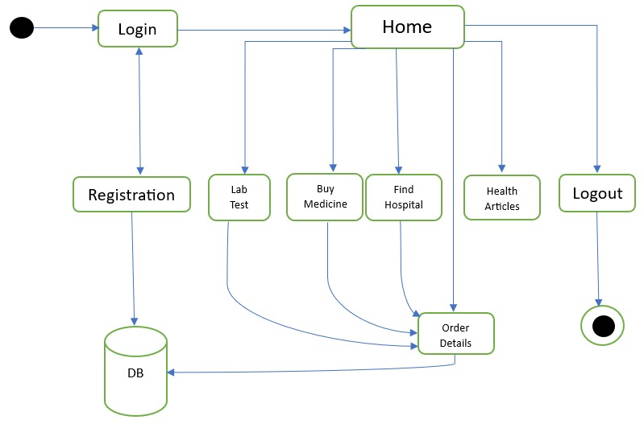
Architecture

Slide 12
Software Components
Platform:
Native Android Development using Android Studio.
UI/UX Design:
XML for designing user interfaces.
Programming Language:
Java.
Database:
MySQL

Slide 13
Timeline of the Project
 | REVIEW - 0 |  |  |  | REVIEW - 1
 | 18-Sep-2024 |  |  |  | 21-Oct-2024
PLANNING
REQUIREMENT ANALYSIS
DESIGN
CODING
TESTING
DEPLOYMENT
PAPER PUBLICATION
REVIEW - 2 |  |  |  | REVIEW - 3
22-Nov-2024 |  |  |  | 17-Dec-2024
`
Final Viva-Voce
10-Jan-2025

Slide 14
Expected Outcomes
Real-Time Data Access: Users will receive up-to-date information on hospital services and bed availability, enhancing trust in the data presented.
User-Friendly Experience: A simple and intuitive interface will ensure that users can navigate the app easily, improving overall satisfaction and usability.
Increased Hospital Utilization: The app will help optimize hospital resource usage by directing patients to the most appropriate facilities based on their needs.
Integration with Emergency Services: Future updates may incorporate features for seamless communication with local emergency services to improve response times.

Slide 15
Algorithm
1. Start
Check if the user is registered.
If not registered, go to the registration page.
If registered, proceed to the login page.
2. After login, go to the Home Page:
Once logged in, go to the home page.
3. Home Page Actions:
Check if the user selects one of the following options:
a. Lab Test:
Go to lab test section.
Add the selected lab test to the cart.
Proceed to the cart.
Verify booking details:
If correct, mark the booking as successful and move to order details.
If incorrect, ask the user to provide correct details.
b. Buy Medicines:
Go to buy medicines section.
Add the selected medicines to the cart.
Proceed to the cart.
Verify booking details:
If correct, mark the booking as successful and move to order details.
If incorrect, ask the user to provide correct details.
c. Find Hospital:
Go to find hospital section.
Allow the user to select a hospital.
Display a list of top doctors in the selected hospital.
If the user clicks on a particular doctor, proceed to appointment booking.
Book an appointment with the selected doctor and add it to the order details.
Mark the booking as successful and move to order details.
d. Articles:
If the user selects yes, share details of particular articles.
If the user selects no, go back to the home page.
e. Order Details:
Display all booked orders.
f. Logout:
Logout and return to the login page.
4. End

Slide 16
PSUEDOCODE
Start
// Check if user is registered
If user is not registered:
Go to registration
Else:
Go to login page then home page
// Home page actions
If lab test is selected:
Go to lab test section
Add lab test to cart
Go to cart
If booking details are correct:
Mark booking as successful
Go to order details
Else:
Ask user to provide correct information
Else if buy medicines is selected:
Go to buy medicines section
Add medicines to cart
Go to cart
If booking details are correct:
Mark booking as successful
Go to order details
Else:
Ask user to provide correct information
Else if find hospital is selected:
Go to find hospital section
User selects hospital
Display list of top doctors in the selected hospital
If user clicks on a doctor:
Book appointment with selected doctor
Add appointment to order details
Mark booking as successful
Go to order details
Else if articles is selected:
If user selects yes:
Share details of articles
Else:
Go back to home page
Else if order details is selected:
Display all orders that have been booked
Else:
Logout
Go to login page
End

Slide 17
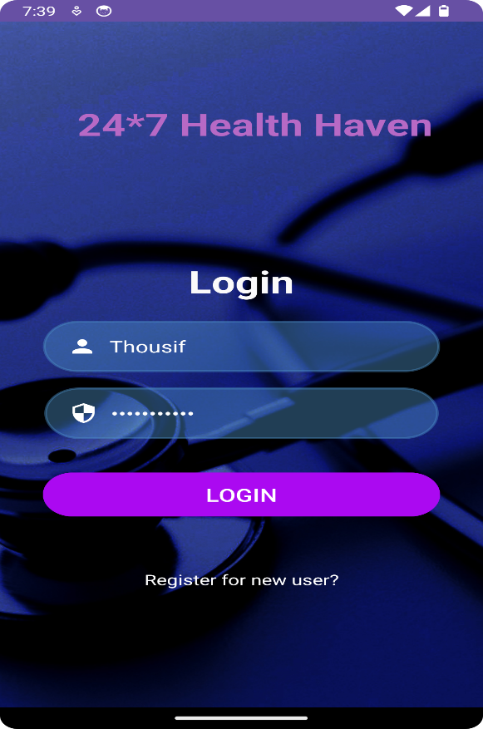
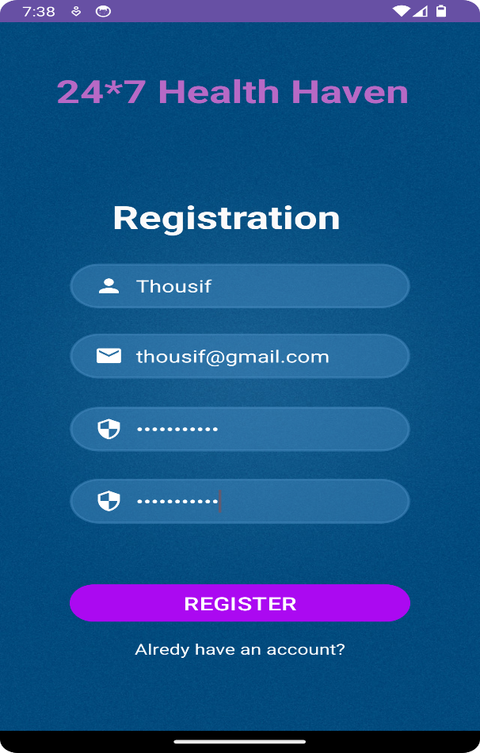
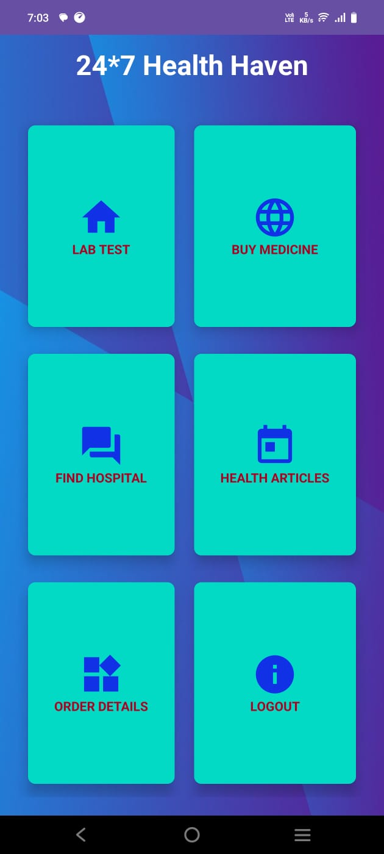
Output
Login page
Registration page
Home page

Slide 18
Conclusion
The proposed work represents a crucial advancement in improving healthcare access during medical emergencies. By providing users with real-time information about hospital services and available specialists, the app empowers individuals to make informed decisions safely, which can be critical to patient outcomes. The emphasis on a user-friendly interface ensures that even in high-stress situations, users can navigate the app easily. Furthermore, the potential for integrating valuable data analytics offers insights that can drive future improvements, ultimately enhancing the overall efficiency of the healthcare system.

Slide 19
Github Link
The Github link provided should have public access permission.
Github Link :
https://github.com/Thousif2004/Hospital-Finder.git

Slide 20
References
[1]. Arvind Mehta, Evaluating the Impact of E-Health Systems on Emergency Medical Services in India.Journal of Public Health Research, Volume 15, Issue 3, September 2021, Pages 15-22. https://jphr.com
[2]. Anjali Bhatt, The Role of Mobile Health Applications in Streamlining Emergency Medical Services in India.Journal of Health Technology, Volume 9, Issue 6, June 2022, Pages 35-42. https://jht.org
[3]. Shruti Desai, Optimization of Hospital Selection Algorithms for Emergency Medical Care in Urban India.Journal of Applied Algorithms and Computation, Volume 10, Issue 4, November 2020, Pages 47-54. https://jaac.org

Slide 21
References
[4]. Amit Kumar, Emergency Health Care Services in India: A Strategic Approach. International Journal for Multidisciplinary Research, Volume 6, Issue 1, January-February 2024, Pages 5-10. https://www.ijfmr.com
[5]. Kartik Mishra, Mobile Health Apps and the Future of Emergency Medical Care in India. Journal of Mobile Technology in Healthcare, Volume 3, Issue 7, July 2020, Pages 21-28. https://www.jmthc.com
[6]. Naveen Sharma, Emergency Response Systems in India: Leveraging Mobile Applications for Faster Access to Healthcare. Journal of Emergency Medical Services, Volume 7, Issue 3, July 2021, Pages 33-40. https://jems.com

Slide 22
Thank You

