Slide 1
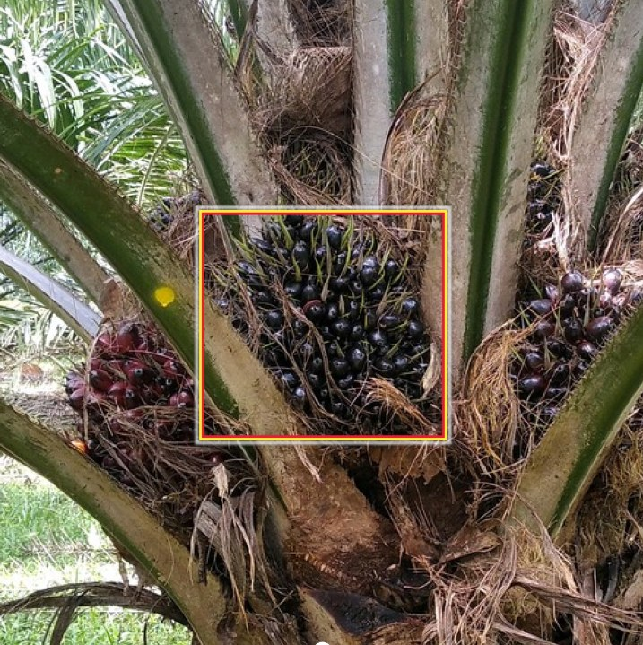
ICIC 2026 · The Tenth International Conference on Informatics and Computing
Benchmarking Multi-View Tree-Level Oil Palm Bunch Counting Under a Fixed Detector
Is the bottleneck the counter — or the detector?
Muhammad Zainal Muttaqin
F. Indriani, S. W. Saputro, A. Rahmi, T. H. Saragih, Hartoni, D. Kartini, N. Said
Lambung Mangkurat University, Banjarbaru, Indonesia
Notes:
[0:30] Good morning, everyone. My name is Muhammad Zainal Muttaqin, from Lambung Mangkurat University, Indonesia. Today I will present our work: Benchmarking Multi-View Tree-Level Oil Palm Bunch Counting Under a Fixed Detector. The whole talk revolves around one simple question: when automatic bunch counting fails, is the problem the counter, or the detector?

Slide 2
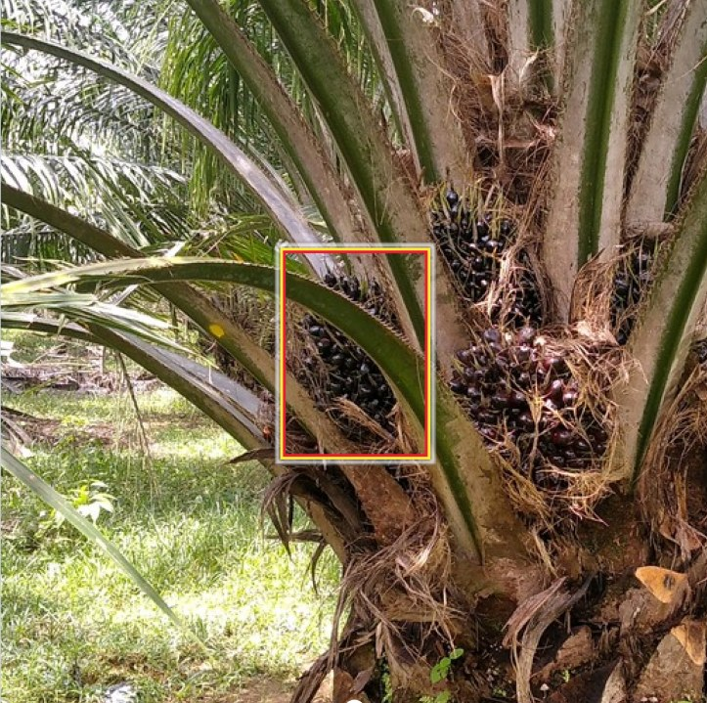
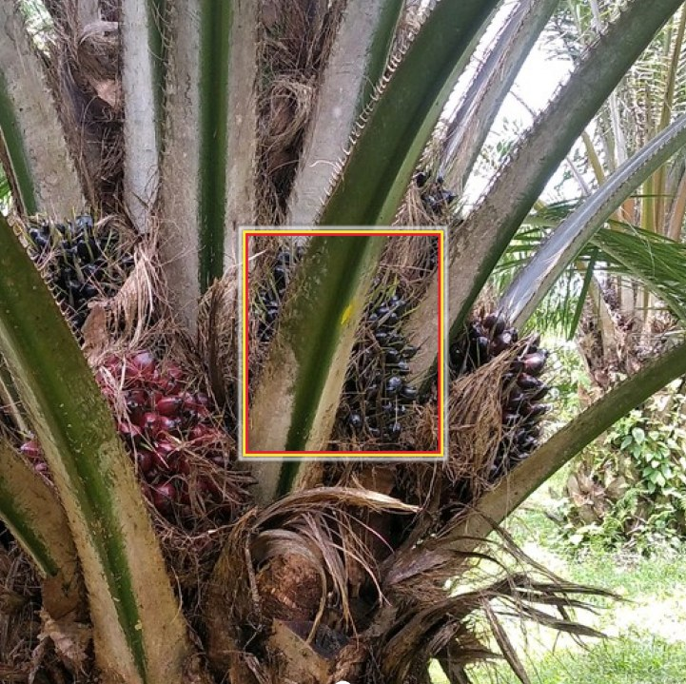



The problem: one bunch, many appearances
Black Bunch Census (BBC) needs a per-tree count for each maturity class B1–B4
Occlusion
Fronds hide bunches, so 4–8 views per tree are captured
Duplication
Summing detections counts the same bunch repeatedly
View 1
View 2
View 3
Open question
3 appearances → only 1 bunch in the tree-level count
Does error come from the counter or the detector?
ICIC 2026
2
Notes:
[1:15] Oil palm plantations plan their harvest using the Black Bunch Census. For every tree, workers count how many bunches belong to each maturity class, from B1 to B4. Doing this manually is slow and subjective, so we want to automate it with images.
But there is a challenge. Bunches grow all around the trunk and are often hidden behind fronds. So we photograph each tree from four to eight sides. Look at these three views: the highlighted bunch is the same B3 bunch, seen three times. If we simply add up the detections, we count it three times. The census needs it counted only once.
So the open question is: where does counting error really come from — from the counting model, or from the detector that feeds it?

Slide 3





SawitMVC dataset & counting pipeline
953
3,992
4
716/96/141
trees
images
maturity classes
train/val/test trees
Multi-view images
Detections
Tree features
Regressor
Counts
4–8 views / tree
GT boxes vs YOLO26m
F0 (13-d) … Fall (67-d)
Linear, Ridge, ElasticNet, SVM, RF
[B1, B2, B3, B4]
Key design: fit the same counters on ground-truth (GT) detections and on a frozen YOLO26m detector — the difference isolates the effect of input quality.
ICIC 2026
3
Notes:
[1:00] We work with SawitMVC: 953 trees, 3,992 images, and four maturity classes, with a fixed split of 716 training, 96 validation and 141 test trees.
The pipeline has five steps. We take the multi-view images, obtain detections, summarize them into tree-level feature vectors, from a 13-dimensional baseline F0 up to 67 dimensions, and a regression model predicts the four class counts.
The key design of this study is here: we fit the same counters twice — once on ground-truth boxes, and once on outputs from a frozen YOLO26m detector. The difference between these two conditions tells us how much input quality matters.

Slide 4

How we measure success
Accuracy within ±1 bunch, plus MAE, RMSE and signed bias
Compared settings
2 heuristic baselines (naive sum, global divisor)
5 regression counters
8 feature sets (confidence, spatial, distribution)
Bootstrap CIs, paired permutation tests + Holm correction
5×5 CV, 2 detector families, 11 thresholds
Class ±1
Tree ±1
Each class count is judged separately.
All four class counts must be within ±1 at the same time.
Is B3 count within ±1?
B1 ✓ B2 ✓ B3 ✓ B4 ✓
ICIC 2026
4
Notes:
[0:50] We use two main accuracy measures. Class plus-minus one checks whether each class count is within one bunch of the truth. Tree plus-minus one is stricter: all four class counts must be correct within one bunch at the same time — which is what a census really needs.
We compare two simple baselines, five regression counters and eight feature sets. To make the comparisons fair, we use bootstrap confidence intervals, paired permutation tests with Holm correction, and several sensitivity checks.

Slide 5
Counters differ little — inputs differ a lot
Class ±1 accuracy (%) on 141 test trees, baseline features F0
3.19 pp
spread among 5 counters with detector inputs — no pair significant after Holm
≈ 21.6 pp
lost by the same counter when GT boxes are replaced by YOLO26m
ICIC 2026
5
Notes:
[1:15] Here is the first main result. The green bars use ground-truth detections, the orange bars use the detector.
First, naive summation fails in both conditions, at around fifty percent. Second, with ground-truth inputs, all the linear counters reach about ninety-eight percent. But when we switch to detector inputs, every counter drops to between seventy-three and seventy-six percent.
The spread among the five counters is only 3.19 percentage points, and no pair is statistically different after correction. In contrast, the same counter loses about 21.6 points just by changing the input. So the choice of counter matters little; the quality of the input matters a lot.

Slide 6
The ground-truth vs detector gap
Best observed configurations: GT ElasticNet+F0 vs fixed Ridge+Fall
Class ±1
98.05%
→
77.48%
−20.57 pp (95% CI 17.20–23.94)
Tree ±1
92.20%
→
32.62%
−59.57 pp
Richer features do not close it: Fall adds only +1.42 pp over F0 (not significant, pH = 1).
6
Notes:
[1:10] Looking at the best configurations, class accuracy falls from 98.05 to 77.48 percent — a gap of 20.57 points, with a confidence interval from 17 to 24. At tree level the drop is dramatic: from 92.2 to 32.6 percent.
The chart on the right shows where it happens. B1 is almost unaffected, but B3 drops to 57 percent and B4 to 72 percent.
Could richer features fix this? Not really. Using all 67 features adds only 1.42 points over the baseline, and this gain is not statistically significant.

Slide 7
Where does the detector lose bunches?
Matching every test detection to annotations (IoU ≥ 0.5)
22.7%
of physical bunches are never detected in any view
Up to 42.3% for B4
158
B2 appearances classified as B3
B2 loses more to confusion than to misses
30.0%
of detections match no annotation (false positives)
Mean confidence 0.337 vs 0.487 matched
ICIC 2026
7
Notes:
[1:10] To understand why, we matched every detection to the annotations. Of 2,612 ground-truth appearances, only 48 percent are both found and correctly classified. 37 percent are missed, and 15 percent are found but given the wrong maturity class.
Three numbers stand out. First, 22.7 percent of physical bunches are never detected in any view — for B4 it is 42 percent. No counter can directly count a bunch it never sees. Second, 158 B2 appearances are read as B3, so class confusion is a major error source. Third, 30 percent of detections are false positives, mostly with low confidence.
These diagnostics are not an additive error budget, but they clearly point to detection quality.

Slide 8




The gap is robust
Class ±1 gap between GT and detector inputs across sensitivity checks
23.58 pp
25.03 pp
Validation-based selection
Matched 5×5 cross-validation
23.94 pp
23.44 pp
Other detector: YOLO11m
4 YOLO26 checkpoints
ICIC 2026
8
Notes:
[1:00] We also checked whether this conclusion is fragile. It is not. The gap remains about 24 points when the best model is selected on validation data instead of the test set, about 25 points in matched five-by-five cross-validation, about 24 points with a separately trained YOLO11m detector, and about 23 points across four YOLO26 checkpoints.
On the right, we varied the detector's confidence threshold from 0.05 to 0.7. No threshold exceeds 77.48 percent, still far below the ground-truth reference of 98 percent.

Slide 9



Takeaways
Detector quality is the priority
Future work
On SawitMVC, improving detector outputs matters more than choosing a counter.
Explicit multi-view association vs learned aggregation
Broader and repeated detector training
Independent plantations and measured camera pitch
Target B3/B4 detection and B2→B3 confusion
These classes drive the tree-level census error.
Evaluate counters under GT and detector inputs
Limitations
Report class, tree and total metrics plus signed bias.
One dataset, two estates; GT is an empirical reference, not an upper bound on future counters.
ICIC 2026
9
Notes:
[1:00] To conclude, three takeaways. First, on this dataset, improving detector output quality matters more than choosing a different counter. Second, for the census, the priorities are better B3 and B4 detection and less B2-to-B3 confusion. Third, we recommend evaluating counters under both ground-truth and detector inputs, and reporting class, tree and total metrics together with signed bias.
Our study has limitations: one dataset from two estates, and ground truth is an empirical reference, not an upper bound for future methods. Next, we plan to compare explicit multi-view association with learned aggregation, and test on independent plantations.

Slide 10


Thank you
Questions & discussion are welcome
github.com/ULM-SawitMVC/Baseline-SawitMVC
mz.muttaqin1@gmail.com
Lambung Mangkurat University · Banjarbaru, Indonesia
Notes:
[0:15] Thank you for your attention. Our code and results are publicly available on GitHub. I am happy to take your questions.

