Slide 1
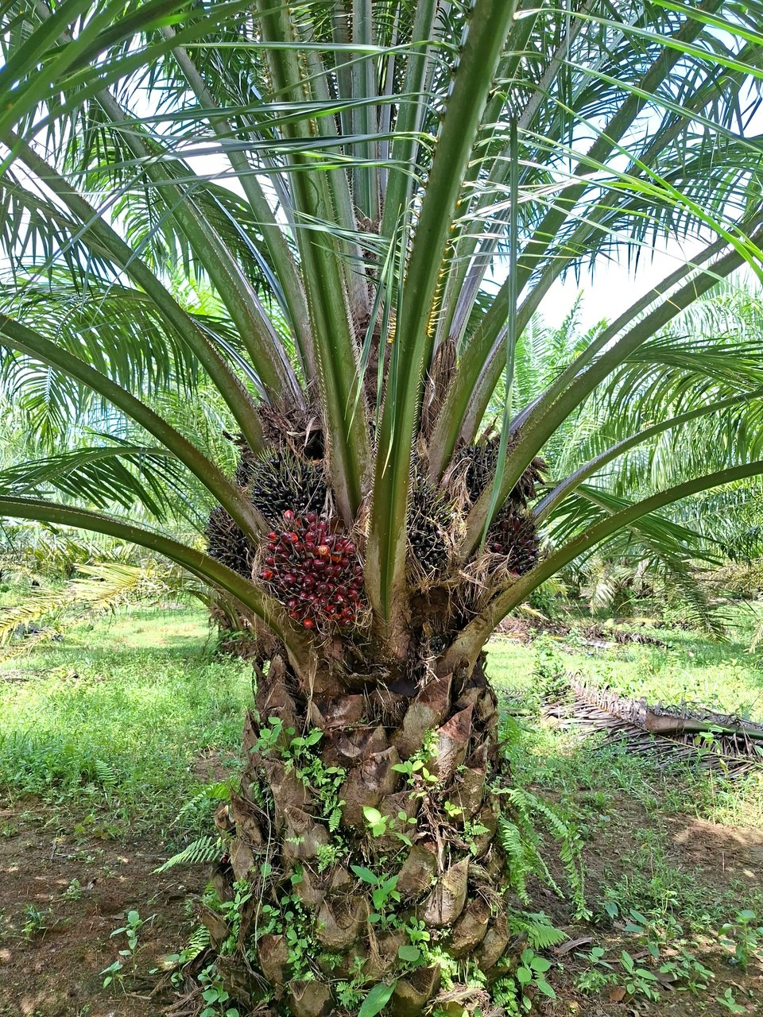
ICIC 2026 · The Tenth International Conference on Informatics and Computing
Benchmarking Multi-View Tree-Level Oil Palm Bunch Counting Under a Fixed Detector
Muhammad Zainal Muttaqin
F. Indriani, S. W. Saputro, A. Rahmi, T. H. Saragih, Hartoni, D. Kartini, N. Said
Lambung Mangkurat University, Banjarbaru, Indonesia
Paper 057 · Funded by BPDP, Indonesia (PRJ-36/BPDP/2026)
Notes:
Good morning, everyone. Today I will present our paper, titled "Benchmarking Multi-View Tree-Level Oil Palm Bunch Counting Under a Fixed Detector". I am Muhammad Zainal Muttaqin from Lambung Mangkurat University, and I am presenting this work on behalf of my co-authors.

Slide 2
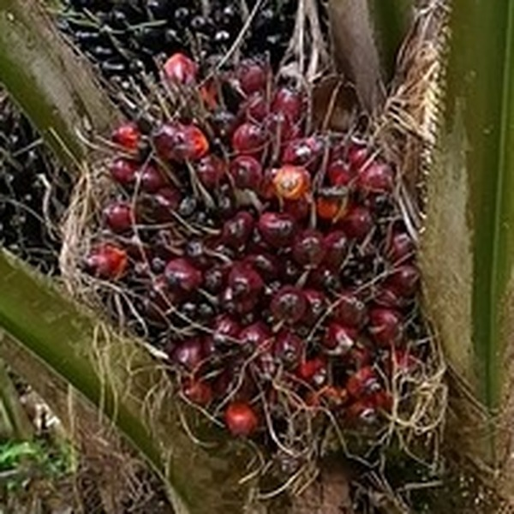
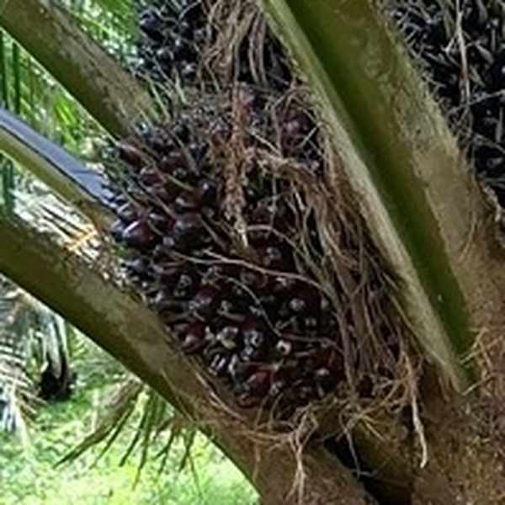
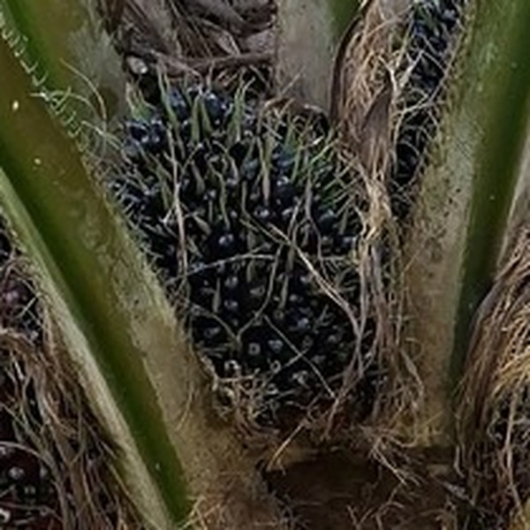
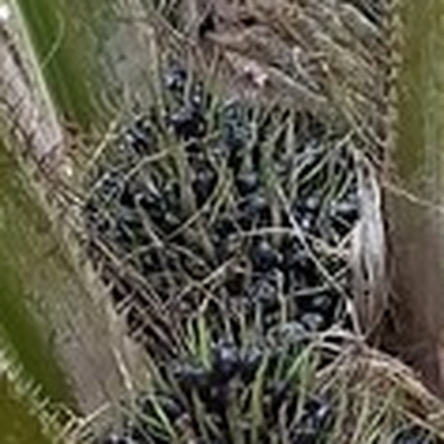
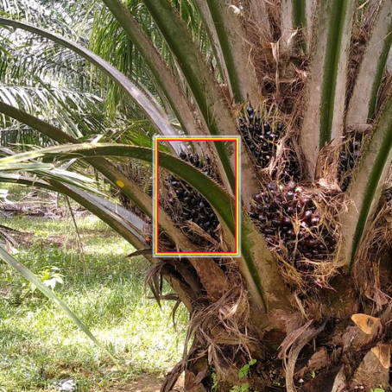
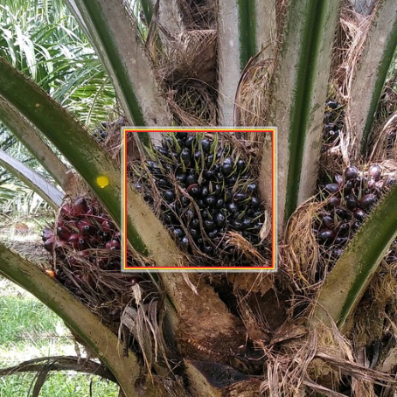
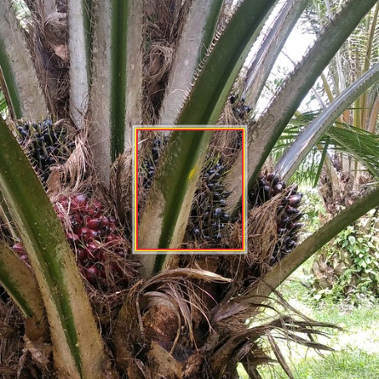
Problem and research objective
1 · Introduction
Black Bunch Census: the plantation survey of bunches on each tree
One tree, several photos: the same bunch is seen again
B1
B2
B3
B4
Photo 1
Photo 2
Photo 3
Ripe
Red, large, round
Transitioning
Dark, turning red
Unripe
Black, spiny
Very unripe
Small, black to green
The survey sorts every bunch on a tree into four maturity classes, B1 (ripe) to B4 (very unripe).
Managers use the count of each class on every tree to plan the harvest.
Today workers count by eye, tree by tree. We want to count from photos.
The orange box marks one B3 bunch: 3 boxes in 3 photos, but only 1 bunch
1.89×
average number of photos in which one bunch appears
50%
of the class counts are right when all boxes are simply added up
How an automatic count works: two parts, and either part can cause the error
Photos of one tree
4 sides (8 sides for 45 trees)
→
Part 1: Detector
finds every bunch in each photo, draws a box around it and gives it a class
→
Part 2: Counter
turns the boxes of all photos into one count per class, without double counting
→
Count for the tree
B1: 1 B2: 2 B3: 5 B4: 2
SawitMVC dataset
953 trees
3,992 photos
2 estates in South Kalimantan
716 / 96 / 141 trees: training / validation / test
RESEARCH OBJECTIVE
To find out which part causes the counting error: the detector or the counter.
Muttaqin et al. · Benchmarking Multi-View Tree-Level Oil Palm Bunch Counting Under a Fixed Detector · ICIC 2026
2
Notes:
In an oil palm plantation, the manager needs to know how many bunches are on each tree and how ripe they are, in four maturity classes from B1 to B4. Today workers count them by eye, so we want to do it from photos.
One photo cannot see the whole tree, so we take four photos from four sides. The problem is that the same bunch then appears in several photos, almost twice on average, so we cannot simply add up what we see in each photo.
A system for this has two parts. A detector finds the bunches in each photo and draws a box around each one. A counter then takes the boxes from all the photos and gives the final number of bunches for the tree. Our research objective is to find out which part causes the counting error, the detector or the counter.

Slide 3
Related work and research gap
2 · Background
Study | Crop | Approach | Why it does not fit 4 to 8 separate photos per tree
Stein et al., 2016 [3] | Mango | Associates detections across views with navigation data and canopy geometry | Needs a moving platform with navigation data
Roy et al., 2019 [4]; Häni et al., 2020 [5] | Apple | Builds yield maps from overlapping scans; reports detection quality as a major source of counting error | Needs dense image overlap along the row
Gaillard 2023 [6]; Freeman 2023 [7]; Meyer 2025 [8] | Other crops | Correspondence-free triangulation, few-view 3D reconstruction, neural radiance fields | Needs calibrated geometry or many overlapping images
Prasetyo, Lai, Mansour, Junos, Naftali et al., 2020–2024 [11]–[15] | Oil palm | Faster R-CNN and YOLO detectors for bunch detection and ripeness classification | Per-image detection only; occluded bunches and similar classes stay difficult
Suharjito et al., 2025 [16] | Oil palm | Public video dataset with frame-level annotations | No tree-level counting labels, no counting evaluation
This work | Oil palm | Regression counters on detection statistics from 4 to 8 smartphone views per tree, scored on ground-truth boxes and on detector boxes | Does not yet match bunches across photos (future work)
Research gap
This study
Existing multi-view methods need dense overlap, a moving sensor or calibrated cameras. A field survey gives only 4 to 8 separate photos per tree.
Oil palm studies stop at detection in single images; the public dataset has no count per tree.
Counting systems are tested as a whole, on detector boxes only, so the errors of the detector and of the counter cannot be separated.
7 counters: 2 simple rules and 5 regression models.
Each counter is tested twice: on boxes drawn by experts (ground truth) and on the boxes of one YOLO26m detector that is never retrained.
The difference between the two tests is tested statistically (bootstrap, permutation, Holm).
Extra checks: a second detector, other checkpoints, other confidence thresholds, cross-validation.
Muttaqin et al. · Benchmarking Multi-View Tree-Level Oil Palm Bunch Counting Under a Fixed Detector · ICIC 2026
3
Notes:
Other researchers have solved this for mango and apple, but their methods need a camera that moves along the row or many overlapping images. We only have four separate smartphone photos per tree.
For oil palm, earlier work stops at detecting bunches in a single image. And when a counting system is tested, it is tested as a whole, so nobody can tell which of the two parts made the mistake.

Slide 4
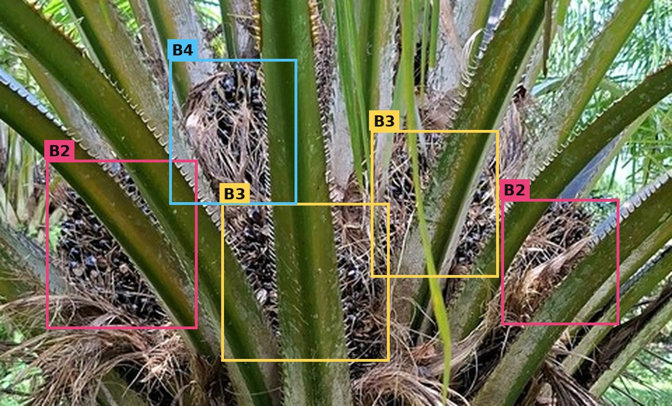
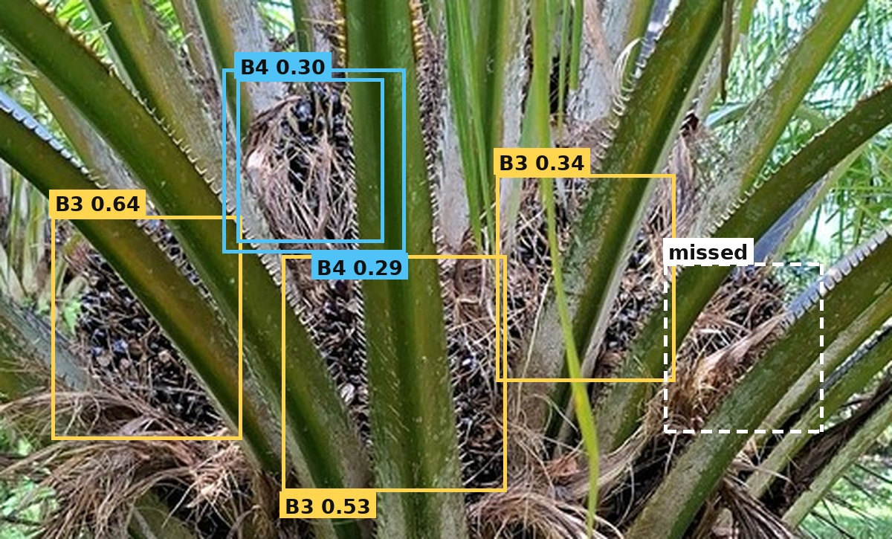
Experimental design: one counter, two inputs
2 · Background
A · Ground truth
1
Counter input: numbers that summarise the boxes of one tree, not images
Baseline set F0, 13 numbers: for each class, the number of boxes in all photos, the largest number in one photo and the mean per photo; plus the number of photos.
Full set F_all, 67 numbers: F0 + box confidence (20) + box position and size (8) + spread across photos (20) + class shares (6).
Example, B3 with 2 boxes in each of 4 photos: sum 8, largest 2, mean 2.0; true count 4.
2
Counters: from these numbers to four counts (B1 to B4)
2 simple rules: add up all boxes (plain sum); or divide that sum by k, the average number of appearances per bunch in the training trees (global divisor; k = 1.891 for expert boxes, 1.793 for detector boxes).
5 regression models, trained on 716 trees: Linear, Ridge, ElasticNet, SVM, Random Forest.
Boxes and classes drawn by experts. Every bunch is found and every class is correct.
B · Fixed detector
3
Accuracy on 141 test trees
 | B1 | B2 | B3 | B4
True | 1 | 2 | 5 | 2
Pred. | 1 | 3 | 7 | 2
Class ±1: share of class counts that are within one bunch of the true count.
Tree ±1: share of trees where all four class counts are within one bunch.
Class ±1 = 3 of 4 = 75%
Tree ±1 = 0 (B3 is off by 2)
4
Bootstrap 95% confidence intervals (10,000 resamples), paired permutation tests, Holm correction for the ten counter pairs.
Statistics
One YOLO26m model, trained on 716 trees and never retrained. It misses bunches, swaps classes and duplicates boxes.
Same counter, different boxes: the drop in accuracy comes from the detector errors.
Muttaqin et al. · Benchmarking Multi-View Tree-Level Oil Palm Bunch Counting Under a Fixed Detector · ICIC 2026
4
Notes:
To separate the two parts, we test every counter twice. The first time, we give it the boxes that experts drew by hand, so the input has no mistakes. The second time, we give it the boxes from a YOLO detector, which misses some bunches and gives some of them the wrong class.
We use one detector model for the whole study and we never retrain it, so every counter receives exactly the same boxes. Because the counter is also the same in both tests, any drop in accuracy comes from the mistakes of the detector.
As counters, we compare two simple rules, such as dividing the total by the average number of repeats, and five regression models. We count a prediction as correct when it is within one bunch of the true number.

Slide 5
Results on the 141 test trees
3 · Results
Class ±1, best: ground truth → detector
98.05 → 77.48%
best counter on each kind of boxes
Tree ±1, best: ground truth → detector
92.20 → 32.62%
trees with all four classes right
Loss caused by the detector boxes
20.57 pp
95% CI 17.20 to 23.94, p < 0.001
Among the 5 regression counters
3.19 pp
not significant, Holm p = 0.628
A · All counters, baseline input F0 (accuracy in %, MAE in bunches)
B · Class ±1 per class (%), loss in red
ground truth
detector
Method | Ground-truth boxes |  |  | Fixed detector boxes
 | Class ±1 | Tree ±1 | MAE | Class ±1 | Tree ±1 | MAE
Plain sum | 50.00 | 6.38 | 2.142 | 50.71 | 10.64 | 2.447
Global divisor | 95.57 | 86.52 | 0.356 | 70.21 | 22.70 | 1.188
ElasticNet | 98.05 | 92.20 | 0.277 | 76.42 | 29.79 | 1.043
SVM | 97.87 | 91.49 | 0.266 | 74.82 | 29.08 | 1.043
Ridge | 97.70 | 90.78 | 0.275 | 76.06 | 28.37 | 1.053
Linear regression | 97.52 | 90.07 | 0.277 | 75.71 | 30.50 | 1.048
Random forest | 95.92 | 84.40 | 0.365 | 73.23 | 26.95 | 1.110
100.00
97.16
99.29
93.62
99.29
98.05
82.98
72.34
77.48
57.45
B1
B2
B3
B4
All
−2.84 pp
−16.31 pp
−36.17 pp
−26.95 pp
−20.57 pp
C · What the detector gets wrong (test photos, per class)
D · Why the counter cannot repair the detector errors
Class | Val. mAP50 | Appearances | Missed | Wrong class | False boxes | Recall
B1 | 0.746 | 252 | 47 | 33 | 58 | 0.683
B2 | 0.425 | 496 | 161 | 209 | 158 | 0.254
B3 | 0.550 | 1,409 | 494 | 65 | 393 | 0.603
B4 | 0.363 | 455 | 262 | 89 | 97 | 0.229
All | 0.521 | 2,612 | 964 | 396 | 706 | 0.479
22.7% of bunches (317 of 1,397) are not detected in any photo of their tree: 8.5% for B1, 42.3% for B4.
158 of 496 B2 appearances get the label B3: the total is right, the class is wrong.
Full input F_all (67 numbers instead of 13): +1.42 pp, not significant.
The loss stays when we change the setup (Class ±1 loss):
23.58 pp
counter chosen on validation trees
25.03 pp
5×5 cross-validation
23.94 pp
other detector (YOLO11m)
23.44 pp
4 YOLO26 checkpoints
Appearance = one bunch in one photo. Of 2,612 appearances: 47.9% found with the right class, 36.9% missed, 15.2% wrong class.
Muttaqin et al. · Benchmarking Multi-View Tree-Level Oil Palm Bunch Counting Under a Fixed Detector · ICIC 2026
5
Notes:
This slide has all our results, so let me point to the main numbers. With the expert boxes, the best counter is correct in 98 percent of the cases. With the detector boxes, it drops to 77 percent. That is a loss of about 21 points.
In contrast, when we compare the five counters with each other, they differ by only 3 points, and that difference is not statistically significant.
Why is the loss so large? Because 23 percent of the bunches are not detected in any of the photos, and the counter cannot count a bunch that it never receives. The detector also often labels B2 bunches as B3.
Giving the counter more information improved it by only about one point. And when we repeated the comparison with another detector and with cross-validation, the gap stayed between 23 and 25 points.

Slide 6
Conclusions
4 · Conclusion
The quality of the boxes matters most.
Ground-truth boxes give 20.57 pp more Class ±1 and 59.57 pp more Tree ±1 than detector boxes. The five counters differ by at most 3.19 pp, which is not significant.
Limitations
1
One dataset from two estates in South Kalimantan; the smaller has 99 trees.
One training run per detector.
Ground truth is an empirical reference, not an upper bound for future counters.
The test set is reused to highlight the best configurations.
The gap is stable.
It stays between 23 and 25 pp with validation-based selection, cross-validation, a YOLO11m detector and four YOLO26 checkpoints.
2
The loss depends on the class.
B3 −36.17 pp, B4 −26.95 pp, B2 −16.31 pp, B1 −2.84 pp. The detector must find more B3 and B4 bunches and separate B2 from B3.
Future work
3
Match bunches across photos explicitly and compare with the regression counters on the same boxes.
Repeated detector training and more detector families.
An independent plantation.
Measured changes of camera pitch.
Recommended evaluation protocol.
Report each counter on ground-truth boxes and on detector boxes, per class and per tree, with the direction of the error.
4
ANSWER TO THE OBJECTIVE
On SawitMVC, the count depends far more on the detector output than on the choice of counter.
Muttaqin et al. · Benchmarking Multi-View Tree-Level Oil Palm Bunch Counting Under a Fixed Detector · ICIC 2026
6
Notes:
So, to answer our question: on this dataset, the count depends much more on the detector than on the choice of counter. The next improvement should therefore be in the detector, especially for the unripe classes B3 and B4.
We also suggest that counting methods be reported with both expert boxes and detector boxes, so that the two sources of error stay visible.
Our data come from only two estates, so we still need to test this on an independent plantation.

Slide 7
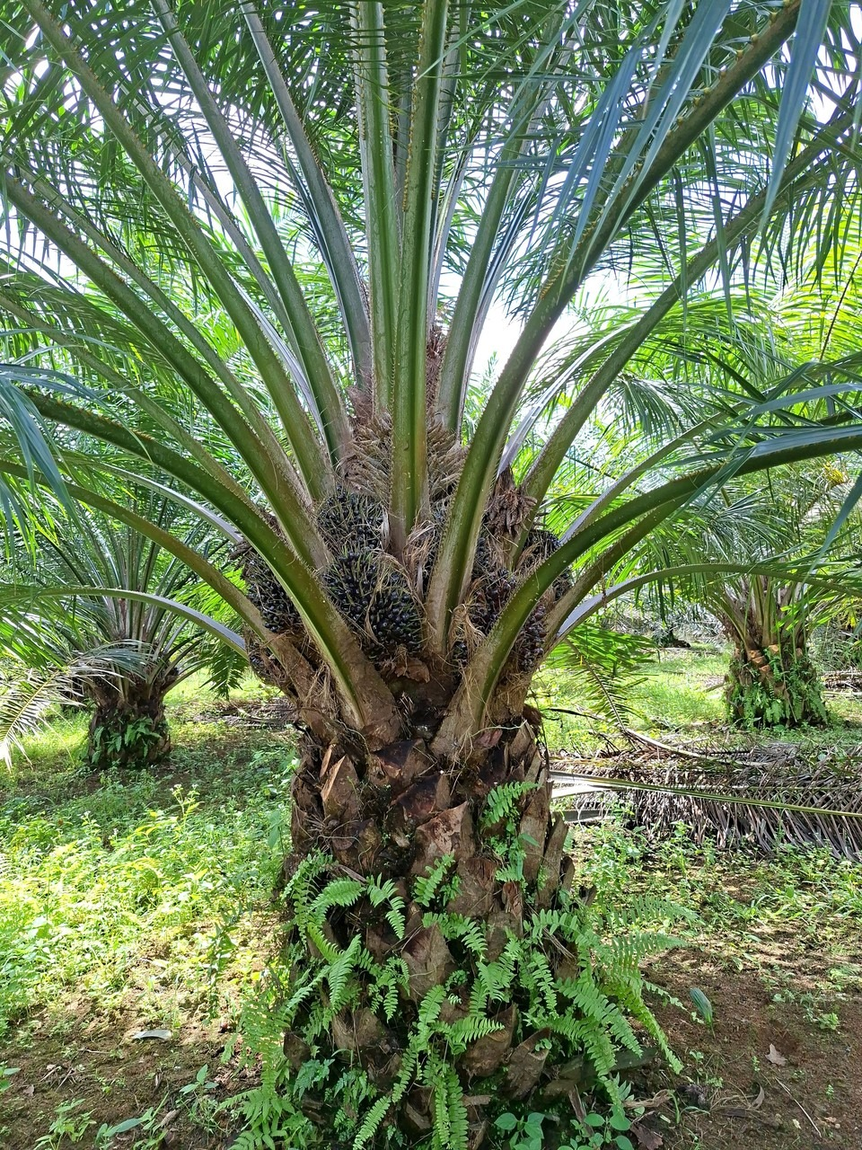


Thank you
github.com/ULM-SawitMVC/Baseline-SawitMVC
mz.muttaqin1@gmail.com
Lambung Mangkurat University · Banjarbaru, Indonesia
Funded by Badan Pengelola Dana Perkebunan (BPDP), Indonesia, contract PRJ-36/BPDP/2026.
Notes:
Thank you for listening. Our code and results are on GitHub, and I am happy to take your questions.

