Slide 1
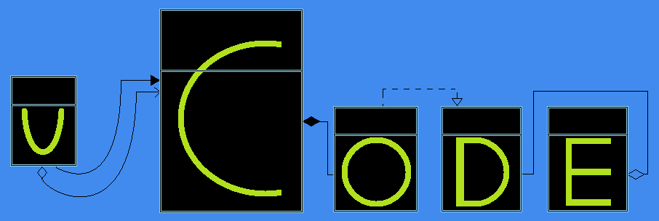
uCode
Rollout Presentation

Slide 2
Team Roles
Dan
Object structure, app logic, integration, user interface
Carlos
Testing, user interface, app logic, integration
Mike
Testing, user interface, integration
External Contribution
Ben Campbell contributed a great python strategy to demonstrate encapsulation within the design.

Slide 3
Development Method - Agile
Git & Github
Issue Tracking
Real Time communication
Weekly informal meetings
Pair Programming

Slide 4
Product Overview
Make UML diagrams in GUI environment
Support for the most common OO concepts
Generate stub code from the UML diagram
Choice of language
Platform independent

Slide 5
Product Use Cases
Business: Shorten development cycle, time to market
Engineering: Rapid prototyping
Education: Reinforce object oriented concepts

Slide 6
Design Overview
Patterns
Strategy
Factory
Composite
Visitor
State
Singleton
Facade
Advantages
Easily integrate new languages
Manage the creation of objects
Ease interaction with groups of objects
Decouple object structure and app logic
Change UI based on user actions
Manage factories, buttons, main, visitor
Simplify UI / Application Interaction

Slide 7

Stop
Demo Time

Slide 8
Possible Enhancements / Stunning Conclusion
Clean UI
Save/Load Diagrams
Create Environment Files
Drag & drop + moving classes in canvas
Lessons learned:
Don’t develop in isolation (GUI, Logic)
Provide facade for GUI events
Make time to learn new framework
Pair programming rocks

