Slide 1

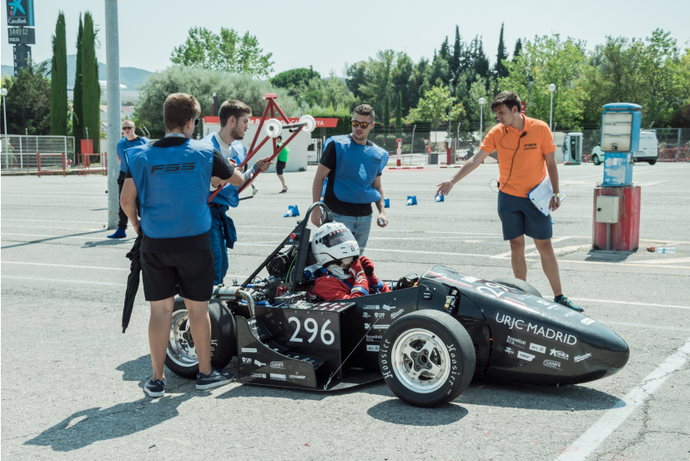
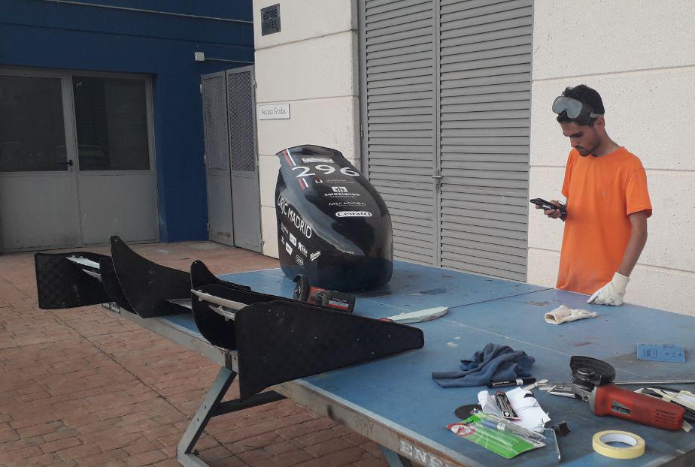

PA – Project Approval
11/09/2020
Project cost estimation: 360€
Sensorization, odometry, and position
David Jiménez Urbano: Division chief
Jose Sebastián, Rubén Jiménez: Project manager

Slide 2
Sensorization, odometry, and position
Index
Concept
Targets
Validation Plan
Deadlines: Design Release and Shipped
Budget
Affected documents

Slide 3
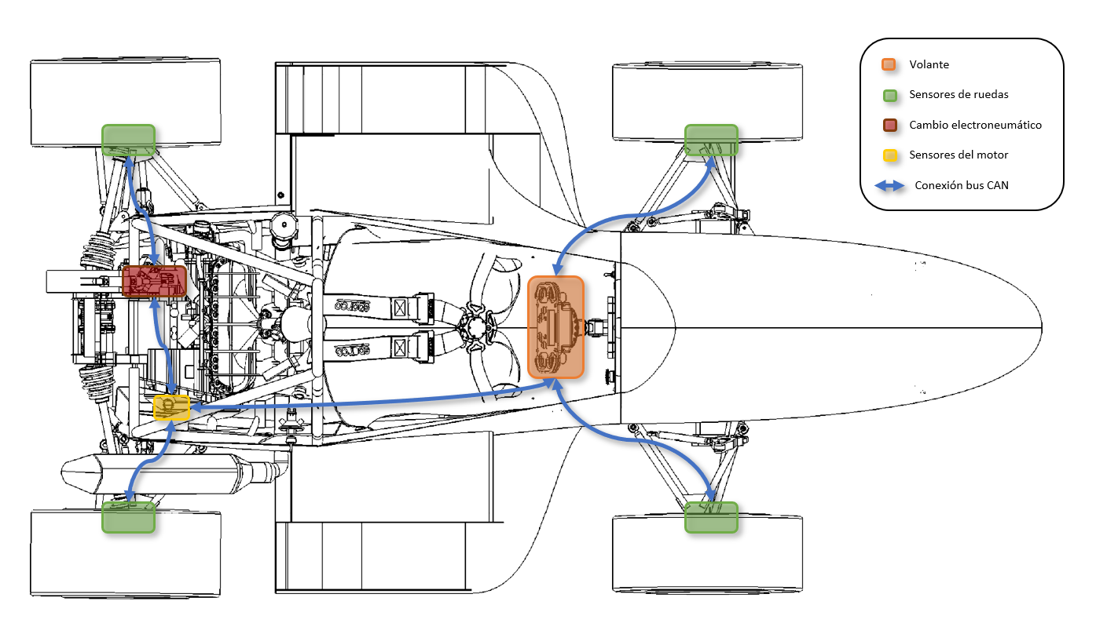
Sensorization, odometry, and position
Concept
Read the speed of all wheels, GPS, IMU data, and any future sensor.
There are going to be 4 sensor boards, one per wheel, mainly for odometry.

Slide 4
Sensorization, odometry, and position
Concept
We have chosen reluctors (passive wheel speed sensors) instead of hall effect sensors, because of their lower price, the lower distortion of a sinusoid signal from a reluctor instead of a square wave from the hall-effect sensor, and the fact the it doesn’t need a power supply to work.
Hall effect | Reluctor
Noisy square wave signal | Sinusoidal wave signal. Not noisy once converted
Not sensitive to air gap | Sensitive to air gap
Sensitive to temperature | Not sensitive to temperature
Active sensor – 3 cables | Passive sensor – 2 cables
Common in normal cars | More reliable under vibrations
More expensive | Cheaper
Also, we will need phonic wheels made from some magnetic steel (Or maybe just magnets). Ideally some Ferritic or Martensitic stainless steel like 440.

Slide 5
Sensorization, odometry, and position
Concept
The GPS and IMU sensors will be placed on the main PMC (PCI Mezzanine Card).
The sensor boards will communicate through a CAN bus.

Slide 6
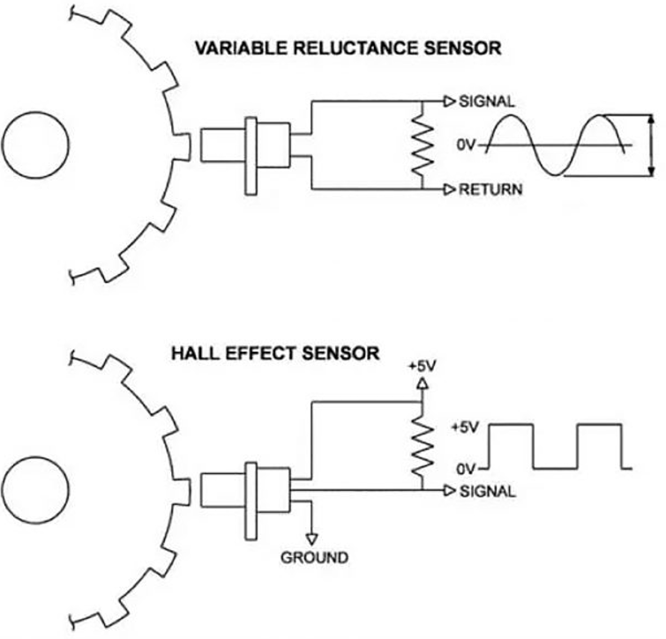
Sensorization, odometry, and position
Targets
Durability. If a sensor breaks under normal use, the design will have to be updated to prevent it.
Ease of assembly and adjustment.
Reliability
For wheel speed sensors: >= 99% of correct detection and <= 1% false positives (Over the amount of teeth that passed the sensor) at all reasonable temperatures and speeds.
Clear data from GPS and IMU. Low noise levels.
Lower possible cost after meeting the previous targets. (About 150g per wheel + sensor according to the first designs)
Lower possible weight after meeting the previous targets

Slide 7
Sensorization, odometry, and position
Validation Plan
Wheel speed sensors:
First visually check the sensor signal.
Check the teeth frequency after manually turning the wheel.
Turn the wheel at high speeds and then stop it at the same position it started with, while counting the tooth detections. The tooth count should be a multiple of the amount of teeth in the phonic wheel.
GPS: Check detection speed, noise and consistency
IMU: Should detect acceleration of 1g downwards
Lab test

Slide 8
Sensorization, odometry, and position
Validation Plan
Wheel speed sensors:
Check that the measured speed matches with GPS and calculations with tracks of known length.
Check the temperature and general condition of the sensor after prolonged use.
GPS: Compare gathered data with the track map
IMU: Check reasonable values.
Road test

Slide 9
Sensorization, odometry, and position
Deadlines: Design Release (DR) and Shipped
Preliminary concept
Design Release
Test breadboard
Test PCBs
Test on road
Shipped
18/09/2020
10/10/2020
20/10/2020
20/11/2020
20/12/2020
10/02/2020

Slide 10
Sensorization, odometry, and position
Budget
Item | Unitary Price | Quantity | Total
Wheel Speed Sensor | 27€ (mouser) | 8 (4 + spare parts) | 216€
Phonic wheels (laser cut) | 0 | 12 | 0
GPS | 10€ | 2 | 20€
IMU | 17€ | 2 | 34€
PCB | 5€ | 4 | 20€
Components | 70€ | 1 | 70€
TOTAL |  |  | 360€

Slide 11


Sensorization, odometry, and position
Affected documents
Document | Name | ¿Affected?
SE3D | Structural equivalency 3D Model
IAD | Impact Attenuator Data
SES | Structural Equivalency Spreadsheet
SESA | Structural Equivalency Spreadsheet Approval
FTO | Fuel Type Order
CRD | Cost Report Documents
BOM + CBOM | Bill of Materials
CEF | Cost Explanation File (Part of CRD)
SM | Supporting Material (Part of CRD)
EDR | Engineering Design Report
DSS | Design Spec Sheet
BPES | Business Plan Executive Summary

