Slide 1
Introduction to SKLearn
Logan Williams
SC2 seminar – Nov 1, 2018

Slide 2


Slide 3
Tutorials
Scikit-Learn itself!
http://scikit-learn.org/stable/tutorial/index.html
Datacamp
https://www.datacamp.com/community/tutorials/machine-learning-python
Coursera classes
Many more on Google!

Slide 4
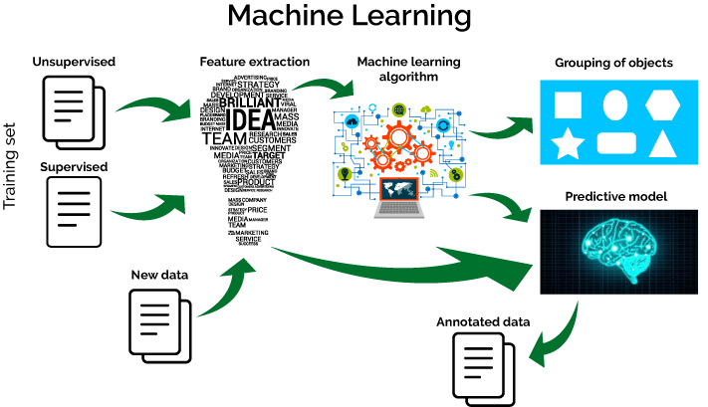
What is Machine Learning?
https://www.xenonstack.com/blog/static/public/uploads/media/Machine-learning-workflow.png

Slide 5
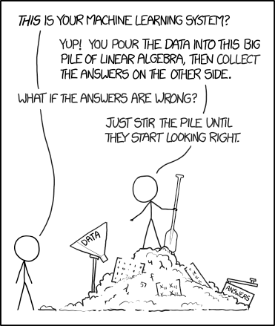
What is Machine Learning?
M Features
A
x
= b
N Data Points
N Labels or Values

Slide 6



How classification “works”
Observe Known Thing
Extract Useful Evidence
Make a Mental Model
If:
- 4 legs
- Tail
- Eyes
- Ears
- Nose
- Mouth
Then: Dog
Train
Dog
Test
Observe Unknown Thing
Extract Useful Evidence
Apply Mental Model
Dog!
4 legs
Tail
Eyes
Ears
Nose
Mouth
Dog?

Slide 7
How classification “works”
Observe Known Thing
Extract Useful Evidence
Make a Mental Model
If:
- 4 legs
- Tail
- Eyes
- Ears
- Nose
- Slobbery Snout
Then: Dog
Train
Dog
Test
Observe Unknown Thing
Extract Useful Evidence
Apply Mental Model
Not Dog!
4 legs
Tail
Eyes
Ears
Nose
Hissing Mouth
Dog?

Slide 8

http://scikit-learn.org/stable/tutorial/machine_learning_map/index.html - clickable links!

Slide 9
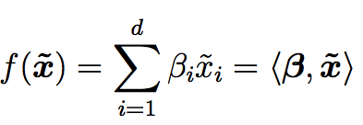
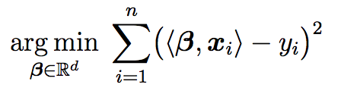
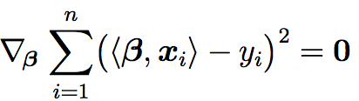

Linear Regression
Simplest form of regression
Fitting function is in the shape:
Fitting is done by minimizing the squared error in the training set:
Optimization is done by setting the gradient to zero:
Equations taken from M. Rupp, Int. J. Quantum Chem. 115, 1058 (2015).

Slide 10
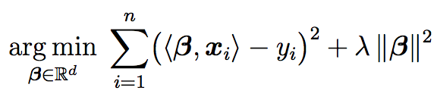

Ridge regression
Linear regression is prone to overfitting errors
Large coefficients β_{i} that cancel in the training set
In the prediction of new inputs, these cause large errors
Ridge regression adds regularization to prevent overfitting
Penalty term added to the optimization problem:
Solving the optimization problem gives:
Equations taken from M. Rupp, Int. J. Quantum Chem. 115, 1058 (2015).
Notes:
Lambda is a hyperparameter determining the strength of the regularlization
Higher lambda -> smoother result

Slide 11
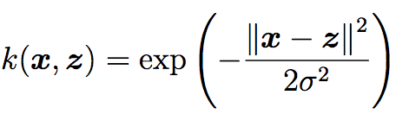
Kernel ridge regression
Kernel ridge regression adds non-linearity
Maps inputs into a higher dimensional space and applies the linear algorithm there
Mapping into higher dimensional space correspondingly increases computational complexity – how to avoid?
The kernel trick
ML algorithms can be written to only use inner products between inputs
Kernel functions operate on input space vectors, but yield the same results as inner product evaluations in feature space
The Gaussian kernel is widely applicable:
Equations taken from M. Rupp, Int. J. Quantum Chem. 115, 1058 (2015).
Notes:
Sigma is a hyperparameter determining the length scale on which the kernel operates

Slide 12
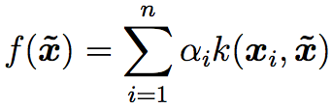
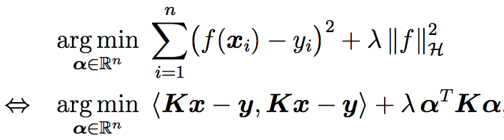
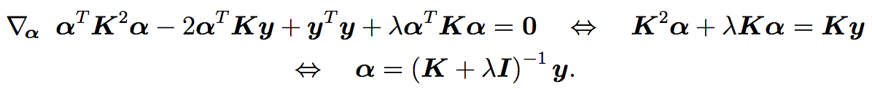
Kernel ridge regression
Fitting function is in the shape:
Fitting is done by minimizing the squared error in the training set plus the regularization penalty:
Optimization done by setting the gradient to zero:
Equations taken from M. Rupp, Int. J. Quantum Chem. 115, 1058 (2015).
Notes:
Extra slide on choosing of lambda and sigma for the regularization and the kernel?

Slide 13
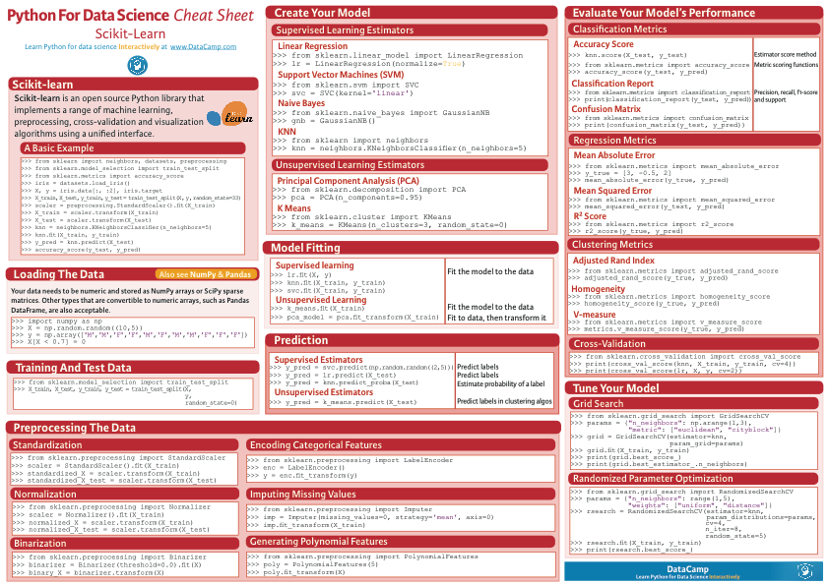
From
DataCamp.com

Slide 14
Hands On Practice
git clone https://github.com/UM-SC2/HPC-DS-workshop-2018.git

Slide 15
Final Remarks
Scikit-learn’s website has great documentation with many examples!
There are MANY more algorithms, data preprocessors, and other tools than were mentioned today.

