Slide 1
VIDEO LLM (LARGE LANGUAGE MODELS)

Slide 2
Real Time Video Understanding with Large Language Models
Problem Statement:
  Develop a real-time video understanding system using large language models (LLMs) that can interpret and narrate the environment to assist visually impaired individuals, or to provide situational awareness when integrated into drones or vehicles. The system should be able to process live video feeds, accurately identify and describe objects, activities, and surroundings, and convey this information through natural language in real-time, ensuring the user stays informed about their environment.

Slide 3
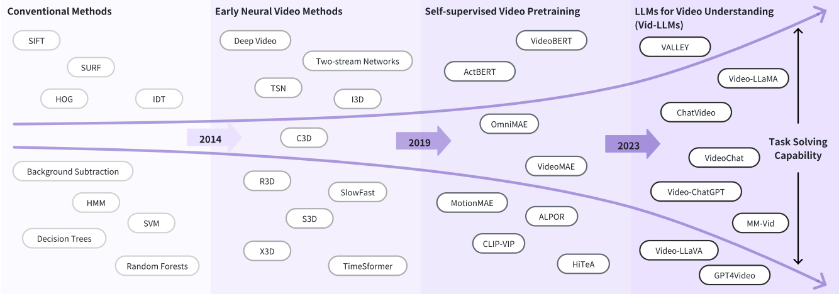
The development of video understanding methods can be summarized into four stages: (1) Conventional Methods, (2) Early Neural Video Models, (3) Self-supervised Video Pretraining, and (4) Large Language Models for Video Understanding, i.e., Vid-LLMs. Their task-solving capability is continuously improving, and they possess the potential for further enhancement.

Slide 4
VID-LLMS
1.)video Analyzer x LLM
Video Analyzer:Multi-step process results in the textual analysis of the video, converting its audio-visual content into structured text data.Detects objects, actions, speech, and text,giving something like: "Man walking dog, car driving by, people sitting on bench."
LLM: Uses the analyzed text to create more meaningful, insightful, and contextual outputs that go beyond the raw detection provided by the Video Analyzer.like "A man walks his dog in the park while a car drives by. People are relaxing on benches."

Slide 5
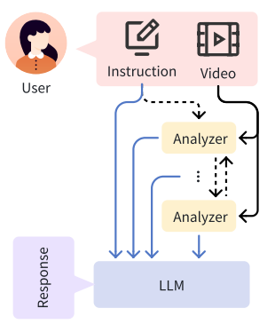
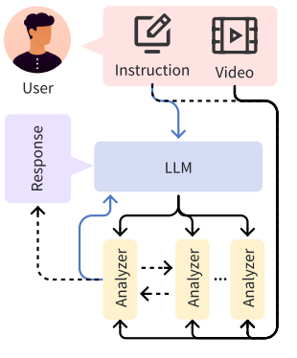
LLM as SUMMMARIZER vs MANAGER
LLM as Summarizer: In this subcategory, the primary function of the LLM is to summarize the analysis results obtained from the Video Analyzers.
LLM as Manager acts like a conductor , coordinating the various Video Analyzers to ensure the system provides the best and most relevant analysis of the video for the user’s needs, rather than simply summarizing the output of a single pass of analysis.

Slide 6
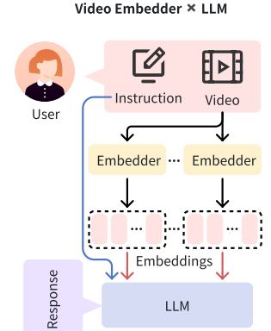
2.) Video Embedder x LLM
Video Embedder:
Purpose: The Video Embedder is responsible for transforming raw video data into vector representations . embeddings are numerical encodings of the video, which capture the visual features in a form that machine learning models can understand.
Process: It typically uses models like ViT (Vision Transformer) or CLIP, which are designed to handle visual inputs (frames of the video) and convert them into embeddings. These embeddings represent the underlying content in the visual semantic space.
Adapter Requirement: Since LLMs operate in a textual space, an adapter is needed to convert these video embeddings into something usable by LLMs.
Video Embedder captures low-level features (e.g., pixel patterns, motion) in an abstract form.
Best for if we compare video content or retrieve similar videos,Applications needing low-level detail(e.g., action recognition, gesture detection)
It is further divided into LLM as Text Decoder,LLM as Regressor and LLM as Hidden Layer

Slide 7
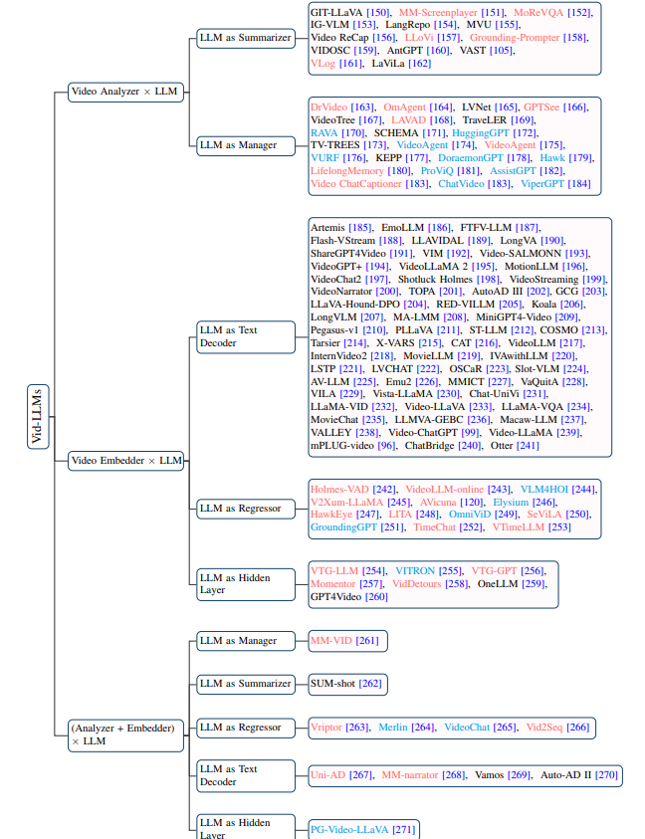
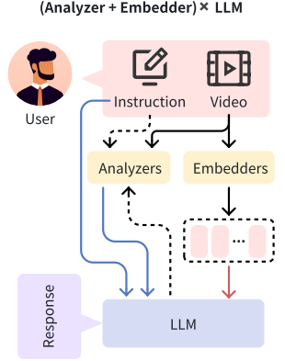
3.) (Analyzer+Embedder)x LLM
It invlolves simultaneously using a Video Analyzer to obtain textual analysis of the video and a Video Embedder to encode the video into embeddings. The LLM receives both types of inputs along with other prompts/instructions and outputs responses to complete tasks.

Slide 8
CURRENT PROGRESS
I have successfully implemented a real-time video frame extraction system as part of the analyzer. This system processes video streams by analyzing individual frames, assigning relevance scores to each, and filtering out frames that are deemed unnecessary. This helps in reducing noise and focusing on frames that carry meaningful information for further analysis.And trying to access cammera from phone and extracting the frame and do further process.

Slide 9
FUTURE WORK:
Optical Character Recognition (OCR): If the video contains text (such as subtitles or on-screen text), OCR can be applied to detect and extract the text from each frame.
Audio-to-Text Conversion (Speech Recognition): If the video has spoken dialogue, speech recognition techniques are used to convert the audio portion into text. This typically involves applying Automatic Speech Recognition (ASR) systems, which analyze the audio track of the video and generate a transcript of the spoken content.
Object and Scene Detection: In cases where visual analysis of objects, actions, or scenes is important, machine learning models (such as object detectors or scene classifiers) identify key elements in the video. The output of these models is often converted into text descriptions (e.g., "person walking" or "car driving").
After that I will apply LLM using prompt and convert into text then to speech

Slide 10
THANK YOU

