Slide 1

Code Refactoring and Bug Fixing
By
Umamahesh Yenamala – IN1240703

Slide 2
Scenario A team of enthusiastic data scientists embarked on a mission to develop a Note Taking Application using Python, Flask, and HTML. However, their lack of experience in backend development has led to challenges in making the application fully functional. Recognizing your proficiency in backend development, you have been tasked with fixing the broken code and ensuring the application works seamlessly. Task Refactor the existing codebase and ensure the proper functioning of the Note Taking Application. Document all identified bugs during the debugging process. Remember, the task is not about recreating the app from scratch. Your goal is to fix the already existing codebase and make the application work as intended.

Slide 3
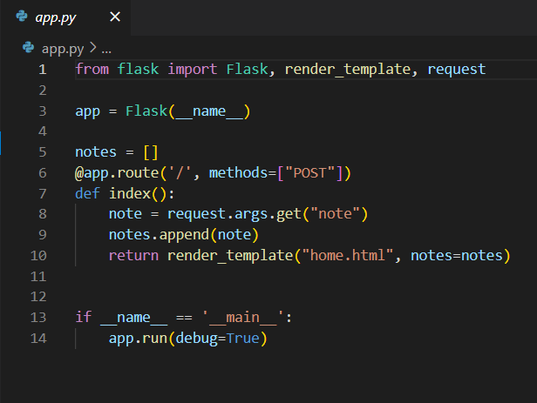
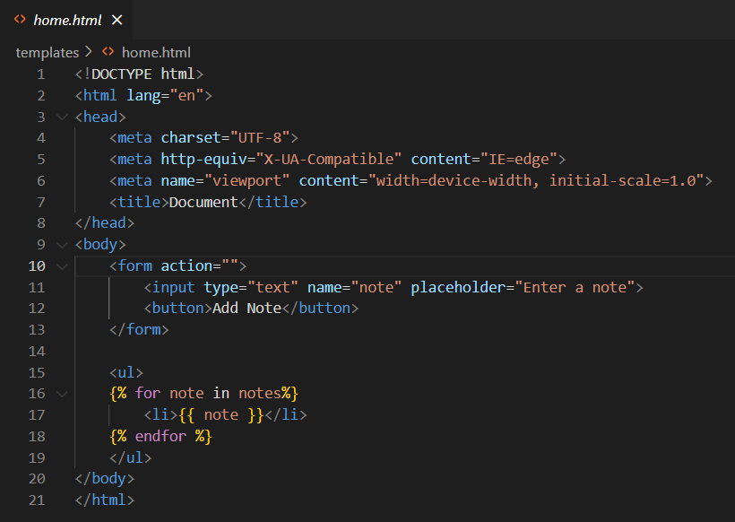
Let’s run the code
Flask code
HTML code

Slide 4
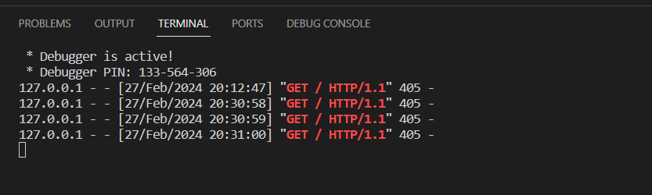
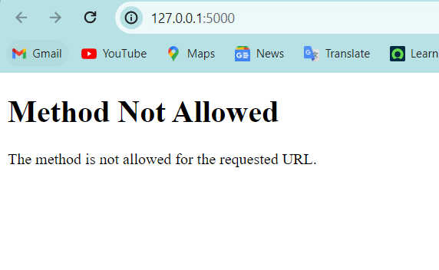
OUTPUT
Terminal
From above we can know that the status code is 405 which there is a problem in client side.
HTML viewer:
“Method Not allowed” occurs when there is no same methods include in methods section of form tag.

Slide 5

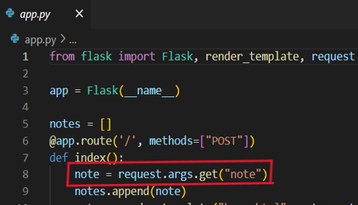
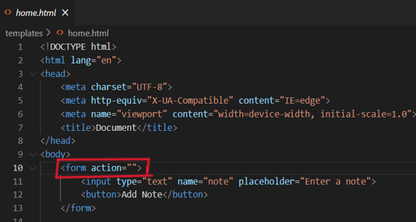
Identified Bugs
Bug1
The marked one is bug because in html code by default it will be a GET method and in flask code we have taken method as POST. Methods should be taken same in both html and flask codes.
Solution :
And request.args should be replace by request.form because we are using POST method in HTML. Methods = [“GET”,”POST”]
Bug2
The marked is bug because in flask code in route we had given it as “/” but in html code we had given a empty route “”. In form tag we need to take POST method for data secure.
Solution :
In form tag : < form action =“/” method = “POST”>

Slide 6
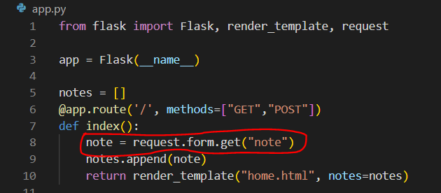
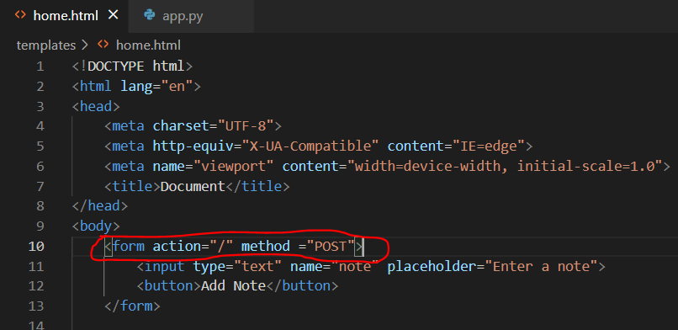
Refactored Code
Flask code
HTML Code

Slide 7
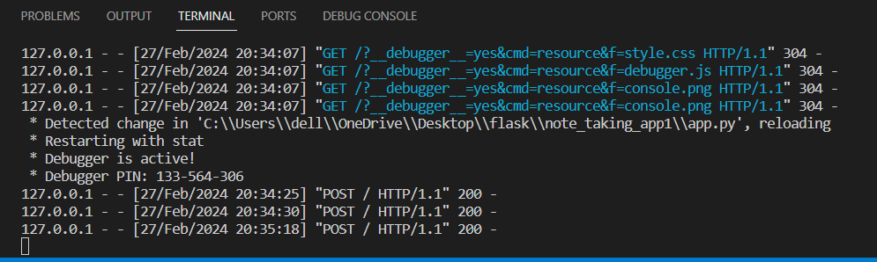
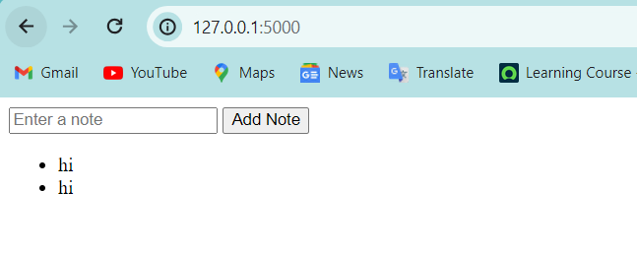
OUTPUT
Terminal
From above fig we can say that status code is 200 which means successfully running without any errors
HTML Viewer
After fixing the bugs this is final output we can expect from the refracted code.

Slide 8

THANK YOU

