Slide 1

CWM Closed World Machine

Slide 2
CWM Overview
CWM is a simple Semantic Web program that can do the following tasks
Read and pretty-print several RDF formats
Store triples in a queryable in-memory triple store
Perform inferences via forward chaining rules
Perform builtin functions, e.g., comparing strings or numbers, retrieving resources, using an extensible builtins suite
CWM was written in Python by Tim Berners-Lee and Dan Connolly of the W3C (circa 2000!)

Slide 3
What’s CWM good for?
CWM is good for experimenting with RDF and RDFS and some OWL
CWM’s rule based reasoner can’t cover all of OWL
A good Unix command line tool
rdfs:seeAlso
http://infomesh.net/2001/cwm/
http://w3.org/2000/10/swap/doc/Processing

Slide 4
CWM in a Nutshell
Reasoning via N3 rules
CWM
rdf in various
encodings
rdf in various
encodings
filter

Slide 5
CWM command line
Example: cwm --rdf foo.rdf --n3 > foo.n3
Args are processed left to right (except for flags --pipe and –help
Here’s what happens:
Switch to RDF/XML input-output format
Read in foo.rdf (use a filename or URI) and add triples to store
Switch to --n3 input-output format
Output triples in store to stdout in N3
Unix redirect captures output in foo.n3

Slide 6
On N3 and Turtle
N3 notation was invented by Tim Berners Lee
Not a standard, but a large subset is as Turtle
What’s in N3 but not in Turtle
Representing inference rules over RDF triples
Some other bits
The rules part is most useful
Supplanted by SWRL and SPARQL
And by RIF (Rule Interchange Formalism)

Slide 7
Reasoning using N3 Rules
N3 has a simple notation for Prolog like rules
These are represented in RDF and can read these into CWM just like a data file
Command line args tell CWM to reason
--apply=X : read rules from X, apply to store, adding conclusions
--rules : apply once the rules in the store to the store, adding conclusions
--filter=X : apply rules in X to the store, REPLACING the store with the conclusions
--think : apply rules in store to the store, adding conclusions to store, iteratively until a fix point reached, i.e. no more new conclusions are made

Slide 8
N3 facts and rules
Consider the following facts in N3/TTL:
:Pat owl:sameAs :Patrick .
:Man rdfs:subclassOf :Human .
:YoungMan rdfs:subclassOf :Man .
:has_father rdfs:domain :Human;
rdfs:range :Man . :Sara :has_father :Alan .
N3 allows to to define rules to infer and add new triples licensed by RDFS
:Sara a :Human .
:Alan a :Man .
:Alan a :Human .
Notes:
:Sara is a :Human
:Alan is a :Man
:Alan is a :Human

Slide 9
N3 facts and rules
We can also add rules for a domain to a knowledge graph:
{ ?x :has_parent ?y } => { ?y :has_child ?x } .
{?x :has_parent ?y. ?y :has_brother ?z} => {?x :has_uncle ?z} .
{ :thermostat :temp ?x. ?x math:greaterThan "70" } => { :cooling :power "high" } .
Notes:
:Sara is a :Human
:Alan is a :Man
:Alan is a :Human

Slide 10
Implications in logic
In logic, an implication is a sentence that is either true or false
Forall x man(x) => mortal(x)
Of course, we may not know if it’s true or false
If we believe an implication is true, we can use it to derive new true sentences from others we believe true
man(socrates) therefore mortal(socrates)
This is the basis for rule based reasoning systems
Prolog, Datalog, Jess, etc.

Slide 11
Quantifiers
In classical logic, we have two quantifiers, forall (∀) and exists (∃)
∀x ∃y has_child(x, y) => is_parent(x)
For all x, if there exists a y such that x has_child y, then x is a parent, or in other words
X is a parent if X has (at least) one child
You only need find one child to conclude that someone is a parent
Variables (e.g., x and y) range over all objects in the universe, but for KB systems, we can narrow this to objects mentioned in the KB

Slide 12
Variables in rules implicitly quantified
Most rule-based systems don’t use explicit quantifiers
Variables are implicitly quantified as either ∀ or ∃, typically using the following scheme:
Variables in rule conclusion are universally quantified
Variables appearing only in premise are existentially quantified
has_child(p,c) => isa_parent(p) interpreted as ∀p ∃c has_child(p,c) => isa_parent(p)

Slide 13
Variables in rules implicitly quantified
To see why this is a reasonable design decision for a rule language, consider
∀x ∀y has_child(x, y) => isa_parent(x)
What does this mean?
X is a parent if we can prove that X has every object in our universe as a child
Such rules are not often useful
Many rule languages do have ways to express them, of course

Slide 14
Reasoning: Forward and Backward
Rule based systems tend to use one of two reasoning strategies (and some do both)
Reasoning forward from known facts to new ones (find all people who are parents; is Bob among them?)
Reasoning backward from a conclusion posed as a query to see if it is true (Is Bob a parent?)
Each has advantages and disadvantages which may effect its utility in a given use case
CWM uses a forward reasoning strategy
We often want to compute all RDF triples that follow from a given set (i.e., find the deductive closure)

Slide 15
N3 Rules: premis => conclusion
An N3 rule has a conjunction of triples as a premise and a conjunction as a conclusion
E.g.: 2nd element of a triple is always a property
{ ?S ?P ?O. } => { ?P a rdf:Property. }
E.g.: Meaning of rdfs:domain
{ ?S ?P ?O. ?P rdfs:domain ?D.} => { ?S a ?D. }
Variables begin with a ?.
Variable in conclusions must appear in premise
Every way to instantiate triples in premise with a set of KB triples yields new conclusion

Slide 16
Note: limited negation & disjunction
What about disjunction, i.e., OR?
You’re a parent if you have a son or a daughter
Disjunction in the premise can be achieved using several rules
{ ?S :has_son ?0.} => { ?S :has_child ?O.}
{ ?S :has_daughter ?0.} => { ?S :has_child ?O.}
No disjunction allowed in conclusion
Allowing this requires a much more complex proof algorithm
“When you have eliminated the impossible, whatever remains, however improbable, must be the truth”

Slide 17
Note: limited negation & disjunction
No general logical negation is provided
This is a common constraint in rule based systems, e.g., Prolog
This makes reasoning amenable to efficient algorithms with some loss of expressive power
Negation and disjunction supported in other ways in OWL and RIF and in other reasoners

Slide 18
N3 rules use cases
Use N3 rules to implement the semantics of RDF, RDFS, and OWL vocabularies
See rdfs-rules.n3
See owl-rules.n3
Use N3 rules to provide domain/application specific rules
See gedcom-relations.n3

Slide 19
A simple example
% more simple1.n3
# A simple example
@prefix foaf: <http://xmlns.com/foaf/0.1/> .
@prefix : <#> .
:john a foaf:Person;
foaf:name "John Smith";
foaf:gender "Male";
foaf:name "John Smith" .

Slide 20
Invoking CWM (1)
% cwm simple1.n3
# Processed by Id: cwm.py,v 1.197 2007/12/13 15:38:39 syosi Exp
# using base file:///Users/finin/Sites/691s13/examples/n3/simple1.n3
# Notation3 generation by notation3.py,v 1.200 2007/12/11 21:18:08 syosi Exp
# Base was: file:///Users/finin/Sites/691s13/examples/n3/simple1.n3
@prefix : <#> .
:john a <http://xmlns.com/foaf/0.1/Person>;
<http://xmlns.com/foaf/0.1/gender> "Male";
<http://xmlns.com/foaf/0.1/name> "John Smith" .
#ENDS

Slide 21
Invoking CWM (2)
n3> cwm –n3=/d simple1.n3
# Processed by Id: cwm.py,v 1.197 2007/12/13 15:38:39 syosi Exp
# using base file:///Users/finin/Sites/691s13/examples/n3/simple1.n3
# Notation3 generation by notation3.py,v 1.200 2007/12/11 21:18:08 syosi Exp
# Base was: file:///Users/finin/Sites/691s13/examples/n3/simple1.n3
@prefix foaf: <http://xmlns.com/foaf/0.1/> .
<#john> a foaf:Person;
foaf:gender "Male";
foaf:name "John Smith" .

Slide 22
Some useful CWM flags
CWM command has a lot of flags and switches
Do cwm --help to see them
Here are a few
--rdf Input & Output ** in RDF/XML insead of n3 from now on
--n3 Input & Output in N3 from now on. (Default)
--n3=flags Input & Output in N3 and set N3 flags
--ntriples Input & Output in NTriples (equiv --n3=usbpartane -bySubject -quiet)
--apply=foo Read rules from foo, apply to store, adding conclusions to store
--think as -rules but continue until no more rule matches (or forever!)
--think=foo as -apply=foo but continue until no more rule matches (or forever!)
--data Remove all except plain RDF triples (formulae, forAll, etc)
--help print this message

Slide 23
RDFS in N3 (1)
@prefix rdf: <http://www.w3.org/1999/02/22-rdf-syntax-ns#>.
@prefix rdfs: <http://www.w3.org/2000/01/rdf-schema#>.
@prefix owl: <http://www.w3.org/2002/07/owl#>.
…
rdfs:comment rdfs:domain rdfs:Resource; rdfs:range rdfs:Literal.
rdfs:domain rdfs:domain rdf:Property; rdfs:range rdfs:Class.
rdfs:label rdfs:domain rdfs:Resource; rdfs:range rdfs:Literal.
rdfs:range rdfs:domain rdf:Property; rdfs:range rdfs:Class.
rdfs:seeAlso rdfs:domain rdfs:Resource; rdfs:range rdfs:Resource.
rdfs:subClassOf rdfs:domain rdfs:Class; rdfs:range rdfs:Class.
rdfs:subPropertyOf rdfs:domain rdf:Property; rdfs:range rdf:Property.
rdf:type rdfs:domain rdfs:Resource; rdfs:range rdfs:Class.
…

Slide 24
RDFS in N3 (2)
{?S ?P ?O} => {?P a rdf:Property}.
{?S ?P ?O} => {?S a rdfs:Resource}.
{?S ?P ?O} => {?O a rdfs:Resource}.
{?P rdfs:domain ?C. ?S ?P ?O} => {?S a ?C}.
{?P rdfs:range ?C. ?S ?P ?O} => {?O a ?C}.
{?Q rdfs:subPropertyOf ?R. ?P rdfs:subPropertyOf ?Q}
=> {?P rdfs:subPropertyOf ?R}.
{?P rdfs:subPropertyOf ?R. ?S ?P ?O} => {?S ?R ?O}.
{?A rdfs:subClassOf ?B. ?S a ?A} => {?S a ?B}.
{?B rdfs:subClassOf ?C. ?A rdfs:subClassOf ?B}
=> {?A rdfs:subClassOf ?C}.

Slide 25
Demonstration
Install cwm
pip install cwm
Download files in the n3 examples directory http://cs.umbc.edu/courses/graduate/691/fall19/07/examples/n3/

Slide 26
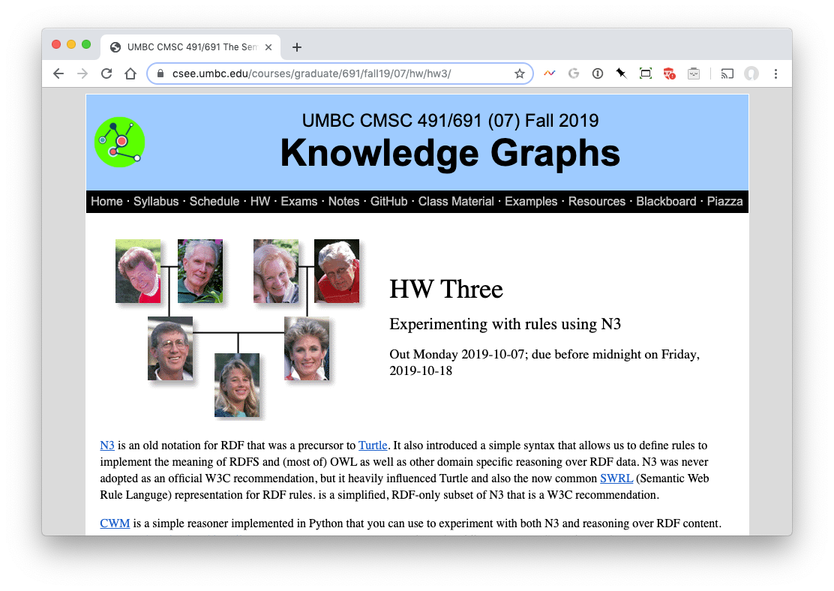
HW3

Slide 27
Summary
CWM is a relatively simple program that lets you manipulate and explore RDF and Semantic Web technology
It’s limited in what it can do and not very efficient
But useful and “close to the machine”
Written in Python
There are related tools in Python, see rdflib
And lots more tools in other languages

Slide 28
genesis
# A simple example of family relations using the gedcom vocabulary.
@prefix gc: <http://www.daml.org/2001/01/gedcom/gedcom#>.
@prefix log: <http://www.w3.org/2000/10/swap/log#>.
@prefix owl: <http://www.w3.org/2002/07/owl#>.
@prefix : <#> .
# data from the Bible in GEDCOM form
:fam1 a gc:Family.
:Able gc:sex gc:Male;
gc:givenName "Able";
gc:childIn :fam1;
owl:differentFrom :Cain.
:Cain gc:sex gc:Male;
gc:givenName "Cain";
gc:childIn :fam1;
owl:differentFrom :Able.
:Adam gc:sex gc:Male;
gc:givenName "Adam";
gc:spouseIn :fam1;
owl:differentFrom :Eve.
:Eve gc:sex gc:Female;
gc:givenName "Eve";
gc:spouseIn :fam1;
owl:differentFrom

