Slide 1
An overview of Semantic Web Languages and Technologies

Slide 2
Semantic Web Technologies
W3C “recommendations”
RDF, RDFS, RDFa, OWL, SPARQL, RIF, R2R, etc…
Common tools and systems -- commercial, free and open sourced
Ontology editors, triple stores, reasoners, etc.
Common ontologies and data sets
Foaf, DBpedia, SKOS, PROV, etc.
Infrastructure systems
Search, ontology metadata, linking services
Non W3C: Schema.org, Freebase, …

Slide 3
Common KR languages
Knowledge representation and reasoning (KR&R) has always been an important part of AI & other disciplines
Many approaches have been developed, implemented and evolved since the 1960s
Most were one-offs, used only by their developers
Starting in the 1990s, there was an interest in developing a common KR language to support knowledge reuse and distributed KB systems
The Semantic Web languages (e.g., OWL) are a current generation of this idea
There are currently no other widely used KR languages

Slide 4
Questions
Database (DB) vs. knowledge base (KB)?
TL;DR: DBs have facts, KBs have general knowledge and (maybe) facts
DBs typically have simple schemas (knowledge) and lots of data (facts)
KBs have complex schemas (aka ontologies) and may or may not have a lot of instances (data)
KBs support inference, e.g.,
parent(?x,?y) => person(?x), person(?y), child(?y,?x), older(?x,?y), ?x≠?y
Parent(john,mary) => person(john), child(mary,john), …

Slide 5
Questions
What’s the impact of using different structures to represent data or knowledge?
Natural language
Program code
Relations vs. graphs vs. objects
Logic vs. rules vs. procedures
Neural networks
Tensors

Slide 6
Questions
What’s our “semantic” model for facts and knowledge?
Classical logic is a common choice
man(socrates), ∀x man(x) => mortal(x)
Classical logic has limitations: facts and relations and “rules” are either (always) True or False for all time
May need to represent and reason with probabilistic or fuzzy facts and knowledge
May need to handle dynamic facts or knowledge

Slide 7
Semantic Web Technologies
Basic approach uses classical logic for underlying semantics
+ Simple, well understood, good reasoning algorithms
- No probabilities, adding extensions (e.g., for time) adds complexity
Knowledge represented as a graph
+ Simple, good tool support - May be too simple

Slide 8
Two Semantic Web Notions
The semantic web
Idea of a web of machine understandable information
Agnostic about the technology used to support it
May involve more AI (e.g., NLP, machine learning)
Human end users in the center
The Semantic Web
Current vision of a semantic web as defined by the W3C community: a Web of data
Using W3C supported standards, i.e., RDF, OWL, SPARQL, XML, RIF, etc.
By machines for machines with human-oriented applications on top

Slide 9
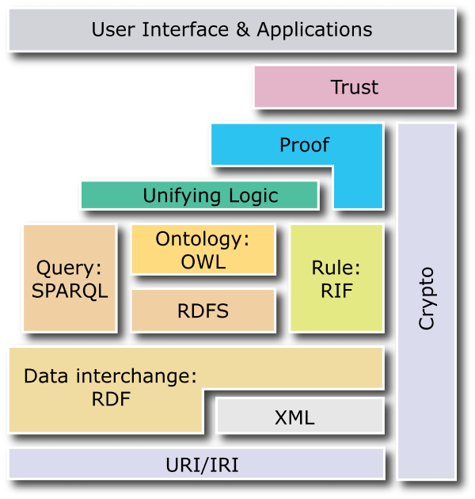
W3C Semantic Web Stack

Slide 10
RDF is the first SW language
Graph
XML Encoding
RDF
Data Model
<rdf:RDF ……..>
<….>
<….>
</rdf:RDF>
Good for people, viz, graph DBMS
Good for
Machine Processing
Triples
stmt(docInst, rdf_type, Document)
stmt(personInst, rdf_type, Person)
stmt(inroomInst, rdf_type, InRoom)
stmt(personInst, holding, docInst)
stmt(inroomInst, person, personInst)
JSON Encoding
{"@context":{
"name": "http://…/name",
"Person": "http://…/Person"}
"@type": "Person",
"name": "Markus Lanthaler"
}
Good For Reasoning and Databases
RDF is a simple language for building graph based representations

Slide 11
The RDF Data Model
An RDF document is an unordered collection of statements, each with a subject, predicate and object (aka triples)
A triple can be thought of as a labelled arc in a graph
Statements describe properties of web resources
Resource are objects that can be pointed to by a URI:
a document, a picture, a paragraph on the Web, …
E.g., http://umbc.edu/~finin/cv.html
a book in the library, a real person (?)
isbn://5031-4444-3333
Properties themselves are also resources (URIs)

Slide 12
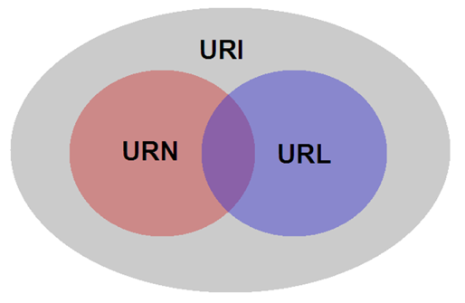
URIs are a foundation
URI = Uniform Resource Identifier
"The generic set of all names/addresses that are short strings that refer to resources"
URLs (Uniform Resource Locators) are a subset of URIs, used for resources that can be accessed on the web
URIs look like URLs, often with fragment identifiers pointing to a document part:
http://foo.com/bar/mumble.html#pitch

Slide 13
URIs are a foundation
URIs are unambiguous, unlike natural language terms -- the web provides a global namespace
We can use a URI to denote something, e.g., a concept, entity, event or relation
We usually assume references to the same URI are to the same thing

Slide 14
What does a URI mean?
Sometimes URIs denote a web resource
http://umbc.edu/~finin/finin.jpg denotes a file
We can use RDF to make assertions about the resource, e.g., it’s an image and depicts a person with name Tim Finin, …
Sometimes concepts in the external world
E.g., http://umbc.edu/ denotes a particular university located in Baltimore
This is done by social convention
Cool URIs don’t change
http://www.w3.org/Provider/Style/URI

Slide 15
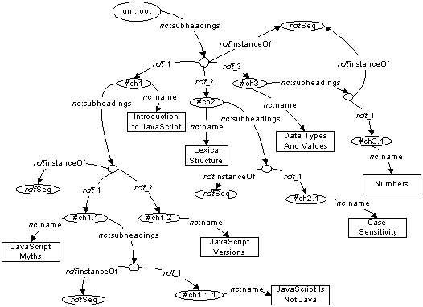
The RDF Graph
An RDF document is an unordered collection of triples
The subject of one triple can be the object of another
The result is a directed, labelled graph
A triple’s object can also be a literal, e.g., a string
Graphs are simpler that relational tables or objects
This is both a plus and a minus

Slide 16
Simple RDF Example
http://umbc.edu/ ~finin/talks/idm02/
dc:Title
“Intelligent Information Systems on the Web”
dc:Creator
bib:Aff
http://umbc.edu/
bib:email
bib:name
“Tim Finin”
“finin@umbc.edu”

Slide 17
Serialization
A graph is an abstract model, we’ll need to serialize it as text for many reasons, e.g., display, editing, exchange, …
Multiple standard RDF serializations
Most important: XML, Turtle, ntriples, JSON-LD
Most Semantic Web tools can read or write in any of these serializations

Slide 18
XML encoding for RDF
<rdf:RDF xmlns:rdf="http://www.w3.org/1999/02/22-rdf-syntax-ns#"
xmlns:dc="http://purl.org/dc/elements/1.1/"
xmlns:bib=http://daml.umbc.edu/ontologies/bib/>
<rdf:Description rdf:about="http://umbc.edu/~finin/talks/idm02/">
<dc:title>Intelligent Information Systems on the Web</dc:title>
<dc:creator>
<rdf:Description>
<bib:Name>Tim Finin</bib:Name>
<bib:Email>finin@umbc.edu</bib:Email>
<bib:Aff rdf:resource="http://umbc.edu/" />
</rdf:Description>
</dc:creator>
</rdf:Description>
</rdf:RDF>

Slide 19
Note the prefix declarations
<rdf:RDF xmlns:rdf="http://www.w3.org/1999/02/22-rdf-syntax-ns#"
xmlns:dc="http://purl.org/dc/elements/1.1/"
xmlns:bib=http://daml.umbc.edu/ontologies/bib/>
<rdf:Description rdf:about="http://umbc.edu/~finin/talks/idm02/">
<dc:title>Intelligent Information Systems on the Web</dc:title>
<dc:creator>
<rdf:Description>
<bib:Name>Tim Finin</bib:Name>
<bib:Email>finin@umbc.edu</bib:Email>
<bib:Aff rdf:resource="http://umbc.edu/" />
</rdf:Description>
</dc:creator>
</rdf:Description>
</rdf:RDF>

Slide 20
Note the prefix declarations
<rdf:RDF xmlns:rdf="http://www.w3.org/1999/02/22-rdf-syntax-ns#"
xmlns:dc="http://purl.org/dc/elements/1.1/"
xmlns:bib=http://daml.umbc.edu/ontologies/bib/>
<rdf:Description rdf:about="http://umbc.edu/~finin/talks/idm02/">
<dc:title>Intelligent Information Systems on the Web</dc:title>
<dc:creator>
<rdf:Description>
<bib:Name>Tim Finin</bib:Name>
<bib:Email>finin@umbc.edu</bib:Email>
<bib:Aff rdf:resource="http://umbc.edu/" />
</rdf:Description>
</dc:creator>
</rdf:Description>
</rdf:RDF>
Makes it easy to include terms from three different “vocabularies”:
rdf for terms that are part of its representation language (e.g., rdf:type)
dc for terms from the Dublin Core vocabulary developed by librarians
bib for terms from a bibliography vocabulary developed at UMBC

Slide 21
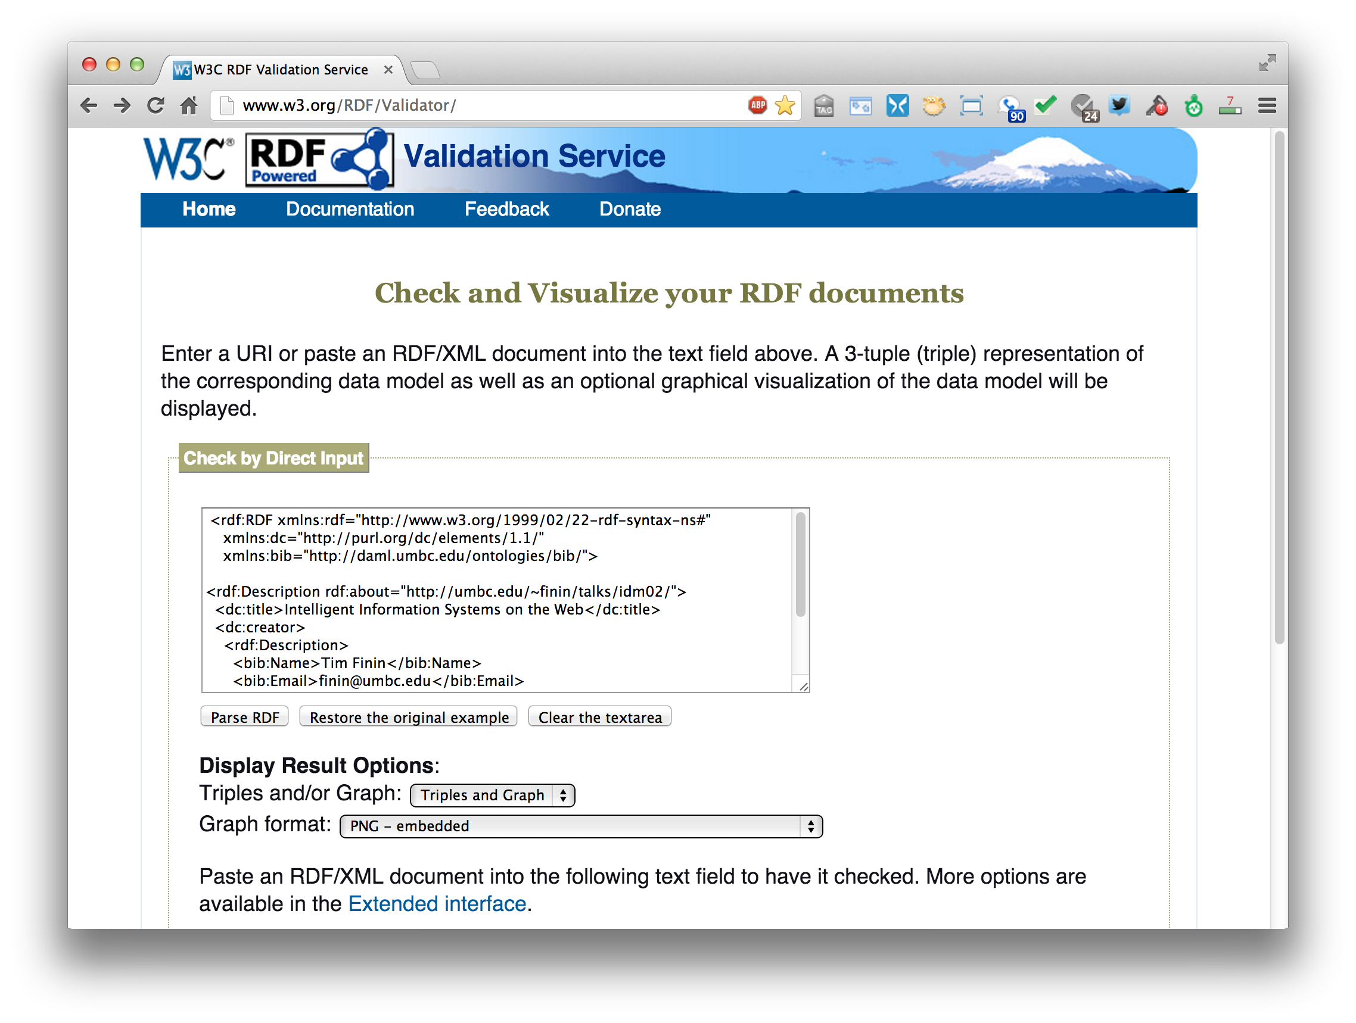
An RDF validation service
http://www.w3.org/RDF/Validator/

Slide 22
Easy to convert between serializations
Most software tools can read and write different serializations
rdf2rdf is a simple handy utility for converting from one RDF serialization to another
Any23 is an open source library, web service and command line tool that extracts structured data in RDF format from a variety of Web documents

Slide 23
N-triple representation
RDF can be encoded as a set of triples
<subject> <predicate> <object> .
<http://umbc.edu/~finin/talks/idm02/> <http://purl.org/dc/elements/1.1/title> "Intelligent Information Systems on the Web" .
<http://umbc.edu/~finin/talks/idm02/> <http://purl.org/dc/elements/1.1/creator> _:node17i6ht38ux1 .
_:node17i6ht38ux1 <http://daml.umbc.edu/ontologies/bib/Name> "Tim Finin" .
_:node17i6ht38ux1 <http://daml.umbc.edu/ontologies/bib/Email> "finin@umbc.edu" .
_:node17i6ht38ux1 <http://daml.umbc.edu/ontologies/bib/Aff> <http://umbc.edu/> .

Slide 24
N3/Turtle notation for RDF
N3 is a compact notation for RDF that is easier for people to read, write and edit
It’s just syntactic sugar
Aka Notation 3, developed by TBL himself
But, XML is largely unreadable and even harder to write
Turtle is a W3C standard covering most of N3

Slide 25
Turtle Example
@prefix rdf: http://www.w3.org/1999/02/22-rdf-syntax-ns# .
@prefix dc: http://purl.org/dc/elements/1.1/ .
@prefix bib: http://daml.umbc.edu/ontologies/bib/ .
<http://umbc.edu/~finin/talks/idm02/>
dc:title "Intelligent Information Systems on the Web" ;
dc:creator
[ bib:Name "Tim Finin";
bib:Email "finin@umbc.edu"
bib:Aff: "http://umbc.edu/" ] .

Slide 26
Triple Notes
RDF triples have one of two forms:
<URI> <URI> <URI>
<URI> <URI> <quoted string>
Triples are also easily mapped into logic
<subject> <predicate> <object> becoming:
<predicate>(<subject>,<object>)
With type(<S>,<O>) becoming <O>(<S>)
Example:
subclass(man,person)
sex(man,male)
domain(sex,animal)
man(adam)
age(adam,100)
Triples are easily stored and managed in DBMS
Flat nature of a triple a good match for relational DBs
; Note: we’re not ; showing the actual ; URIs for clarity

Slide 27

A usecase: FOAF
FOAF (Friend of a Friend) is a simple ontology to describe people and their properties and social networks
See the foaf project page: http://www.foaf-project.org/
In 2008 we crawled the web and found >1M valid RDF FOAF files
Many from http://liveJournal.com/blogging system which encoded basic user in FOAF
Apache currently use FOAF for open source commiters
See http://xmlns.com/foaf/spec/ for the vocabulary specification
<foaf:Person>
<foaf:name>Tim Finin</foaf:name>
<foaf:mbox_sha1sum>2410…37262c252e</foaf:mbox_sha1sum>
<foaf:homepage rdf:resource="http://umbc.edu/~finin/" />
<foaf:img rdf:resource="http://umbc.edu/~finin/images/passport.gif" />
</foaf:Person>

Slide 28
FOAF Vocabulary
Basics
Agent
Person
name
nick
title
homepage
mbox
mbox_sha1sum
img
depiction (depicts)
surname
family_name
givenname
firstName
Personal Info
weblog
knows
interest
currentProject
pastProject
plan
based_near
workplaceHomepage
workInfoHomepage
schoolHomepage
topic_interest
publications
geekcode
myersBriggs
dnaChecksum
Documents & Images
Document
Image
PersonalProfileDocument
topic (page)
primaryTopic
tipjar
sha1
made (maker)
thumbnail
logo
Online Accts
OnlineAccount
OnlineChatAccount
OnlineEcommerceAccount
OnlineGamingAccount
holdsAccount
accountServiceHomepage
accountName
icqChatID
msnChatID
aimChatID
jabberID
yahooChatID
Projects & Groups
Project Organization
Group member
membershipClass fundedBy
theme

Slide 29
FOAF: why RDF? Extensibility!
FOAF vocabulary has 50+ basic terms for simple facts about people
FOAF files can use other RDF terms too: RSS, MusicBrainz, Dublin Core, Wordnet, Creative Commons, blood types, starsigns, …
RDF gives freedom of independent extension
OWL provides fancier data-merging facilities
Freedom to say what you like, using any RDF markup you want, and have RDF crawlers merge your FOAF documents with other’s and know when you’re talking about the same entities
After Dan Brickley, danbri@w3.org

Slide 30
No free lunch!
Must plan for lies, mischief, mistakes, stale data, slander, idiosyncratic terms
Dataset is out of control, distributed, dynamic
Importance of knowing who-said-what
Anyone can describe anyone
We must record data provenance
Modeling and reasoning about trust is critical
Legal, privacy and etiquette issues emerge
Welcome to the real world
After Dan Brickley, danbri@w3.org

Slide 31
More RDF Vocabulary
RDF has terms for describing lists, bags, sequences, simple datatypes, etc.
RDF is a “pure” graph representation language
Nodes and edges are simple objects
Both have identifiers that are URIs
Suppose we want to associate a probability with an edge, e.g.,
(:flipper rdf:type :mammal) :probability 0.9
(:flipper rdf:type :fish) :probability 0.1

Slide 32
Property graphs?
RDF is a “pure” graph model with only labeled nodes and edges
Many popular graph databases implement property graphs (e.g., Neo4j)
Nodes & edges can have properties, whose values are literals or maybe lists of literals
Results in a more compact graph
But, as we’ll see, introduces some limitations

Slide 33
More RDF Vocabulary
RDF also can describe triples through reification
Enabling statements about statements
:flipper rdf:type :mammal .
All non-literals have to be URIs
RDF uses prefixes for readability
We can specify what a null prefix means
If we don’t it means “in this file”
https://prefix.cc/ is one service for looking up prefixes

Slide 34
More RDF Vocabulary
RDF also can describe triples through reification
Enabling statements about statements
:flipper rdf:type :mammal . _:s1 rdf:type rdf:Statement .
_:s1 rdf:subject :flipper .
_:s1 rdf:predicate :type .
_:s1 rdf:object :mammal .
_:s1 :probability 0.9
The underscore prefix is special
It introduces blank nodes
We’ll talk about this in more detail later
For now, think of it as introducing “a new, nameless thing”

Slide 35
More RDF Vocabulary
RDF also can describe triples through reification
Enabling statements about statements
:flipper rdf:type :mammal .
_:s1 a rdf:Statement;
rdf:subject :flipper;
rdf:predicate :type;
rdf:object :mammal;
:probability 0.9 .

Slide 36
More RDF Vocabulary
RDF also can describe triples through reification
Enabling statements about statements
:john bdi:believes _:s.
_:s rdf:type rdf:Statement.
_:s rdf:subject <http://ex.com/catalog/widgetX>.
_:s rdf:predicate cat:salePrice .
_:s rdf:object "19.95" .

Slide 37
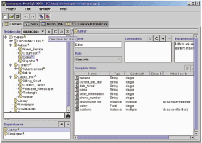
RDF Schema (RDFS)
RDF Schema adds taxonomies for classes & properties
subClass and subProperty
and some metadata.
domain and range constraints on properties
Several widely used KB tools can import and export in RDFS
Stanford Protégé KB editor
Java, open sourced
extensible, lots of plug-ins
provides reasoning & server capabilities

Slide 38
RDFS Vocabulary
RDFS introduces the following terms and gives each a meaning w.r.t. the rdf data model
Terms for classes
rdfs:Class
rdfs:subClassOf
Terms for properties
rdfs:domain
rdfs:range
rdfs:subPropertyOf
Special classes
rdfs:Resource
rdfs:Literal
rdfs:Datatype
Terms for collections
rdfs:member
rdfs:Container
rdfs:ContainerMem-bershipProperty
Special properties
rdfs:comment
rdfs:seeAlso
rdfs:isDefinedBy
rdfs:label

Slide 39
RDF and RDF Schema
<rdfs:Property rdf:ID=“name”>
<rdfs:domain rdf:resource=“Person”>
</rdfs:Property>
<rdfs:Class rdf:ID=“Chair”>
<rdfs:subclassOf rdf:resource=
“http://schema.org/gen#Person”>
</rdfs:Class>
rdfs:Class
rdfs:Property
rdf:type
rdf:type
rdf:type
g:Person
rdfs:domain
<rdf:RDF xmlns:g=“http://schema.org/gen” xmlns:u=“http://schema.org/univ”>
<u:Chair rdf:ID=“john”>
<g:name>John Smith</g:name> </u:Chair>
</rdf:RDF>
rdfs:subclassOf
u:Chair
g:name
rdf:type
g:name
John Smith

Slide 40
RDFS supports simple inferences
New and Improved!
100% Better than XML!!
An RDF ontology plus some RDF statements may imply additional RDF statements
Not true of XML data
Note that this is part of the data model and not of the accessing or processing code
@prefix rdfs: <http://www...>.
@prefix : <…genesis.n3>.
:parent rdfs:domain :Person;
rdfs:range :Person.
:mother
rdfs:subProperty parent;
rdfs:domain :Woman.
:eve :mother :cain.
:parent a rdf:Property.
:Person a rdf:Class.
:Woman rdfs:subClassOf Person.
:mother a rdf:Property.
:eve a :Person;
a :Woman;
:parent :cain.
:cain a :Person.

Slide 41
N3 example
Here’s how you declare a namespace.
<> Is an alias for the URI of this document.
This defines the “empty prefix” as refering to “this document”
@prefix rdf: <http://www.w3.org/1999/02/22-rdf-syntax-ns#>.
@prefix rdfs: <http://www.w3.org/2000/01/rdf-schema#>.
@prefix : <#> .
<> rdfs:comment “This is an N3 example”.
:Person a rdfs:Class.
:Woman a rdfs:Class; rdfs:subClassOf :Person.
:eve a :Woman; :age “100”.
:sister a rdf:Property; rdfs:domain :Person; rdfs:range :Woman.
:eve :sister [a :Woman; :age 98].
:eve :believe {:eve :age “100”}.
[is :spouse of [is :sister of :eve]] :age 99.
:eve.:sister.:spouse :age 99.
“person is a class”. The “a” syntax is sugar for rdf:type property.
“Woman is a class and a subclass of person”. Note the ; syntax.
“eve is a woman whose age is 100.”
“sister is a property from person to woman”
“eve has a sister who is a 98 year old woman”. The brackets introduce an anonymous resource.
“eve believes that her age is 100”. The braces introduce a reified triple.
“the spouse of the sister of eve is 99”.
“the spouse of the sister of eve is 99”.

Slide 42
Is RDF(S) better than XML?
Q: For a specific application, should I use XML or RDF?
A: It depends…
XML's model is
a tree, i.e., a strong hierarchy
applications may rely on hierarchy position
relatively simple syntax and structure
not easy to combine trees
RDF's model is
a loose collections of relations
applications may do database-like search
not easy to recover hierarchy
easy to combine relations in one big collection
great for the integration of heterogeneous information

Slide 43
W3C Semantic Web Stack

Slide 44
Problems with RDFS
RDFS too weak to describe resources in detail, e.g.
No localised range and domain constraints
Can’t say that the range of hasChild is person when applied to persons and dog when applied to dogs
No existence/cardinality constraints
Can’t say that all instances of person have a mother that is also a person, or that persons have exactly two parents
No transitive, inverse or symmetrical properties
Can’t say isPartOf is a transitive property, hasPart is the inverse of isPartOf or touches is symmetrical
We need RDF terms providing these and other features.

Slide 45
W3C’s Web Ontology Language (OWL)
DARPA project, DAML+OIL, begat OWL
OWL released as W3C recommendation 2/10/04
See the W3C OWL pages for overview, guide, specification, test cases, etc.
Three layers of OWL are defined of decreasing levels of complexity and expressiveness
OWL Full is the whole thing
OWL DL (Description Logic) introduces restrictions
OWL Lite is an entry level language intended to be easy to understand and implement
Owl 2 became a W3C recommendation in 2009

Slide 46
OWL ↔ RDF
An OWL ontology is a set of RDF statements
OWL defines semantics for certain statements
Does NOT restrict what can be said; documents can include arbitrary RDF
But no OWL semantics for non-OWL statements
Adds capabilities common to description logics, e.g., cardinality constraints, defined classes, equivalence, disjoint classes, etc.
Supports ontologies as objects (e.g., importing, versioning, …
A complete OWL reasoning is significantly more complex than a complete RDFS reasoner.

Slide 47
Embedding Semantic Data in HTML
Embedding semantic data in HTML allows documents to be understood by people and machines
RDFa is a ‘standard’ for embedding RDF in HTML as tag attributes
JSON-LD is a ‘standard’ for embedding RDF in a simple json-compatibl serialization
Facebook looks for embedded RDFa state-ments using its opengraph (og) vocabulary
Bestbuy embeds produce info in RDFa

Slide 48
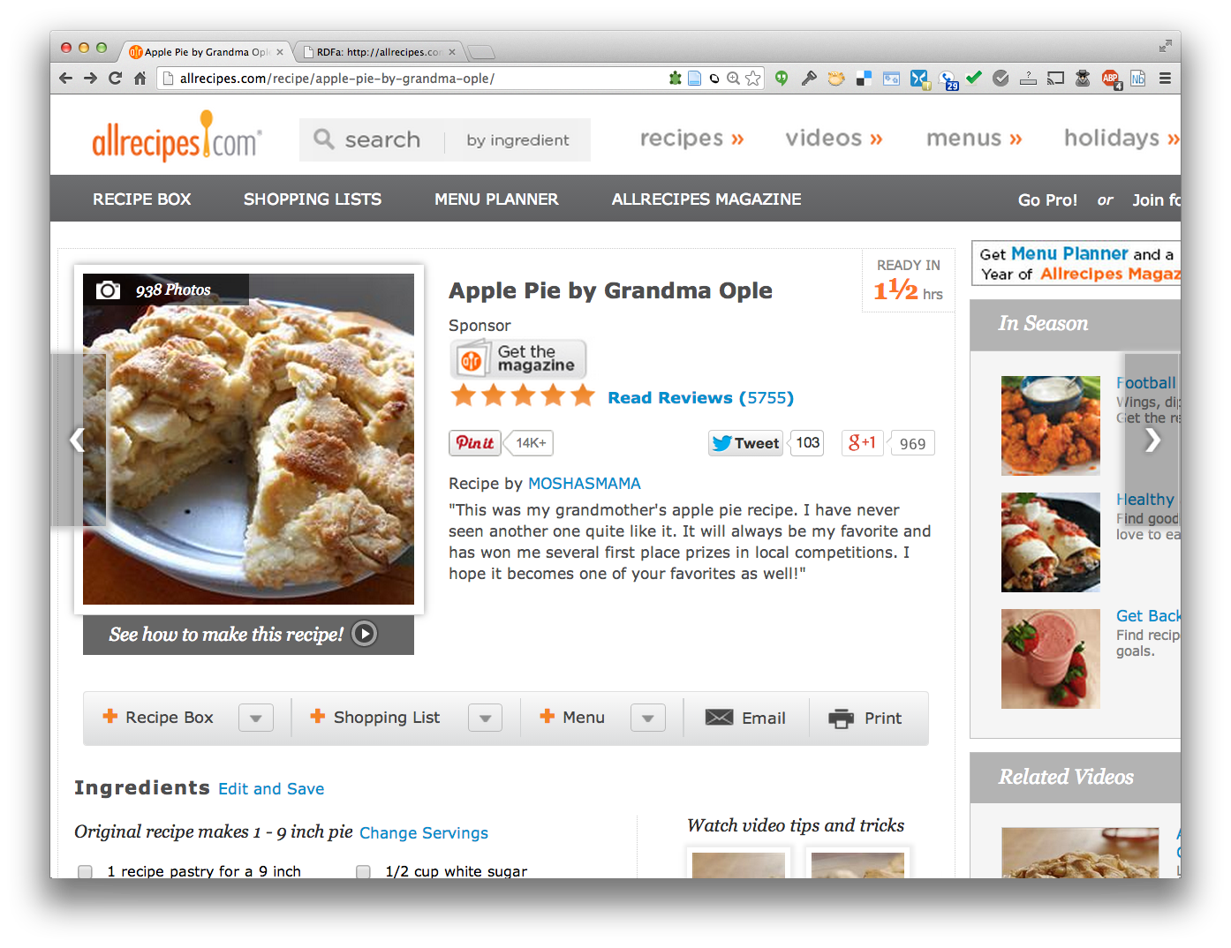
Detecting semantic data via a browser

Slide 49

Detecting semantic data via a browser
Plugin shows up if RDFa detected. Shows statements if clicked. http://bit.ly/gturtle
Plugin shows up if Schema.org statements detected. Shows statements if clicked. http://bit.ly/sdotoch

Slide 50
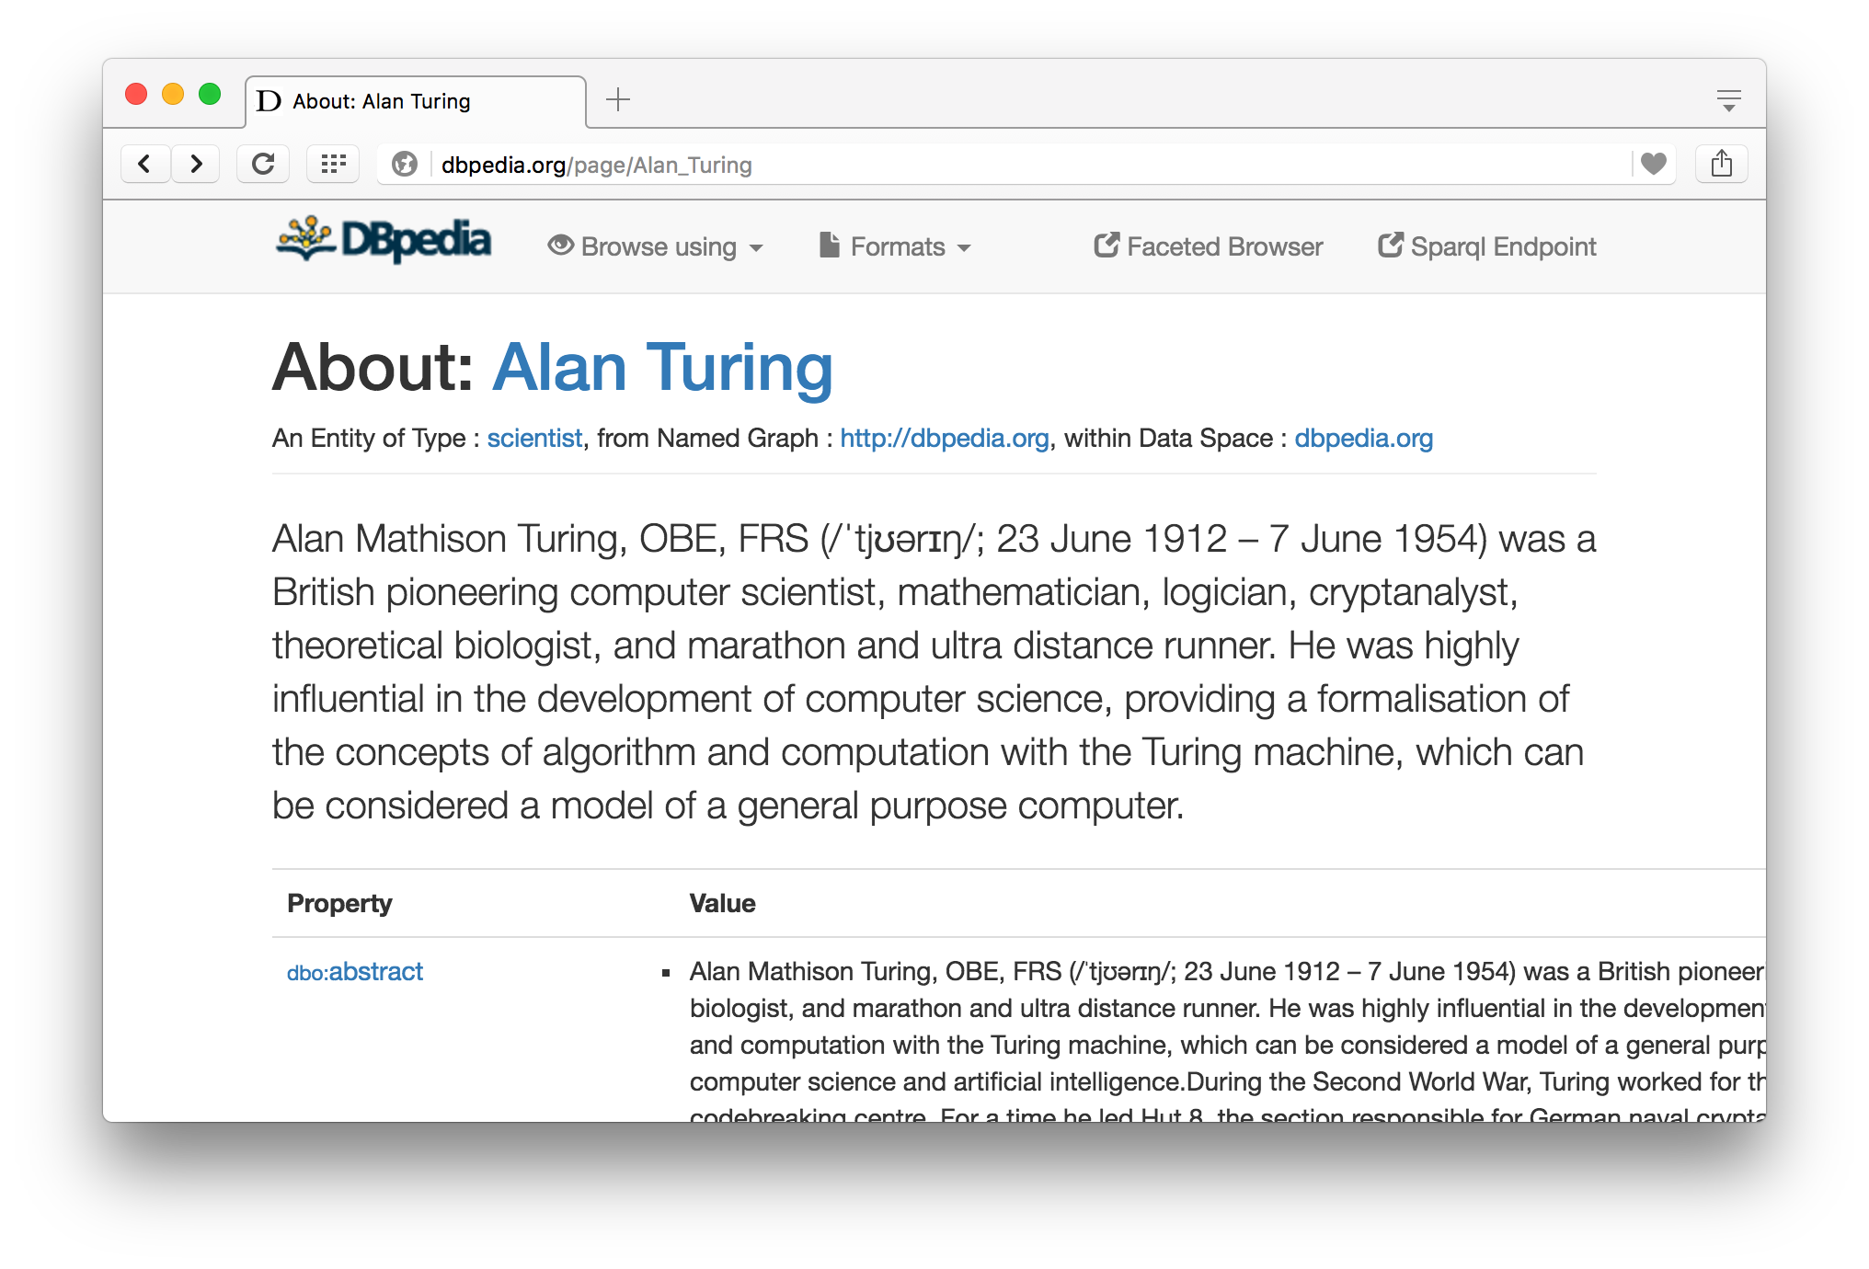
Semantic Data Browser/Query
Notes:
Click on the images to view this page in your browser

Slide 51
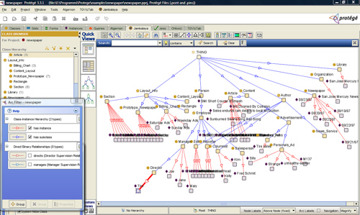
Ontology Editor
There are a number of editors available for creating and editing ontologies and data
We recommend using Protégé, a java-based free system developed at Stanford
Good support for reasoning
Lots of plugins

Slide 52
Triple Stores
A triple store is a database for RDF triples
It usually has a native API and often accepts SPARQL queries
It might do reasoning, either in an eager manner (as triples are loaded) or on demand (to answer queries), etc
Some stores focus on scalability and others on flexibility and features
We’ll look at several, including Sesame, Apache Jena and stardog

Slide 53
Frameworks and Libraries
There are frameworks, libraries and packages for most programming languages
Jena is a very comprehensive Java framework originally developed by HP and now Apache
Others are available for Python, Ruby, C#, Perl, PHP, Prolog, Lisp, etc.

Slide 54
Conclusion
There’s quite a bit of technology needed to support the Semantic Web
This has been a brief tour
We’ll cycle back on these and explore them in more detail
And give you a chance to use and experiment with them

