Slide 1
Ontology Editors

Slide 2
IDEs for Ontologies
Some people use simple text editors
Working with XML serialization will drive you crazy
Using Turtle or an abstract syntax works well
Others prefer an IDE
Good IDEs include support for reasoning, visualization, and more
Protégé is a very popular IDE
From Stanford, free, lots of plugins
TopQuadrant Composer is also good
Feature rich but expensive ($600 for a single license)

Slide 3
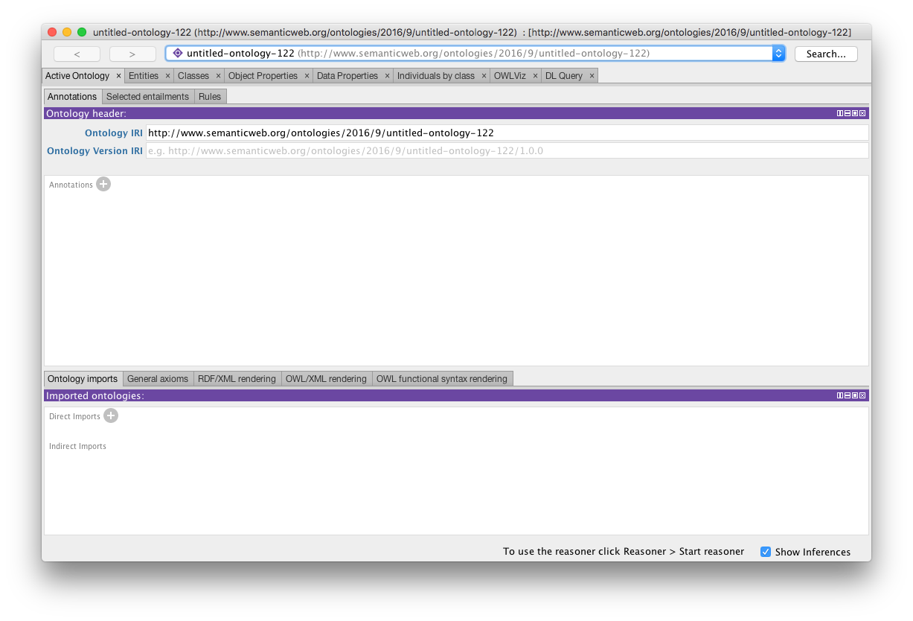
Protégé 5.5

Slide 4
Protégé 5.5
http://protege.stanford.edu/
Free, open source ontology editor and KB framework
Predates OWL, still supports earlier Frames representation
In Java, extensible, large community of users
Requires Java Runtime Environment
Desktop and Web versions
Works will under Linux, Mac OS X and Windows

Slide 5
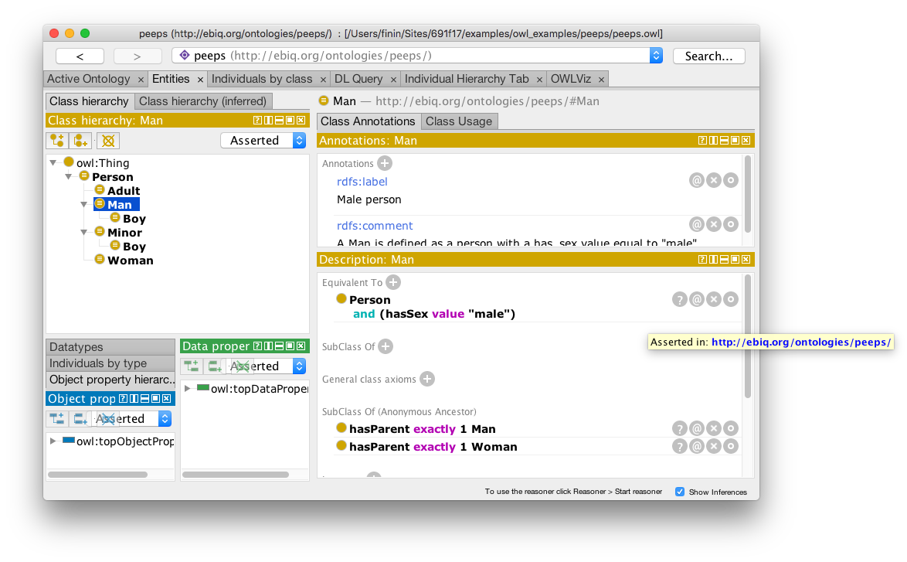
Desktop Protégé

Slide 6
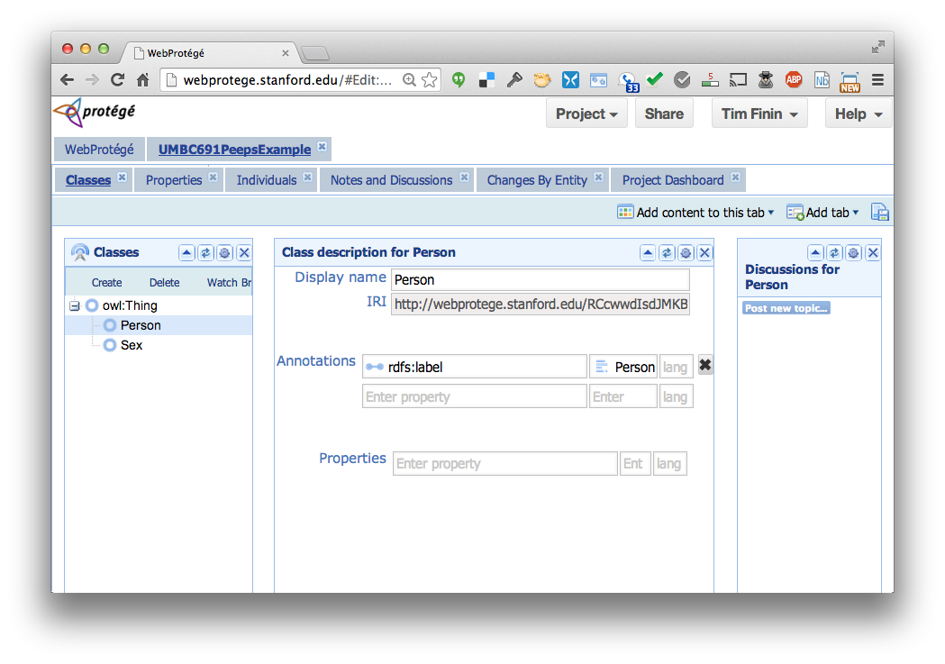
Web Protégé

Slide 7
YAS: Yet Another Syntax
Neither OWL's official abstract syntax nor XML serialization is easy to read or use
Protégé uses the Manchester syntax
Simpler and more compact: “some” and “only”, not “someValuesFrom” and “allValuesFrom”
A W3C recommendation (http://bit.ly/manSyn), used in the OWL 2 Primer (http://bit.ly/OWL2Pri)
Class: man
Annotations: rdfs:label "man"
EquivalentTo: adult and male and person

Slide 8
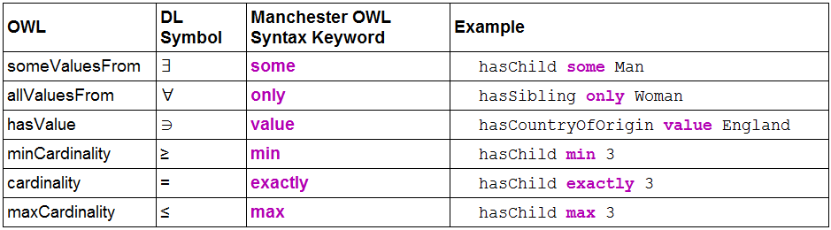
Manchester OWL syntax

Slide 9
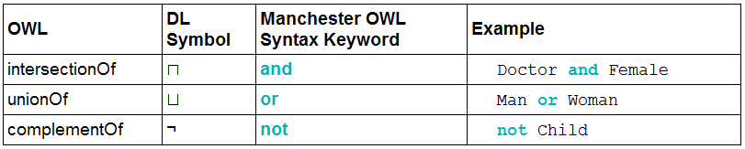
Manchester OWL syntax

Slide 10
Example 1
How can we define a class that is people who have children and all of them are male?

Slide 11
Example: People with just boys
How can we define a class that is people who have children and all of them are male?
Define as the union of three classes
Person
Things that have children
Things where all of their children are male

Slide 12
Example: People with just boys
How can we define a class that is people who have children and all of them are male?
An owl:someValuesFrom restriction on hasChild property
Define as the union of three classes
Person
Things that have children
Things where all of their children are male
An owl:allValuesFrom restriction on hasChild property

Slide 13
Example: People with just boys
How can we define a class that is people who have children and all of them are male?
Person and
(hasChild only Man)and
(hasChild some Person)

Slide 14
Example 2
Person and
hasChild some
(Person and
(hasChild only Man) and
(hasChild some Person))
The set of people who have at least one child that has some children that are only men (i.e., grandparents that only have a Pjb)

Slide 15
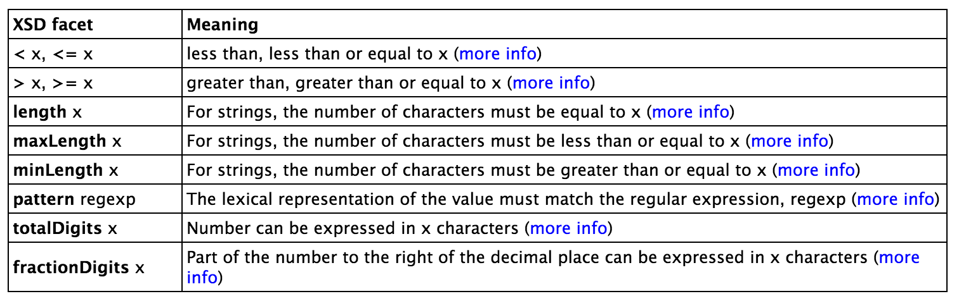
Data values and datatypes
Data values typed or untyped (e.g., int, boolean, float)
Constants w/ or w/o type, e.g.: hasAge value "21"^^long
Use datatype names as classes: hasAge some int
XSD facets, e.g.: Person and hasAge some int[>= 65]
Ranges: Person and hasAge some int[>= 18, <= 30]

Slide 16
Demonstration
We’ll use Protégé OWL v5.5 to implement a tiny ontology for people
Start by downloading and installing Protégé 5.5 (You will need the JRE installed)
You may want to install Graphviz
Configure Protégé
E.g., select a reasoner to use (e.g., HermiT)

Slide 17
A basic workflow
Think about usecases
Preliminaries
Choose namespace URL, import other ontologies used
Identify and define classes
Place in hierarchy, add axioms and run reasoner to check for errors or omissions
Identify and define properties
Place in hierarchy, add axioms, run reasoner
Add individuals & reasoner to check for problems
Add comments and labels
Export in desired formats, maybe upload to Web

Slide 18
More workflow steps
Use OOPS to find common ontology pitfalls
OntOlogy Pitfall Scanner detect many common pitfalls introduced when developing ontologies
Link concepts (and individuals) to common ontologies (e.g., DBpedia, Freebase, foaf)
Use owl:sameAs
Generate visualizations
Produce documentation
Develop examples with your use case(s)
Encode data, describe in VoID (Vocabulary of Interlinked Datasets), add to LOD cloud

Slide 19
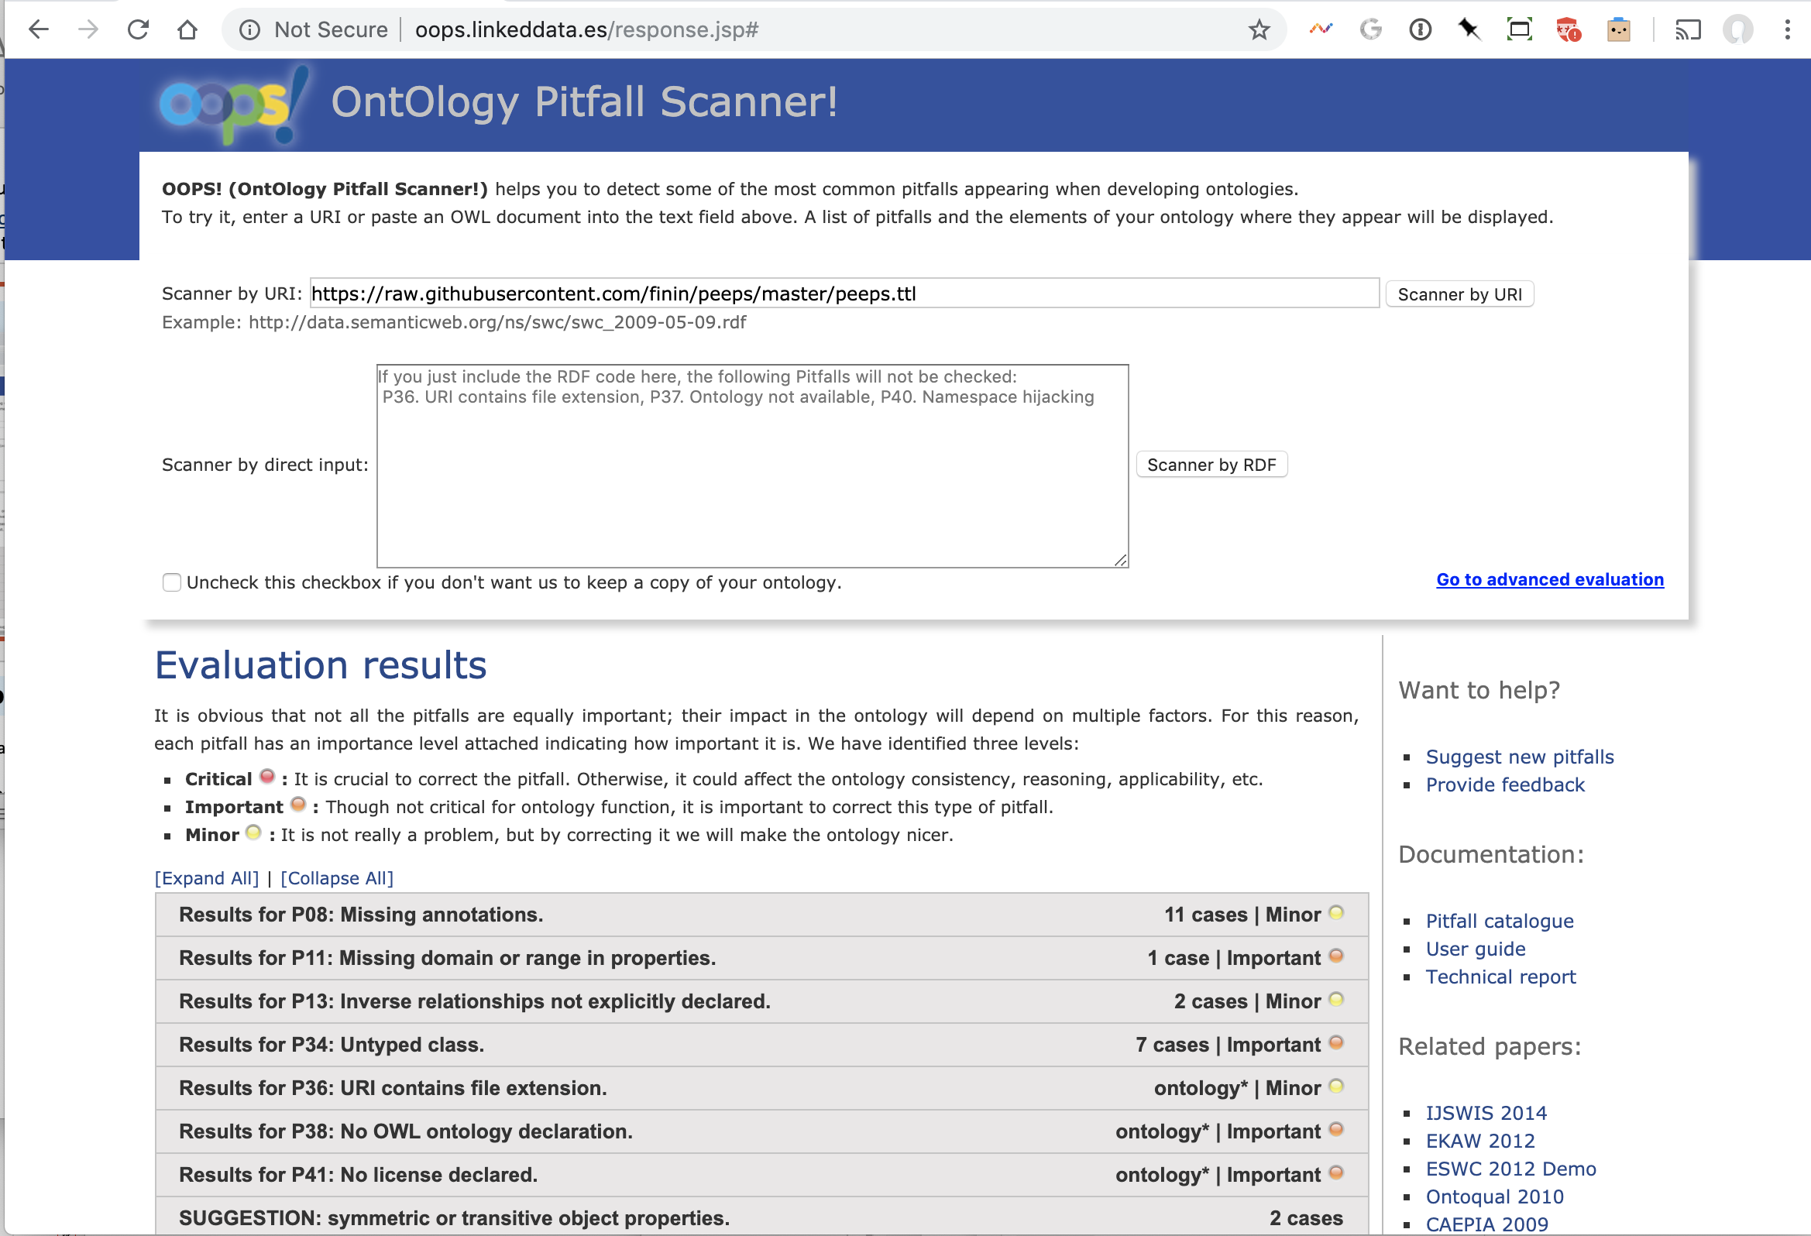
http://oops.linkeddata.es/

Slide 20
What to watch out for
After editing your ontology or data you should (1) stop the reasoner and (2) run it again
Look for any of the following problems
Unexpected inferences
Missing inferences
Reasoner stops with an error
Reasoner stops after finding a contradiction
Reasoner concludes a class is equivalent to owl:Nothing

Slide 21
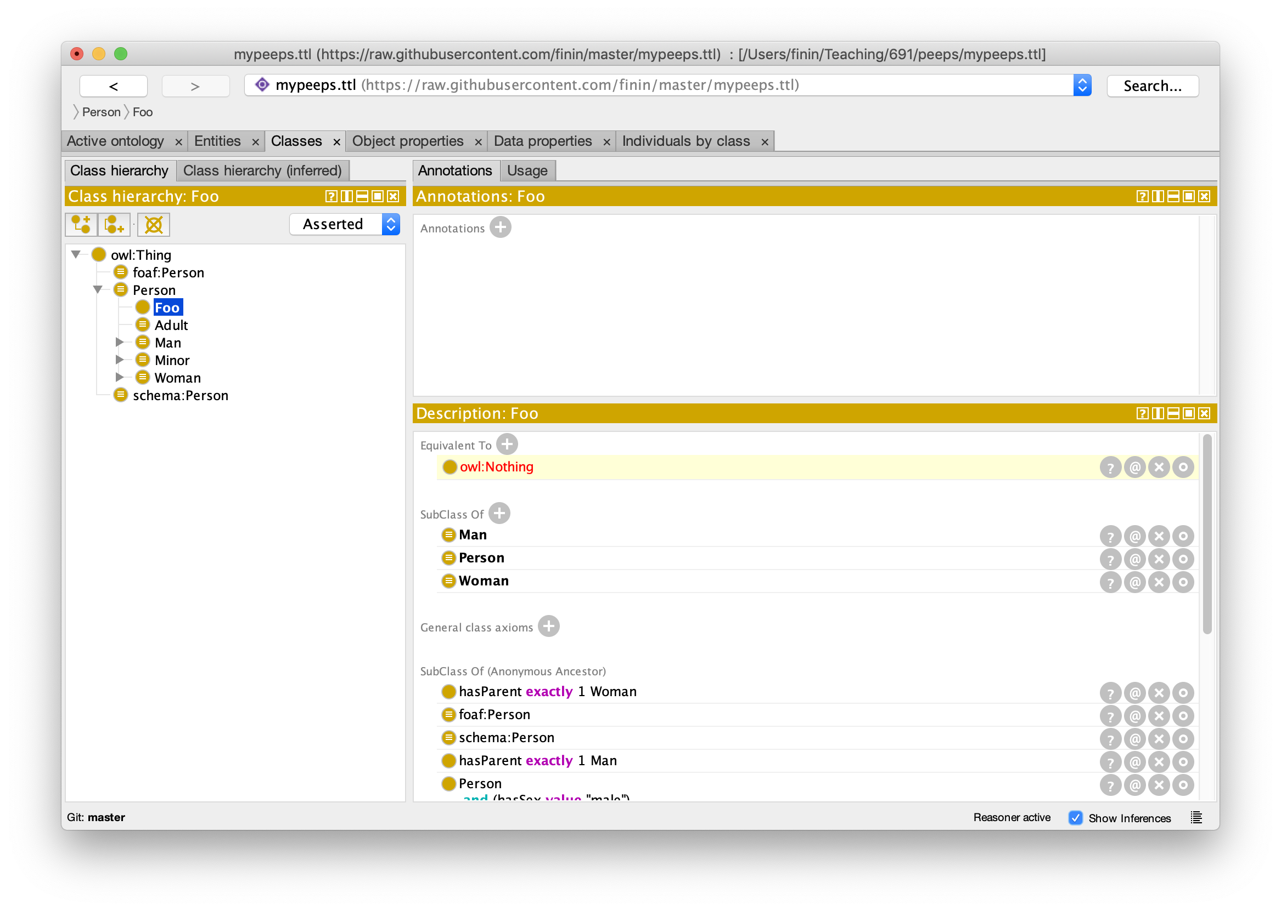
Error: Impossible Class

Slide 22
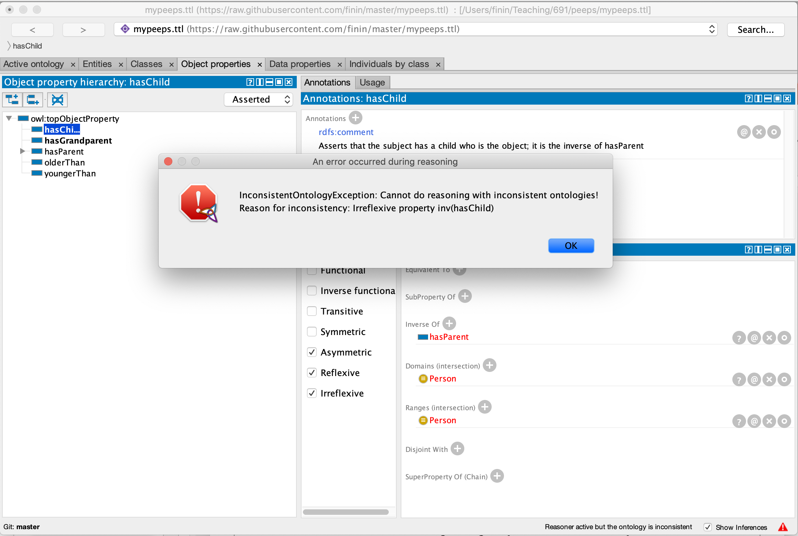
Inconsistent Ontology

Slide 23
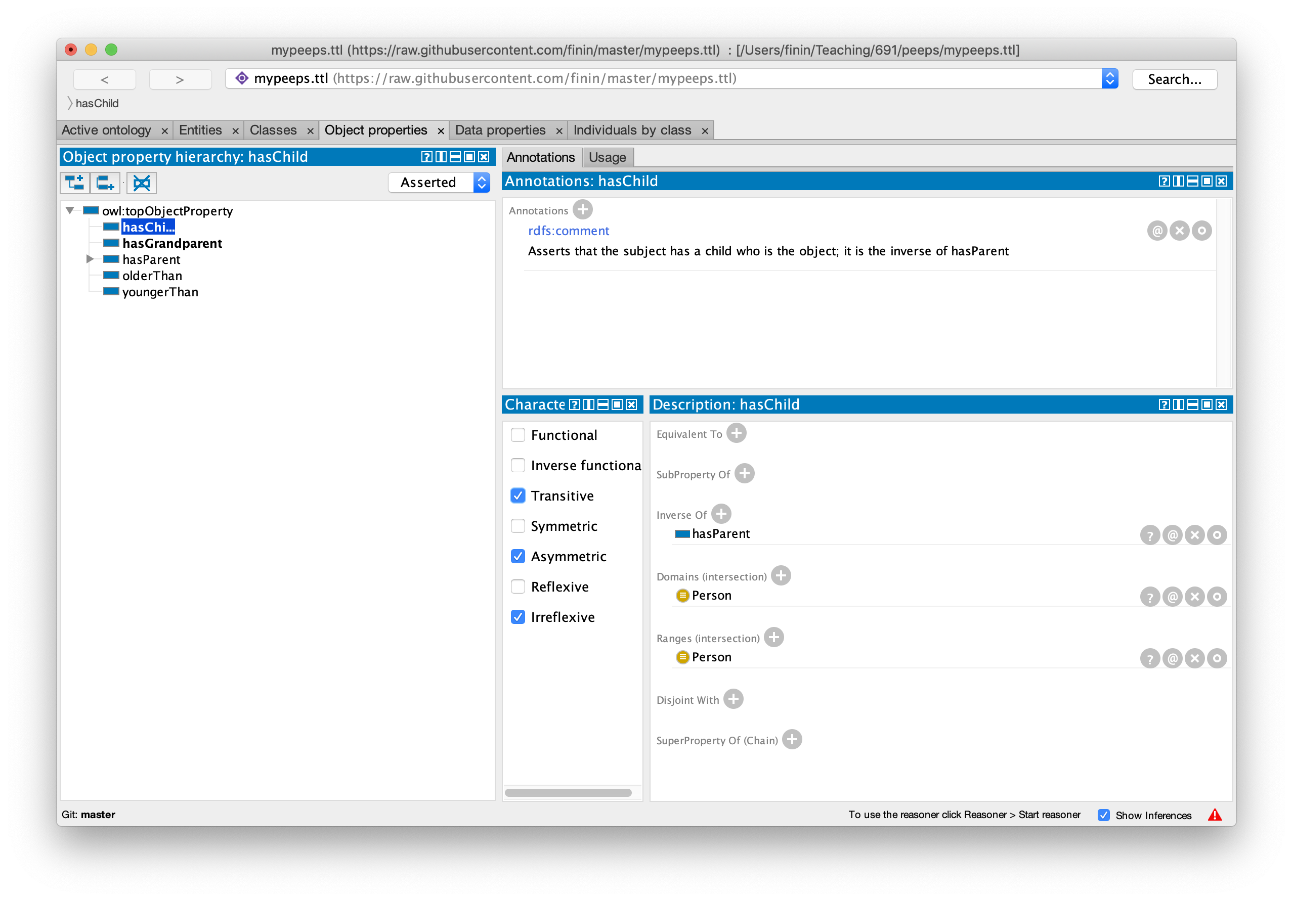
Reasoner fails

Slide 24
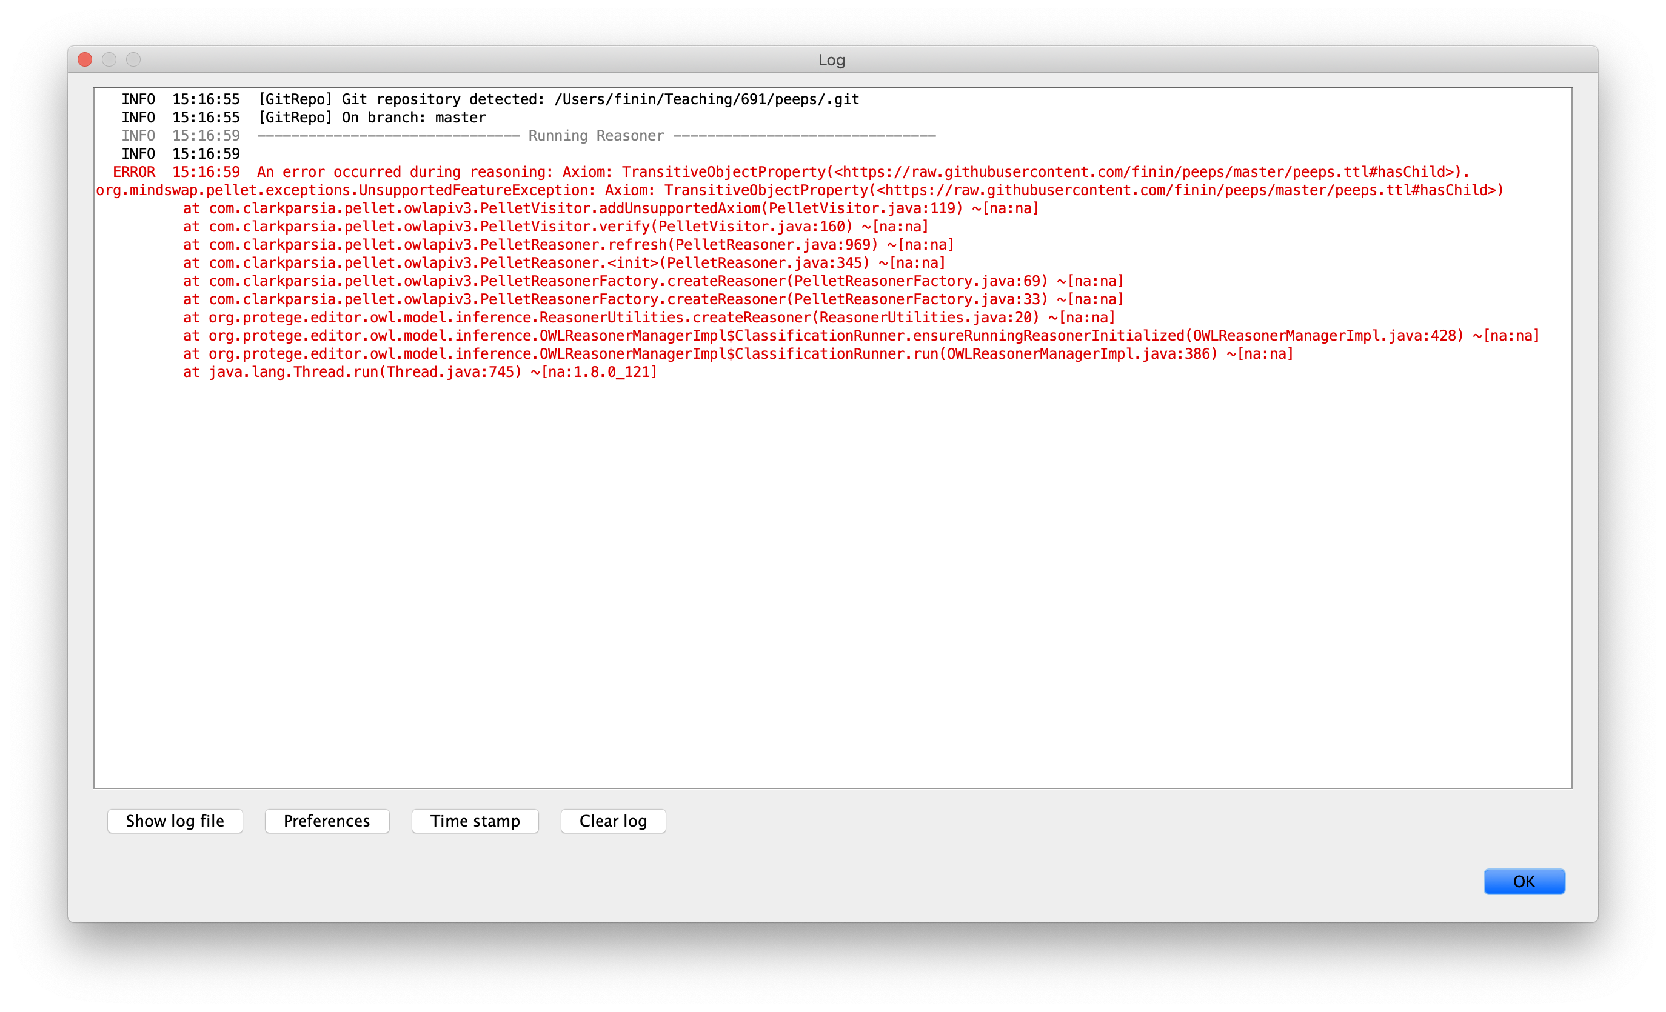
Reasoner fails

Slide 25
Reasoner fails
Owl reasoners don’t like a property to be transitive and irreflexive or asymmetric
Restriction is necessary in order to guarantee decidability of reasoning problems for OWL 2 DL
You can make a property transitive via rules as a work around

Slide 26
Demonstration/HW4
Use Protégé OWL (v5.5) to build a simple ontology for people based on the following
People have just one sex that’s either male or female, an integer age, and two parents, one male, one female
A person’s grandparent is the parent of their parent
Every person is either a man or a woman but not both
A man is defined as any person whose sex is male and a woman as any person whose sex is female
A boy is defined as a person whose sex is male and whose age is less than 18, a girl is …
A person is either an adult or (age >18), minor (age <18), …

Slide 27
Test cases
AllDifferent people
Alice F
Bob M
Carol F
Don M
Edith F
Pat ?
Other people
Frank M
Gwen F
Some possible test cases
Alice parent Bob . Bob parent Carol
Alice grandparent Carol
Alice parent Bob . Alice parent Don.
Contradiction
Alice parent Bob . Pat parent Bob
Pat a female
Alice parent Bob . Gwen parent Bob .
Alice owl:sameAs Gwen

