Slide 1
SPARQL An RDF Query Language

Slide 2
SPARQL
SPARQL is a recursive acronym for
SPARQL Protocol And Rdf Query Language
SPARQL is the SQL for RDF
Example query suitable for DBpedia
# find countries and their languages
PREFIX dbo: <http://dbpedia.org/ontology/>
SELECT * WHERE {
?country a dbo:Country;
dbo:officialLanguage ?lang .
}
LIMIT 10

Slide 3
SPARQL History
Several RDF query languages were developed prior to SPARQL
W3C RDF Data Access Working Group (DAWG) worked out SPARQL 2005-2008
Became a W3C recommendation in Jan 2008
SPARQL 1.1 (2013) is the current standard
Support for many prog. languages available
W3 SPARQL 1.2 Community Group established in 2019 to explore extensions

Slide 4
Typical Architecture
SPARQL endpoint receives queries and requests via HTTP from programs or GUIs, accesses associated RDF triple store and returns result, e.g., data
Program
Rdf
module
SPARQL protocol
Web Browser GUI
SPARQL endpoint
RDF Triple
Store

Slide 5
Some SPARQL endpoints
There are many public endpoints, e.g.
Dbpedia: https://dbpedia.ort/sparql/
Wikidata: https://query.wikidata.org/sparql
DBLP: https://dblp.l3s.de/d2r/sparql
See W3C’s list of currently alive SPARQL endpoints
It’s not hard to set up your own, e.g.
UMBC cybersecurity knowledge graph: http://eb4.cs.umbc.edu:9090/ckg/query/

Slide 6
Endpoint GUIs
Some endpoints offer their own SPARQL GUI you can use to enter ad hoc queries
They may use the same URL as the REST interface and rely on the protocol to know when it’s a person and when a query
Dbpedia: http://dbpedia.org/sparql/
Wikidata: https://query.wikidata.org/
DBLP: https://dblp.l3s.de/d2r/snorql/

Slide 7
General SPARQL GUIs
You can also access or run a general SPARQL GUI that can talk to any SPARQL endpoint
A nice example is YASGUI, which has a public resource: https://yqagui.org/ and is available to download
Another open-source GUI is Twinkle

Slide 8
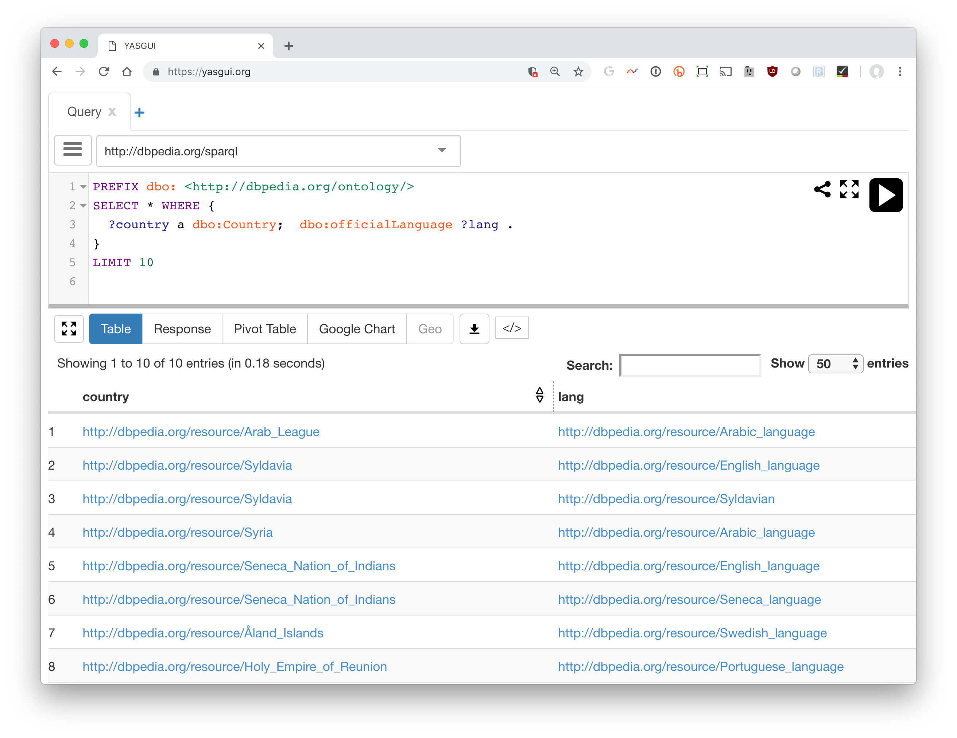
YASGUI: Yet Another SPARQL GUI
https://yasgui.org

Slide 9
SPARQL query structure
Prefix declarations for abbreviating URIs
Dataset definition: what RDF graph(s) are being queried
Result clause: what information to return from the query
Query pattern: what to query for in dataset
Query modifiers, slicing, ordering, rearranging query results
# prefix declarations
PREFIX ex: <http://example.com/rdf/> …
# optional named graph source FROM ... # result clause (select,ask,update…) SELECT ... # query pattern WHERE { ... } # query modifiers ORDER BY ...
GROUP BY …. LIMIT 100

Slide 10
Basic SPARQL Query Forms
SELECT
Returns all, or a subset of, the variables bound in a query pattern match
ASK
Returns boolean indicating whether a query pattern matches or not
DESCRIBE
Returns an RDF graph describing resources found
CONSTRUCT
Returns an RDF graph constructed by substituting variable bindings in a set of triple templates

Slide 11
A Query: Maryland Cities
# find URIs for cities in Maryland PREFIX yago: <http://dbpedia.org/class/yago/>
SELECT * WHERE {
?city a yago:WikicatCitiesInMaryland
}

Slide 12
SPARQL protocol parameters
To use this query, we need to know]
What endpoint (URL) to send it to
How we want the results encoded (JSON, XML, …)
… other parameters …
These are set in GUI or your program
Except for the endpoint, all have defaults
Can even query with the unix curl command:
curl http://dbpedia.org/sparql/ --data-urlencode query='PREFIX yago: <http://dbpedia.org/class/yago/> SELECT * WHERE {?city rdf:type yago:WikicatCitiesInMaryland.}'

Slide 13
Maryland Cities and population
PREFIX yago: <http://dbpedia.org/class/yago/>t
PREFIX dbo: <http://dbpedia.org/ontology/>
SELECT * WHERE {
?city a yago:WikicatCitiesInMaryland;
dbo:populationTotal ?population .
}

Slide 14
Maryland cities, population, names
# this returns names in multiple languages ☹
PREFIX yago: <http://dbpedia.org/class/yago/>
PREFIX dbo: <http://dbpedia.org/ontology/>
PREFIX rdfs: <http://www.w3.org/2000/01/rdf-schema#>
SELECT ?city ?name ?population WHERE {
?city a yago:WikicatCitiesInMaryland;
dbo:populationTotal ?population ;
rdfs:label ?name .
}

Slide 15
Just the @en names, w/o lang tag
# FILTER gives conditions that must be true
# LANG(x) returns string’s language tag or ””
# STR(x) returns a string’s value, i.e. w/o language tag
PREFIX yago: <http://dbpedia.org/class/yago/>
PREFIX dbo: <http://dbpedia.org/ontology/>
PREFIX rdfs: <http://www.w3.org/2000/01/rdf-schema#>
select (str(?name) as ?name) ?population where {
?city a yago:WikicatCitiesInMaryland;
dbo:populationTotal ?population;
rdfs:label ?name .
FILTER (LANG(?name) = "en")
}

Slide 16
Order results by population (descending)
# sort results by population
PREFIX yago: http://dbpedia.org/class/yago/
PREFIX dbo: <http://dbpedia.org/ontology/>
select str(?name) ?population where {
?city a yago:WikicatCitiesInMaryland;
dbo:populationTotal ?population;
rdfs:label ?name .
FILTER (LANG(?name) = "en")
}
ORDER BY DESC(?population)

Slide 17
Wait, where’s Catonsville? ☹
MD’s government focused on counties
Catonsville not considered a city – it has no government
We need another category of place
Census designated place? Populated Place?
Populated places include counties & regions; let’s use census designated place
But some ‘real’ cities in Maryland are not listed as census designated places and some are

Slide 18
UNION operator is OR
PREFIX yago: <http://dbpedia.org/class/yago/>
PREFIX dbo: http://dbpedia.org/ontology/
PREFIX dbr: <http://dbpedia.org/resource/>
SELECT str(?name) ?population where {
{?city dbo:type dbr:Census-designated_place;
dbo:isPartOf dbr:Maryland .}
UNION
{?city a yago:WikicatCitiesInMaryland . }
?city dbo:populationTotal ?population; rdfs:label ?name .
FILTER (LANG(?name) = "en")
}
ORDER BY DESC(?population)

Slide 19
Now we have duplicate entries ☹
This happens because:
Some “cities” are just in WikicatCitiesInMaryland
Some are just in Census-designated_places
Some are in both
SPARQL’s procedure finds all ways to satisfy a query, and for each one, records the variable bindings
We add DISTINCT to get SPARQL to remove duplicate bindings from the results

Slide 20
DISTINCT produces unique results
PREFIX yago: <http://dbpedia.org/class/yago/>
PREFIX dbo: http://dbpedia.org/ontology/
PREFIX dbr: <http://dbpedia.org/resource/>
SELECT DISTINCT str(?name) ?population where {
{?city dbo:type dbr:Census-designated_place;
dbo:isPartOf dbr:Maryland .}
UNION
{?city a yago:WikicatCitiesInMaryland . }
?city dbo:populationTotal ?population;
rdfs:label ?name .
FILTER (LANG(?name) = "en")
}
ORDER BY DESC(?population)

Slide 21
Some cities are missing ☹
Experimentation with query showed there are 427 entities in MD that are either census designated places or cities
Only get 411 because nine have no population and one has neither a population nor a label
Typical of a large and somewhat noisy knowledge graph created from crowdsourced data
SPARQL’s OPIONAL directive to the rescue
Notes:
Was 439 -> 423??

Slide 22
OPTIONAL handles missing data
PREFIX yago: <http://dbpedia.org/class/yago/>
PREFIX dbo: <http://dbpedia.org/ontology/>
PREFIX dbr: <http://dbpedia.org/resource/>
select DISTINCT str(?name) ?population where {
{?city dbo:type dbr:Census-designated_place;
dbo:isPartOf dbr:Maryland .}
UNION
{?city a yago:WikicatCitiesInMaryland . }
OPTIONAL {?city dbo:populationTotal ?population.}
OPTIONAL {?city rdfs:label ?name . FILTER (LANG(?name) = "en") }
}
ORDER BY DESC(?population)

Slide 23
Handling queries with many results
Endpoints typically have limits on a query’s runtime or the number of results it can return
You can use the LIMIT and OFFSET query modifiers to manage large queries
Suppose we want to find all types that DBpedia uses
SELECT distinct ?type WHERE {?x a ?type.}
DBpedia’s public endpoint limits queries to 10K results

Slide 24
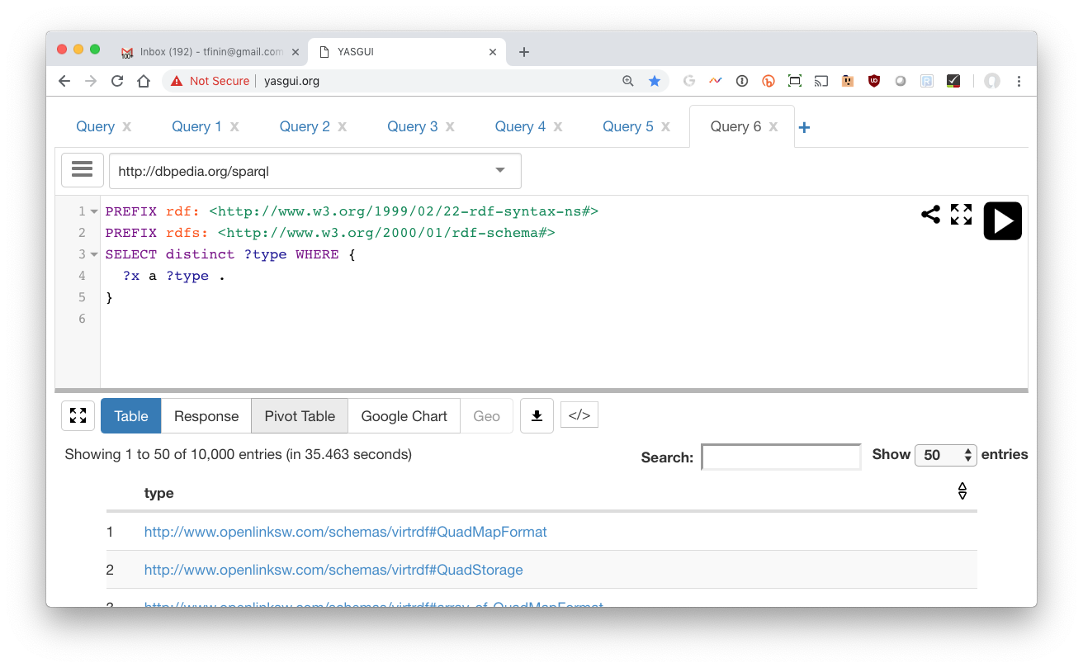
Get the first 10K

Slide 25
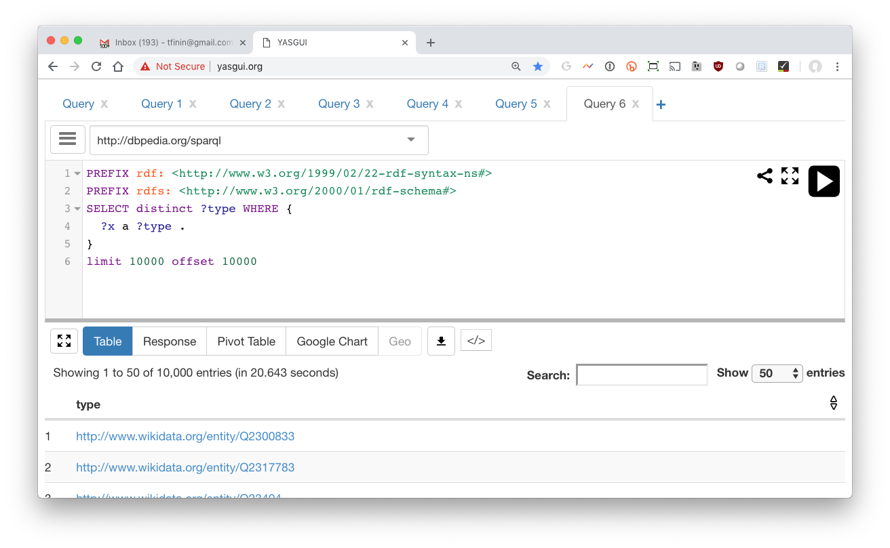
Get the second 10K with OFFSET

Slide 26
A simple program gets them all
from SPARQLWrapper import SPARQLWrapper, JSON
default_endpoint = "http://dbpedia.org/sparql"
type_query = """SELECT DISTINCT ?class WHERE {{?x a ?class}} LIMIT {LIM} OFFSET {OFF}"""
def getall(query, endpoint=default_endpoint):
limit = 10000
offset = total = 0
found = limit
tuples = []
sparql = SPARQLWrapper(endpoint)
sparql.setReturnFormat('json')
while found == limit: # keep going until we don't get limit results
q = query.format(LIM=limit, OFF=offset)
sparql.setQuery(q)
results = sparql.query().convert()
found = 0
for result in results["results"]["bindings"]:
found += 1
tuples.append(tuple([str(v['value']) for v in result.values()]))
print('Found', found, 'results')
total = total + found
offset = offset + limit
return tuples

Slide 27
ASK query
An ASK query returns True if it can be satisfied and False if not
Was Barack Obama born in the US?
PREFIX dbo: <http://dbpedia.org/ontology/>
PREFIX dbr: <http://dbpedia.org/resource/>
ask WHERE {
{dbr:Barack_Obama dbo:birthPlace dbr:United_States}
UNION
{dbr:Barack_Obama dbo:birthPlace ?x .
?x dbo:isPartOf*/dbo:country dbr:United_States }
}

Slide 28
DESCRIBE Query
“Describe ?x” means “tell me everything you know about ?x
Example: Describe Alan Turing …
DESCRIBE <http://dbpedia.org/resource/Alan_Turing>
-- or –
PREFIX dbr: <http://dbpedia.org/resource/>
DESCRIBE dbr:Alan_Turing
Returns a collection of ~1500 triples in which dbr:Alan_Turing is either the subject or object

Slide 29
Describes’s results?
The DAWG did not reach a consensus on what describe should return
Possibilities include
All triples where the variable bindings are mentioned
All triples where the bindings are the subject
Something else
What is useful might depend on the application or the amount of data involved
So it was left to the implementation

Slide 30
DESCRIBE Query (2)
Describe the film “Double Indemnity”
PREFIX foaf: <http://xmlns.com/foaf/0.1/>
PREFIX dbo: <http://dbpedia.org/ontology/>
describe ?x WHERE {
?x a dbo:Film; foaf:name ?filmName .
FILTER (STR(?filmName) = "Double Indemnity")
}
Returns a collection of ~500 triples

Slide 31
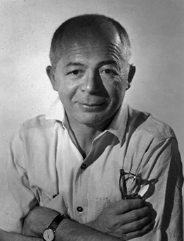
DESCRIBE Query (3)
Describe can return triples about multiple entities
Describe films directed by Billy Wilder
PREFIX dbo: http://dbpedia.org/ontology/
PREFIX dbr: <http://dbpedia.org/resource/>
describe ?x WHERE {
?x a dbo:Film; dbo:director dbr:Billy_Wilder.
}
Returns a collection of ~8400 triples about the 27 films he directed

Slide 32
DESCRIBE Query (4)
Describe can return triples about multiple entities, but you can limit the number
Describe films directed by Billy Wilder
PREFIX dbo: http://dbpedia.org/ontology/
PREFIX dbr: <http://dbpedia.org/resource/>
describe ?x WHERE {
?x a dbo:Film; dbo:director dbr:Billy_Wilder.
} LIMIT 1
Returns a collection of ~500 triples about just one film, The Apartment.

Slide 33
Construct query (1)
Construct queries return graphs as results, e.g., film directors and the actors they’ve directed
PREFIX dbo: <http://dbpedia.org/ontology/>
PREFIX ex: <http://example.org/>
CONSTRUCT {?director ex:directed ?actor}
WHERE {?film a dbo:Film;
dbo:director ?director;
dbo:starring ?actor}
Returns a graph with ~21,000 triples

Slide 34
On construct
Having a result form that produces an RDF graph is a good idea
It enables on to construct systems by using the output of one SPARQL query as the data over which another query works
This kind of capability was a powerful one for relational databases

Slide 35
Construct query (2)
Construct queries return graphs as results, e.g., film directors and the actors they’ve directed
PREFIX dbo: <http://dbpedia.org/ontology/>
PREFIX ex: <http://example.org/>
CONSTRUCT {?director ex:directed ?actor}
WHERE {?film a dbo:Film;
dbo:director ?director;
dbo:starring ?actor}
Returns a graph with ~21,000 triples

Slide 36
Construct query (3)
SPARQL 1.1 allows using alternative properties separated by vertical bar
Actors and directors or producers they’ve worked for
PREFIX dbo: <http://dbpedia.org/ontology/>
PREFIX ex: <http://example.org/>
Construct {?actor ex:workedFor ?directorOrProducer}
WHERE {
?film a dbo:Film;
dbo:director|dbo:producer ?directorOrProducer;
dbo:starring ?actor}
Returns a graph with ~31,000 triples

Slide 37
Example: finding missing inverses
DBpedia is missing many inverse relations, inclueing more than 10k missing spouse relations
This creates a graph of all the missing ones, which can be added back to the KG via UPDATE ADD
PREFIX dbo: <http://dbpedia.org/ontology/>
CONSTRUCT { ?p2 dbo:spouse ?p1. }
WHERE {?p1 dbo:spouse ?p2.
FILTER NOT EXISTS {?p2 dbo:spouse ?p1}}
Not the NOT EXISTS operator that succeeds iff its graph pattern is not satisfiable

Slide 38
RDF Named graphs
Having multiple RDF graphs in a single document/repository and naming them with URIs
Provides useful additional functionality built on top of the RDF Recommendations
SPARQL queries can involve several graphs, a background one and multiple named ones, e.g.:
SELECT ?who ?g ?mbox
FROM <http://example.org/dft.ttl>
FROM NAMED <http://example.org/alice>
FROM NAMED <http://example.org/bob>
WHERE
{ ?g dc:publisher ?who .
GRAPH ?g { ?x foaf:mbox ?mbox }
}

Slide 39
UPDATE QUERIES
Simple insert INSERT DATA { :book1 :title "A new book" ; :creator "A.N.Other" . }
Simple delete DELETE DATA { :book1 dc:title "A new book" . }
Combine the two for a modification, optionally guided by the results of a graph pattern
PREFIX foaf: <http://xmlns.com/foaf/0.1/>
DELETE { ?person foaf:givenName 'Bill’ }
INSERT { ?person foaf:givenName 'William’ }
WHERE { ?person foaf:givenName 'Bill' }

Slide 40
Aggregation Operators
SPARQL 1.1 added many aggregation operators, like count, min, max, …
Generally used in the results specification
PREFIX dbo: <http://dbpedia.org/ontology/>
SELECT (COUNT(?film) AS ?numberOfFilms)
WHERE {?film a dbo:Film .}
This finds 129,980 films

Slide 41
Group by
GROUP BY breaks the query's result set into groups before applying the aggregate functions
Find BO’s properties and group them by property and find the number in each group
PREFIX dbr: <http://dbpedia.org/resource/>
PREFIX dbo: <http://dbpedia.org/ontology/>
SELECT ?p (COUNT(?p) as ?number)
WHERE { dbr:Barack_Obama ?p ?o }
GROUP BY ?p ORDER BY DESC(count(?p))

Slide 42
Inference via SPARQL
This query adds inverse spouse relations that don’t already exist:
PREFIX dbo: <http://dbpedia.org/ontology/>
INSERT { ?p2 dbo:spouse ?p1. }
WHERE {?p1 dbo:spouse ?p2.
FILTER NOT EXISTS {?p2 dbo:spouse ?p1}}
SPIN and SHACL are systems to represent simple constraint & inference rules that are done by sparql
A big feature is that the rules are represented in the graph

Slide 43
SPARQL 1.1 Additions
SPARQ 1.1 added many more features …
Subqueries
Negation: MINUS
Federated queries that access multiple endpoints
Data you want to extract from an RDF graph can probably be returned by one query
Might be a complicated one, though …
Search web for SPARQL tricks or this book

